Slide 1
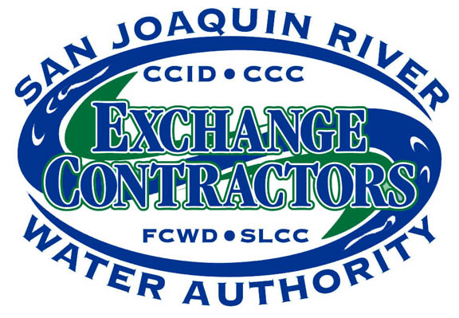
San Joaquin River Exchange Contractors Water Authority
WEF Tour Presentation
March 14, 2018
Mission Statement : To effectively protect the Exchange Contract and maximize local water supply, flexibility and redundancy in order to maintain local control over the members’ water supply, whatever circumstances occur.

Slide 2
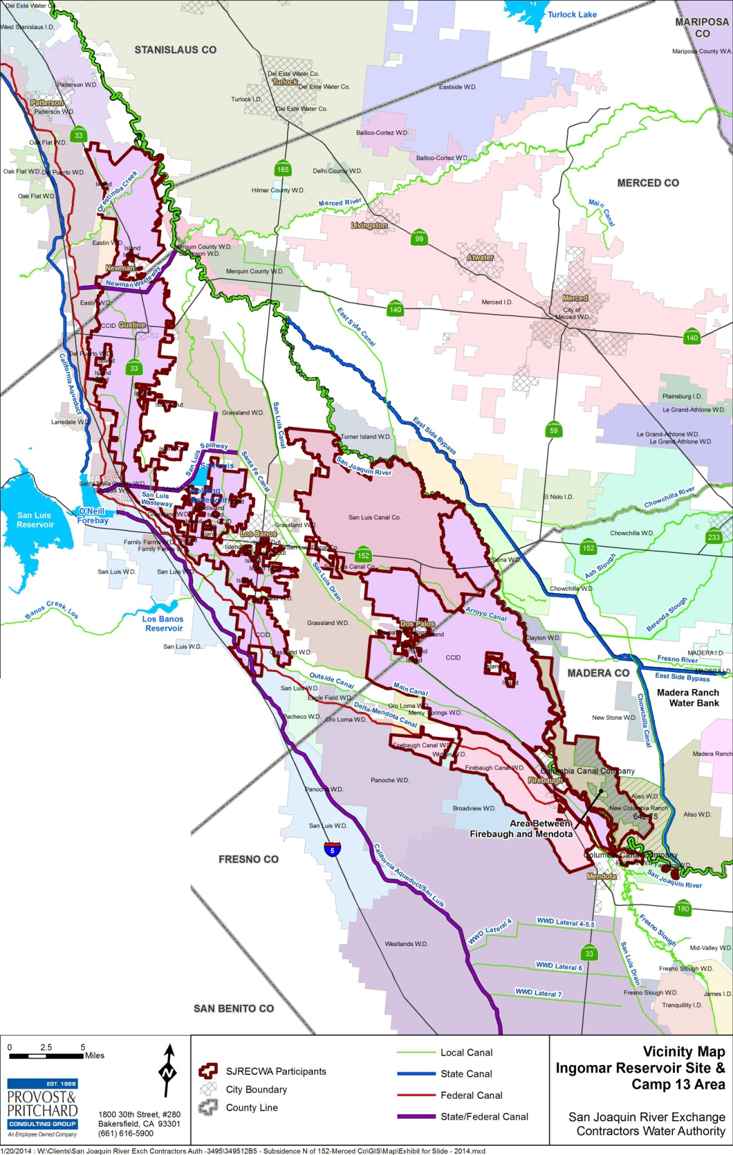
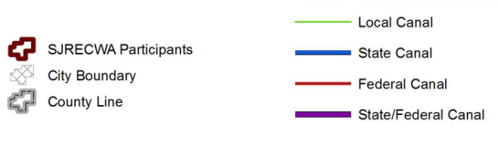
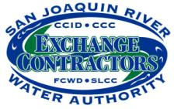

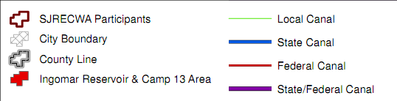
San Joaquin River Exchange Contractors Water Authority
N⬆

Slide 3
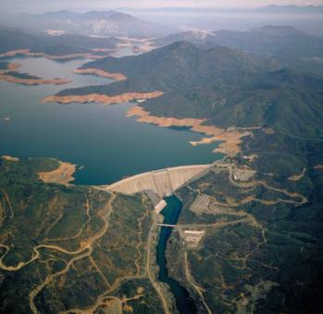
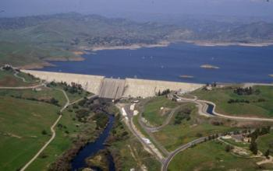
The Exchange Contract -
What is it Anyway?
The cornerstone for the Development of the CVP ( Friant Dam, Shasta Dam, DMC)
Two documents were signed in 1939:
  1. Exchange Contract
    Monthly Delivery Limits, Flow Limits, Water Quality Criteria, Water Supply( Shasta) Criteria [ We operate under the 1967 Second Amended Contract]
  2. Purchase Contract
    Conveyed high flow rights to the Bureau of Reclamation, reserved low flow rights. We retained our senior water rights on the San Joaquin River
3
Notes:
3

Slide 4
Background of the
Exchange Contractors
  Pre-1914 and Riparian Rights on the San Joaquin and Kings Rivers dating back to early 1870’s
  Irrigate approximately 240,000 ac in Fresno, Madera Merced and Stanislaus Counties
  Normal Year allocation 840,000 acre feet (Jan–Dec)
  Critical Year allocation 650,000 acre feet (Jan–Dec)
  Allocation is based on Forecasted inflow into Shasta Lake (3.2 MAF)

Slide 5
Background of the
Exchange Contractors
  The SJRECWA is a Joint Powers Authority that was formed in 1993, its members include:
    Central California Irrigation District (145,000 ac)
    Columbia Canal Company (16,000 ac)
    Firebaugh Canal Water District( 22,000 ac)
    San Luis Canal Company (47,000 ac)
  Main Duties:
    Protect water rights
    Main point of contact for the administration of the Exchange Contract
    Administer SGMA, Water Conservation Plans Water Transfer Programs
    Political Outreach

Slide 6
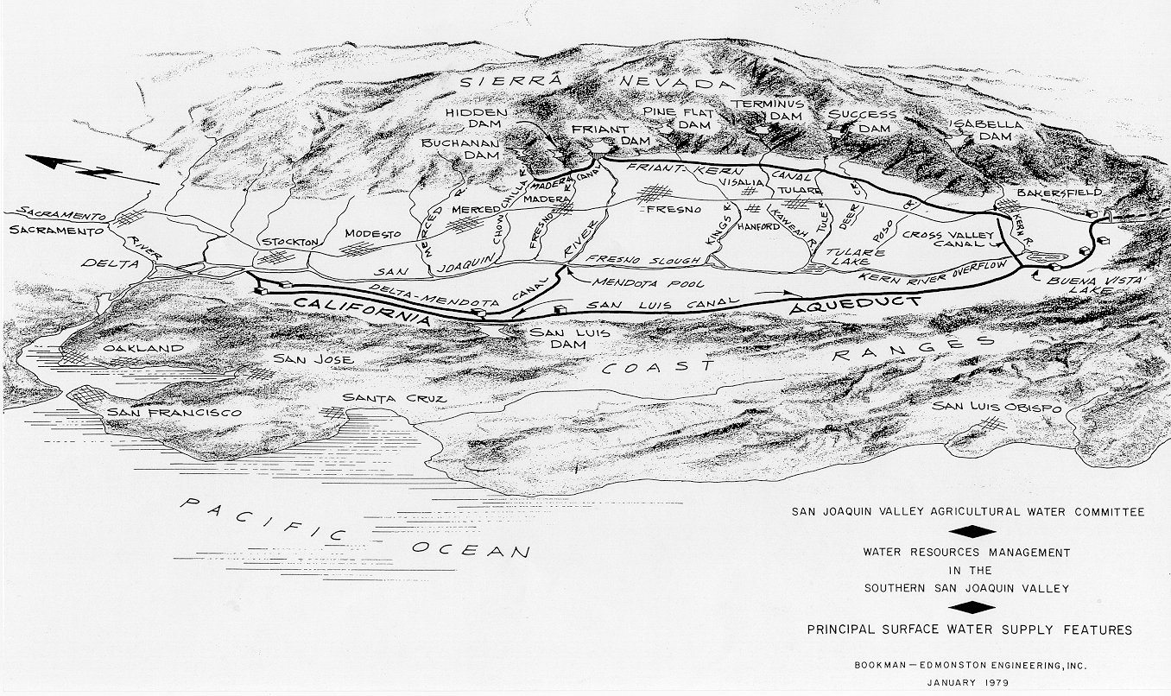
How The Exchange Contract Works
The SJR Exchange Contract
Madera Canal
250,000 AF
Friant-Kern Canal
1,050,000 AF
San Joaquin River
Delta
Exchange
Contractors
Mendota Pool
Cross Valley Canal
128,300 AF
Federal Delta Project Supply
Delta Mendota Canal
840,000 AF

Slide 7
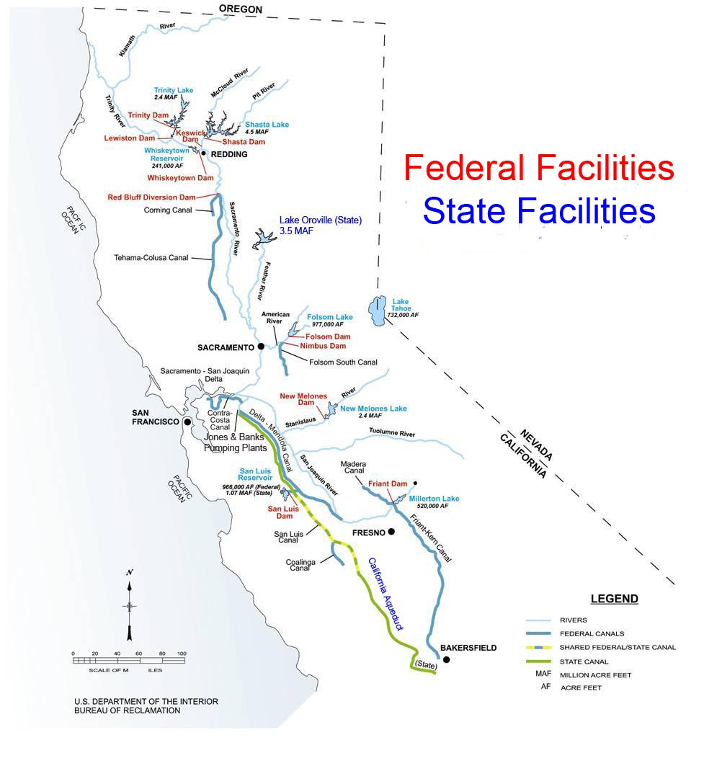
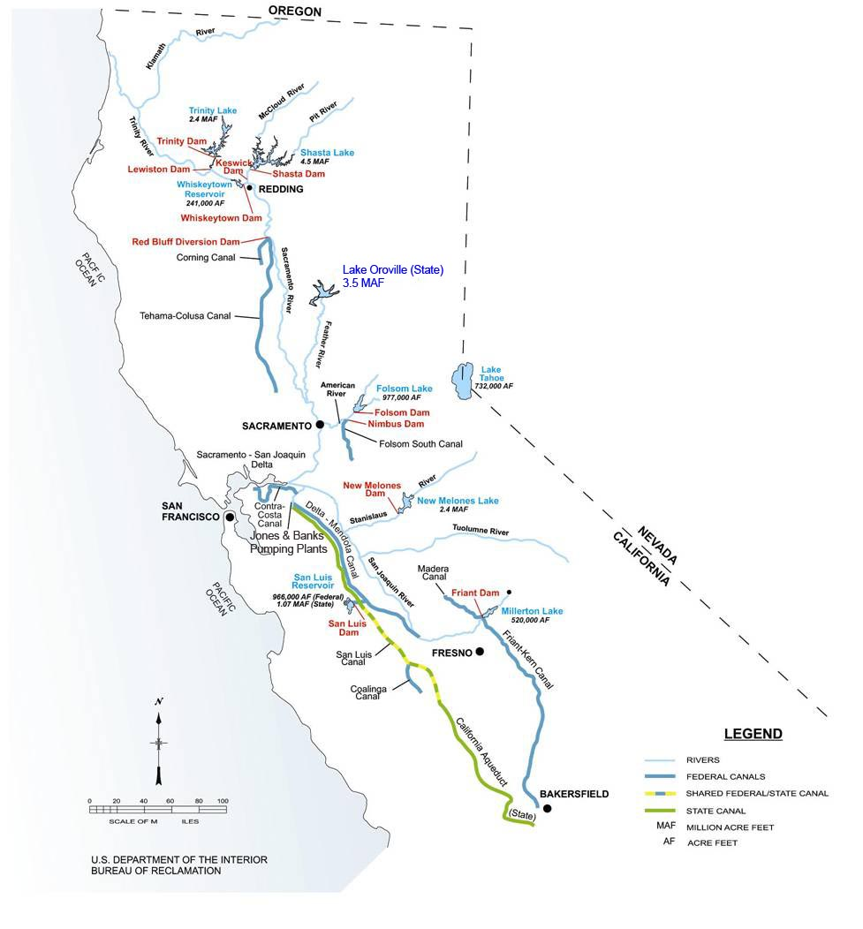
1960s

Slide 8
Regulatory Constrained Operations
Federal
  Endangered Species Act – Biological Opinions
    Shasta Temperature Control Plan for Salmon
    OMR for Delta Smelt (Dec – Jun)
    OMR for Winter-Run Salmon (Jan-Jun)
    Export/Inflow Ratio - Steelhead (April – May)
State
  State Board Decision D-1641
    Delta Outflow and Export/Inflow Ratio (All Year)
    SWP/CVP Export Limits of 1,500 cfs (Apr 14 –May 15)
2014,2015,2016 & 2018 CVP water supply reductions

Slide 9
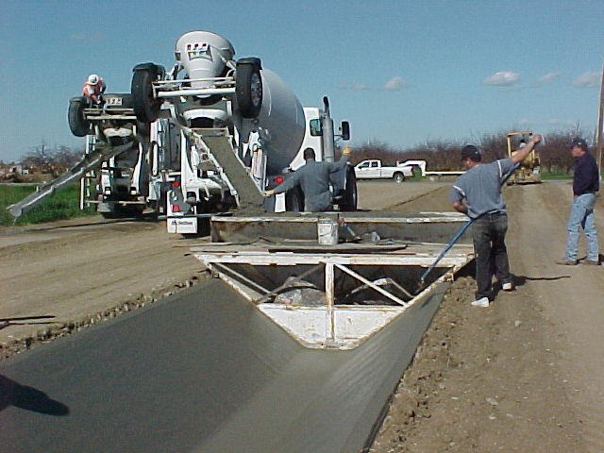
Increased Regional Water Availability
As a result of member agency conservation programs, water service to the growers has improved and the SJRECWA members has the ability to redirect water to other local water agencies.
These savings come from large investments in both large district-wide projects and smaller on-farm conservation projects.
Due to high investment costs, we needed an innovative approach to fund these efforts. (Water Transfers fulfills this need)

Slide 10
Exchange Contractors
Water Resources Plan
Exchange Contractor Board commissioned an initial analysis in 2011 and identified several potential projects with the goal to:
  Provide both seasonable and multi-year flexibility
  Enhance local resources due to delta export reductions or failure
  Provide reliability if we were to receive a major portion our water from Friant Dam
10
Notes:
10

Slide 11
Water Resources Plan
Joint Exchange Contractors Projects
  Los Banos Creek WRP
    City of LB, SLWD, GWD, Exchange Contractors
  Various Water Banking Projects
    SLWD, DPWD, Exchange Contractors
  Internal Surface Storage
Joint Projects with SLDMWA
Founding member of the San Joaquin Valley Water Infrastructure Authority ( Temperance Flat)

Slide 12
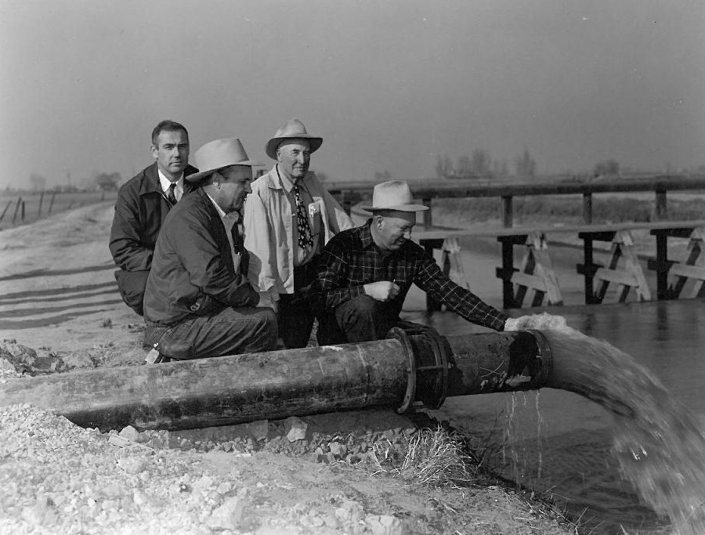
Exchange Contractors
Groundwater Management
Groundwater Management
The member agencies have conjunctively manage their surface water and groundwater supplies for decades
The Authority is actively implementing the Sustainable Groundwater Management Act(SGMA)
In March 2016, the SJRECWA became the Exclusive GSA for our members.
February 2017, Introduced SB 372- San Joaquin River Exchange Contractors Groundwater Sustainability Agency – The bill was passed in September 2017.
12
Notes:
12

Slide 13
CONTACT INFORMATION:
San Joaquin River Exchange Contractors
Water Authority
541 H Street/P.O. Box 2115
Los Banos, CA 93635
(209) 827-8616
Steve Chedester, Executive Director
Email: schedester@sjrecwa.net
Website: www.sjrecwa.net

