Slide 1
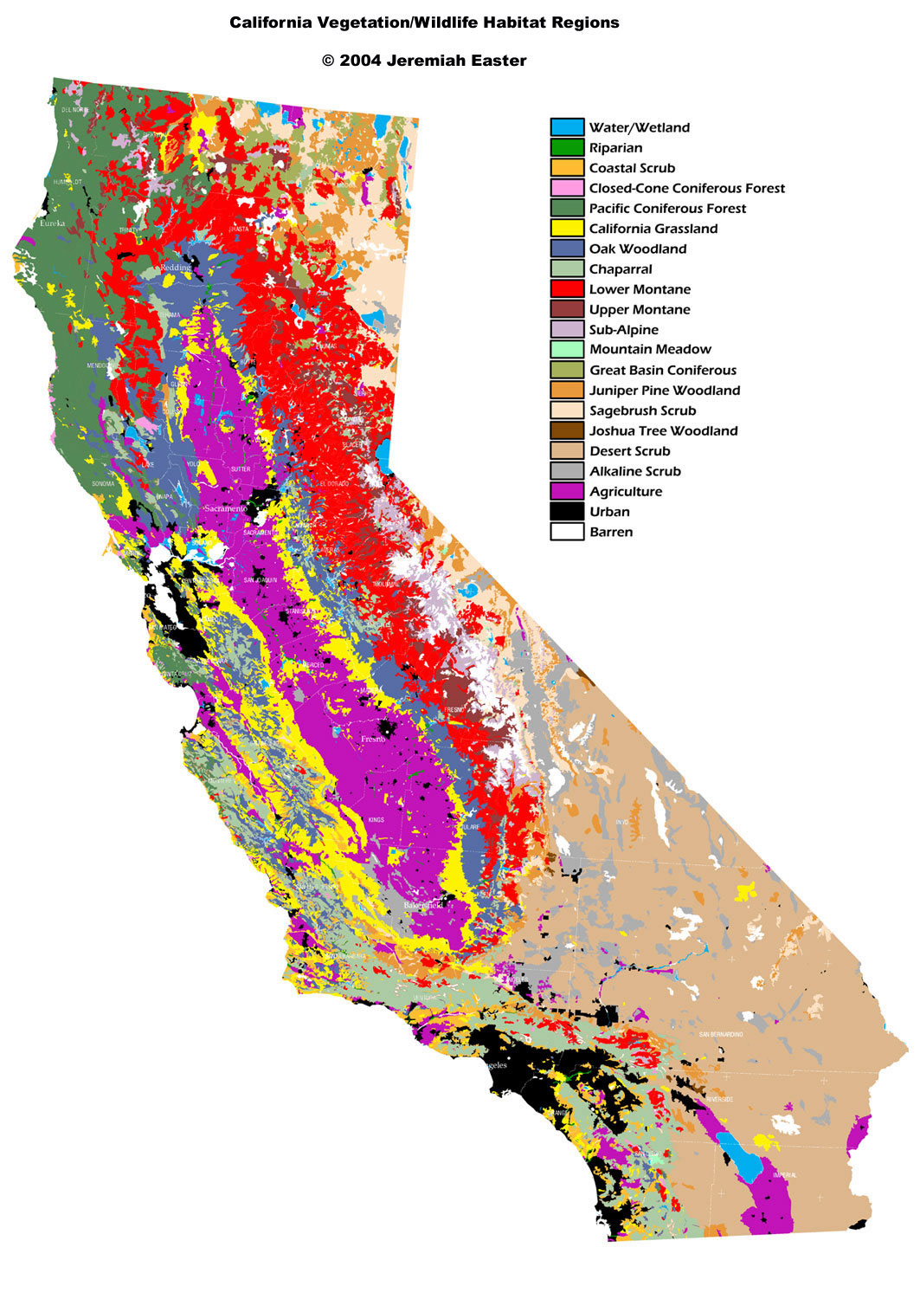
California has a variety of climate and land use zones
Natural diversity allows diverse agriculture to thrive
A relatively small share of the total land mass is suitable for high-productivity irrigated crops

Slide 2
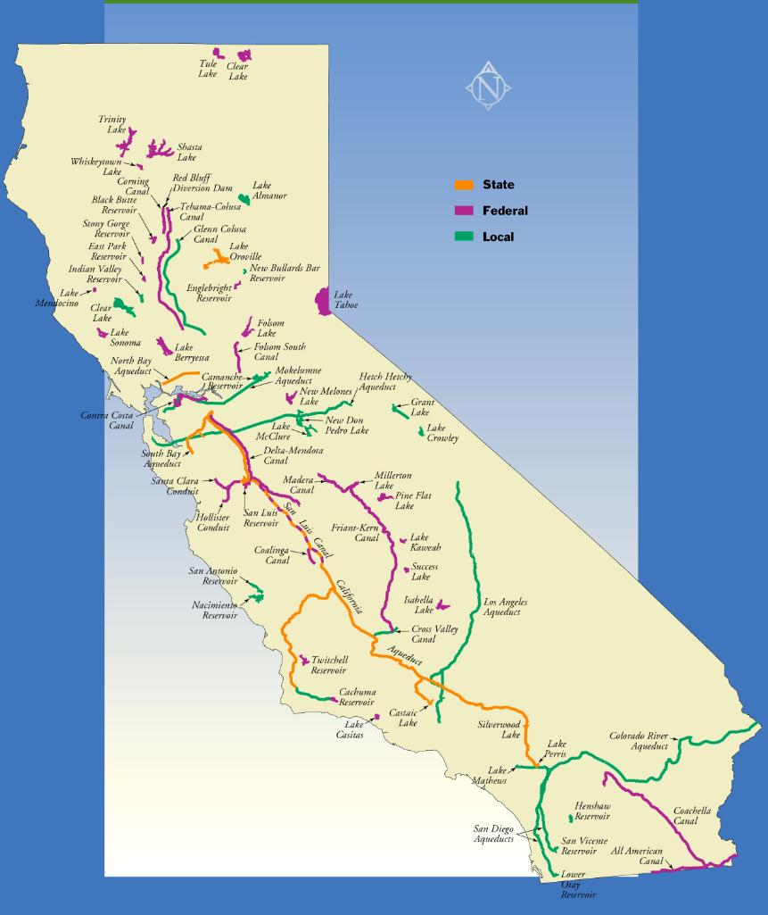
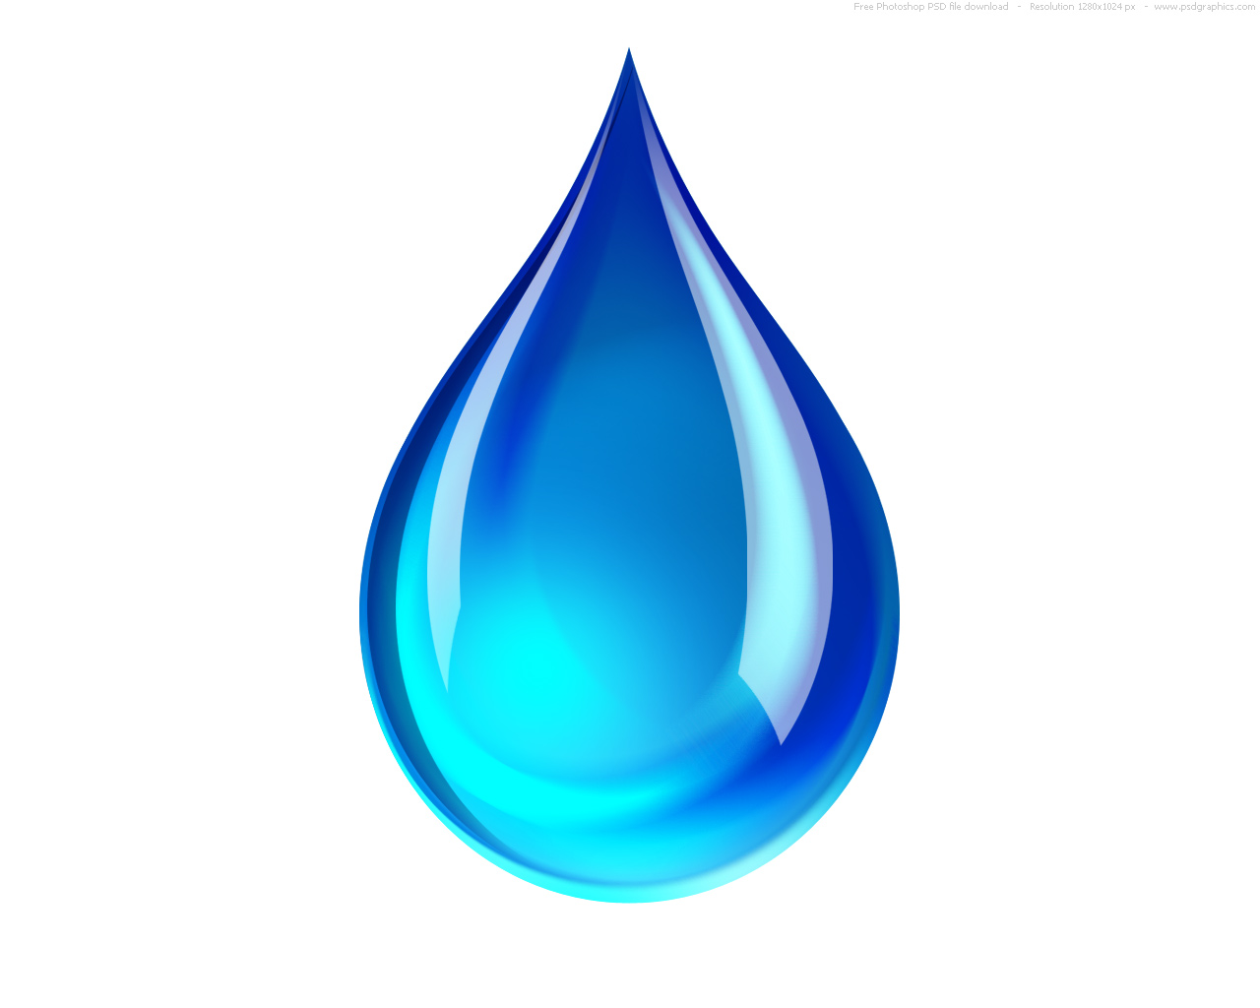
Major Water
Projects
Federal – Central Valley Project (CVP)
State – State Water Project (SWP)
Local – Many smaller projects throughout state

Slide 3
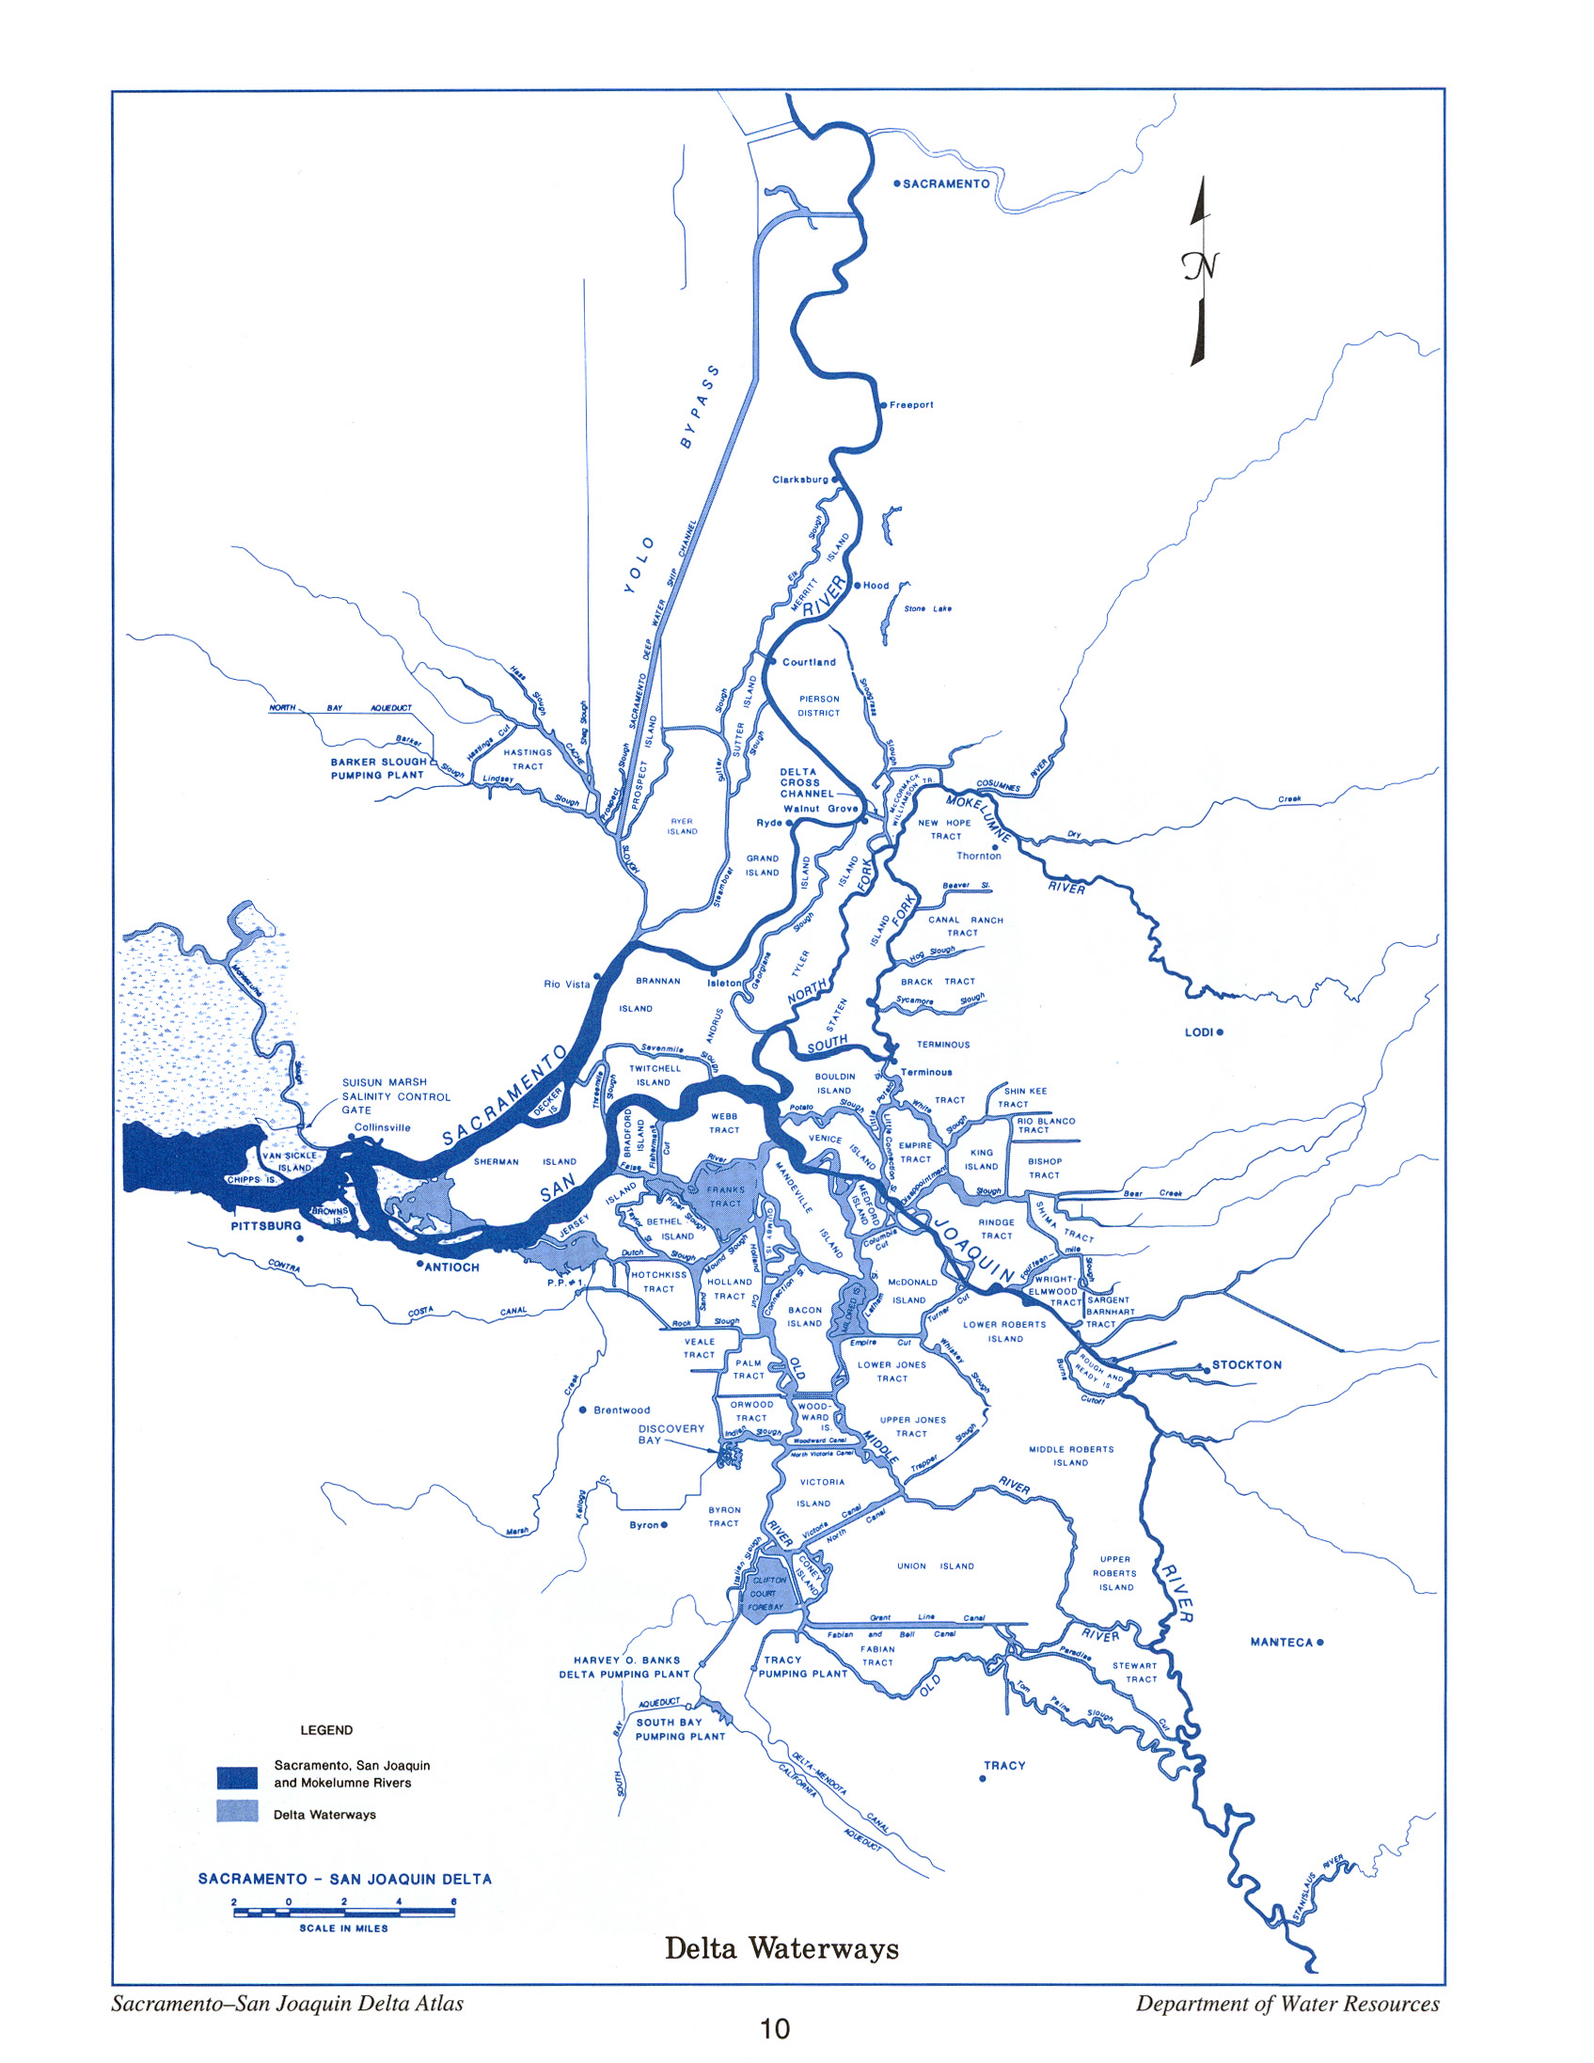

Slide 4
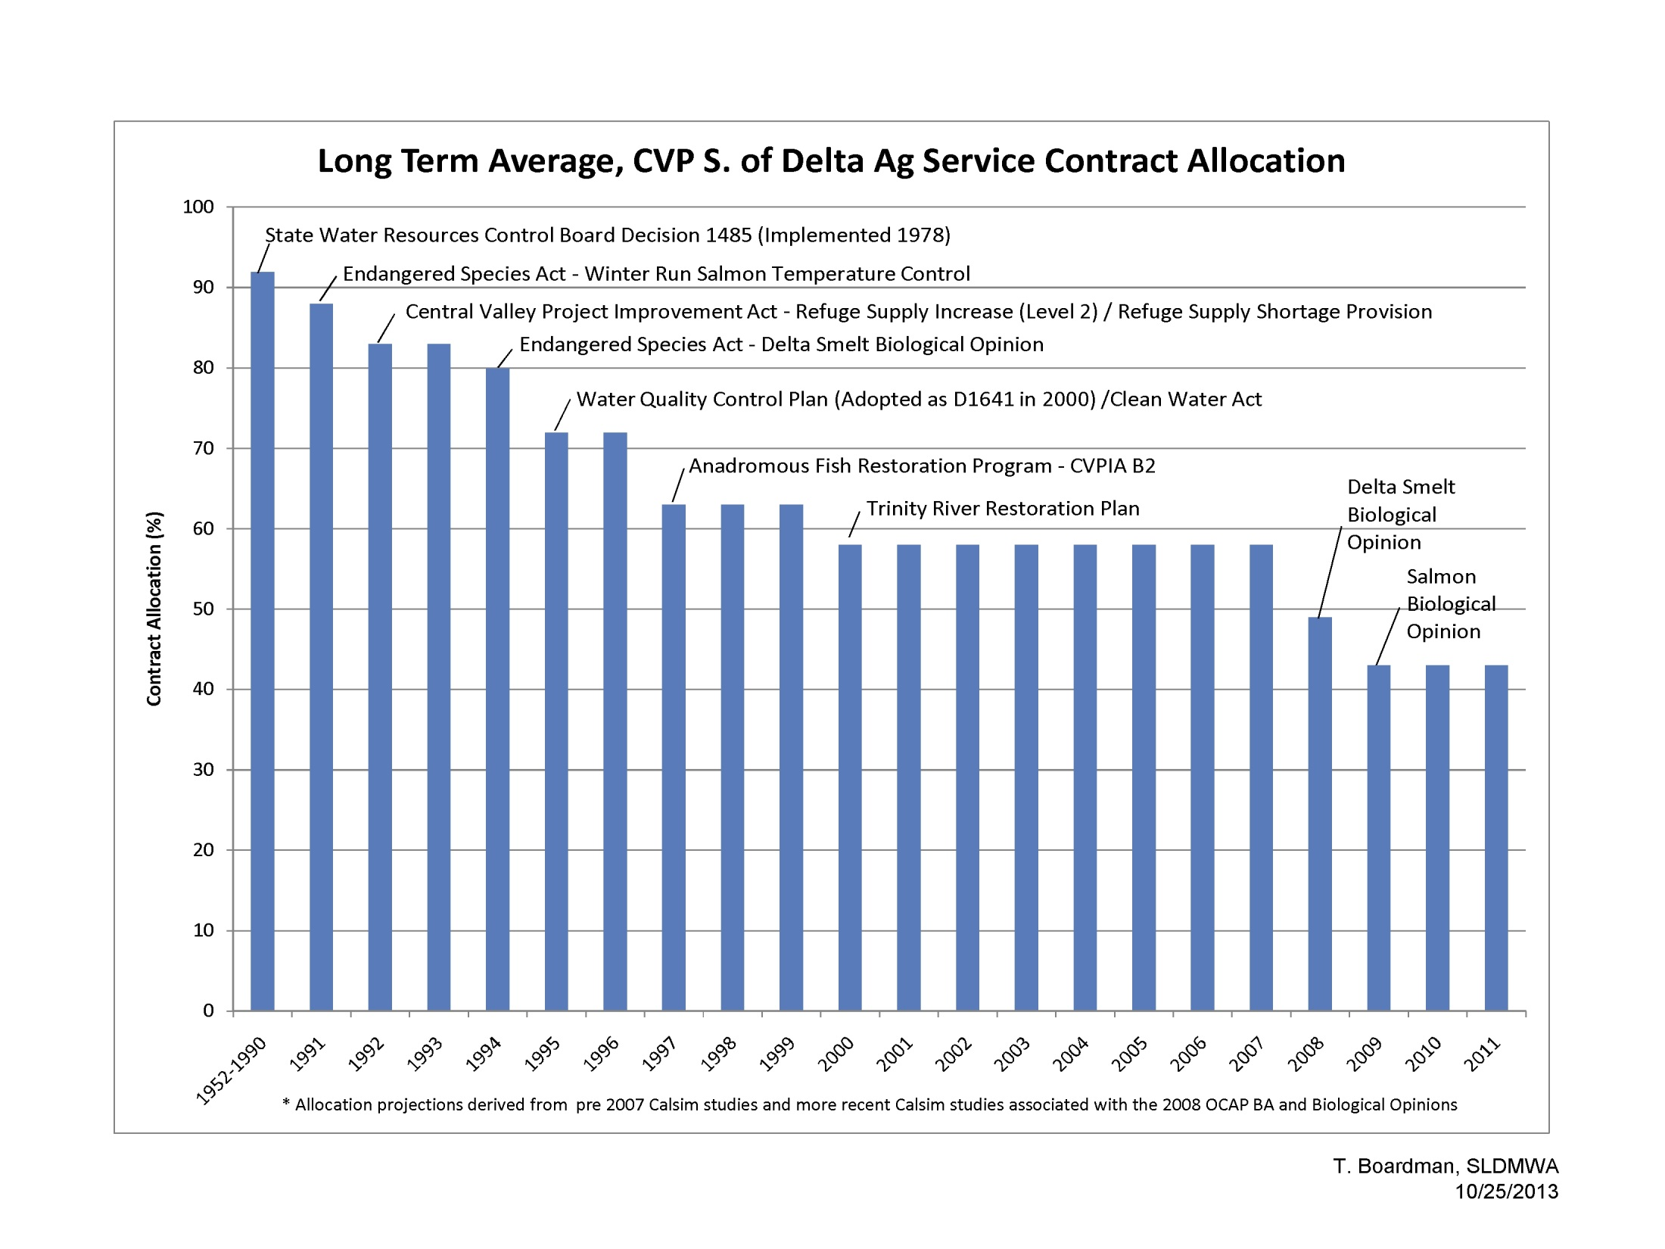

Slide 5
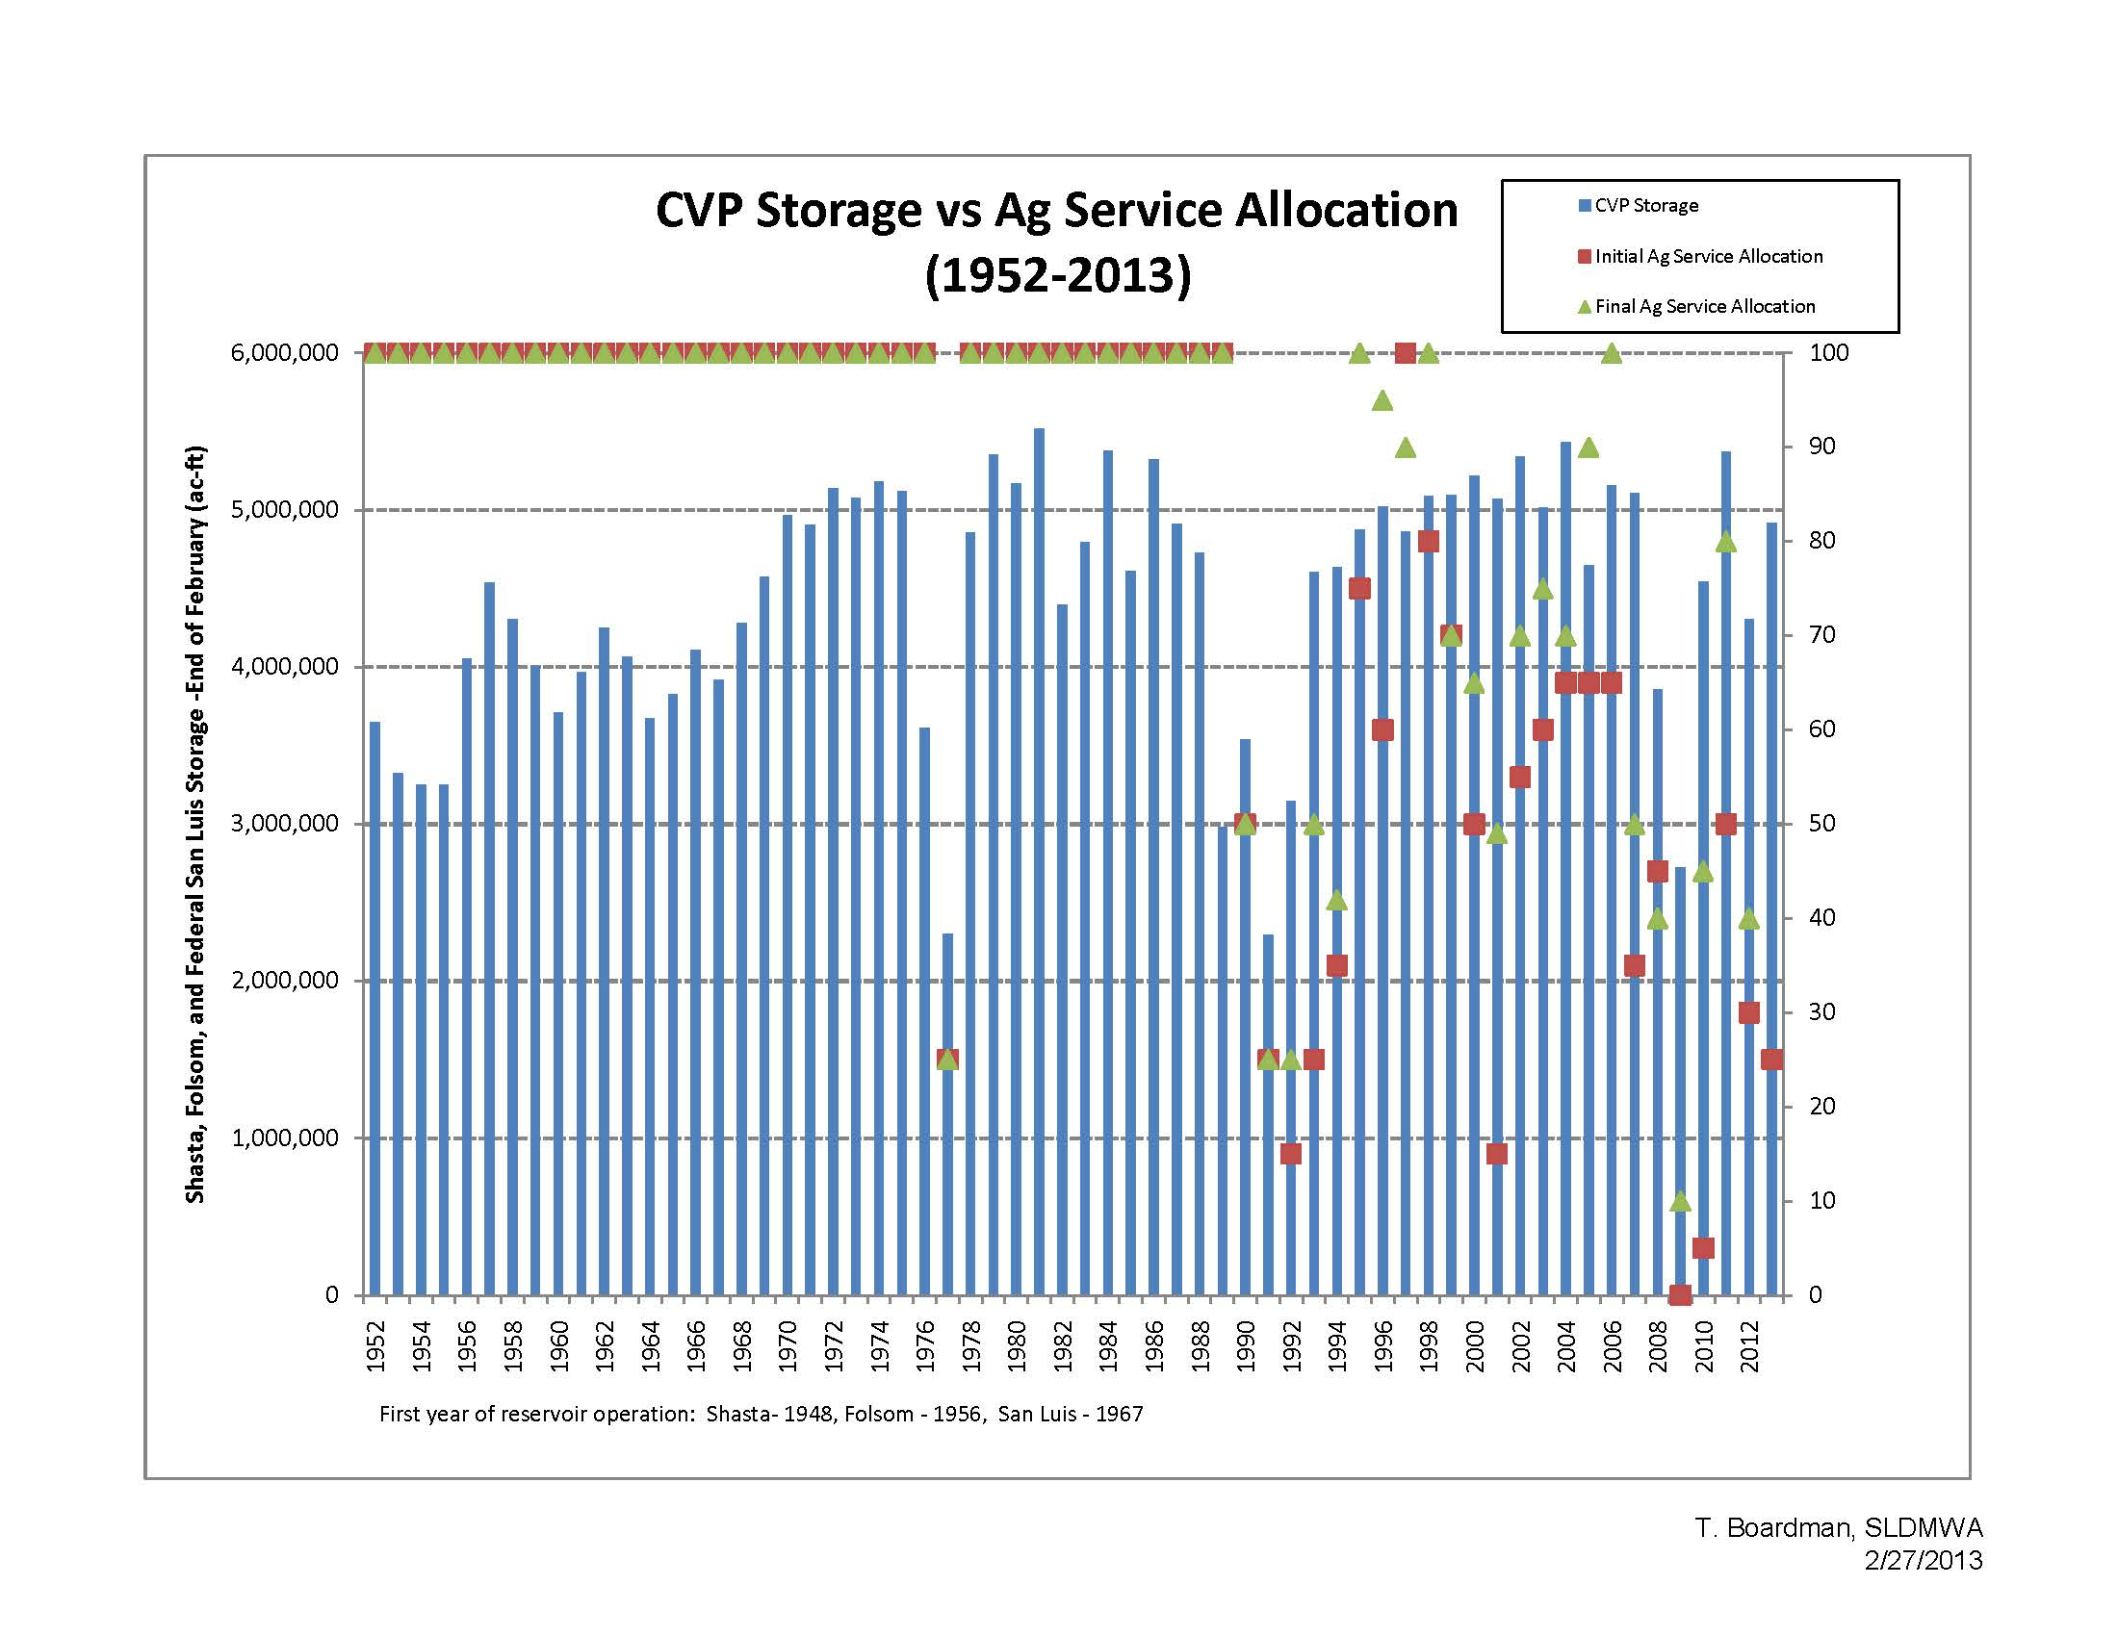

Slide 6
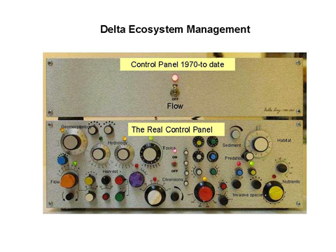

Slide 8
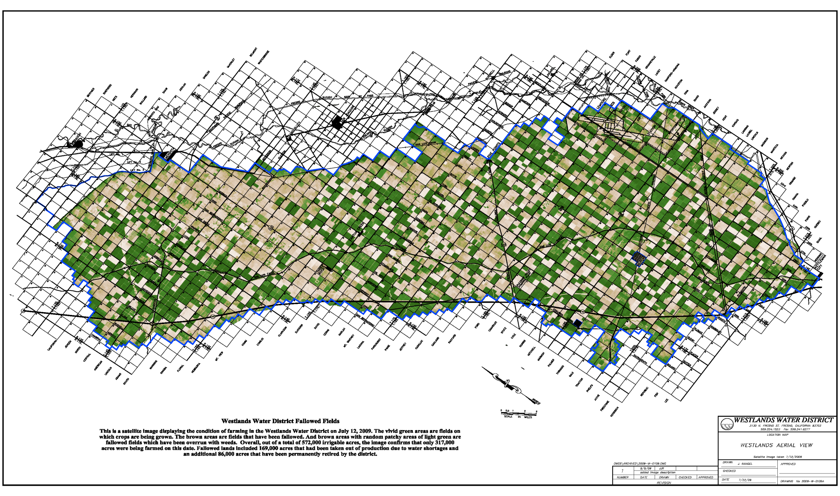
2009 Satellite Image of Westlands
Reflects only 317,000 acres farmed

Slide 9
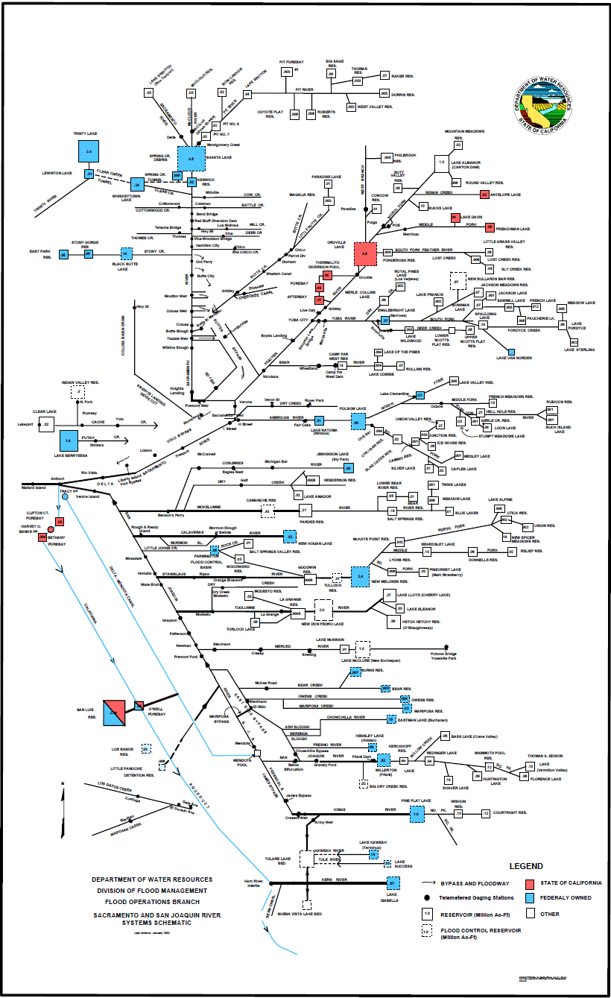

Slide 10
