Slide 1
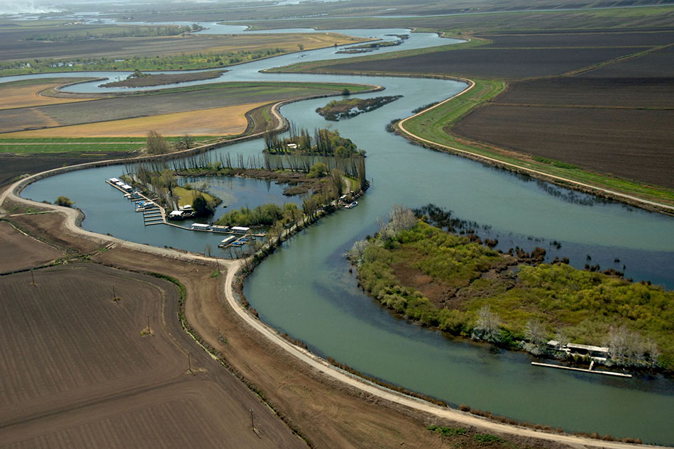
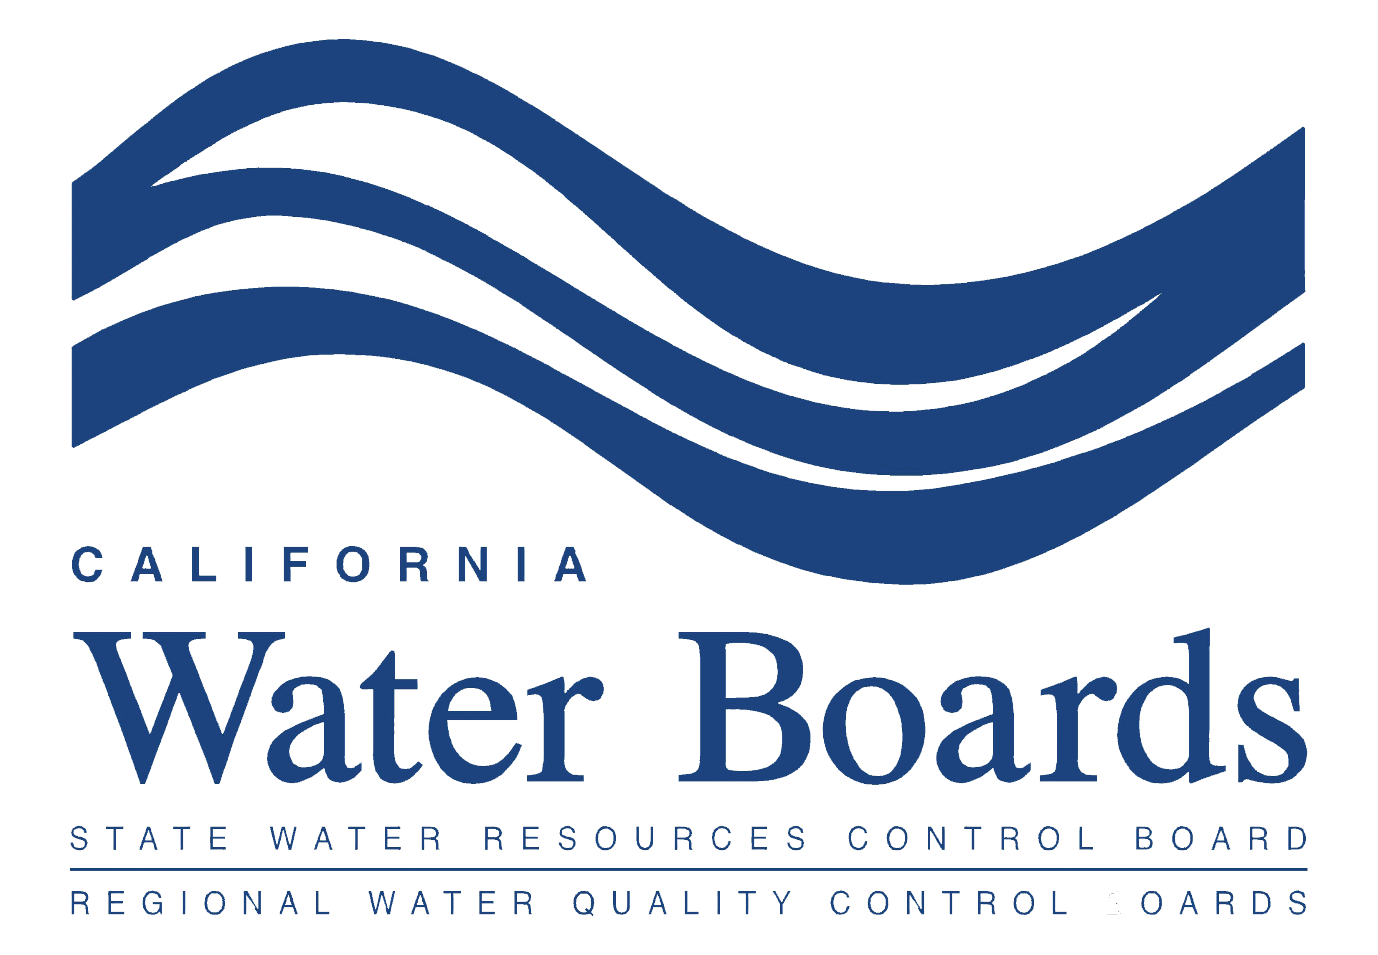
The Sacramento / San Joaquin River Delta
Michael Patrick George
Delta Watermaster
May 16, 2018
The Water Education Foundation’s Delta Tour

Slide 2
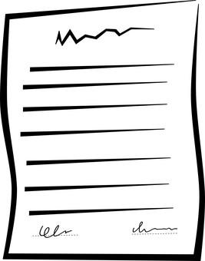
Disclaimer
I am not speaking for the:
- State Water Resources Control Board or
- The Delta Stewardship Council
I am not presenting State policy
I am expressing personal observations and opinions (except where specifically referenced to published materials).

Slide 3
Overview
Role of the Delta Watermaster
Water Rights and Water Allocation
Managing for Drought, Flood and Climate Change
Planning in the Bureaucratic Labyrinth
What to Watch For

Slide 4
Role of the Delta Watermaster
Independent Officer of the State
Created as part of 2009 Delta Reform Act
Four-year Term
Reports jointly to Water Board and Delta Stewardship Council
Notes:
Independent Officer of the State
Office of DWM was created as part of the Delta Reform Act 2009
Appointed to a four-year term by the SWRCB (Water Board)
Reports jointy to the Water Board & Delta Stewardship Council
Responsible for:
Administration of Delta Water Rights
Assisting with realization of legislation mandates (co-equal goals)
Coordination implementation activities of many agencies
Advising on policy and practices in the Delta

Slide 5
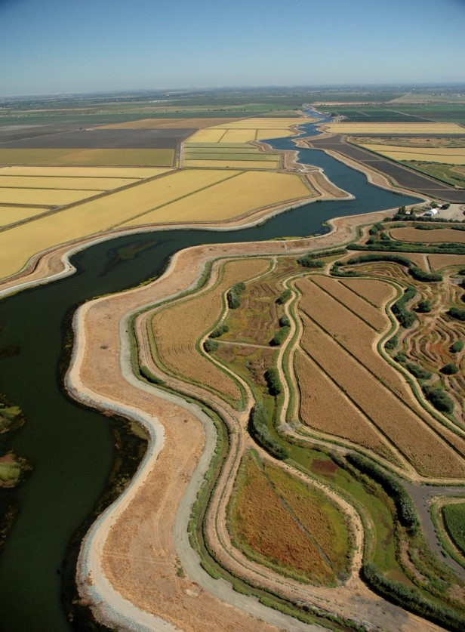
Water Rights and Water Allocation in the Delta
Appropriation System Overlain on Riparian System
Appropriation by Priority: “First in Time, First in Right”
Riparian by Correlative Curtailment: “Shared Sacrifice”
Most Senior Delta Water Rights “Pre-date” Administrative System
Curtailment: “Whack-a-Mole”
Notes:
Water Rights and Water Allocation in the Delta
Appropriation System Overlain on Riparian System
Two Different and Unreconciled Ways of Dealing with Shortage Correlative Curtailment (“Shared Sacrifice”) vs.
Priority Curtailment (“First in Time, First in Right”)
Most Senior Water Rights in the Delta Pre-date the Administrative System
In the Last Drought, Curtailment Administration Turned into Whack-a-Mole

Slide 6
Response: Division of Water Rights Issued Informational Order During 2015 Drought
Short-term:
Report Recent and Projected Water Use
Informed Regular Updates to Water Supply Availability Analyses (“Supply/Demand Curves”)
Notes:
Response: Division of Water Rights Issued an Informational Order
Short-term: Report Recent and Projected Water Use
Informed Regular Updates to Water Supply Availability Analyses (“Supply/Demand Curves”)
[Grab the curve reproduced in Erik’s Slide #5]
Longer-term: Provide Documentation Supporting the Senior Water Right Claim
Very High Compliance Rate (although quality of responses varied widely)
Avalanche of Material without Organizational Structure
Two-year Process of Organization, Review and Analysis

Slide 7
Water Availability
Notes:
[Grab the curve reproduced in Erik’s Slide #5]
Longer-term: Provide Documentation Supporting the Senior Water Right Claim
Very High Compliance Rate (although quality of responses varied widely)
Avalanche of Material without Organizational Structure
Two-year Process of Organization, Review and Analysis

Slide 8
Response: Division of Water Rights Issued Informational Order During 2015 Drought
Longer-term:
Provide Documentation Supporting the Senior Water Right Claim
Very High Compliance Rate
Avalanche of Material
Two-year Process of Organization, Review and Analysis
Culminated in First-ever Taxonomy of Delta Senior Water Rights Claims
Notes:
Response: Division of Water Rights Issued an Informational Order
Short-term: Report Recent and Projected Water Use
Informed Regular Updates to Water Supply Availability Analyses (“Supply/Demand Curves”)
[Grab the curve reproduced in Erik’s Slide #5]
Longer-term: Provide Documentation Supporting the Senior Water Right Claim
Very High Compliance Rate (although quality of responses varied widely)
Avalanche of Material without Organizational Structure
Two-year Process of Organization, Review and Analysis

Slide 9
First Comprehensive Taxonomy of Senior Water Right Use in the Watershed
Undergoing “Crowd Correction”
Cracks Open “Black Box” of Delta Claims
Fills Gaps in Understanding Water Diversion and Use
Notes:
Demonstrates that Most Delta Demand Has Support
Squarely Presents the Riparian/Pre-1914 Conundrum
Improves Transparency and Predictability of Future Shortage Response

Slide 10
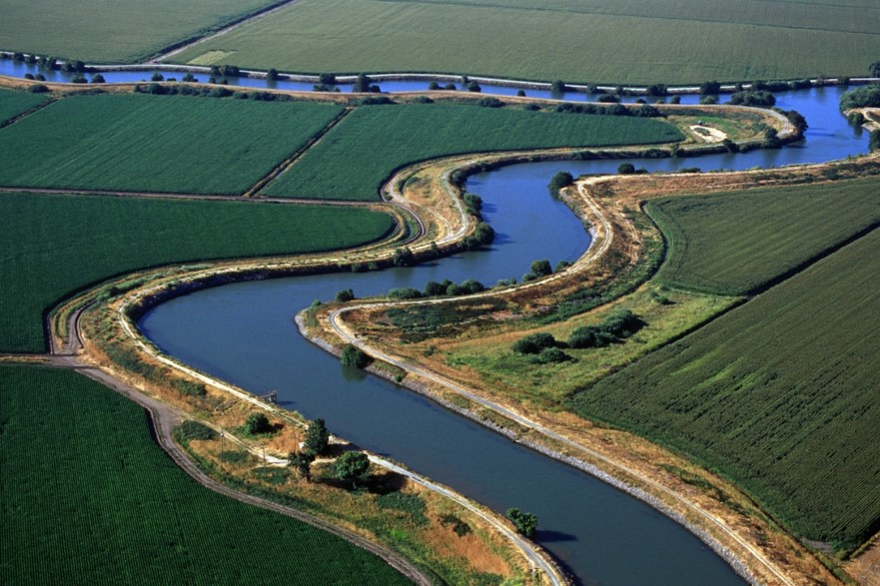
Managing Complexity Under the Delta Reform Act
“Co-equal Goals”
Three Issues:
Water Supply Reliability
Ecosystem Renewal
Regard for Delta as an Evolving Place
We Can All Agree on the Appropriate Balance, Right?
Notes:
Managing a Complex System under the Delta Reform Act
"'Coequal goals' means the two goals of providing a more reliable water supply for California and protecting, restoring, and enhancing the Delta ecosystem. The coequal goals shall be achieved in a manner that protects and enhances the unique cultural, recreational, natural resource, and agricultural values of the Delta as an evolving place."
(CA Water Code §85054)
Three legs to the Stool:
Water Supply Reliability
Ecosystem Renewal
Regard for the Delta as an Evolving Place
We Can All Agree on the Appropriate Balance, Right

Slide 11
Delta Plan – Thread the Needle
Challenges:
Natural
Economic
Infrastructure
Cultural
Ecological
Vision
Notes:
The Delta Plan Attempts to Thread the Needle:
Natural Challenges: Drought, Flood and Climate Change
Economic Challenges: Dependence on an Unstable Resource
Infrastructure Challenge: Investment in an Unstable Area
Cultural Challenge: Delta as a Place
Ecological Challenge: Ecosystem is Crashing from Multiple Stressors
Vision Challenge: Perfect May be the Enemy of the Good

Slide 12
The Delta Plan
Currently Suspended – Procedural Attack (Of course!)
Undergoing Major Revision:
Levee Investment Strategy
Storage, Conveyance and Operation of Both
Ecosystem Renewal
Delta Plan Interagency Implementation Committee
Notes:
Sustained as Legally Enforceable (Requirement of Consistency of Major Actions)
Delta Plan Interagency Implementation Committee

Slide 13
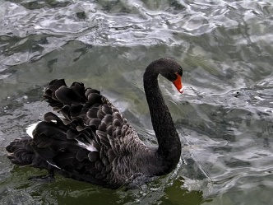
What to Watch For
Water Quality Control Plan Update (Can we set minimum flows?)
WaterFix (Credible operating conditions?)
EcoRestore (Practical, actionable, affordable, scalable or utopian?)
Delta Plan Revisions (Can we escape the ESA single-species straightjacket?)
Arrival of the Black Swan (Can a mature democracy manage change?)
Notes:
Water Quality Control Plan Update (Can WE Set Minimum Flows?)
WaterFix (Can We Devise Credible Conditions for Operation of New Infrastructure?)
EcoRestore (Practical, Actionable, Affordable or Utopian?)
Delta Plan Revisions (Can We Escape the ESA Single-species Straightjacket?)
Arrival of the Black Swan (Can a Mature Democracy Manage Change?)

Slide 14
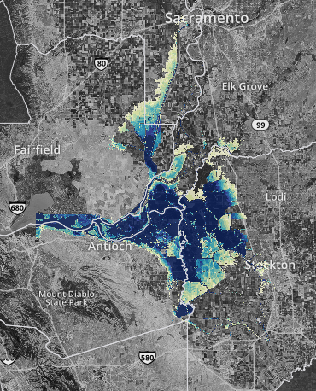
Sea Level Rise Scenario
Sacramento San Joaquin Delta
Inundation of 100-year Flood with 1.4M of Sea Level Rise
(Cal-Adapt.org)

Slide 15
Questions  Thank You
Michael George Delta Water Master Email: michael.george@waterboards.ca.gov Office Phone: (916) 445-5962 Kristi Matal Communication and Outreach Specialist Email: kristi.matal@waterboards.ca.gov Office Phone: (916) 319-8264
Photo Credits: Maven’s Notebook, Michael George, Robert Waghorn, Pixabay.com, Morguefile.com

