Slide 1
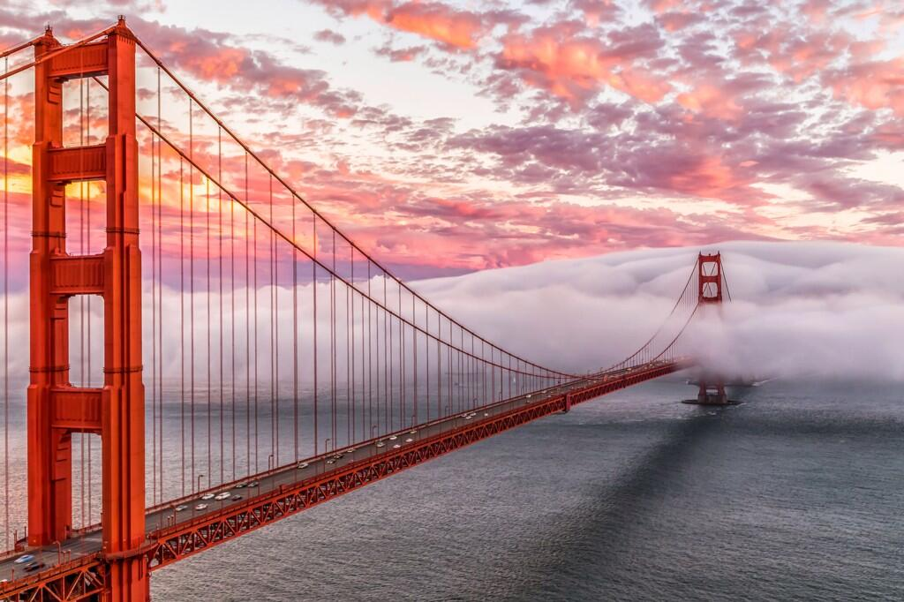

Regional Monitoring for Water Quality
Matthew Heberger
May 18, 2018

Slide 2
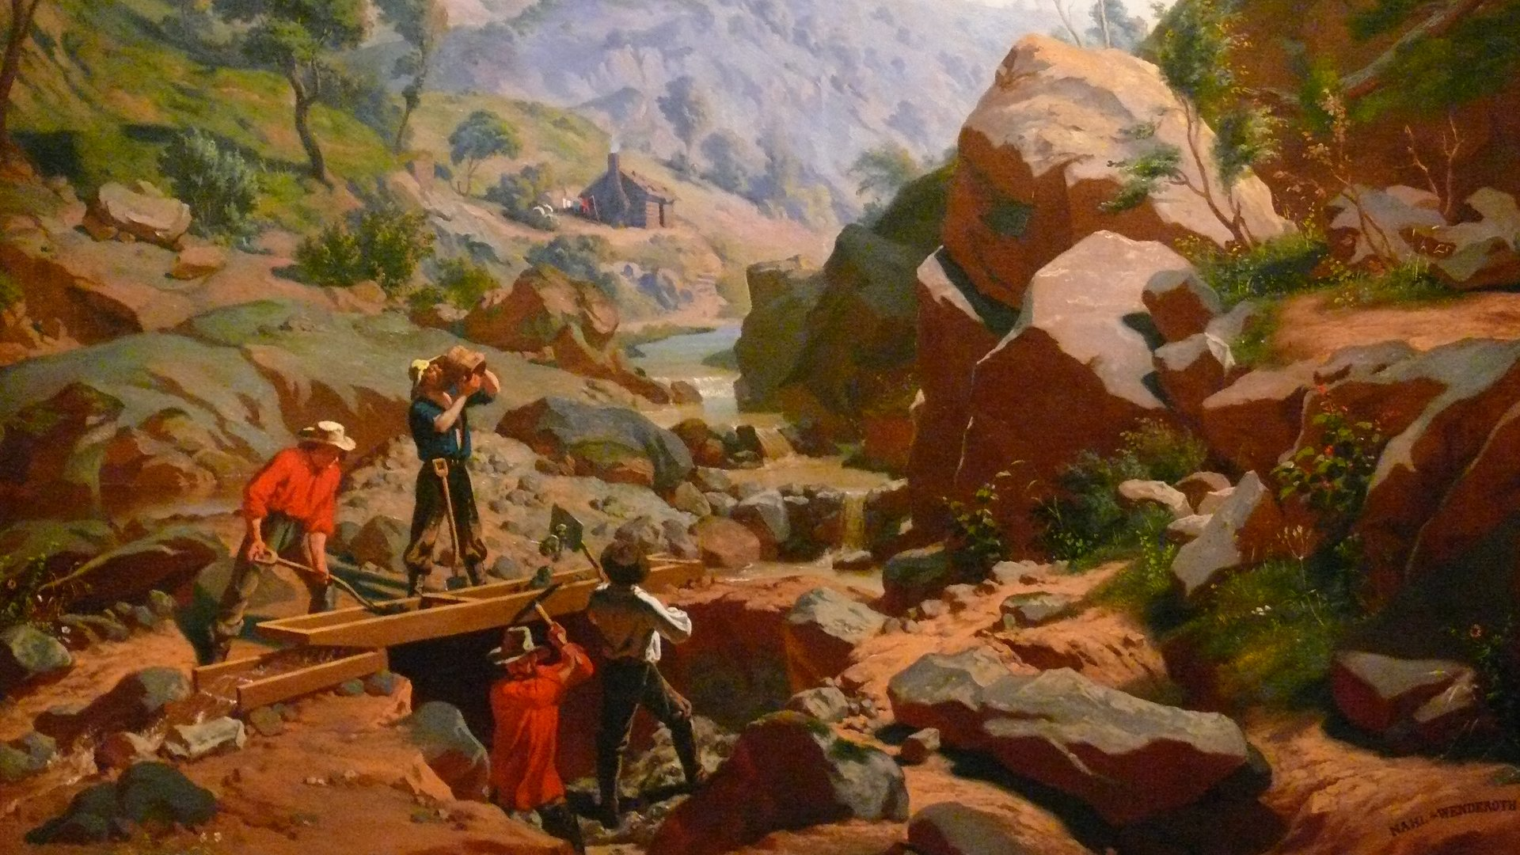

Slide 3
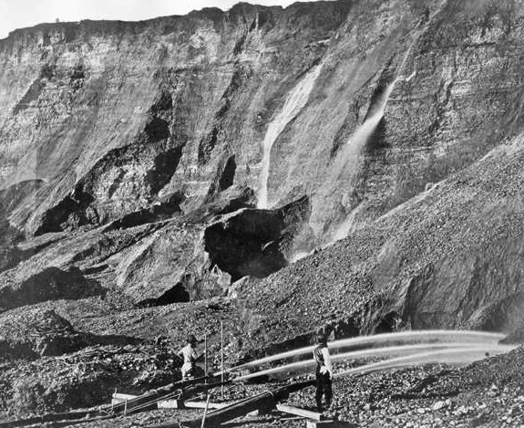
Notes:
A lot of it came from New Almaden mine, just a few miles south of San Jose. 1845-1976. The mines there ramped up production in the 1850s, shortly after the first few years of the gold rush, when prospecting dimmed and new, destructive, industrial-scale techniques were being pioneered for gold production.

Slide 4
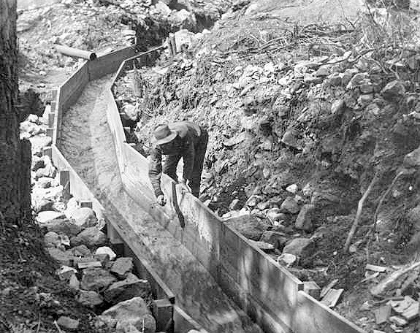

Slide 5
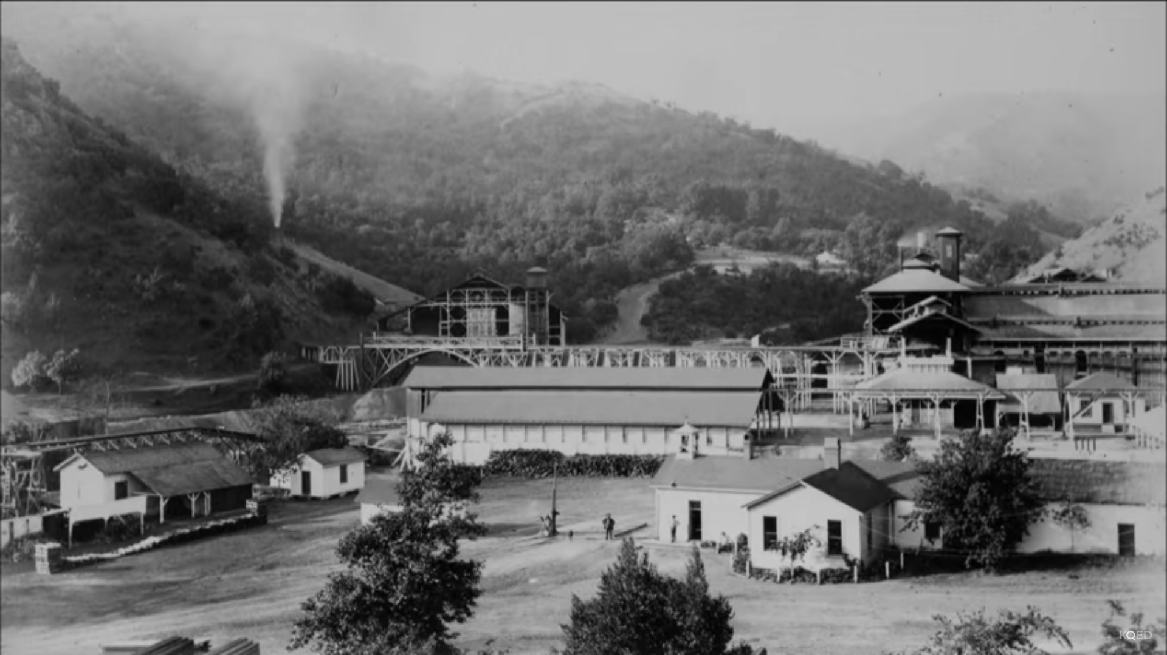
Notes:
26 million pounds

Slide 6
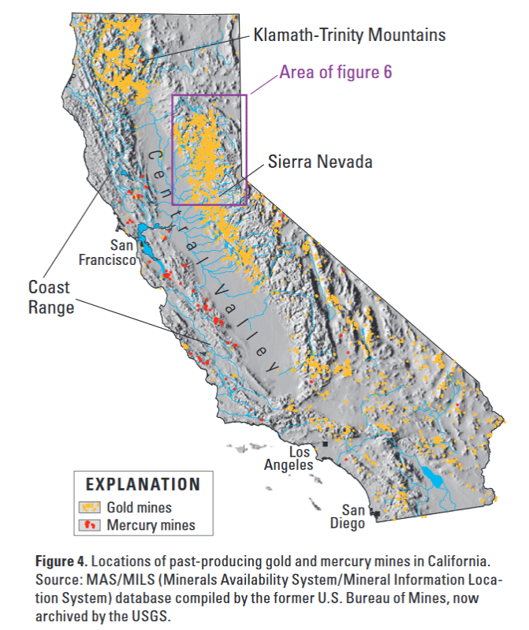
Notes:
It’s in the sediments
How long does it last?
What makes it toxic?

Slide 7
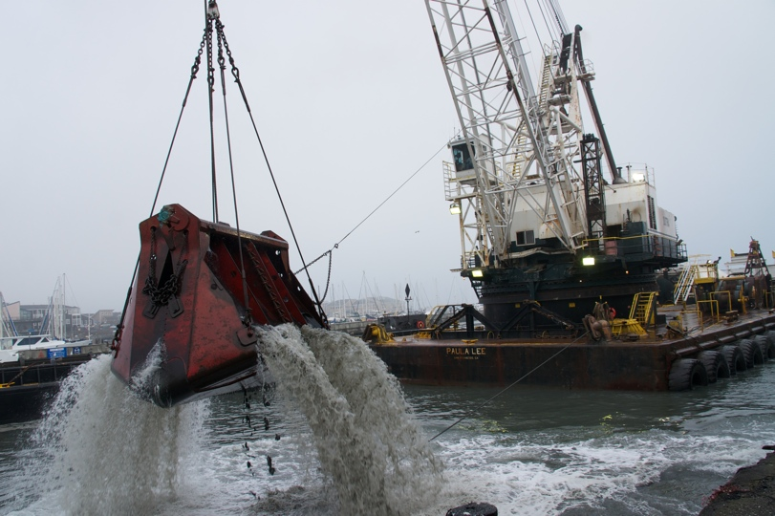
Notes:
Very low concentrations in the water. On the order of ug/L, or parts per billion. We’re talking a drop in an Olympic size swimming pool.

Slide 8
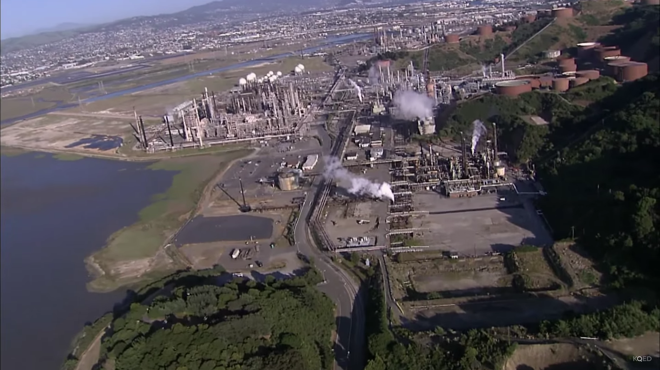

Slide 9
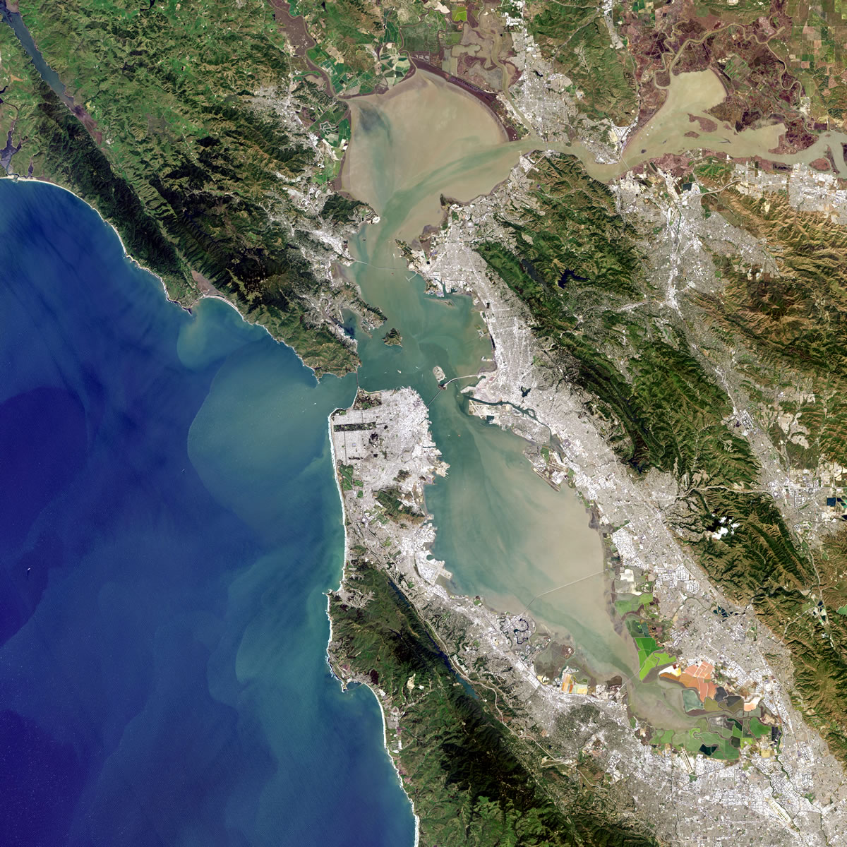
Notes:
1986 Despite the fact that over $3 billion had been invested around the Bay in upgrading wastewater treatment plants

Slide 10
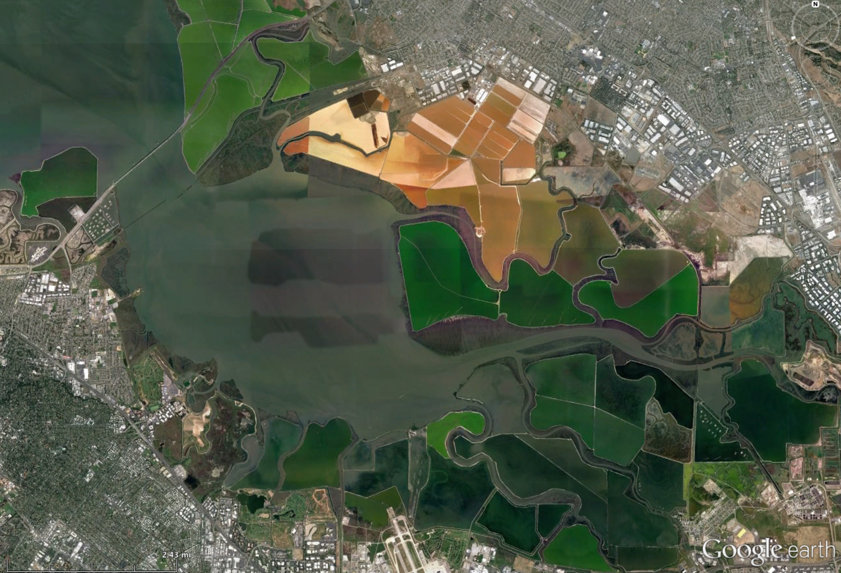

Slide 11
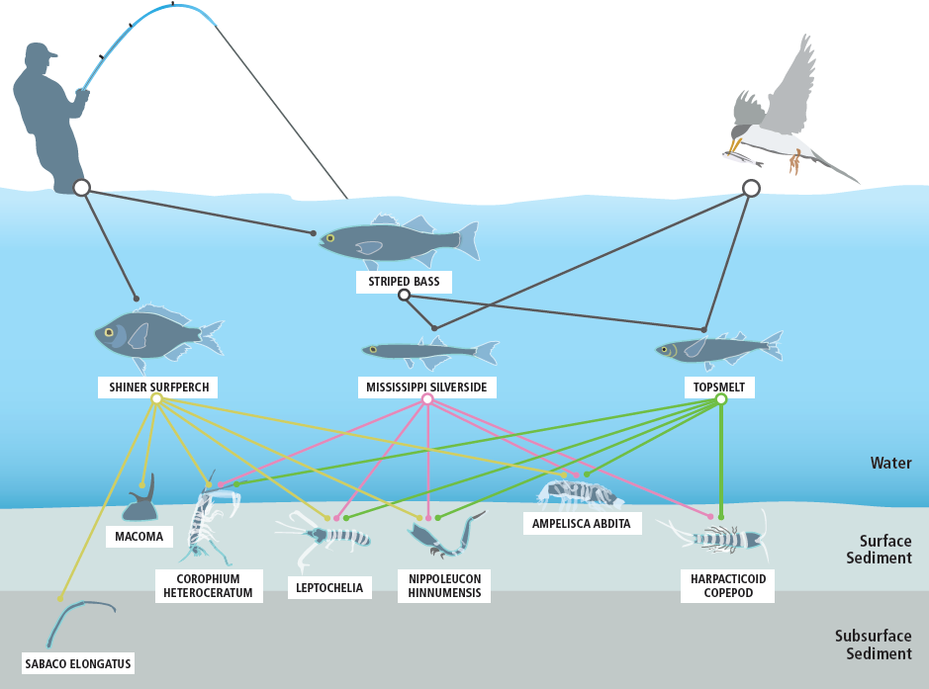

Slide 12
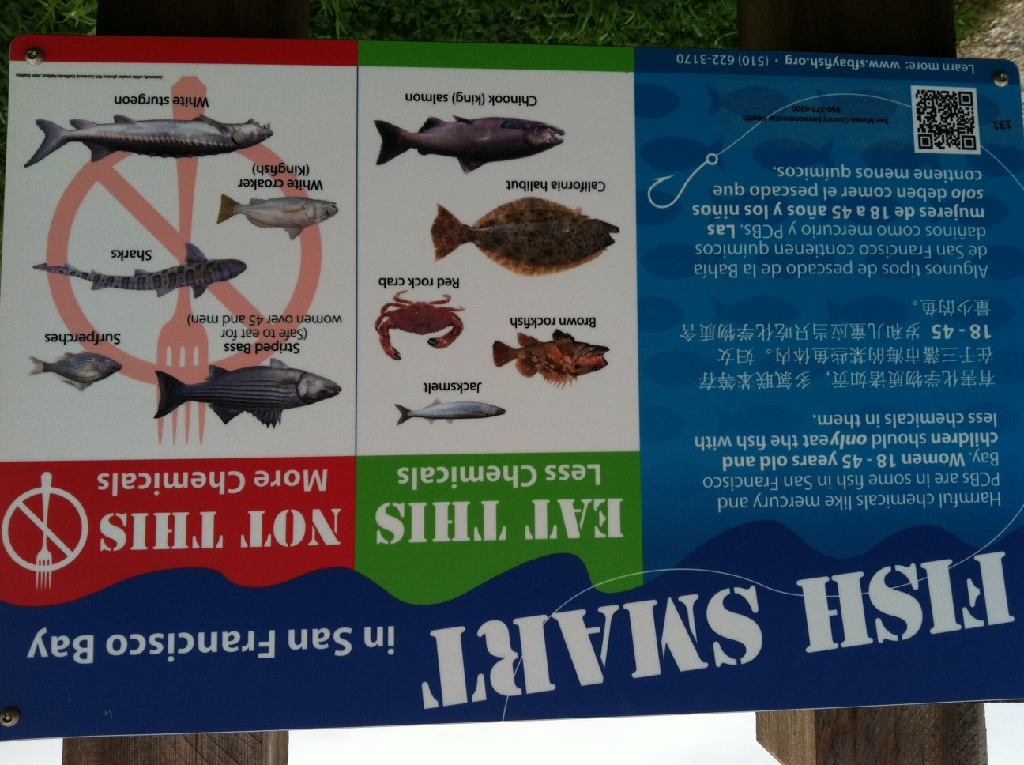

Slide 13
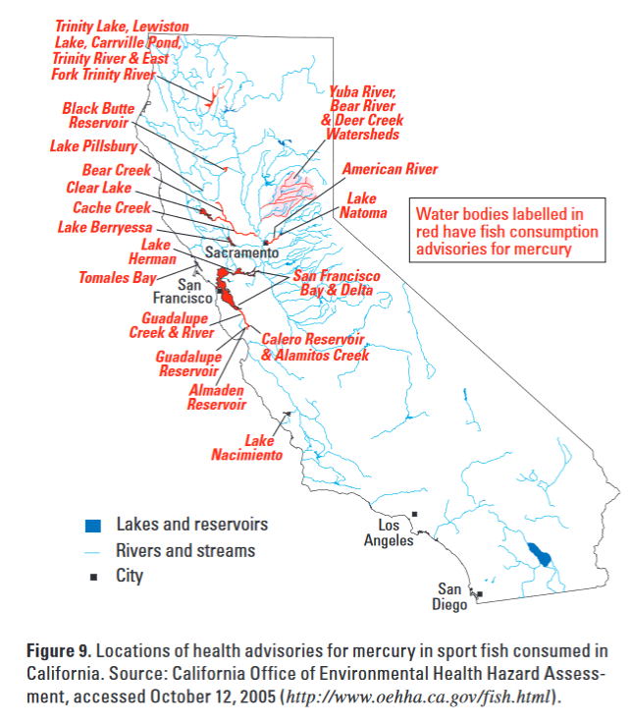

Slide 14
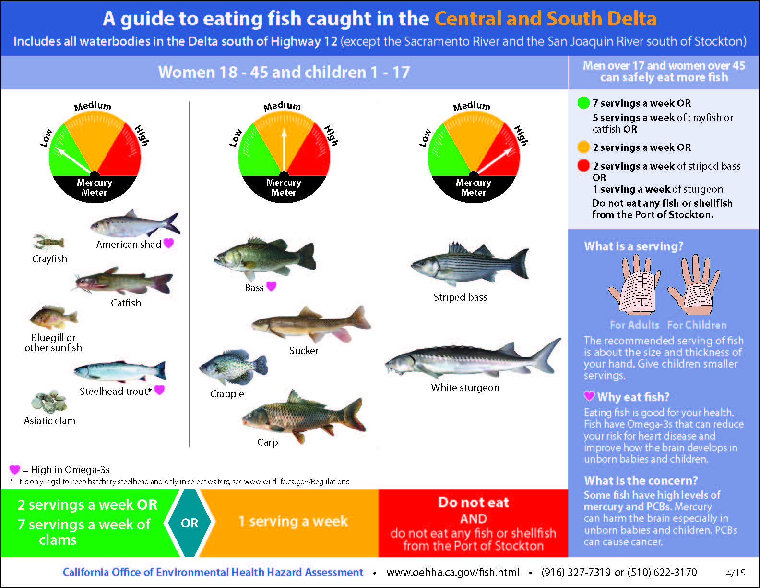

Slide 15
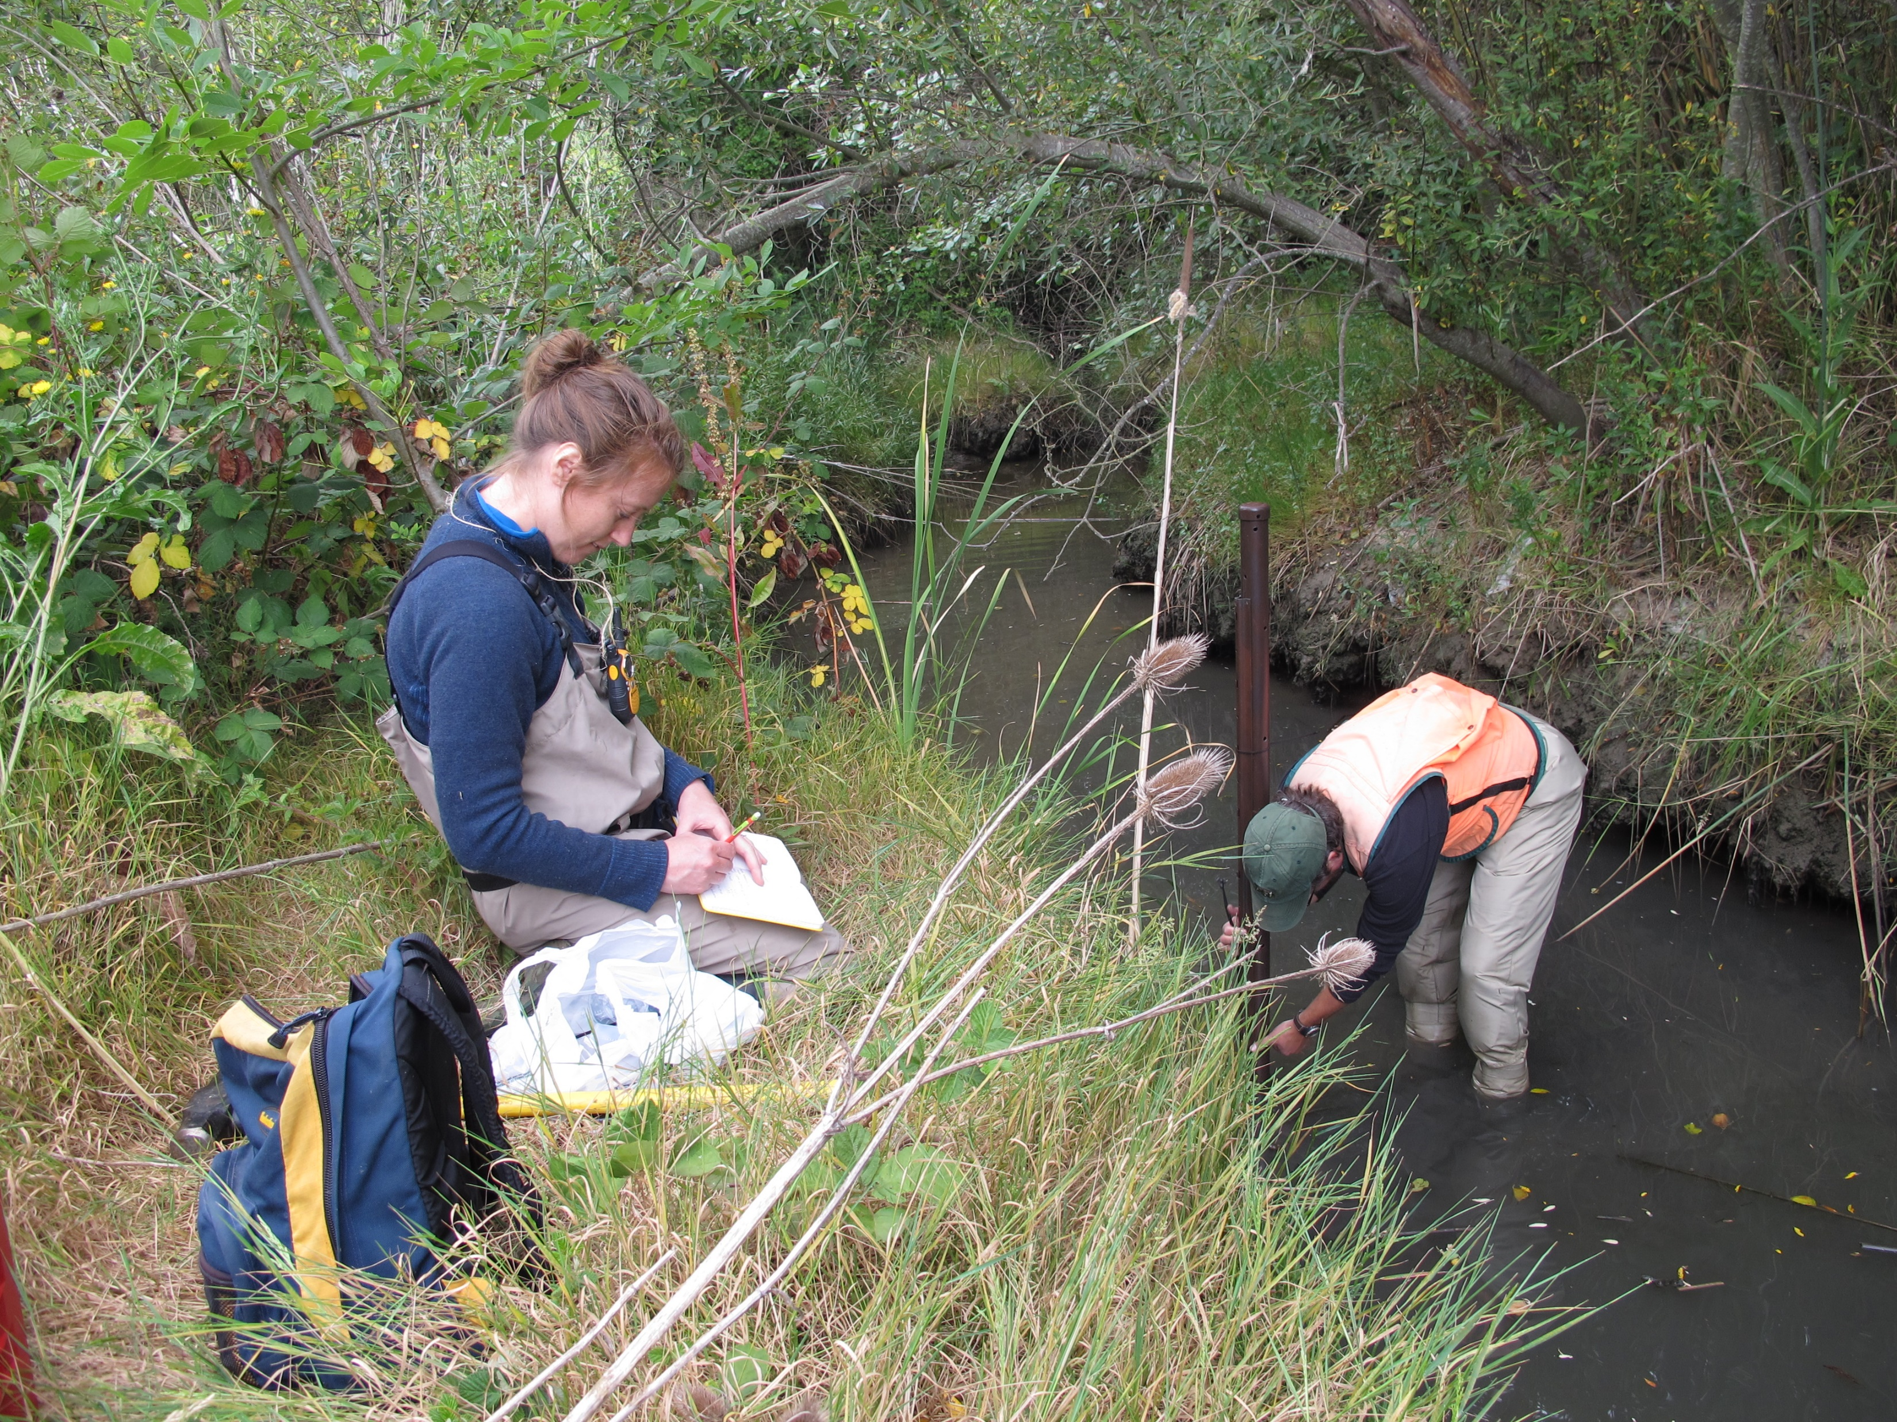

Slide 16
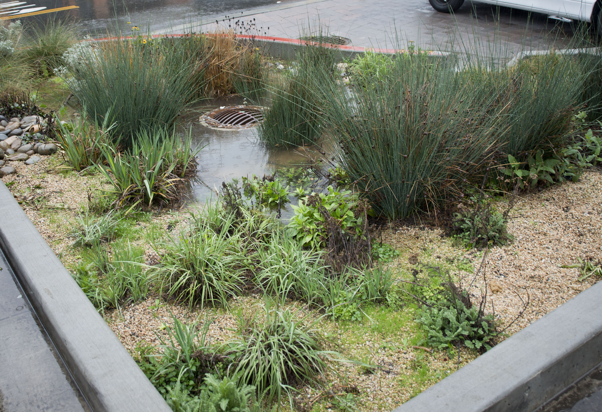

Slide 17
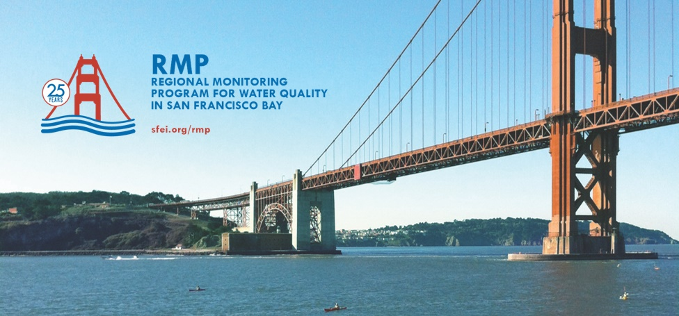
Notes:
Non-Profit Science think tank
Been around 23 years. One of the Bay Area’s best kept secret
It’s creation and original focus was on water Quality in SF Bay.
In the mid-90’s there were about 40 major pipes discharging into the bay
From oil refineries to water treatment and power plants.
The regulatory agencies (EPA, water board) had each facility monitor what came out. Situation at the time was a patchwork.
The came up with a better plan. Create a non-profit board, 1/3rd of members were regulators, 1/3 dischargers, 1/3 public interest groups (enviros, academics, business expert)
The Board would set the management questions. The dischargers would pay into a common fund
An independent team of scientists would produce a plan for monitoring the bay’s health that the board would approve.
That structure exists today

Slide 20
Notes:
Polybrominated diphenyl ethers
Banned by CA in 2005, took effect in 2008.

Slide 21
Notes:
Shiboard analysis. Also contract with labs. Private, UC system, USGS.

Slide 22
Notes:
Long-term records allow us to track trends over time and monitor changes to the ecosystem. Equally important, they let us track the impact and the effectiveness of investments and projects intended to improve water quality.

Slide 23
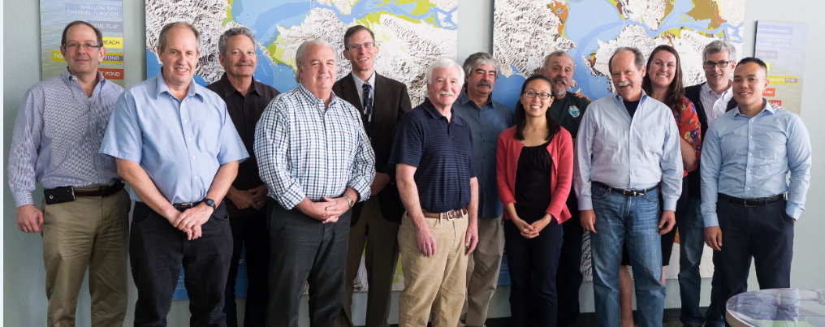

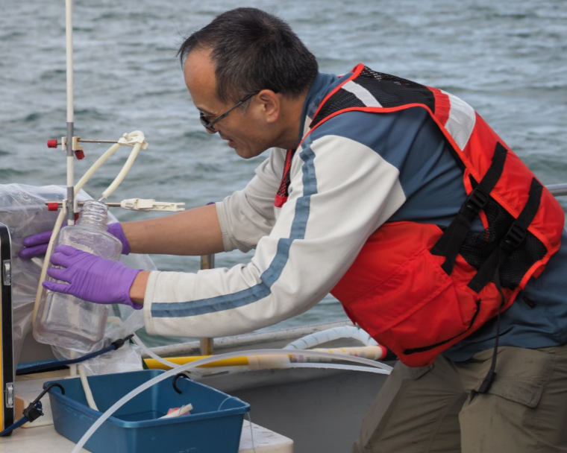

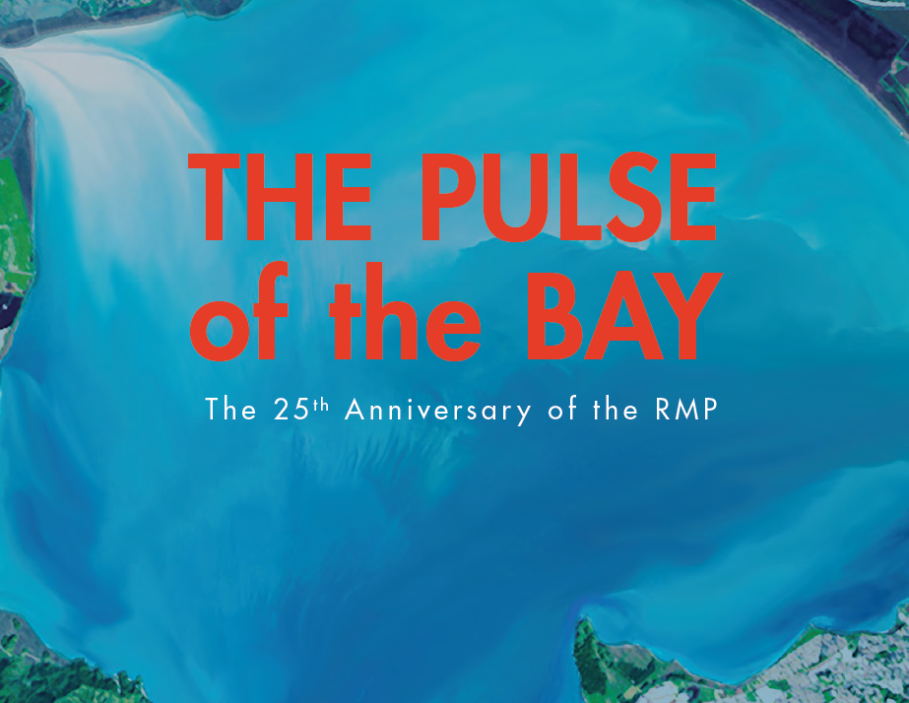
Keys to the RMP’s Success
Forum for Collaboration
Clear Objectives
Relevant to Decisions
Stable Funding
Sound Science
Adaptability
Reporting
Notes:
So, if we have achieved success, how did we do it. There are 5 major factors.
sustained financial support;
sound science supported by rigorous peer review of both study plans and reporting products;
active participation, collaboration, and partnership on the part of regulators, dischargers, scientists, and other stakeholders;
thoughtful and forward-looking planning;
effective communication of the information generated; and
adaptation in response to changes in the ecosystem, the regulatory framework, and advances in understanding of pollutants and the ecosystem
Top two -- Collaboration and Relevance to Mgmt Decisions -- are absolutely necessary.
--Without the forum and willingness to collaborate, the program would not have even started.
--With regard to relevance to mgmt. decisions, I will be perfectly blunt: Monitoring programs without management relevance are …. Hard to fund and sustain.
Stable Funding and Long Term Planning have allowed us to be efficient with our time and dollars, which makes our stakeholders happy and lets us focus on the work.
Adaptability has been crucial for keeping us relevant. Next year is the RMP’s 25th anniversary. The program looks nothing like what it was when it started in 1993. The monitoring design, the management questions, and the target parameters have all changed. Normally we think a good monitoring program does the same thing forever. If he had followed that model, we would not exist now.

Slide 24
RMP Fees for 2018
Total =
$3.4M

Slide 25
Notes:
Governance structure: Steering Committee – sets policy and budgets
Tells us what are the priority questions for management
and Technical Review Committee,
Quarterly meetings
Lots of technical working groups
Dozens of science advisors, small honoraria

Slide 26
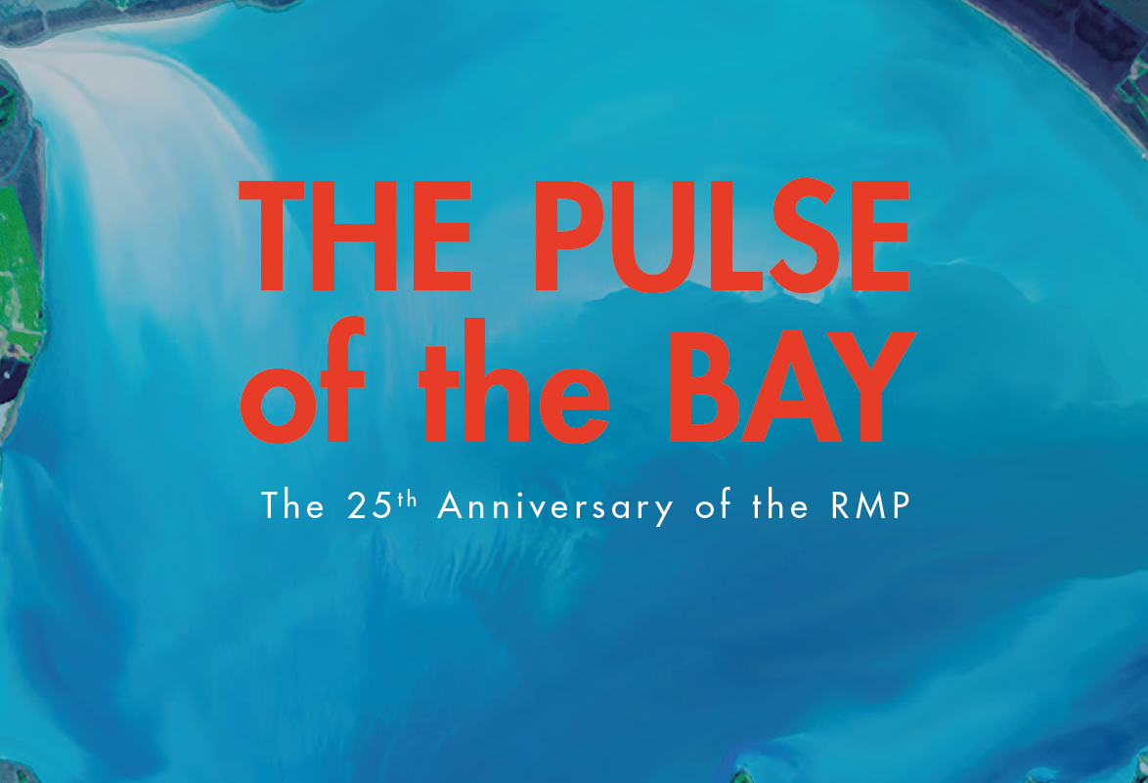
Notes:
Communication – flagship publications
Journal articles
Outreach to the media

Slide 27
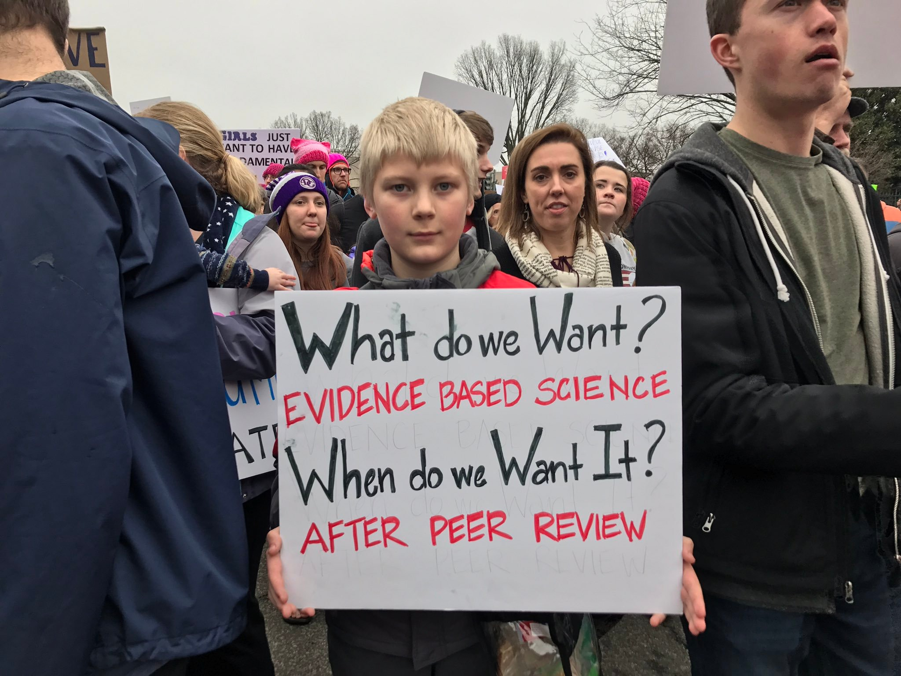

Slide 28
Notes:
1997 Review: Don’t limit sampling to the Bay’s spine

Slide 29
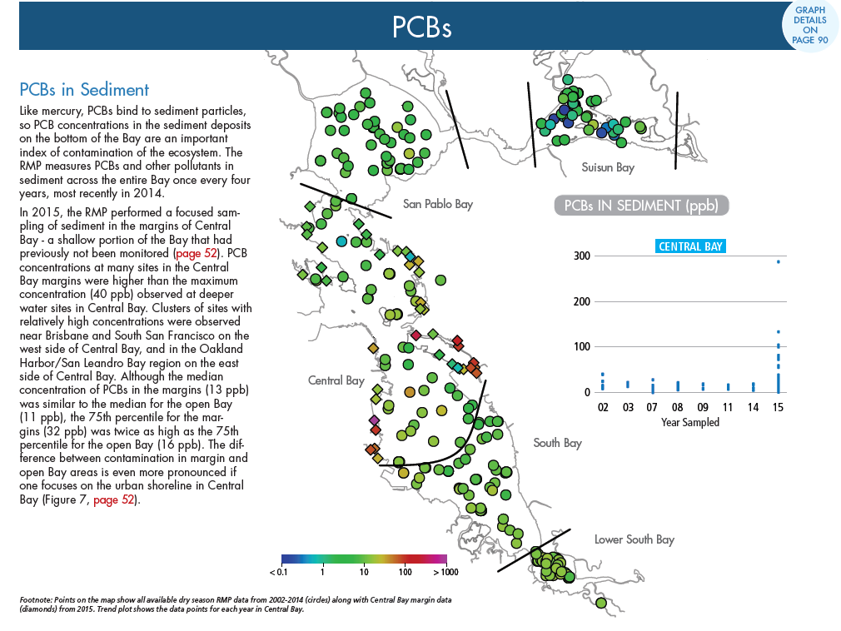

Slide 30
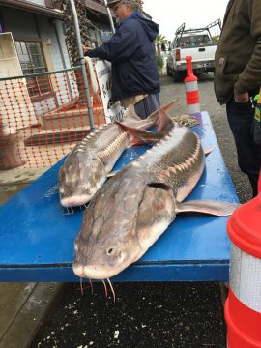
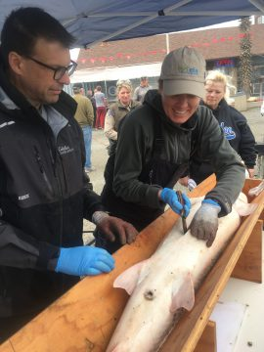
Notes:
2004 Review: Add a biological component
Sampling fish, bird eggs, mussels,

Slide 31
Notes:
Harbor seals

Slide 33
Notes:
Long-term storage of samples
Meat locker in San Leandro for 3-5 years.
Afterwards NIST. -300 degrees.

Slide 34
Notes:
Measuring stormwater.

Slide 35

Notes:
Margins are where the wild things are.

Slide 36
Notes:
Also pollutant hot spots. Palo Alto Baylands Dump 1953
Link to sea level rise and remobilization of contaminants
we

Slide 38
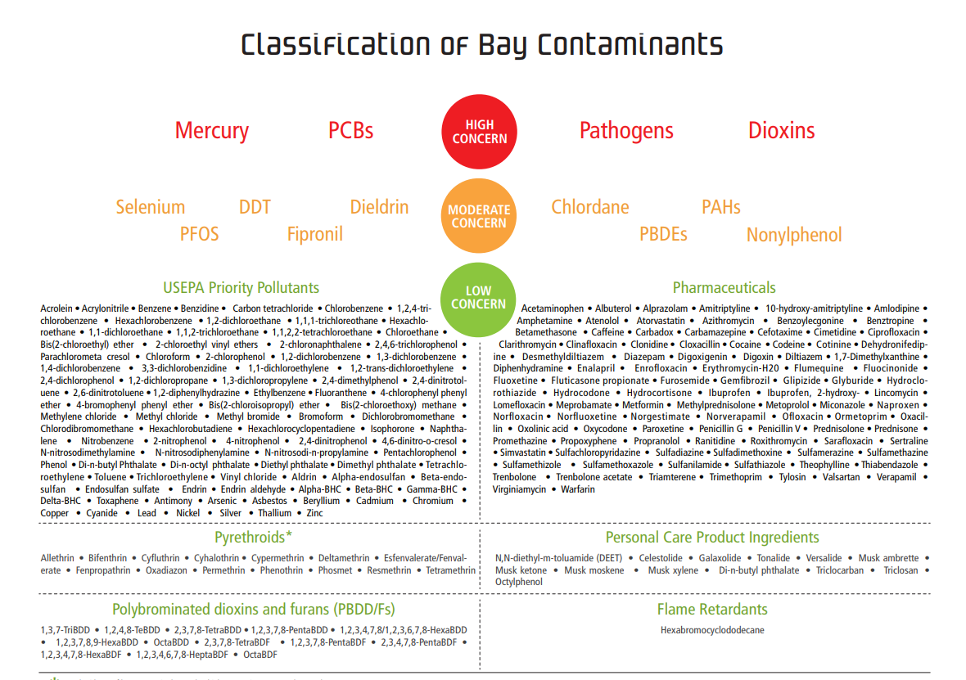
Notes:
Contaminants of Emerging Concern (CEC)
Pesticides, pharmaceuticals, flame retardants
Over 80,000 chemicals used in industry
Which CECs have the potential to adversely impact beneficial uses in San Francisco Bay?
What are the sources, pathways, loadings, and processes leading to CEC pollution in the Bay?
Have the concentrations of CECs in the Bay increased or decreased?
Which management actions may be effective in reducing CEC levels?

Slide 39
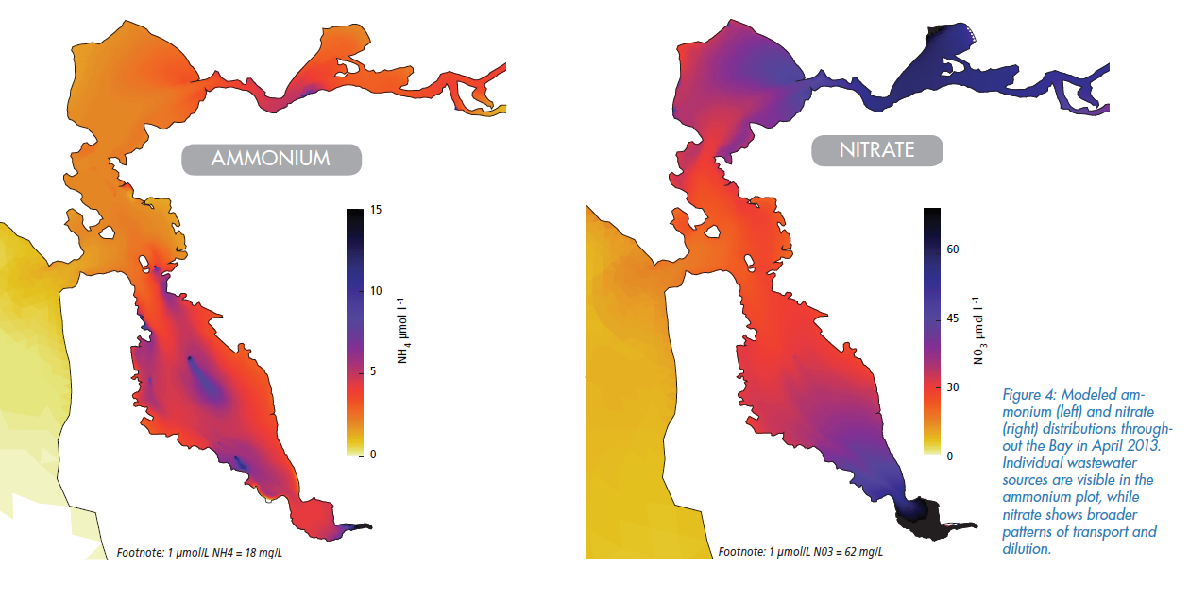

Slide 40
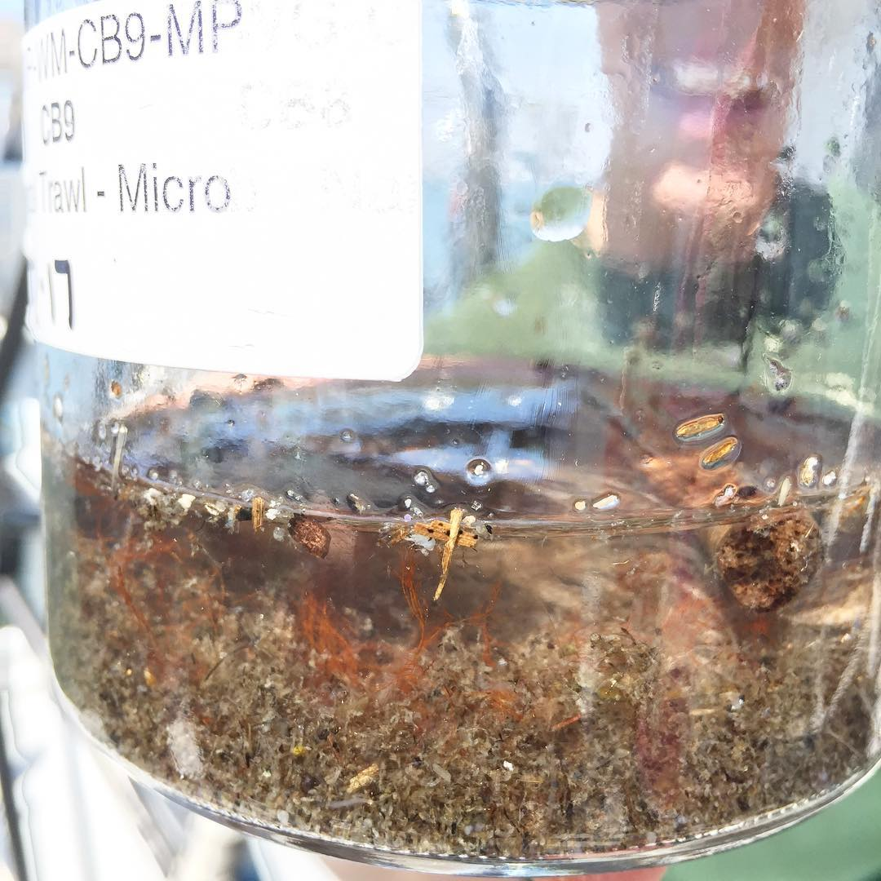
Notes:
Microplastics
Beads banned in CA – look just like fish eggs, a delicacy
2015 law prohibit the sale of soaps, facial and body scrubs, toothpaste and other products with plastic microbeads as of Jan. 1, 2020.

Slide 41
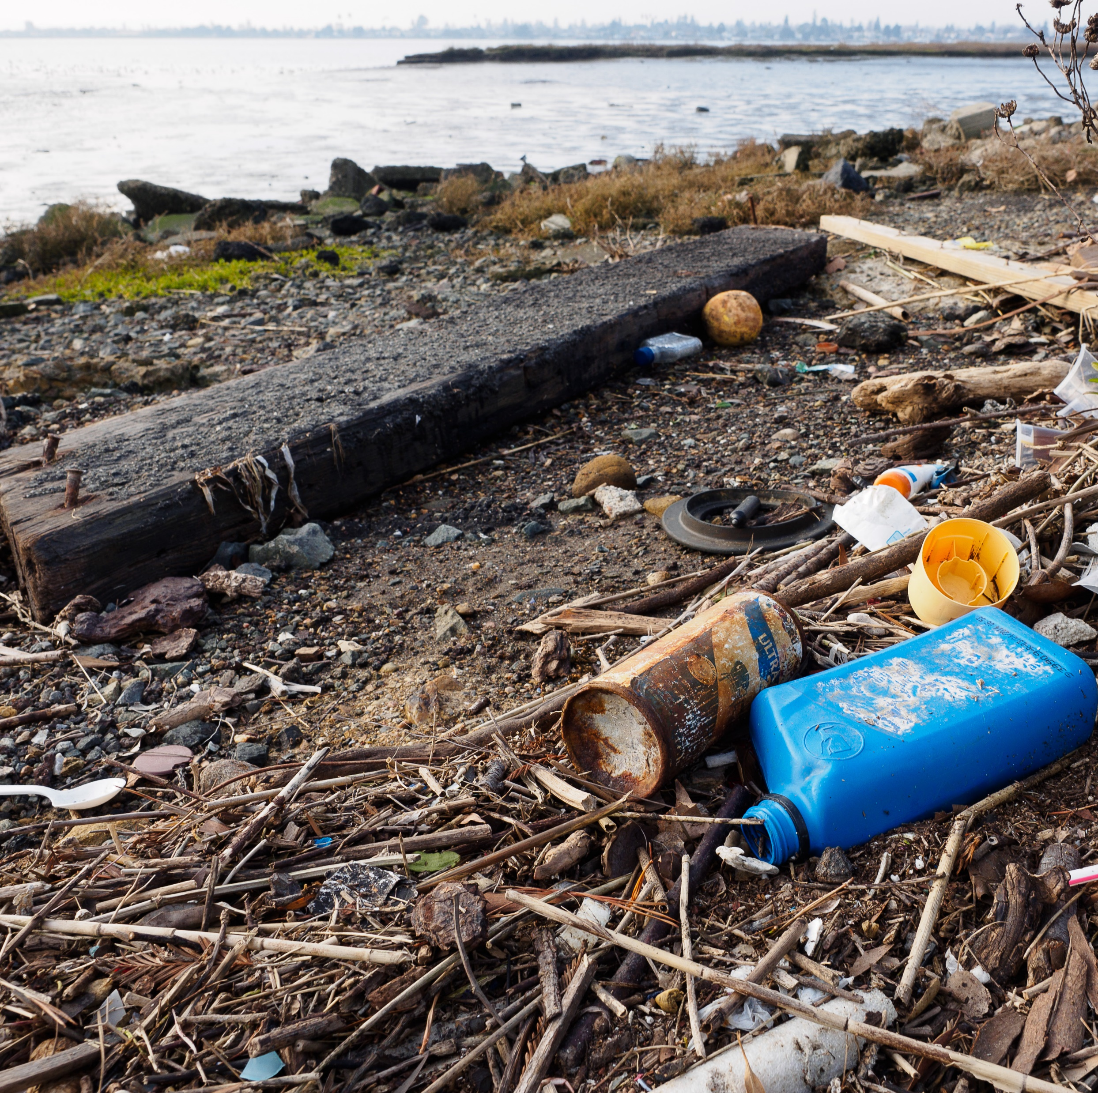
Notes:
Trash
We just bought a very expensive drone.
I work with a PhD computer scientist, machine learning, artificial intelligence.
But the goal is to identify sources, track how its moving through the environment, understand how it affects wildlife, and ultimately put in place better management strategies.
It’s already working. Early surveys recognized that highways are a significant source of trash entering the Bay.

Slide 42
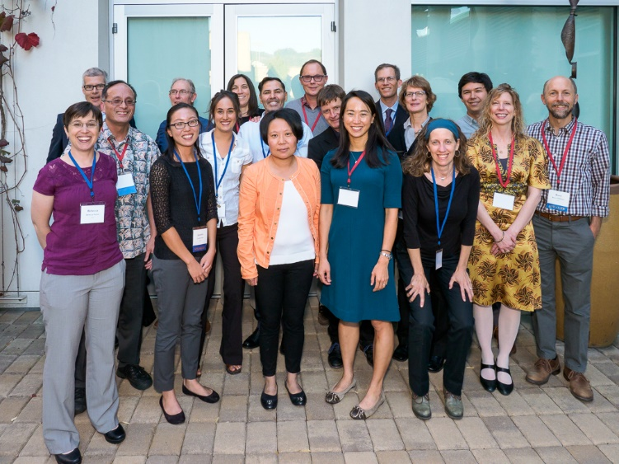
Notes:
Great team of co-workers.

Slide 43
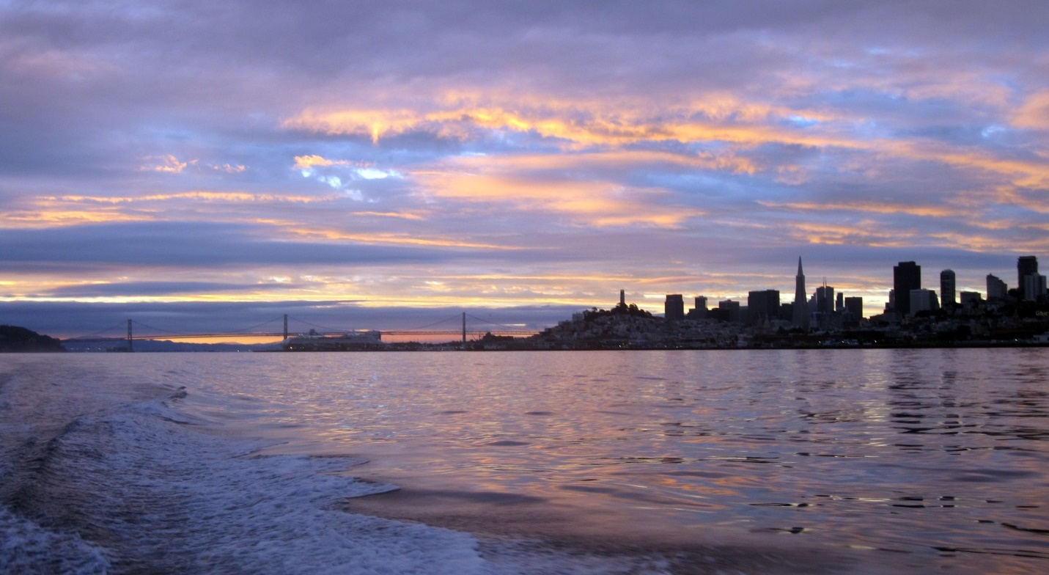
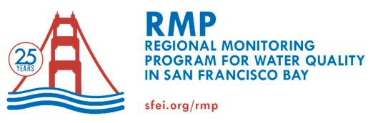
Matthew Heberger
510-746-7391
matth@sfei.org
Notes:
Main keys to success after 25 years:
Collaboration
Management relevance
You’ve got to innovate and adapt. About a third of our monitoring budget is for “status and trends” monitoring. We go out month after month and year after year and make the same measurements. Consistency and reliabity are key to creating these long-term data sets that let us see how the Bay is changing over time. And help us track progress of programs and policies designed to improve the Bay.
Another third is special studies. Examples are microplastics, emerging contaminants. Surveillance is really important. If we can predict what tomorrow’s problems will be, maybe we can prevent them. “To see the future is good. To prepare for it is better.”
Unless someone like you cares a whole awful lot, nothing’s going to get better, it’s not.

