Slide 1
WATER EDUCATION FOUNDATION DELTA TOUR May 17, 2018
John Herrick, Esq., Counsel & Manager
South Delta Water Agency

Slide 2
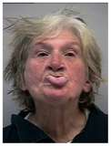
My wife couldn’t make it but sends her regards.

Slide 3
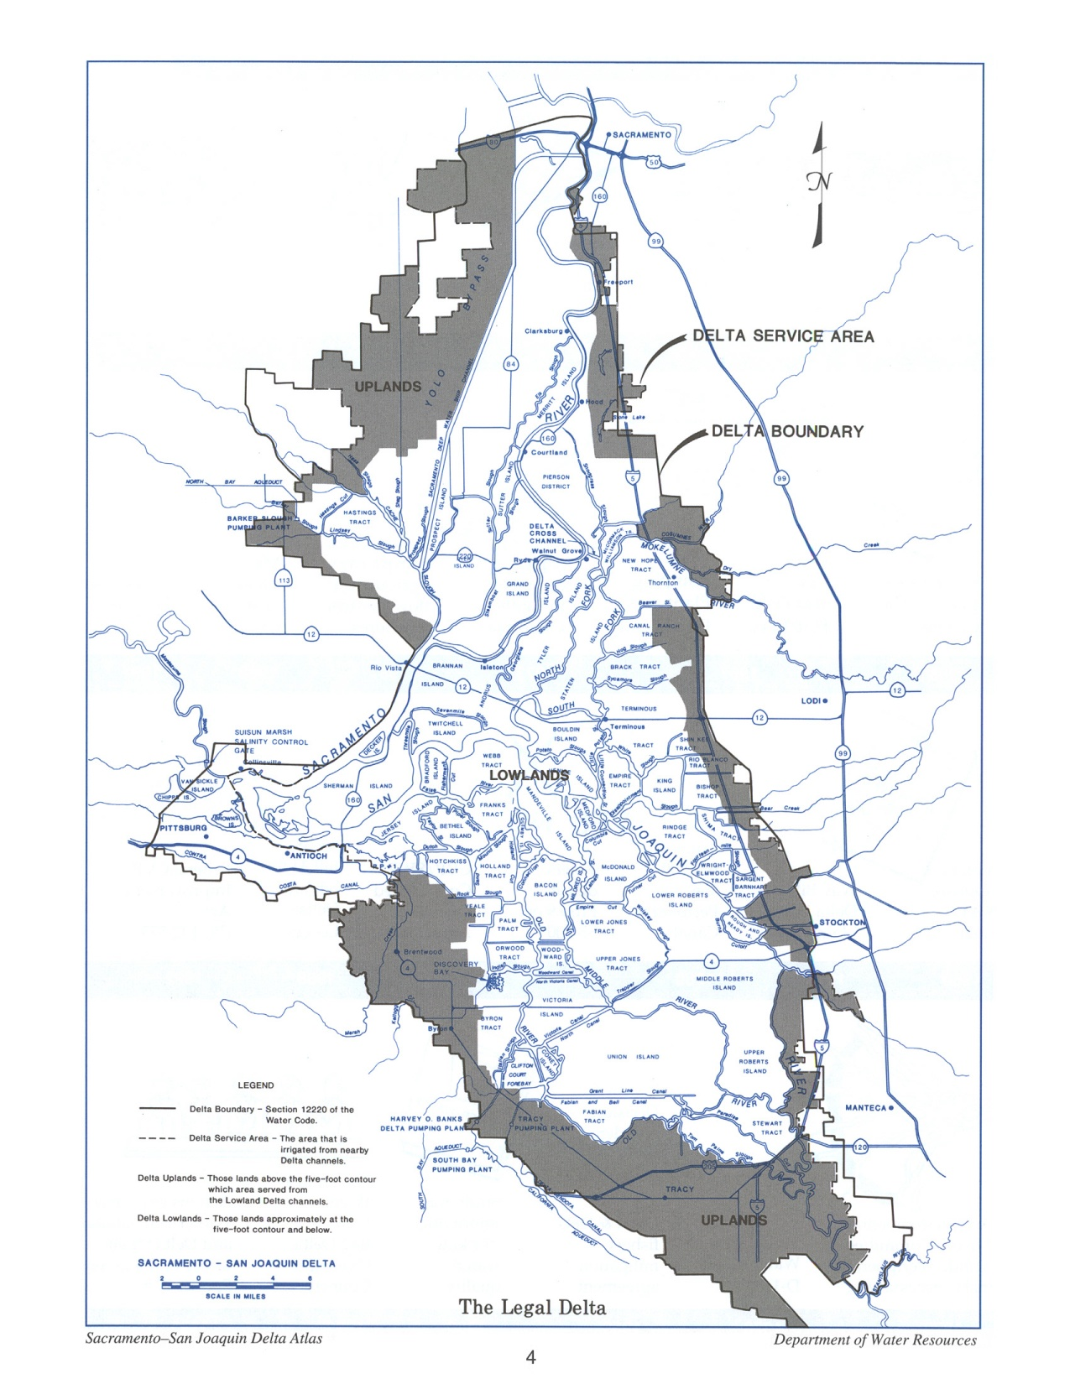

Slide 4
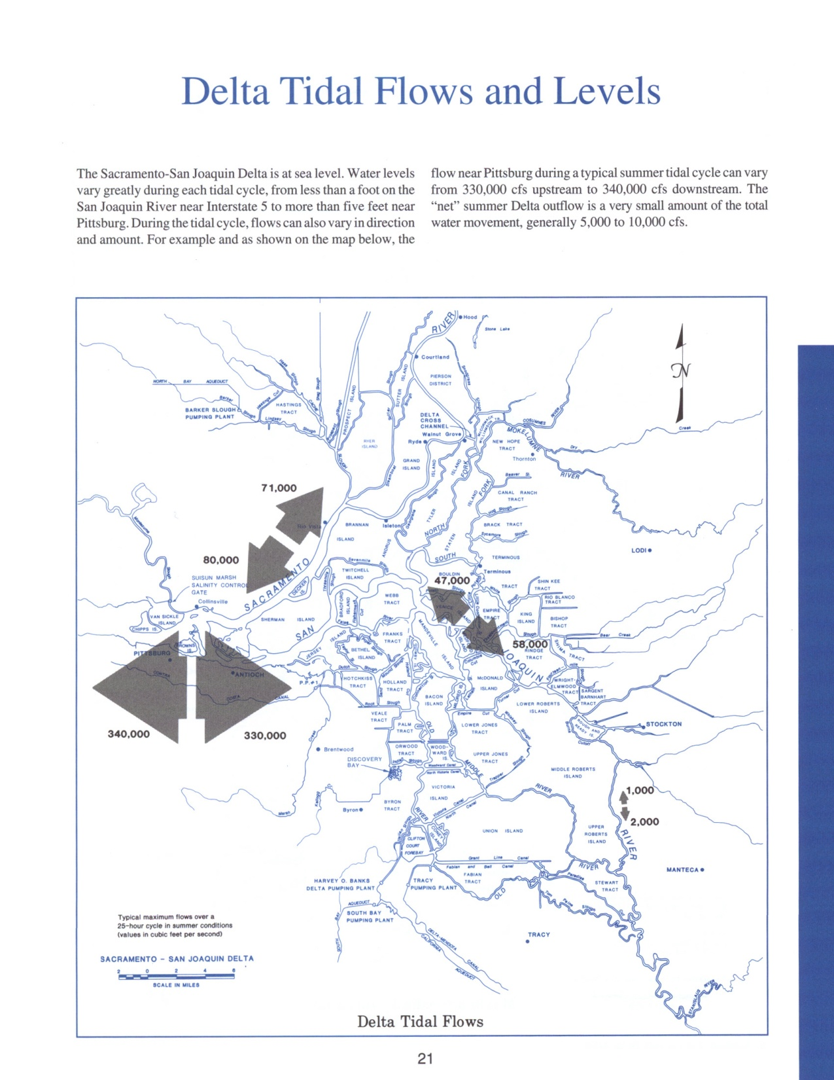

Slide 5
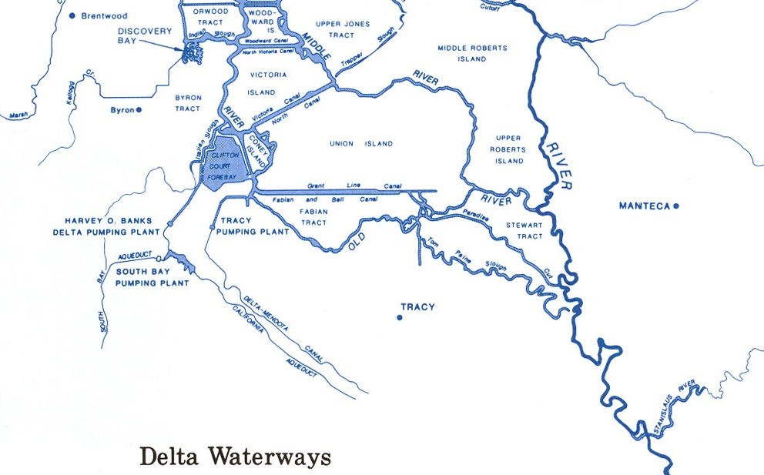

Slide 6
HOW THE PROJECTS AFFECT THE SOUTHERN DELTA

Slide 7
The CVP had a number of effects on the San Joaquin River and Southern Delta.
It significantly decreased flows due to Friant Dam:
It added large amounts of salt to the River via drainage from lands irrigated with CVP water: and
It altered flows in the southern Delta and lowered water levels due to the massive export pumps.

Slide 8
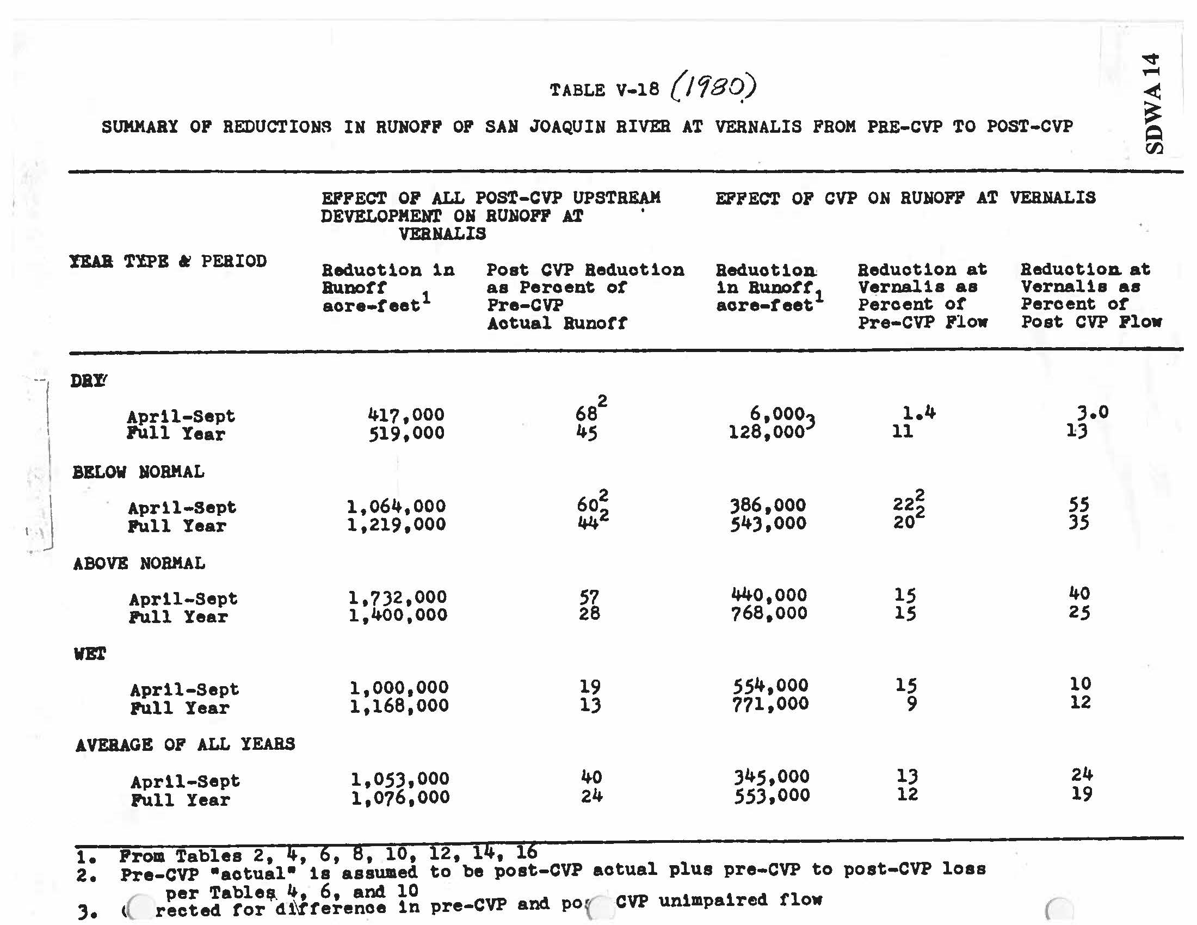

Slide 9
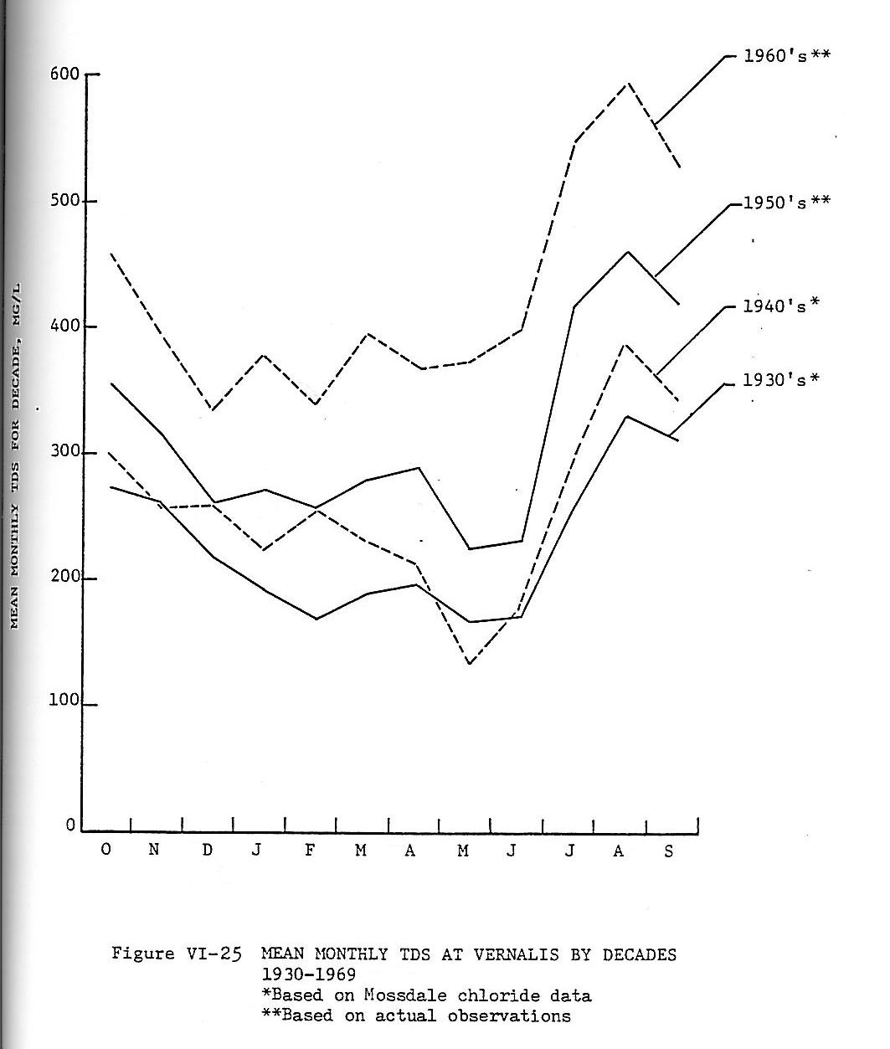

Slide 10
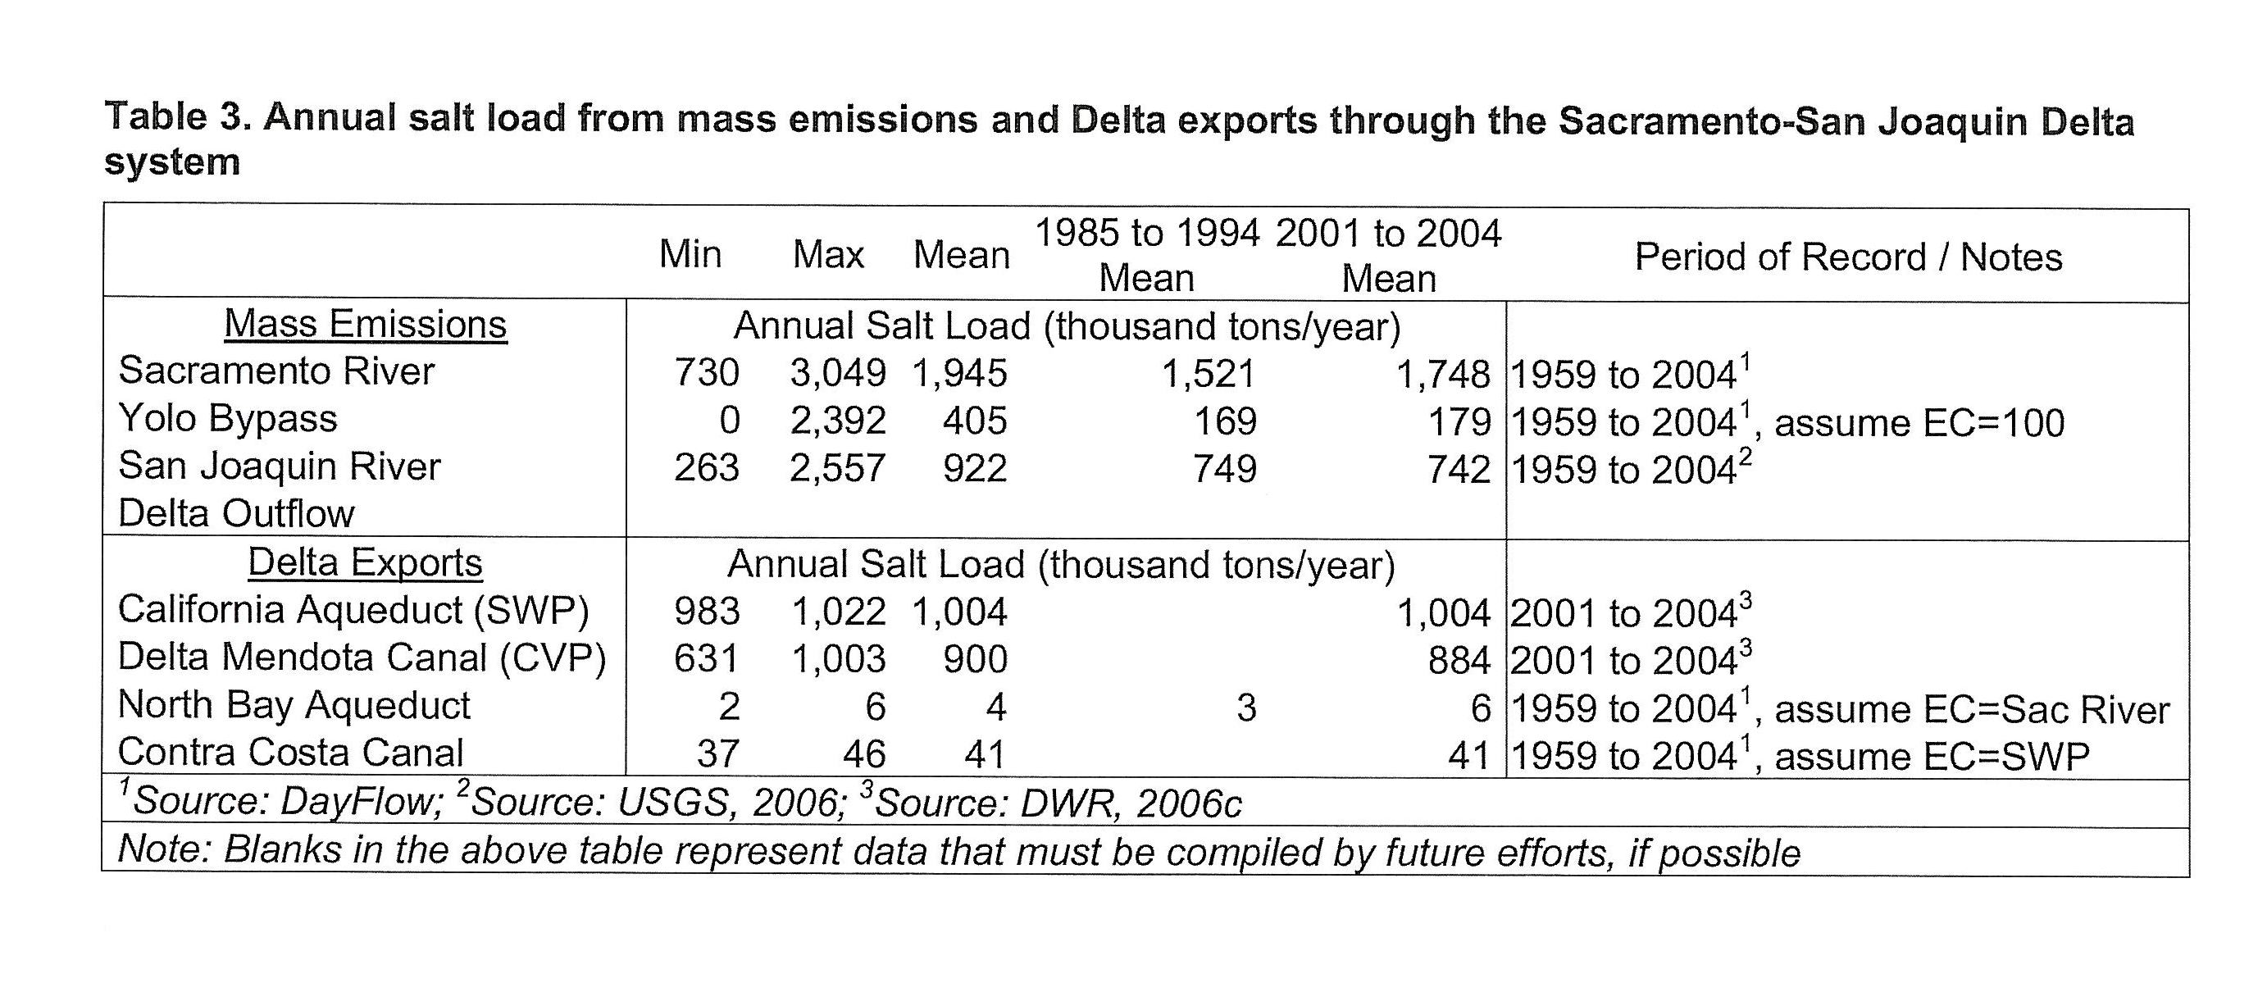

Slide 11
WE GOT SALT PROBLEMS!
Typically in summer the measured EC is higher than the current standards.

Slide 12
WHY DO SALTS COLLECT IN SOUTH DELTA CHANNELS?
Tidal Inflow
San Joaquin River Inflow
Net Consumptive Use in Area

Slide 14
LOCAL FARMERS’ TESTIMONY OF CURRENT ADVERSE IMPACTS

Slide 15
Chip Salmon: Salt damage to grapes, beans and walnuts; decreased production;
Rudy Mussi: Salt problems require additional expenditures to partially mitigate;
Richard Marchini: Salt damages to walnuts causing decreased crop yields;
Jack Alvarez: Salt in applied water causes decreased crop yields in cannery tomatoes and lima beans;
Mark Bacchetti: Salt damages to plants/crops and increased soil salinity;

Slide 16
WATER LEVEL PROBLEMS AND SILTATION

Slide 17
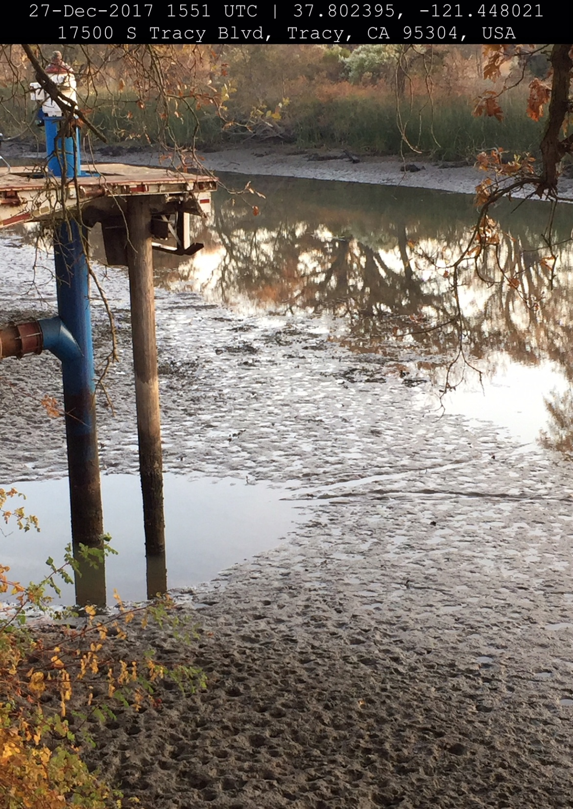

Slide 18
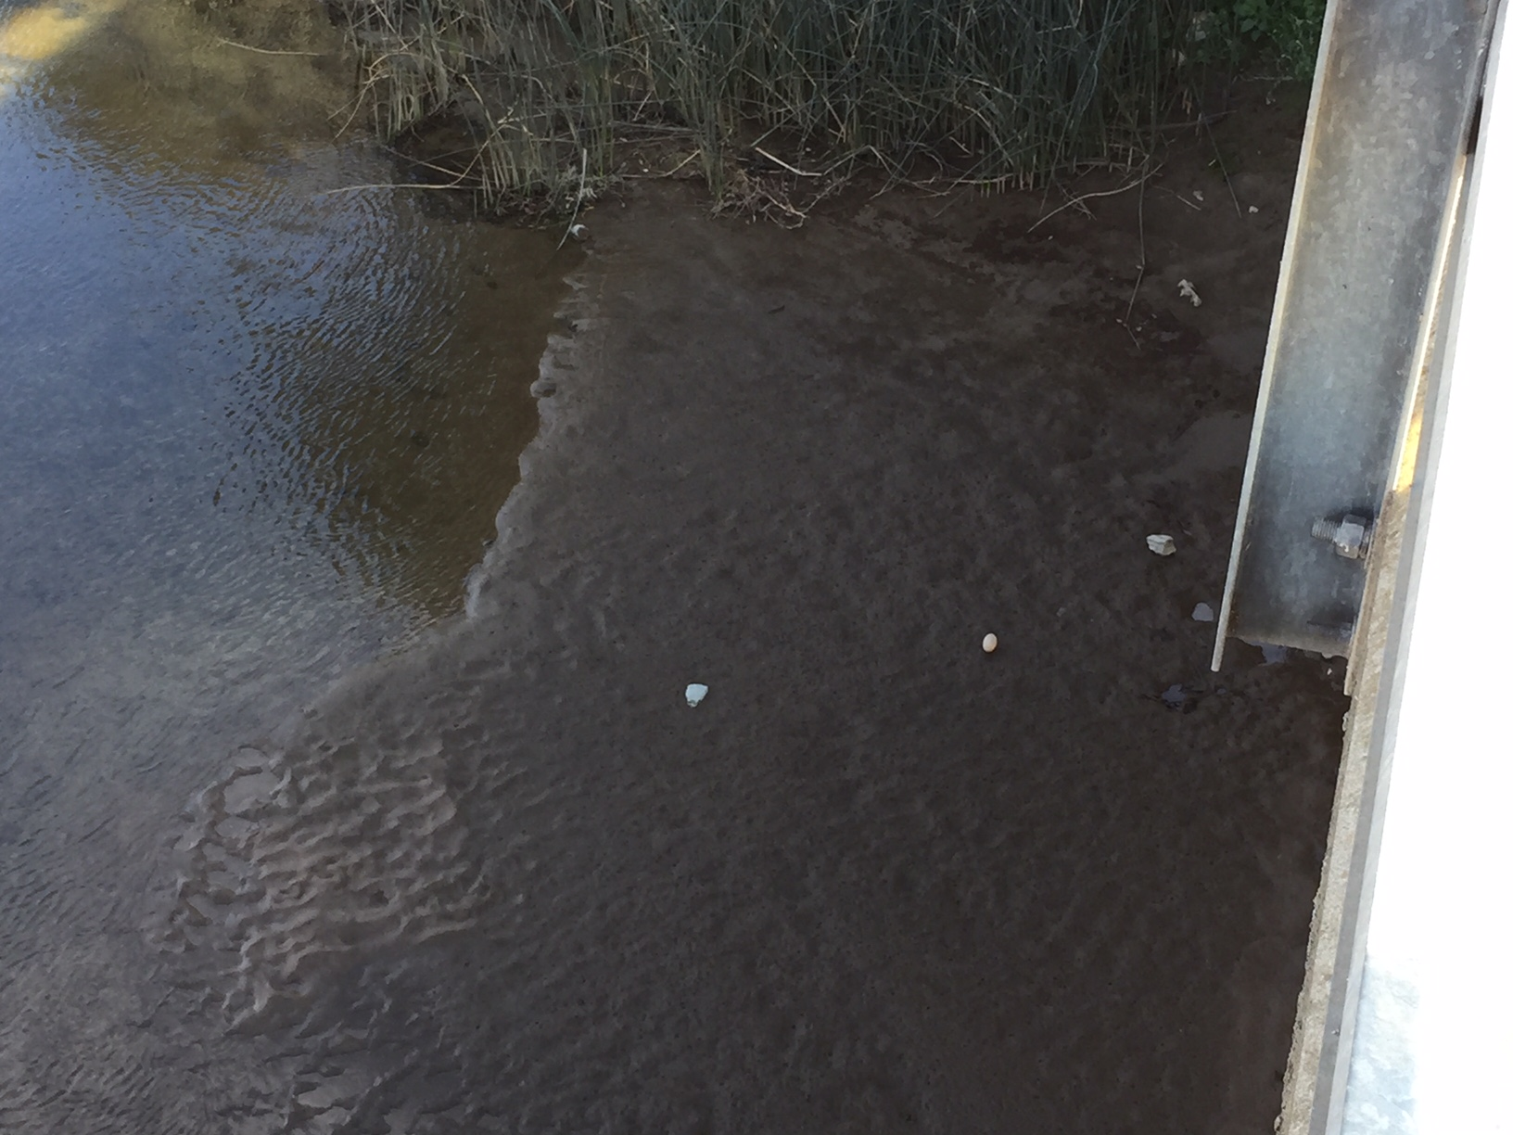

Slide 19
Exports siphon off a portion of the incoming tide. With increased siltation, we are less able to tolerate the impacts of exports.

Slide 20
“ORIGINAL” CHANNEL CONDITIONS
Amount taken by exports
Incoming tide
Depth of channel

Slide 21
CURRENT CHANNEL CONDITIONS
Amount taken by exports
Depth of channel
Incoming tide
Siltation

Slide 22
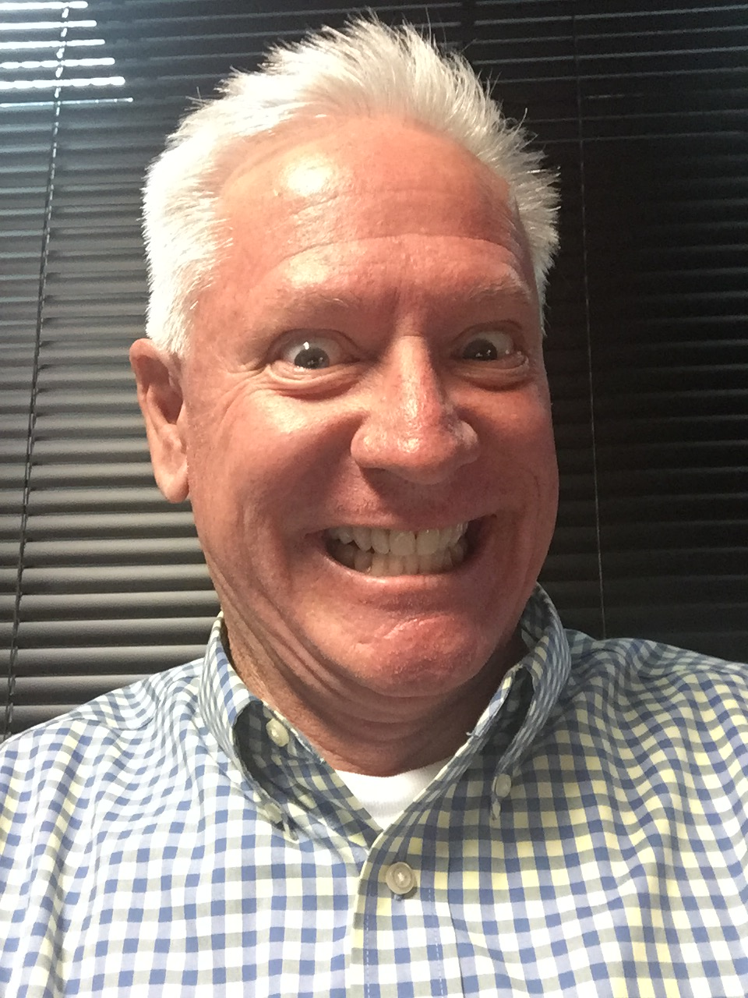
YOU DON’T WANT ME TO COMPLAIN ABOUT WATERFIX ……….

Slide 23
WATERFIX WATER QUALITY IMPACTS ACCORDING TO DWR MODELING

Slide 24
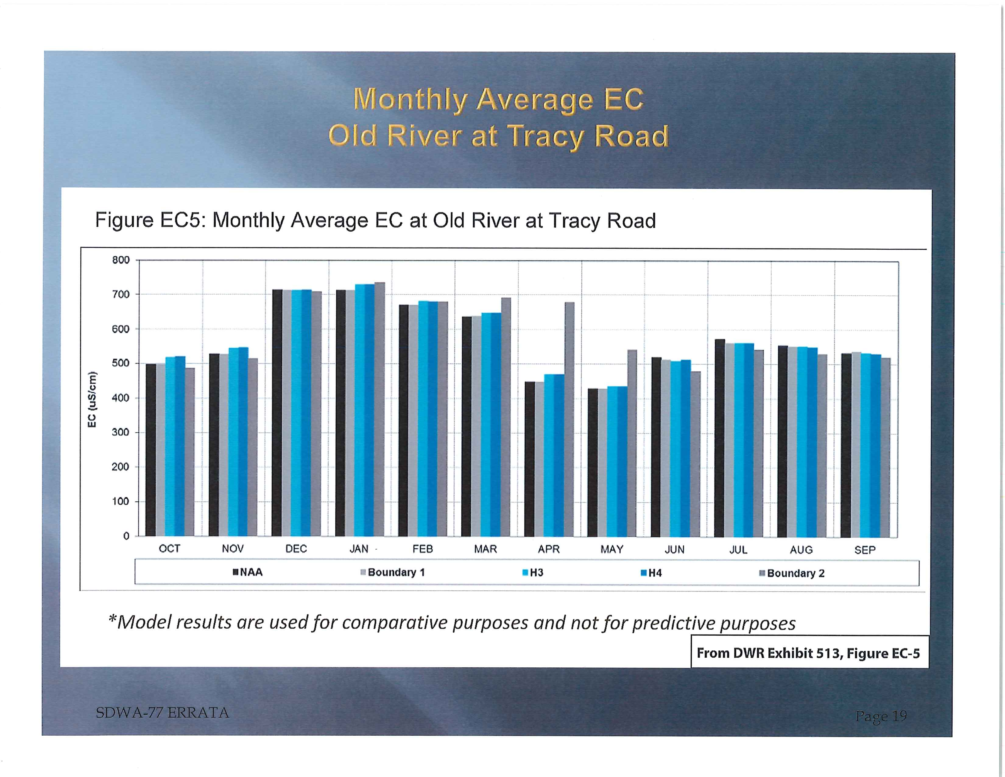

Slide 26
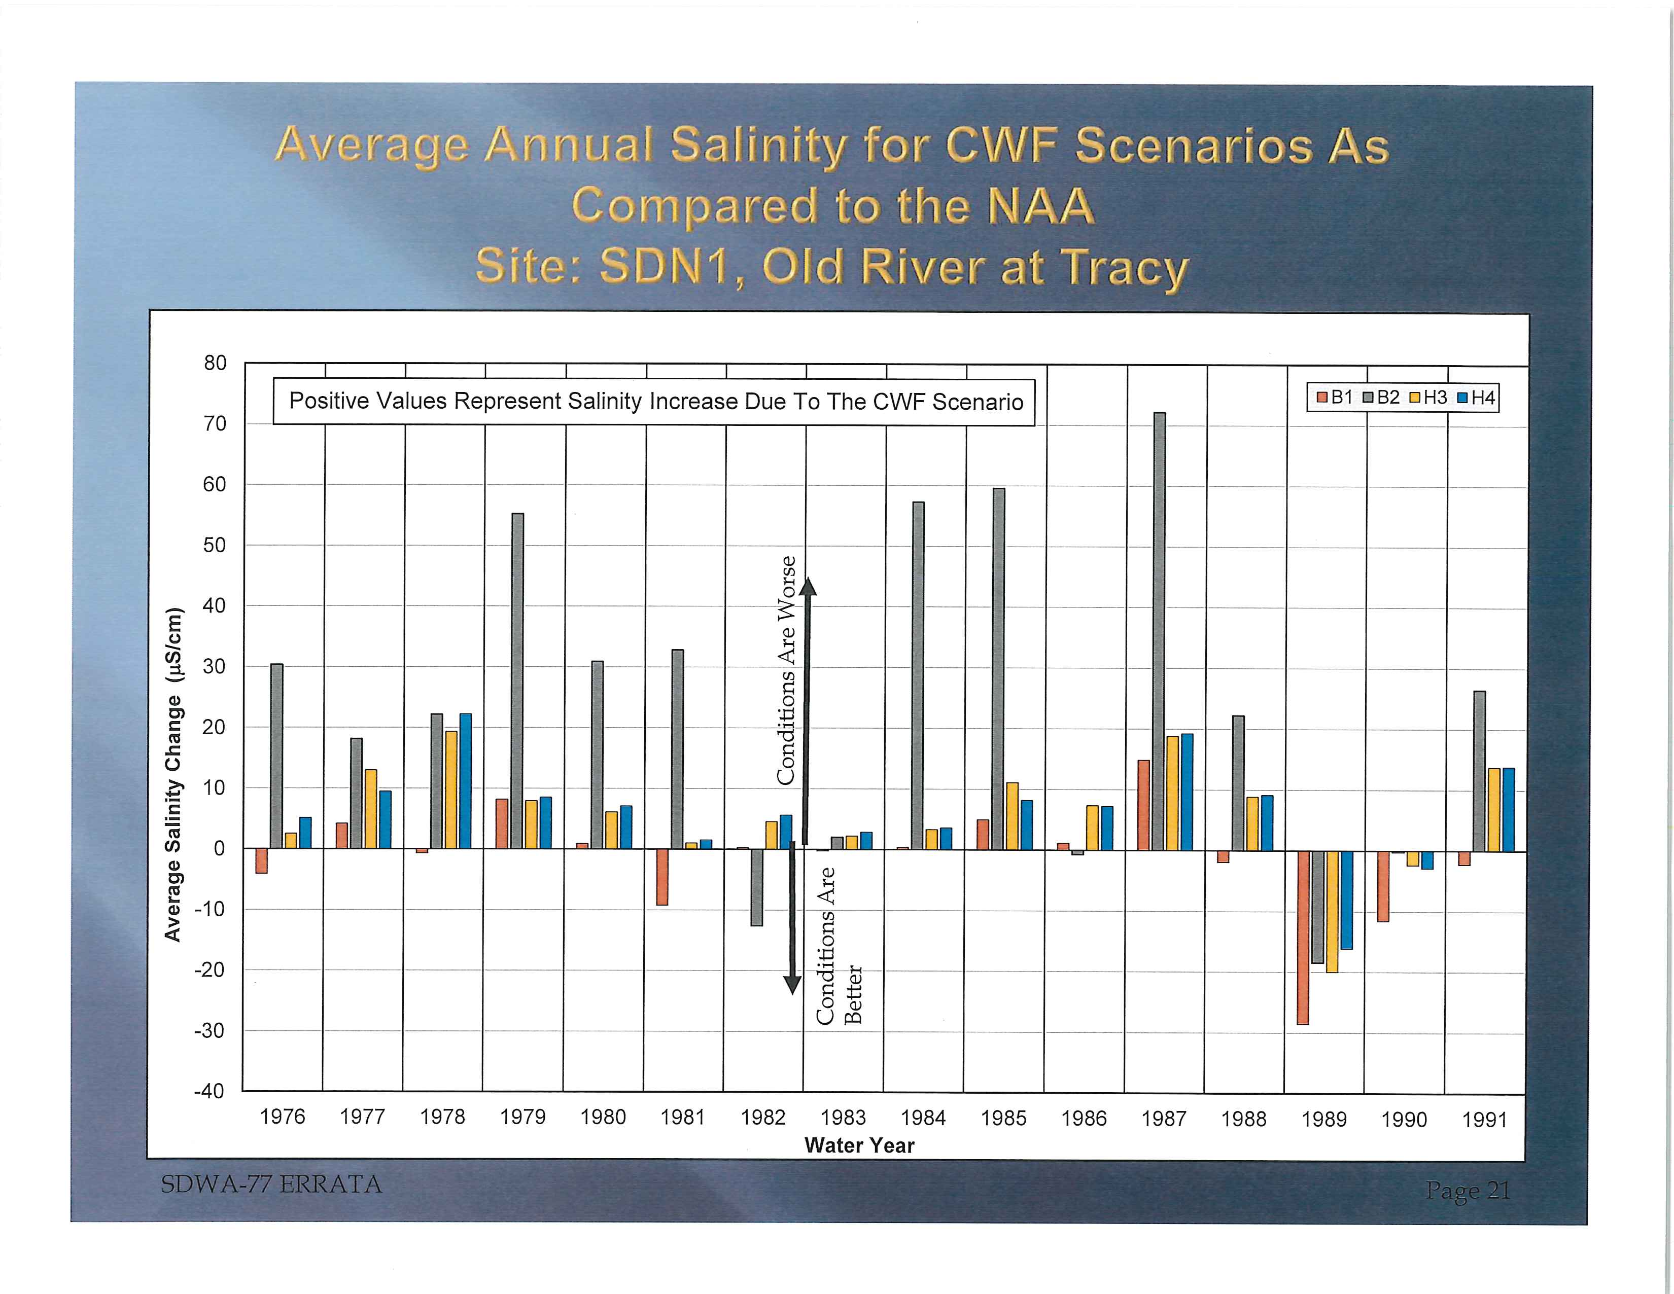

Slide 29
WATERFIX WATER LEVEL IMPACTS ACCORDING TO DWR MODELING

Slide 30
Middle River Stage Profile
SDWA Exhibit 258

Slide 31
DON’T WORRY, THE WORLD IS FAIR, TRUTH AND JUSTICE ALWAYS PREVAIL AND THE PROCESS WILL RUN IT’S COURSE.

Slide 32
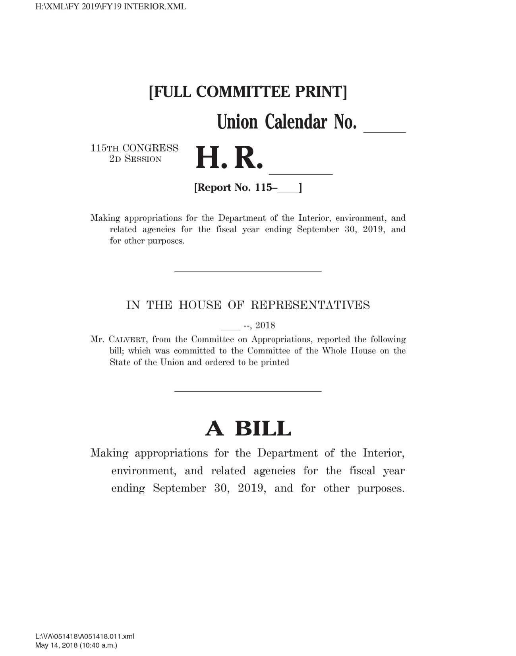

Slide 35
QUESTIONS?
COMPLAINTS? PETITION TO GET NEW SDWA ATTORNEY?

Slide 36
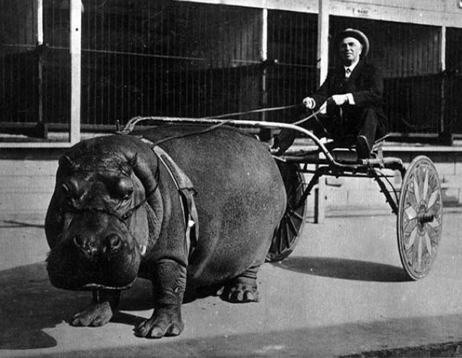
DWR Hyacinth Removal Program.

