Slide 1
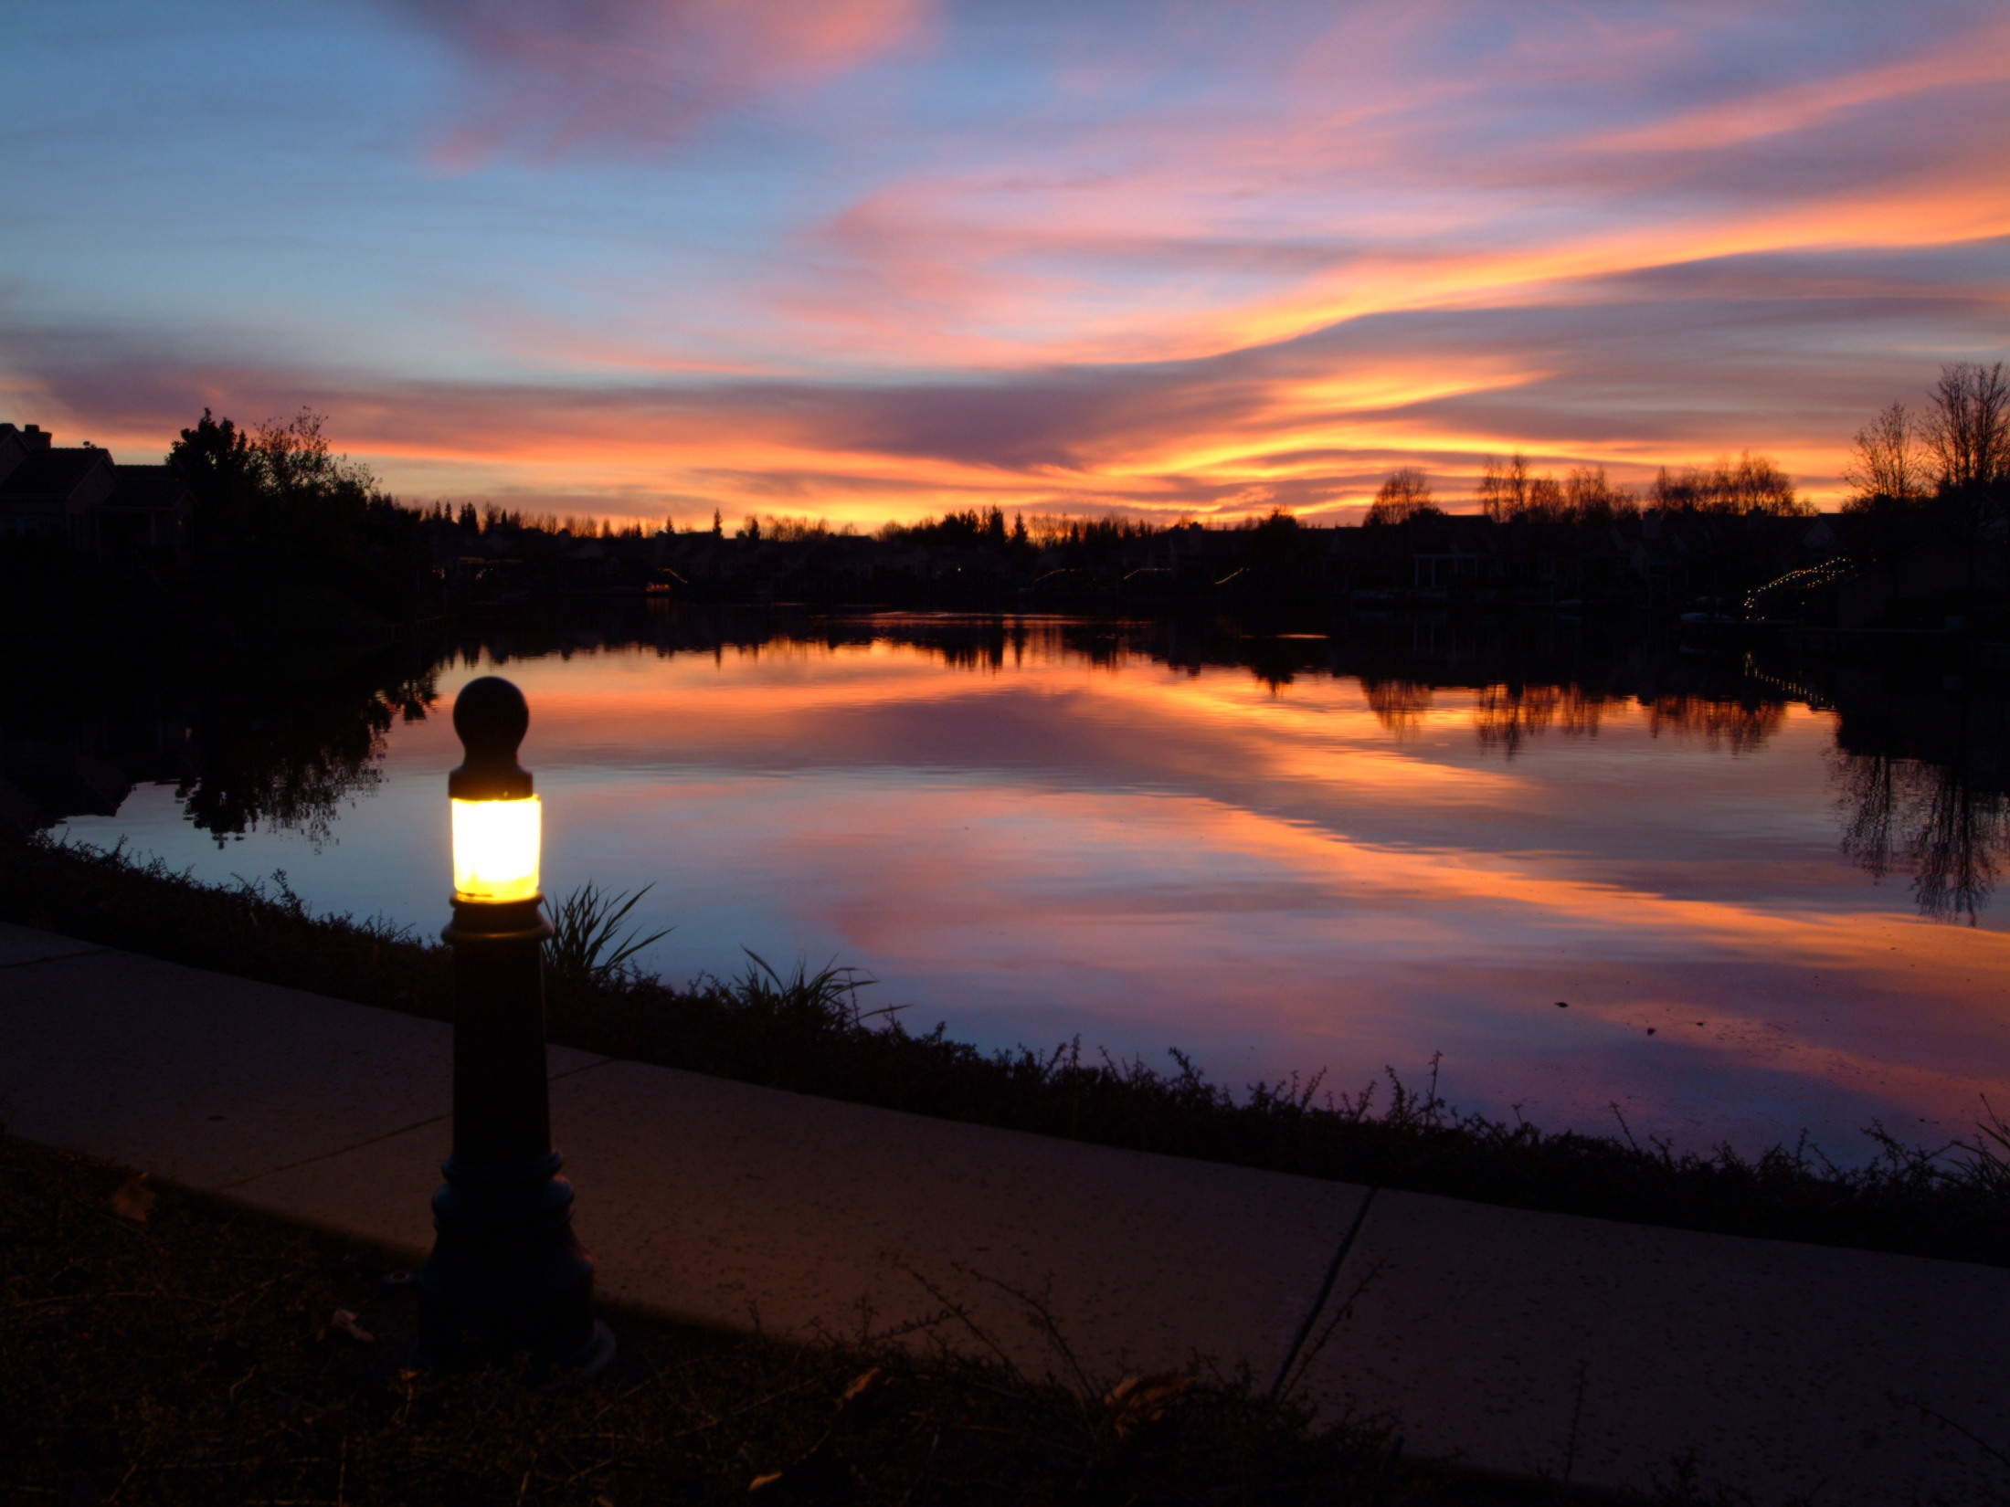
BDCP:
A PLAN TO LOSE THE DELTA
Water Education Foundation
Bay-Delta Tour
June 19, 2014
John Herrick, Counsel & Manager
South Delta Water Agency

Slide 2
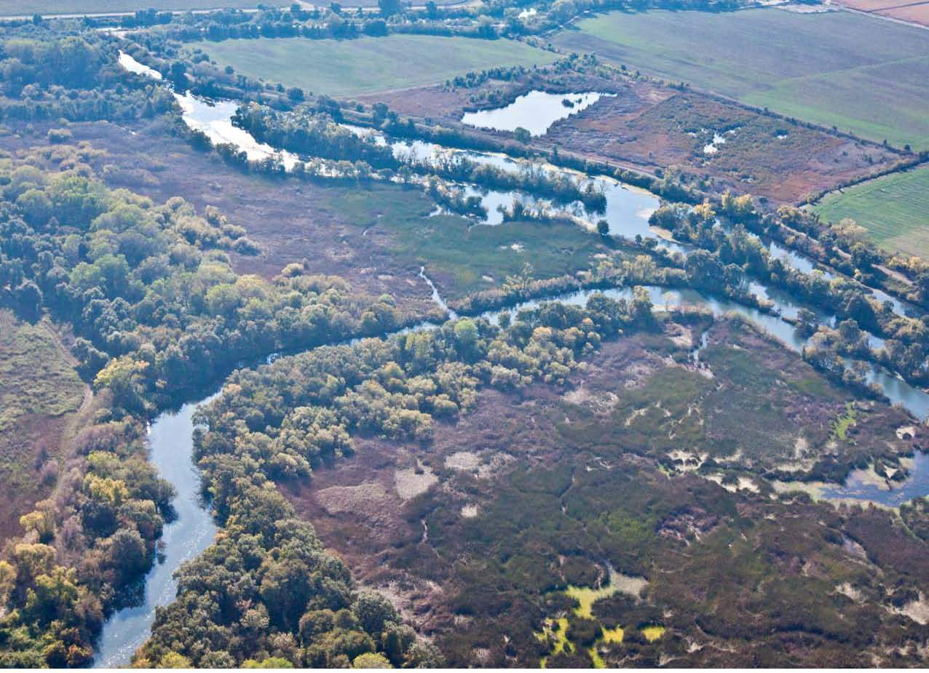

Slide 3
THE SYSTEM

Slide 4
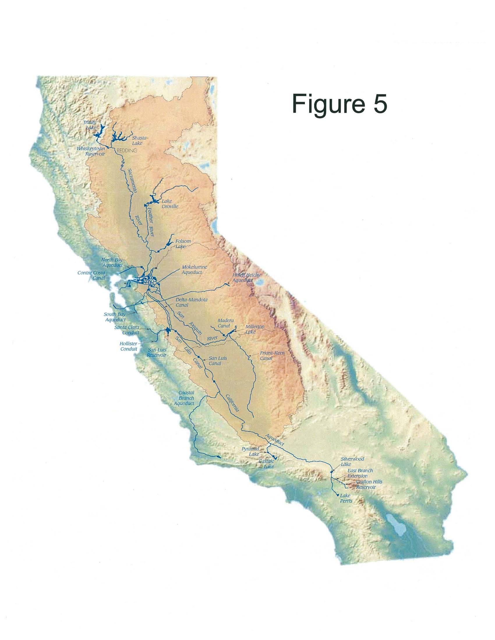
SWP and CVP Facilities

Slide 5
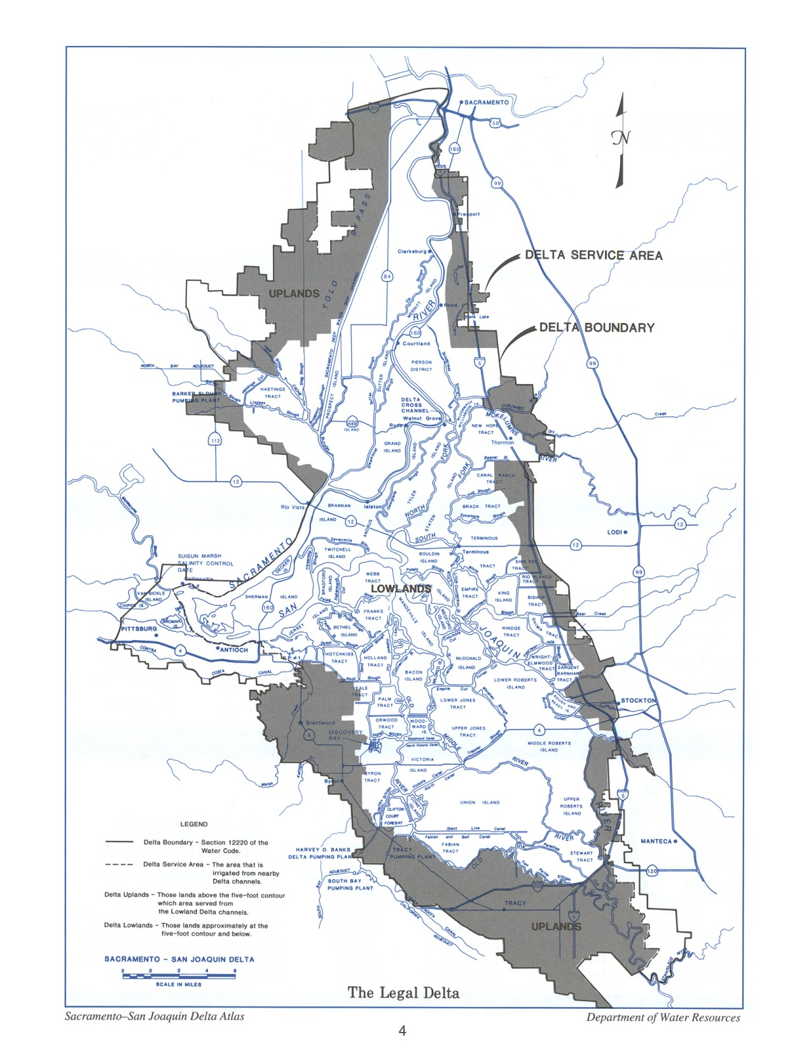

Slide 6
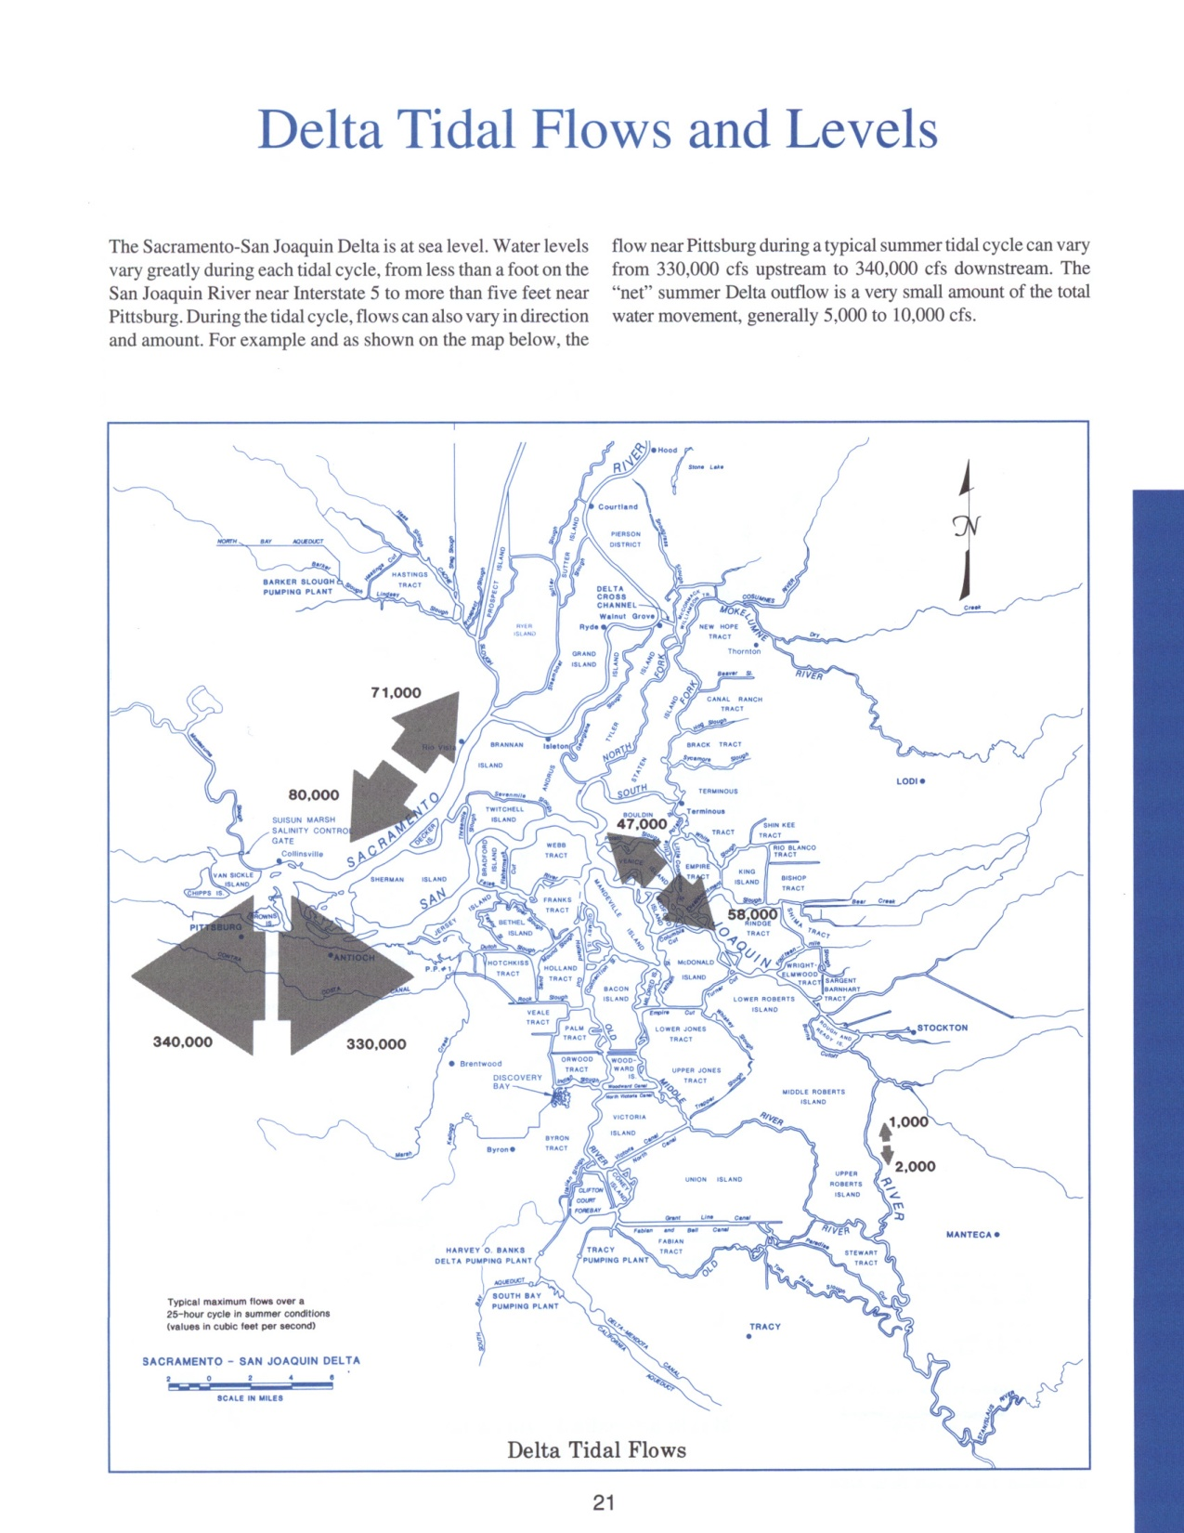

Slide 7

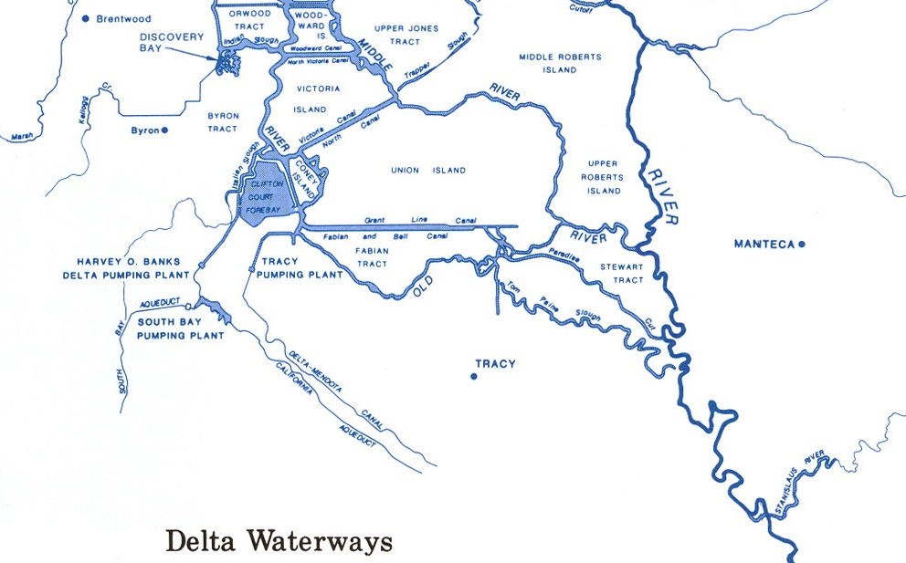


Slide 8
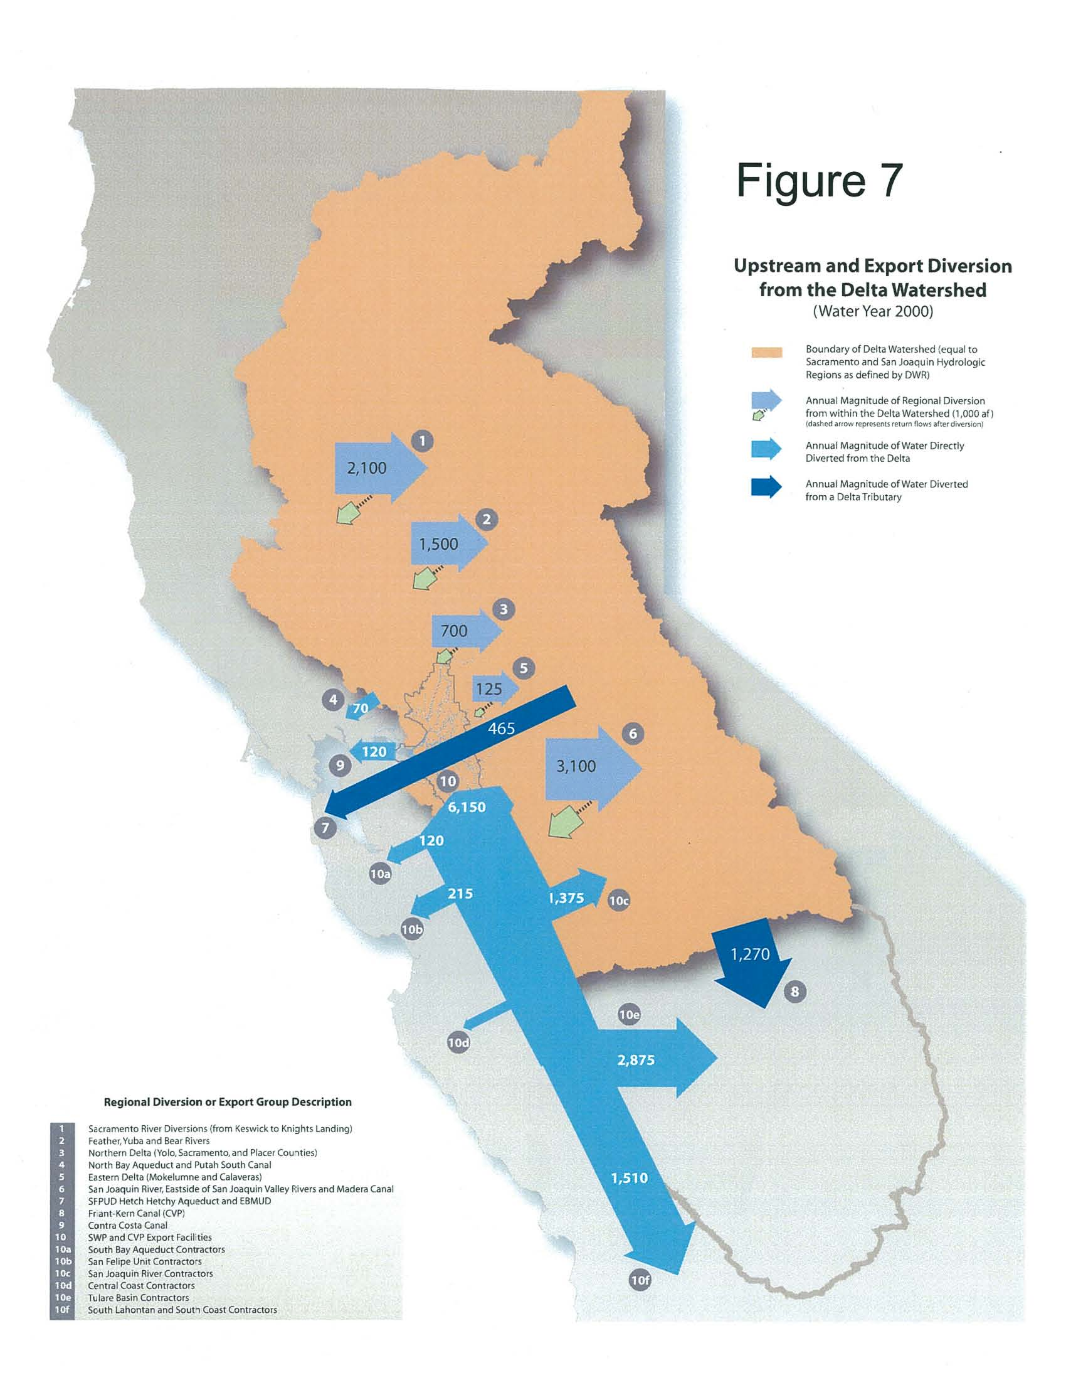
Most exports go to southern Valley Ag

Slide 9
LAWS and PROMISES

Slide 10
“The Bureau will not divert from any watershed any water which is needed to satisfy the existing or potential needs within that watershed. For example, no water will be diverted which will be needed for the full development of all of the irrigable lands within the watershed, nor would there be water needed for municipal and industrial purposes or future maintenance of fish and wildlife resources.”
“No area will be deprived of water to meet the needs of another. Nor will any area be asked to pay for water delivered to another.”
“Under this Act the water rights of northern California will remain securely protected. In addition, sufficient money is provided for construction of local projects to meet the pressing needs for flood control, recreation and water deliveries in the north.”
USBR Acting Regional Director, R. C. Callard, 1956

Slide 11
Water Code § 11460. Prior right to watershed water
In the construction and operation . . . of any project . . . a watershed or area wherein water originates . . . shall not be deprived by the department directly or indirectly of the prior right to all of the water . . . needs of the . . . property owners therein.

Slide 12
Sacramento-San Joaquin Delta Act
Water Code § 12200 et. seq.

Slide 13
§ 12201. Necessity of maintenance of water supply
. . . the maintenance of an adequate water supply in the Delta sufficient to maintain and expand agriculture, industry, urban, and recreational development ... to provide a common source of fresh water . . . is necessary . . .
§ 12202. Salinity control and adequate water supply
Among the functions . . . by the State . . . in coordination with the . . . United States in providing salinity control for the Delta through operation of the Federal Central Valley Project, shall be the provision of salinity control and an adequate water supply for the users of water in the Sacramento-San Joaquin Delta. . . .

Slide 14
§ 12203. Diversion of waters from channels of delta
[N]o person . . . or public . . . agency or the State or the United States should divert water from the channels of the Sacramento-San Joaquin Delta to which the users within said Delta are entitled.
§ 12204. Exportation of water from delta
In determining the availability of water for export from the Sacramento-San Joaquin Delta no water shall be exported which is necessary to meet the requirements of Sections 12202 and 12203 of this chapter.

Slide 15
§ 12205. Storage of water; integration of operation and management of release of water
[T]he operation and management of releases from storage . . . shall be integrated to the maximum extent possible in order to permit the fulfillment of the objectives of this part.

Slide 16
Currently the projects export between 3 and 7 million acre feet of water out of the Delta, after the water flows into, and through the Delta to the export pumps .
With an isolated facility, there would be 3-7 million acre feet less fresh water flowing into and through the Delta.

Slide 17
Can a fresh water estuary be improved by removing 3-7 million acre feet from it?

Slide 18
HOW MUCH WATER?

Slide 19
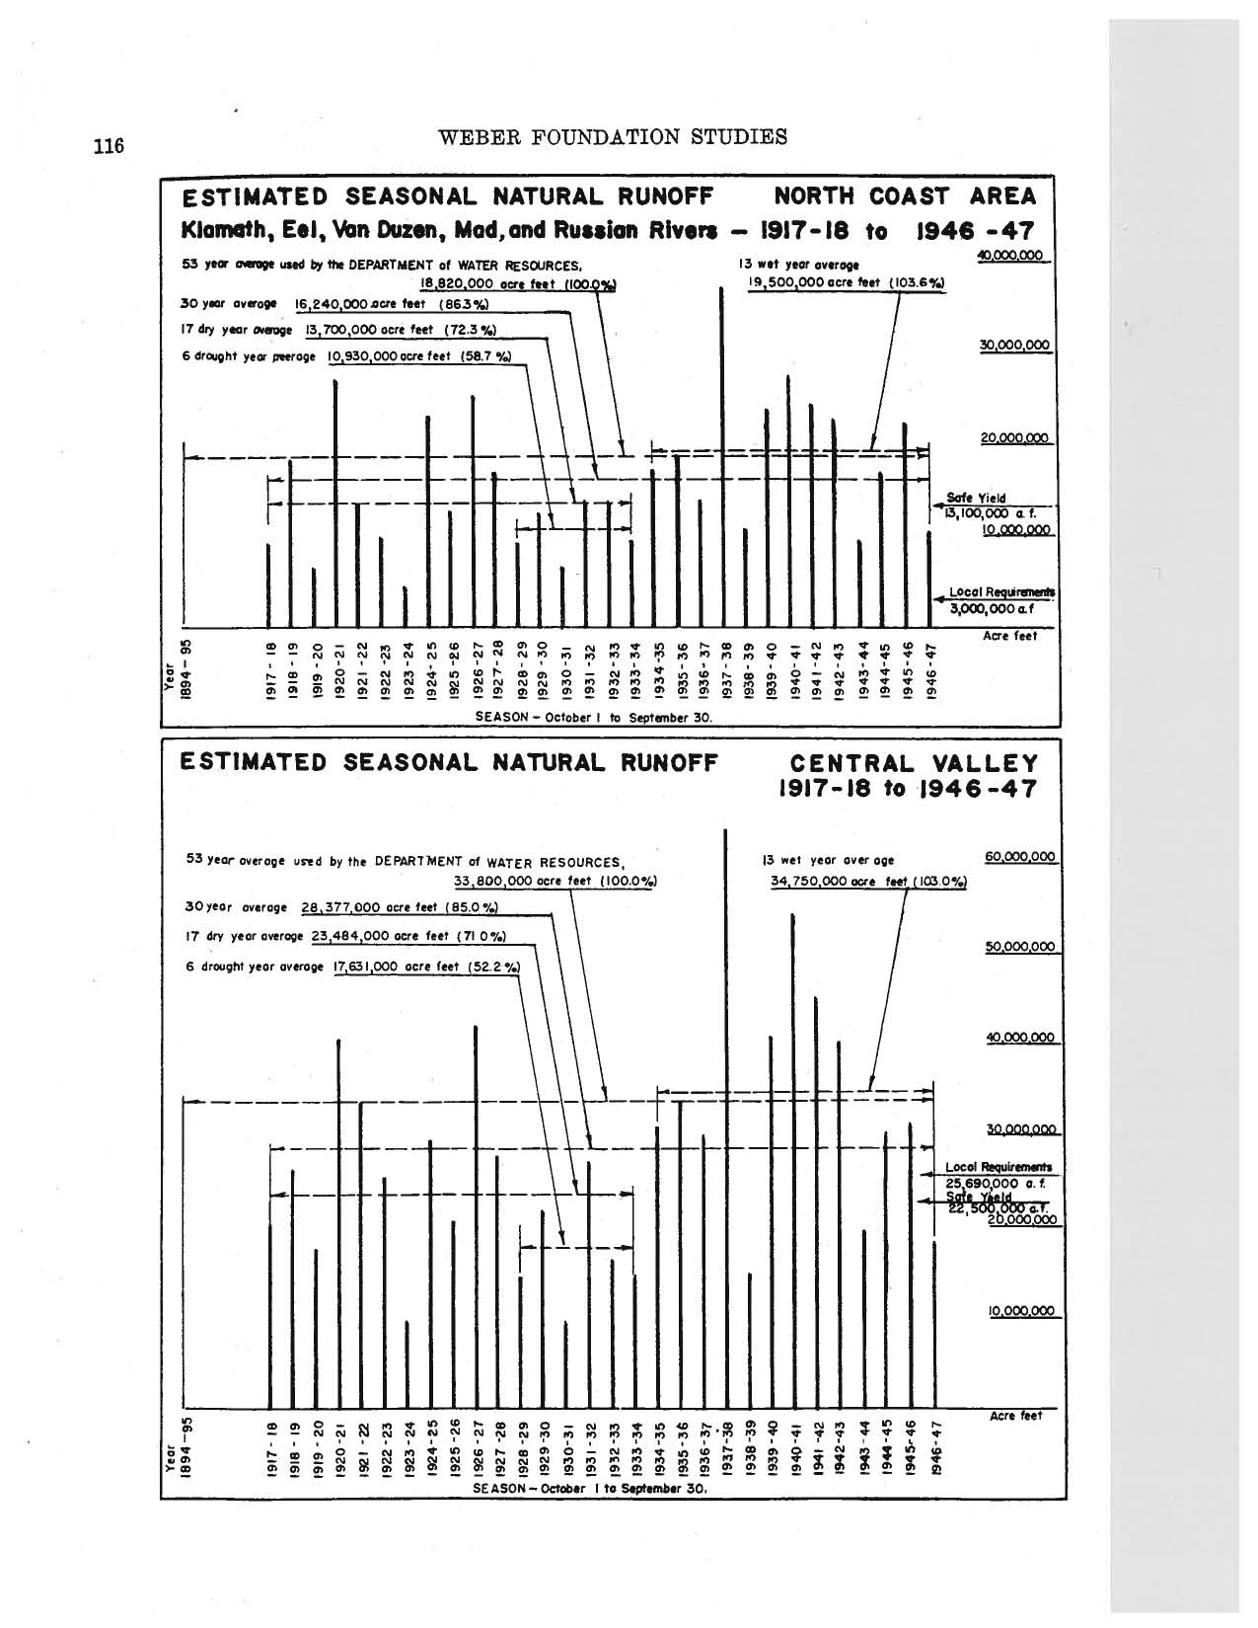
1928-34 NATURAL RUNOFF
Surplus
7,930,000 AF/ YR
SHORTAGE
8,049,000 AF/YR

Slide 20
To address this 8 million acre foot shortage, the State Water Project planned to take 5 million acre feet of North Coast river flow and add it to the Sacramento River system.

Slide 21
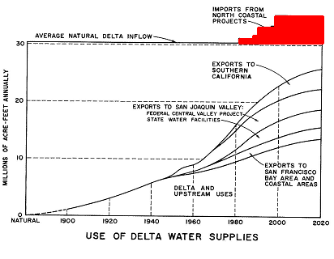

Slide 22
1995 Monterey Agreement
      ● Removed Permanent Shortage Provision

Slide 23
CAN THAT BE TRUE ???

Slide 24
THE PROOF IS IN THE PUDDING
2007-2008 Drought years.
2009 thought to be third drought year.
CVP notified Exchange Contractors they may not be able to supply them with export water.
DWR and USBR Petition SWRCB for relief from permit condition to meet outflow.
Exports rose from 2,000 cfs to 4,000 cfs while outflow was 7,000 cfs instead of required 11,400 cfs

Slide 25
2012 A below normal year.
First six months are one of the driest six month period on record.
Spring of 2013 DWR and USBR ask SWRCB (via letter) to be partially relieved from obligation to meet Western Delta Agriculture Standard and ask for cold water obligation on Sacramento River to be cut in third; due to insufficient storage.
SO AFTER A SIX MONTHS DROUGHT, INSUFFICIENT WATER IN STORAGE TO MEET PERMIT CONDITIONS

Slide 26
2014 DWR and USBR have no drought contingency plans
After 12+ months of drought, DWR and USBR Petition the SWRCB for relief from outflow requirement under “Urgency” process.
USBR subsequently petitioned the SWRCB for relief from the fishery flow requirements on the San Joaquin River.
Urgency process allows no public, notice or input. Urgency Order granted, then changed 7 additional times, also without public notice or comment.

Slide 27
FISH and EXPORTS

Slide 28
Who is responsible for the
fisheries collapsing?
Who should be responsible for
the recovery of the fishery?

Slide 29
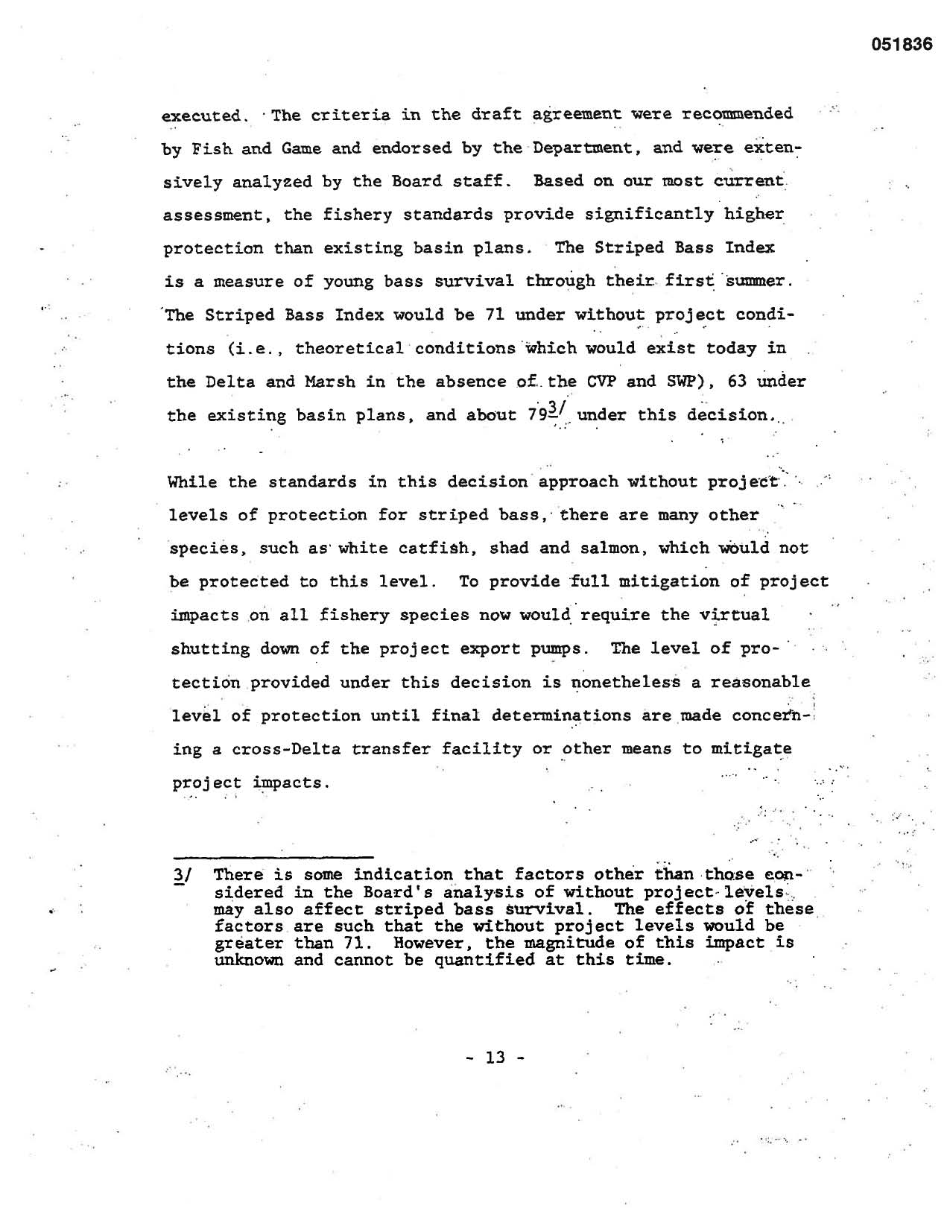
NO SHUT DOWN
INSTEAD
INCREASED EXPORTS
D 1485 1978

Slide 30
Water Code Section 11912. Costs
The department . . . shall include as a reimbursable cost of any state water project an amount sufficient to repay all costs incurred by the department, directly or by contract with other agencies, for the preservation of fish and wildlife and determined to be allocable to the costs of the project works constructed for the development of water and power, or either. Cost incurred for the enhancement of fish and wildlife or for the development of public recreation shall not be included in the prices, rates and charges for water and power, and shall be nonreimbursable costs. [Emphasis added]

Slide 31
State and Federal
Endangered
Species Acts

Slide 32
Federal ESA requires you mitigate your effects on the endangered species so that your actions do not cause “jeopardy” to the species.
State ESA requires that you not only mitigate, but also help restore the population of the endangered species; a higher standard.

Slide 33
Federal enforcement of ESA consists of decades of Biological Opinions which found “no jeopardy” while the fish populations were crashing.
Then a federal judge finally forced strict application of ESA .
Then the judge decided that enforcement was not supported by the data! Then an appellate court overturned that!

Slide 34
Well, what about the State of California?

Slide 35
SUPERIOR COURT OF CALIFORNIA
IN AND FOR THE COUNTY OF ALAMEDA
WATERSHED ENFORCERS, a project of ) Case No. RG06292124
California Sportfishing Protection Alliance, )
a non-profit corporation, )
)
Petitioner, )
)
-vs- )
)
CALIFORNIA DEPARTMENT OF WATER )
RESOURCES, et al., )
)
Respondents. )
____________________________________)

Slide 36
. . . .
“VI. CONCLUSION
The Petition for Writ of Mandate is GRANTED. Respondents and all of them are commanded to cease and desist from further operation of the Harvey O. Banks Pumping Plant Operation until and unless they have obtained authorization in compliance with the California Endangered Species Act from the Department of Fish and Game with regard to their incidental take of Chinook Salmon - Winter-run, Chinook Salmon - Spring-run and Delta Smelt.”
. . . .
“As a final note: This decision has been made without any input from the DFG as to its perceptions of whether the documents put forth as DFG’s authorization for the incidental take were or were not intended as such. While no conclusions can be reached from any party’s failure to provide declarations or information from DFG regarding those documents that were signed by the DFG (as well as those documents that were not signed by them), such information would have assisted the Court in its understanding of this matter. The DFG, after all, is the very entity obligated to determine the requirements of any incidental take under CESA. The Court regrets that an important case such as this one must be decided without all the possible available relevant information.”
Dated: March 22, 2007 _____________________________________
Frank Roesch, Judge of the Superior Court
. . . .

Slide 37
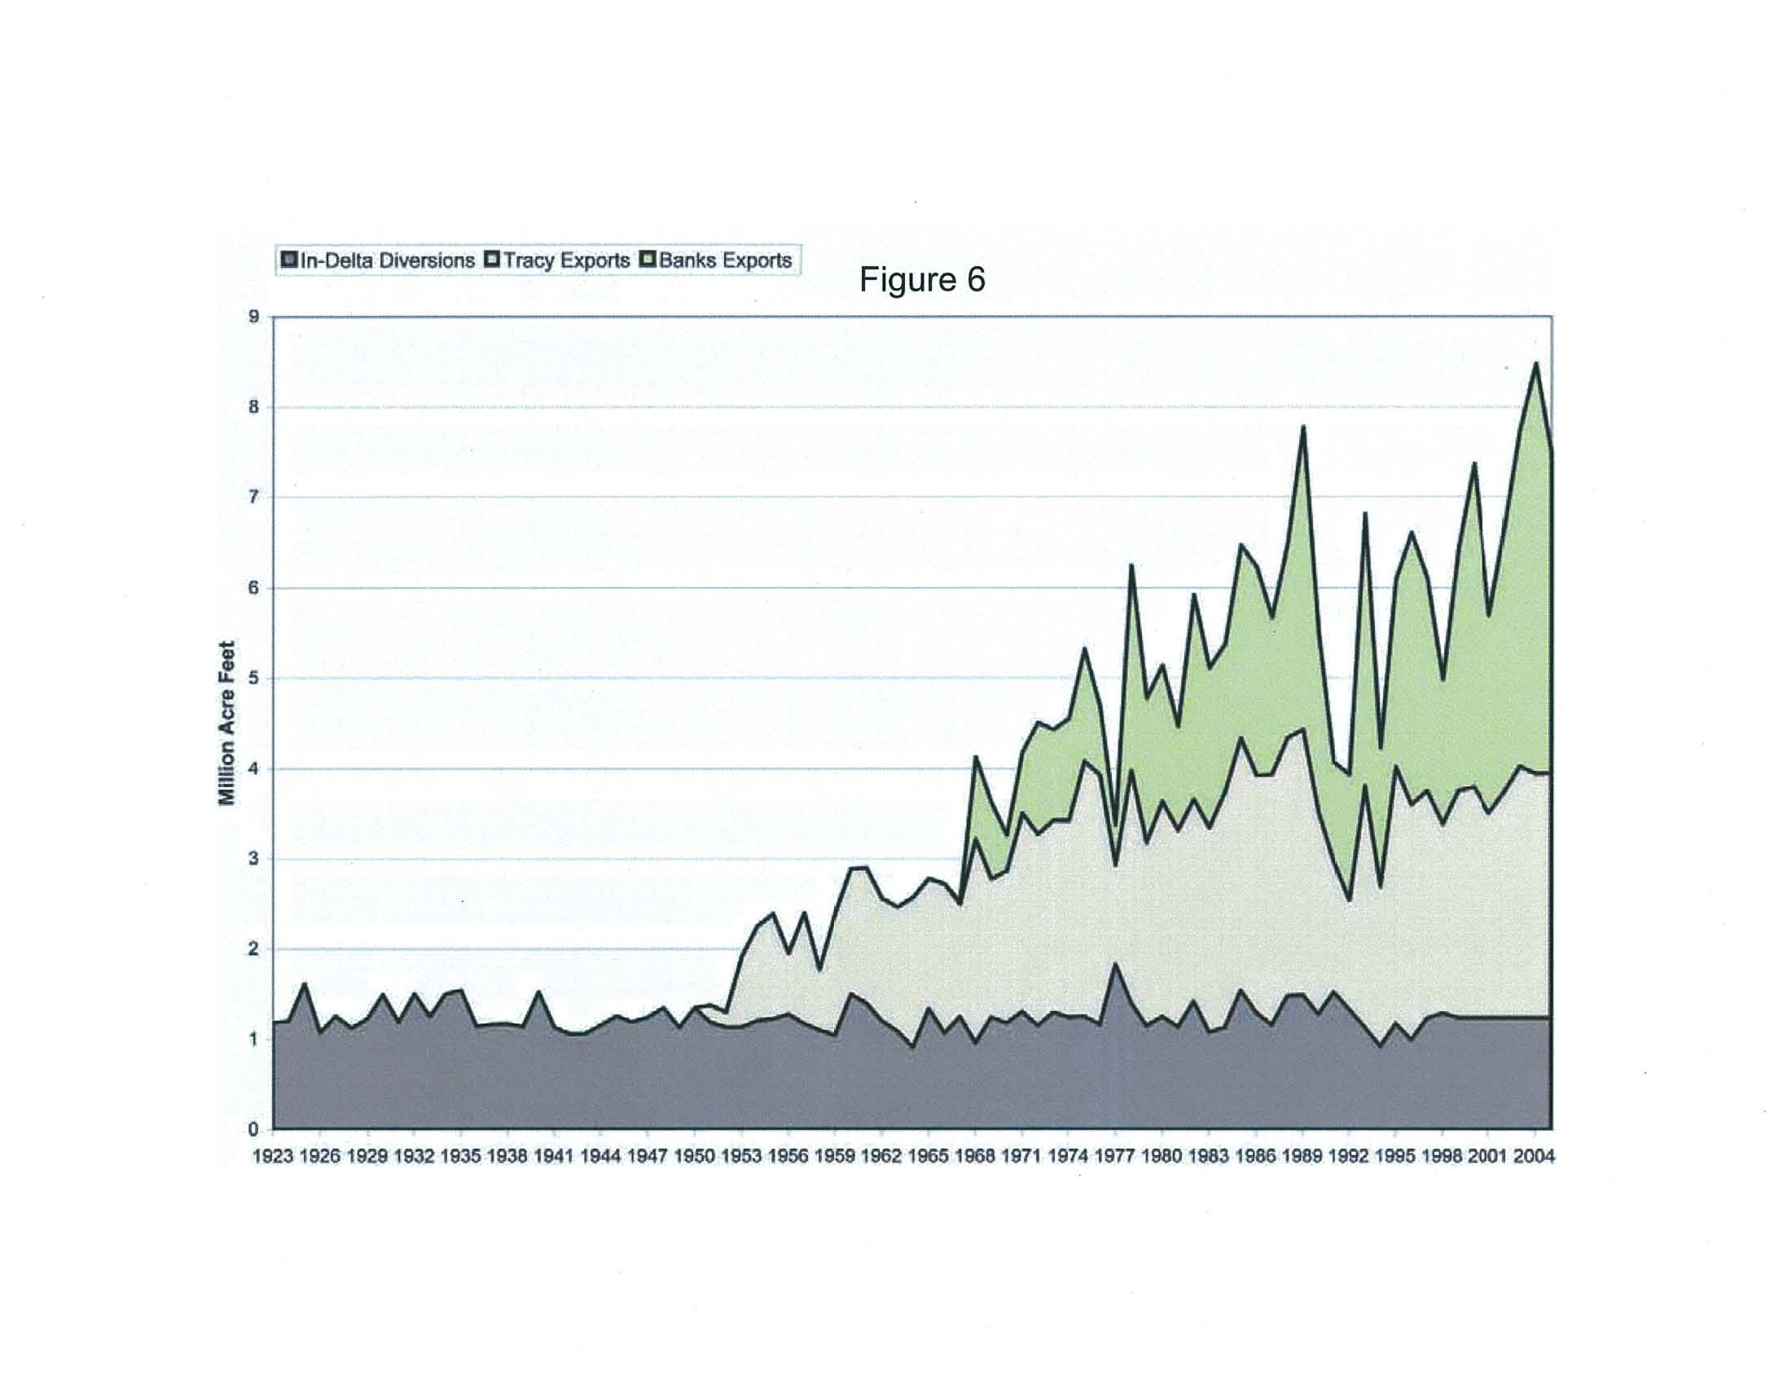

Slide 38
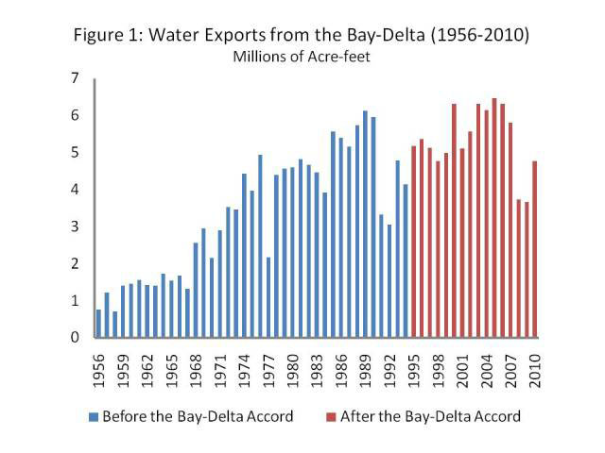

Slide 39
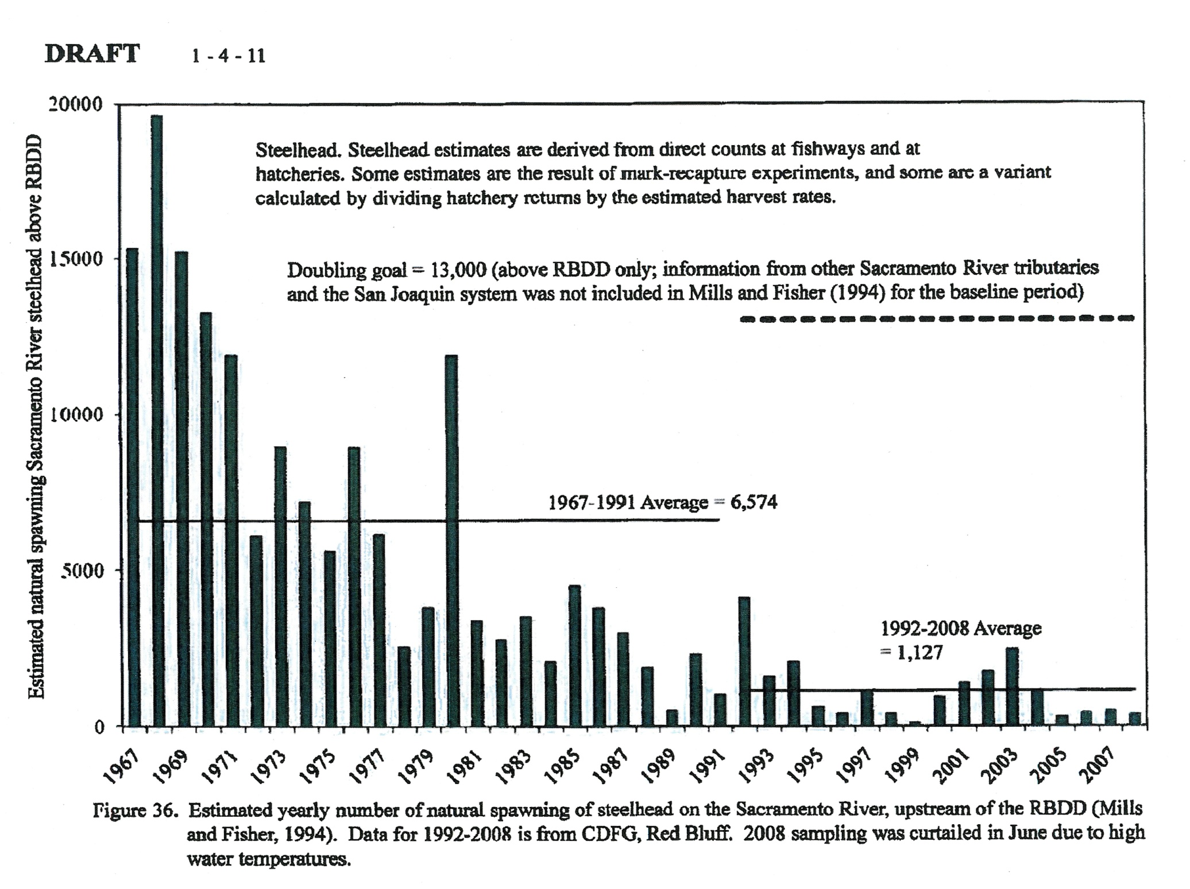

Slide 40
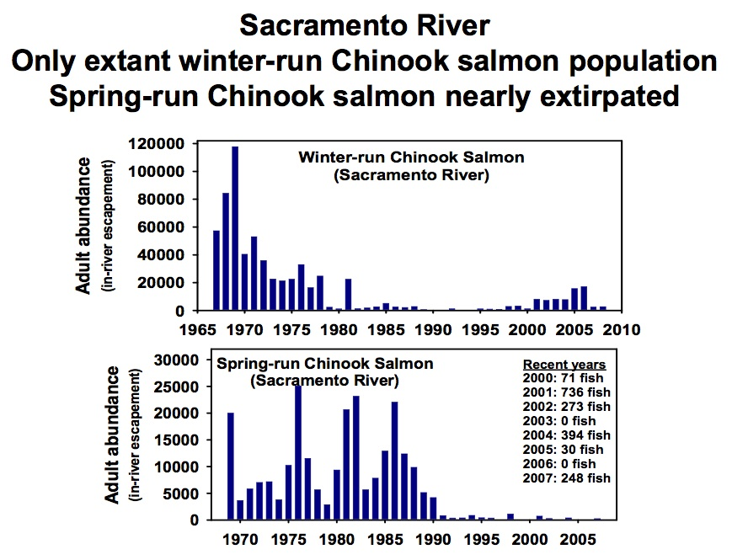

Slide 41
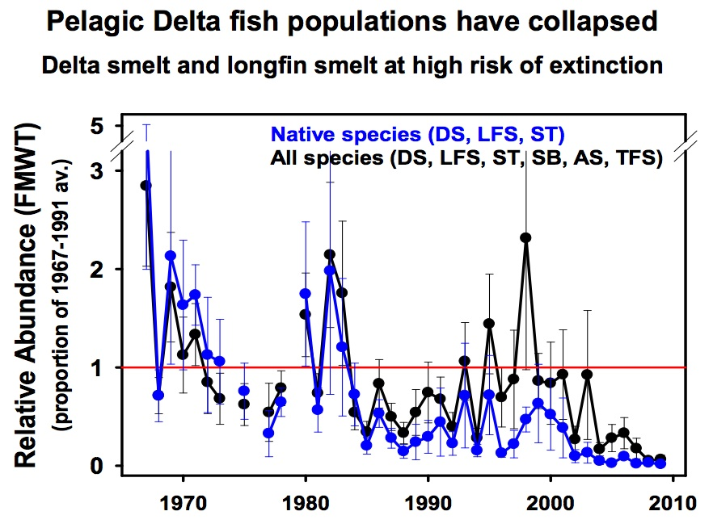

Slide 42
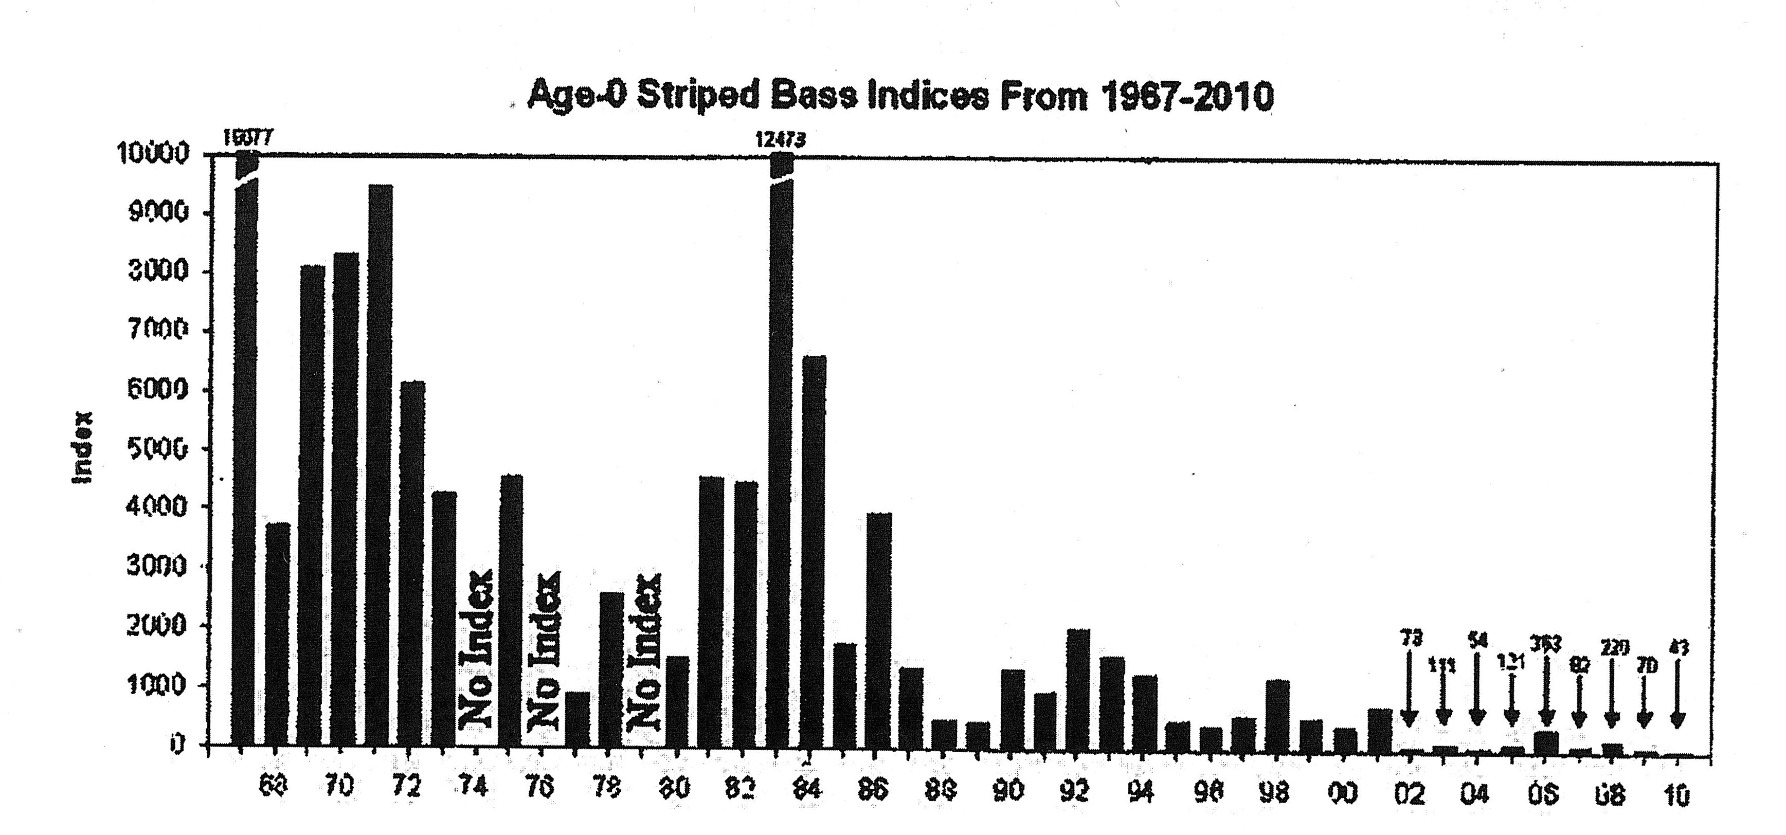

Slide 43
BAY-DELTA CONSERVATION PLAN or “BDCP”
Seeks 50-year permits to build two tunnels to convey 9,000 cfs of Sacramento River water (before it passes through the Delta) to the export pumps under “habitat conservation plans” which plans are to recover endangered species.

Slide 44
HOW IS BDCP GOING TO DO THIS?
Protect fish by decreasing entrainment at export pumps.
Operate system in better manner to protect fish.
Provide habitat to increase fish populations
Avoid interruption of exports due to catastrophic earthquake.

Slide 45
Entrainment

Slide 46
NO SHUT DOWN
INSTEAD
INCREASED EXPORTS
D 1485 1978

Slide 47
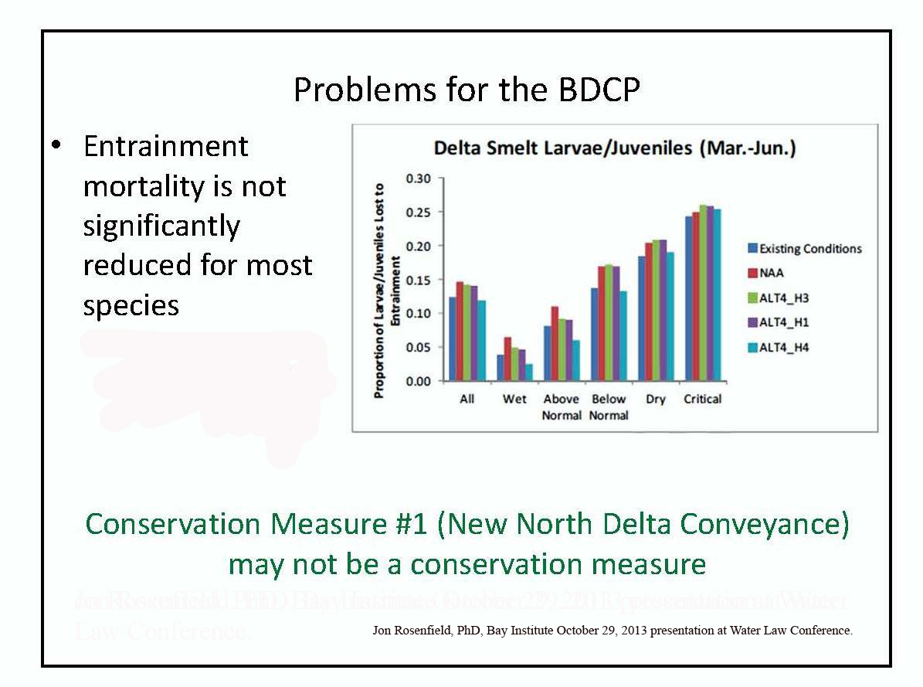

Slide 48
Operate to Improve Fisheries?

Slide 49
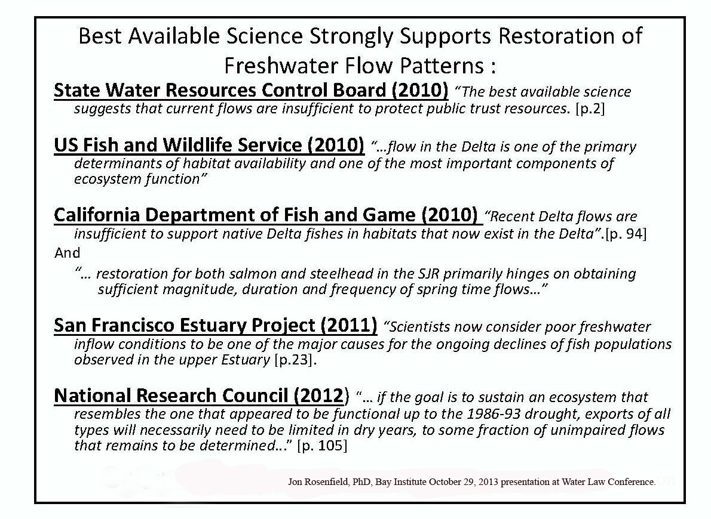

Slide 50
BDCP Preferred Alternative Proposes to Have
LESS OUTFLOW

Slide 51
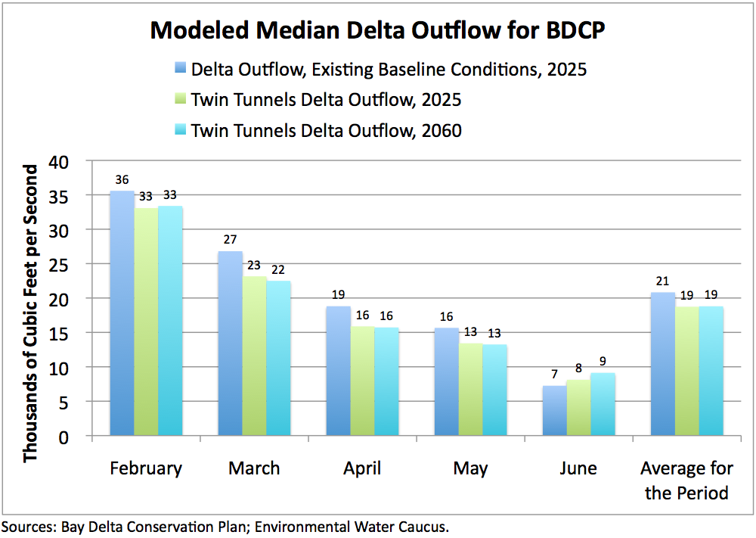

BDCP Will Decrease Delta Outflow
13

Slide 52
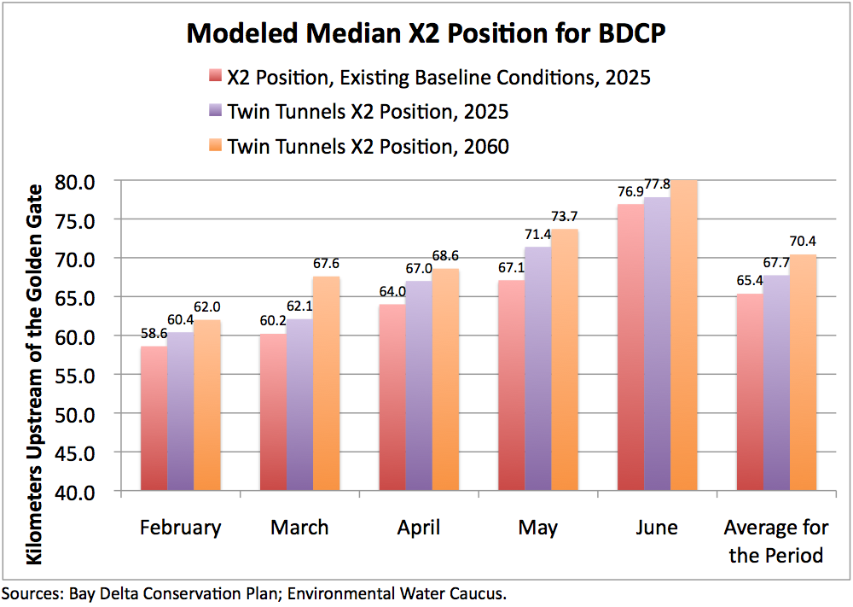
BDCP Will Move X2 Upstream
14

Slide 53
More Habitat to Increase Fish Populations?

Slide 54
In order to preserve and perhaps increase export “reliability” BDCP proposes to increase fish habitat in the Delta by converting 140,000 acres of in-Delta farmland to shallow water and other habitat.
What this means is Delta farmers must go out of business to keep southern valley farmers in business.

Slide 55
Assumption of Habitat Restoration CM Success (Critical)
Previous comments: In several places, the EA assumes that adverse impacts of the PP will be offset by unsubstantiated benefits for habitat restoration. The EA assumes that all restoration will be successful and work as predicted, with little or no evidence to support this prediction and no attempt to analyze the potential outcomes of less than perfect success. …
Update: language has been altered to reflect uncertainty to an extent, but alternative outcome scenarios have not been evaluated; all analyses and results assume that restoration activities will be successful. Alternative outcome scenarios showing varied effectiveness of habitat restoration efforts have not been provides, and therefore it is not possible to assess the effects of CM1 without the assumed benefits of completely successful habitat restoration. The total success of habitat restoration efforts remains highly uncertain, and an appropriate analysis should include an evaluation of the biological effects of at least a partial failure of efforts that are expected to “improve” conditions. ….
The list … shows several estuarine aquatic habitat restoration projects but the “Results” column does not provide any direct links to improved biological metrics such as growth, survival, or abundance of native fish. NMFS Progress Assessment 4/4/13

Slide 56
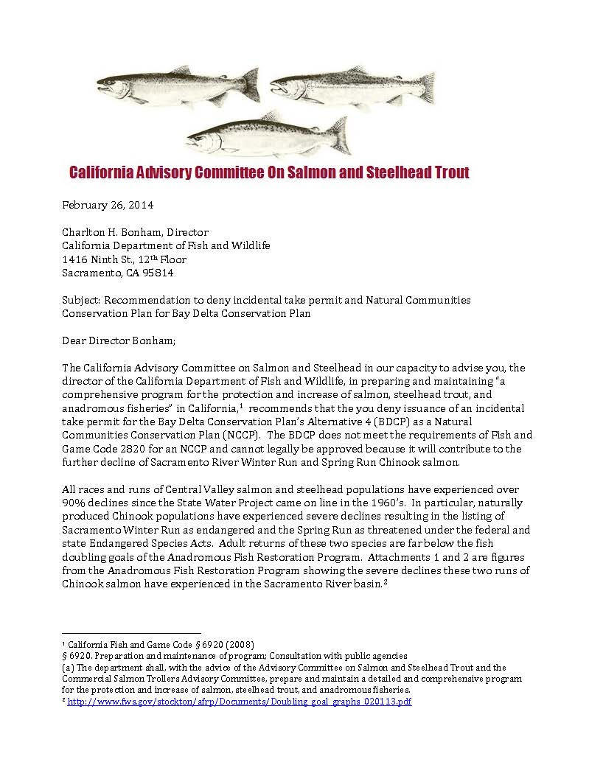

Slide 57
. . . . The BDCP does not meet the requirements of Fish and Game Code 2820 for an NCCP and cannot legally be approved because it will contribute to the further decline of Sacramento River Winter Run and Spring Run Chinook salmon.
. . . .
Chapter 5, Effects Analysis of the November 2013 Draft BDCP, operation of the Twin Tunnels project will reduce winter run and spring Chinook salmon smolt survival by 2.9% and 4%, respectively.
. . . .
BDCP promotes the unproven scientific hypothesis that habitat restoration can substitute for flow. However, the State Water Resources Control Board has already indicated that Delta inflows are presently insufficient to help listed species recover their former abundance. BDCP would reduce Delta outflow, which contributes to the decreases to salmon smolt survival rates modeled by BDCP.
The concept of improving riparian and subtidal habitat to create an aquatic food supply for the Delta to make up for too much water diverted is an unproven theory that has been criticized extensively by federal agencies in their “red flag” comments on the BDCP.

Slide 58
Because Sacramento River Winter Run and Spring Run Chinook salmon are already significantly depleted and BDCP will further reduce smolt survival, the Department of Fish and Wildlife cannot make a finding that the BDCP NCCP will lead to recovery of the species.
. . . .
BDP does not contribute to recovery and would jeopardize the continued existence of Sacramento River winter-run and spring-run Chinook salmon because smolt survival through the Delta is reduced by the project. (Fish and Game Code Section 2081(c) )
The concept of habitat restoration measures to offset impacts from increased water withdrawals from the Delta (increased “reliability”) is not supported by science, including but not limited to the 2010 SWRCB Delta Outflow Criteria. (Fish & Game Code Section 2081(b)(2))
The applicants do not assure funding and water supplies for habitat restoration measures. Habitat restoration measures will not be “shovel-ready” when the Twin Tunnels begin construction. (Fish & Game Code Section 2081(b)(4) and 2820(a)(10))
BDCP does not include analysis of an alternative or alternatives that would meet the recovery goals for Sacramento River Winter Run and Spring Run Chinook salmon. Such an analysis should at least take into consideration the State Water Resources Control Board’s 2010 Delta Outflow decision. (Fish & Game Code Section and 2820(e))

Slide 59
Earthquakes
and the
End of The WORLD

Slide 60
Are Delta Levees Doomed?
The U. S. Army Corps of Engineers commented on the DWR analysis which predicted the imminent failure of Delta levees as follows . . .

Slide 61
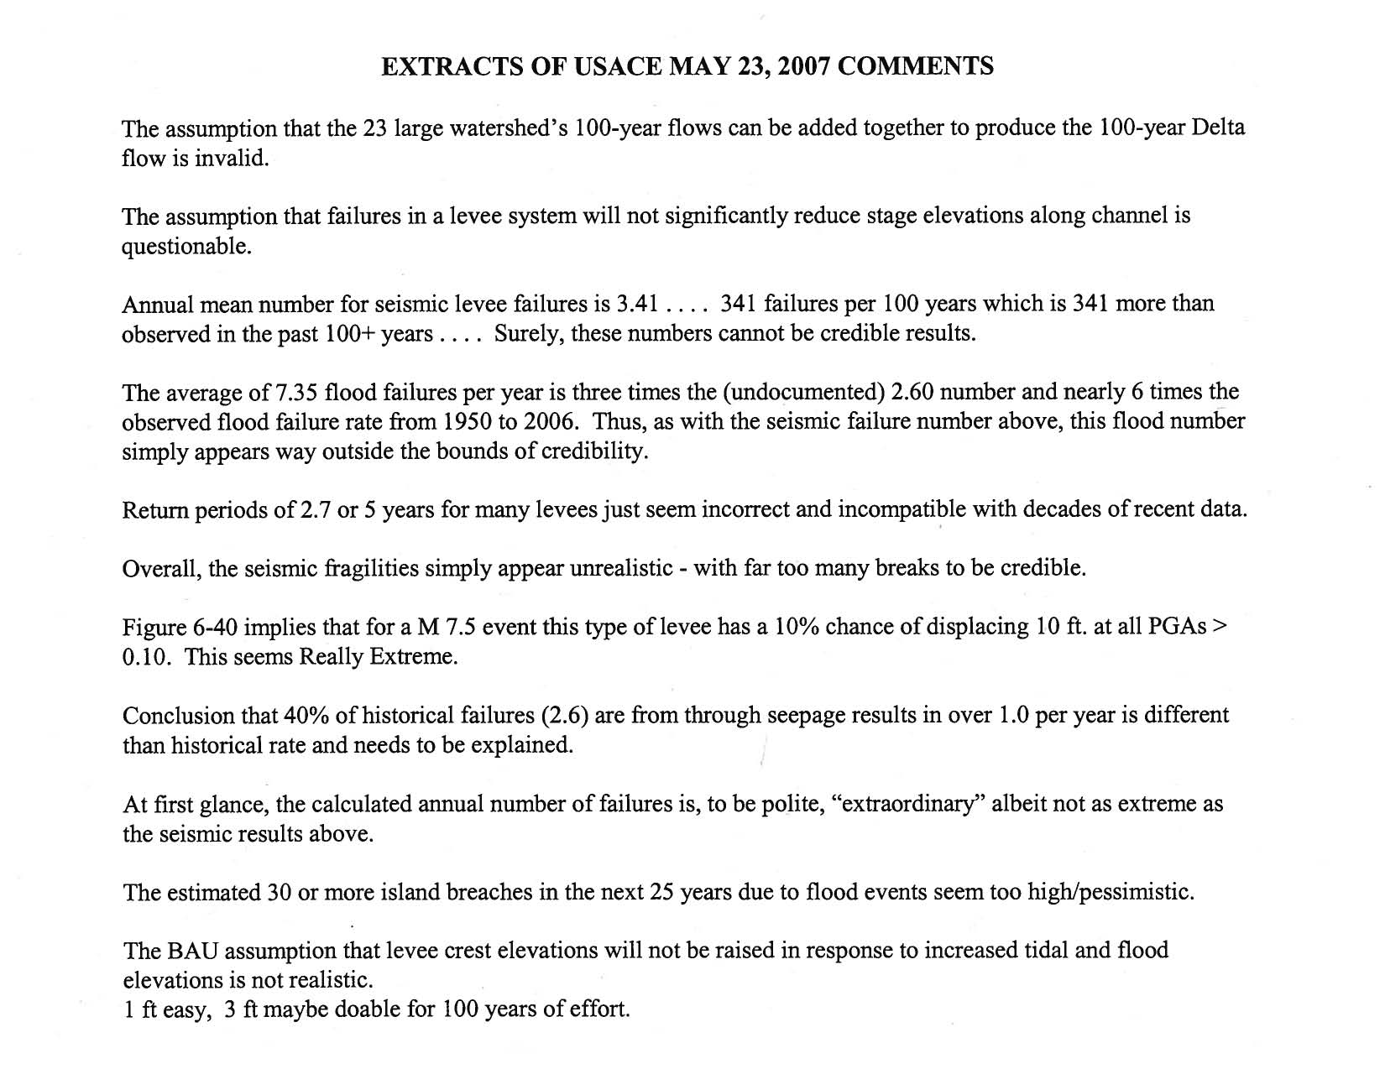
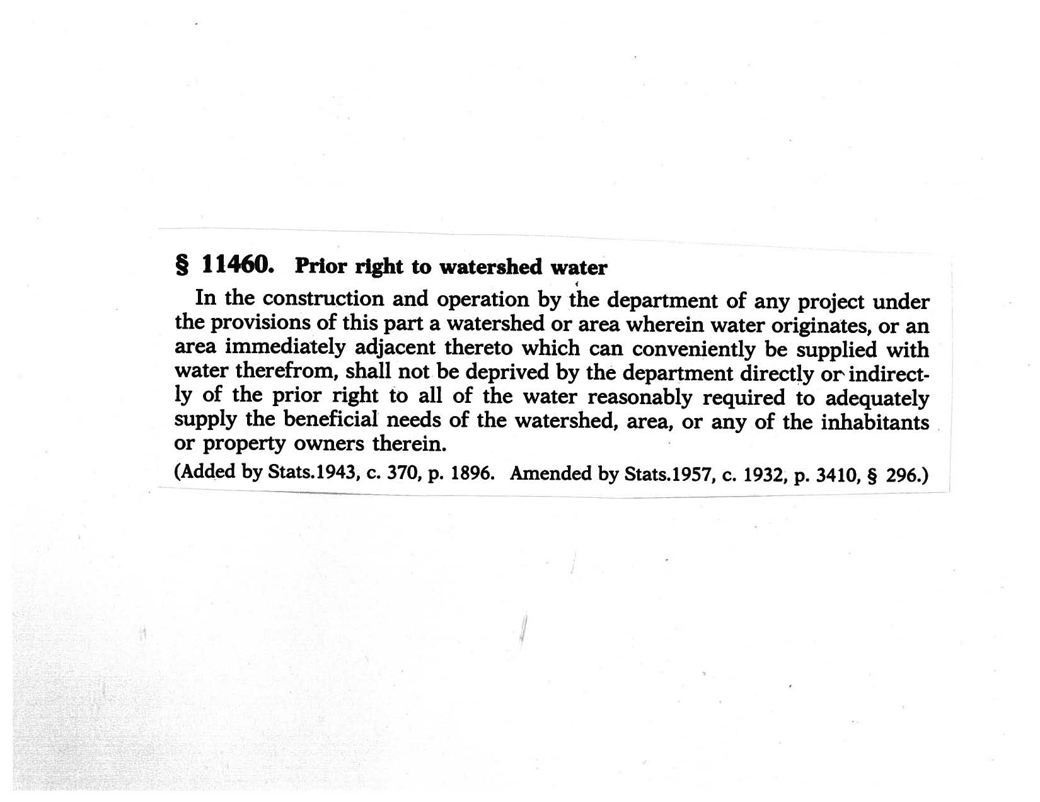
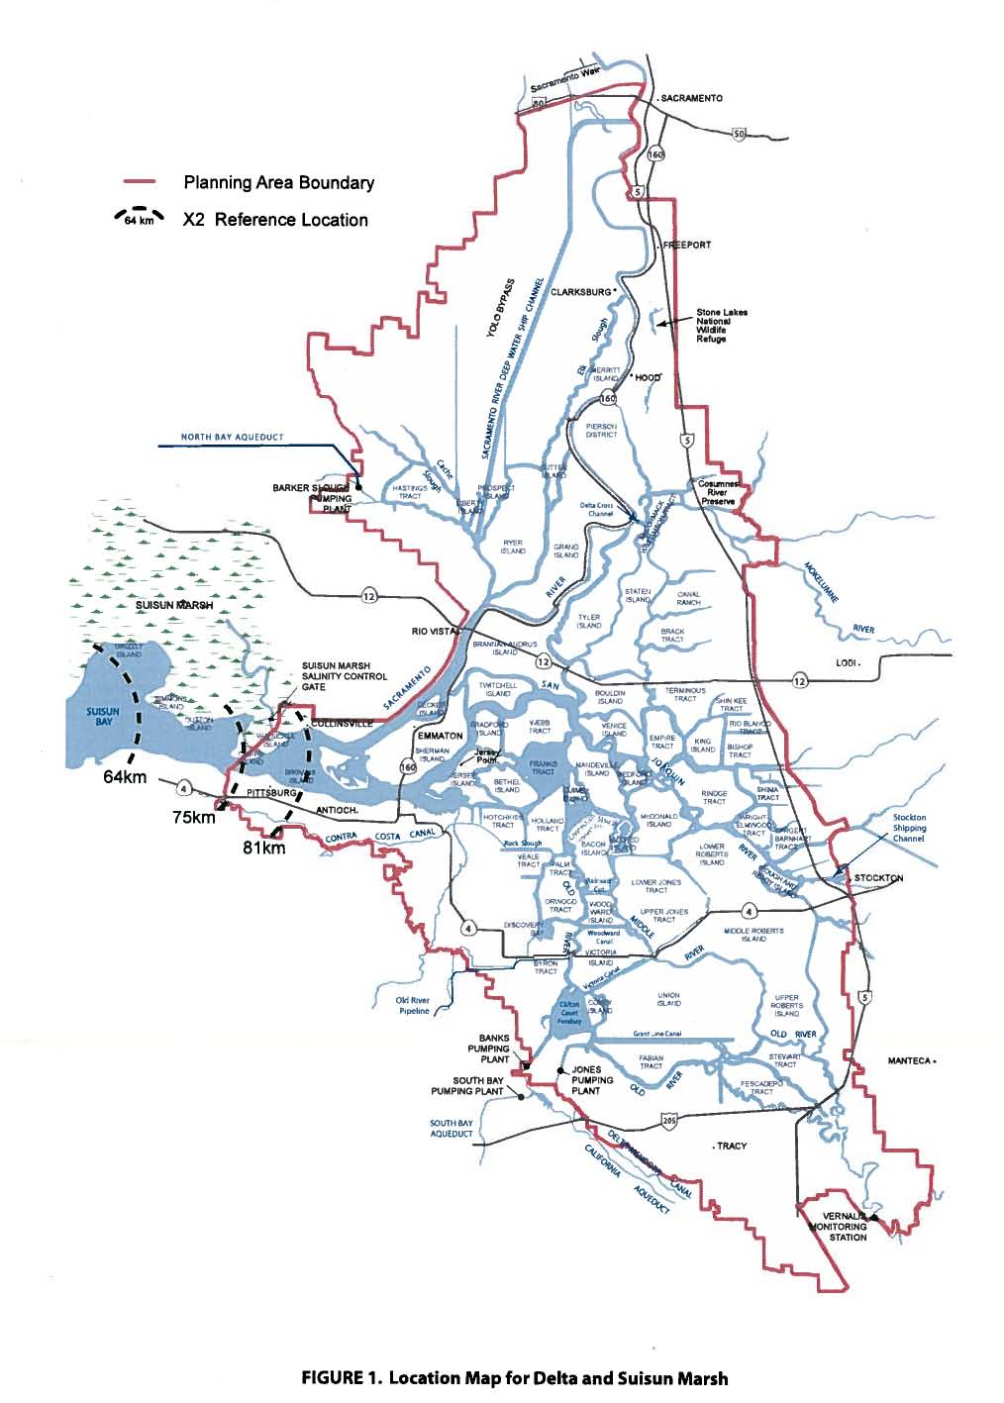

Slide 62
Let’s see …
10.76 in-Delta floods per year for seven years ….
… carry the four, times, … carry the five, seven times zero plus …
WE SHOULD HAVE EXPERIEINCED SEVENTY-FIVE FLOODS IN THE PAST SEVEN YEARS

Slide 63
Draft BDCP documents limit operation of the new intakes to only half of the years and then, only sometimes and at varying rates during the years allowed.
So what is the plan during dry times after the monster earthquake fills the Delta up with salty water?
Violate ESA restrictions on time and export rates?

Slide 64
The Cost of the Tunnels and New Intakes

Slide 65
“BDCP will not result in an overall increase in exports, and may result in less. “
DWR, USBR, FWS
DFW, NMFS, BDCP
etc.

Slide 66
A $14+ Billion facility with operations and maintenance costs requires a yearly payment of $1.2 Billion.

Slide 67
KERN COUNTY WATER AGENCY receives about ¼ of the State Water Project supply. Assuming the BDCP benefits are split 50-50 between the State Water Project and the federal Central Valley Project, KCWA would therefore get 1/8 of the BDCP benefits.

Slide 68
1/8 of 1.2 Billion is $150,000,000.
KCWA’s proposed 2013-2014 budget was $141,000,000.

Slide 69
Double the cost for less water.

Slide 70
Well, what is the worst thing that can happen ….

Slide 71
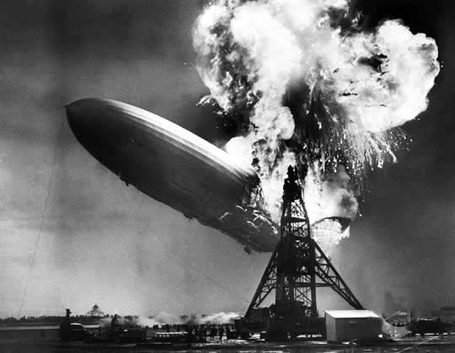

Slide 72
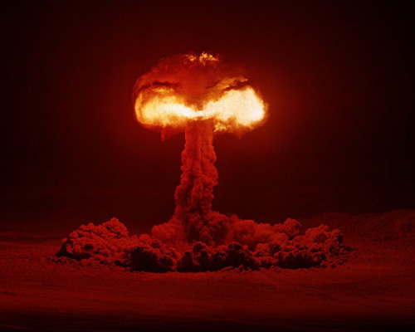

Slide 73
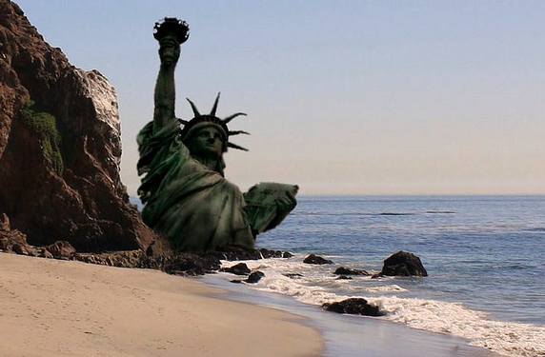

Slide 74


