Slide 1

San Joaquin River Exchange Contractors Water Authority
WEF- Central Valley Tour
April 23, 2014
Mission Statement : To effectively protect the Exchange Contract and maximize local water supply, flexibility and redundancy in order to maintain local control over the members’ water supply, whatever circumstances occur..

Slide 2
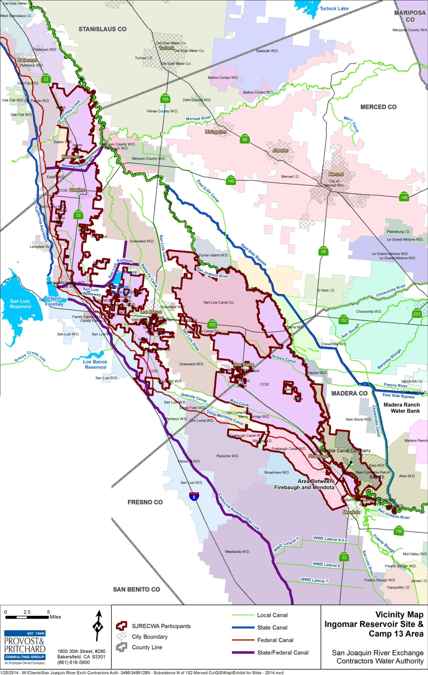
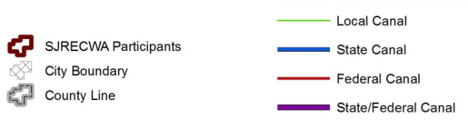


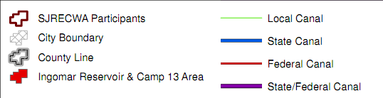
San Joaquin River Exchange Contractors Water Authority
N⬆

Slide 3
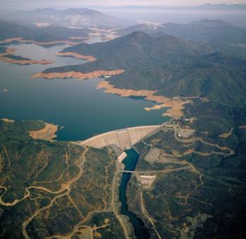
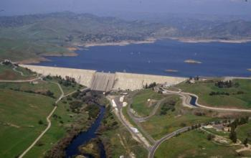
The Exchange Contract -
What is it Anyway?
The corner stone for the Development of the CVP ( Friant Dam, Shasta Dam, DMC)
Two documents were signed in 1939:
  1. Exchange Contract
    Monthly Delivery Limits, Flow Limits, Water Quality Criteria, Water Supply( Shasta) Criteria [ We operate under the 1967 Second Amended Contract]
  2. Purchase Contract
    Conveyed high flow rights, reserved low flow rights, We have our senior water rights on the San Joaquin River
3
Notes:
3

Slide 4
Background of the
Exchange Contractors
  Pre-1914 and Riparian Rights on the San Joaquin and Kings Rivers dating back to the 1870’s
  Irrigate approximately 240,000 ac in Fresno, Madera Merced and Stanislaus Counties.
  Normal Year allocation 840,000 acre feet
  Critical Year allocation 650,000 acre feet
  Allocation is based on Forecasted inflow into Shasta Lake

Slide 5
Background of the
Exchange Contractors
  The SJRECWA is a Joint Powers Authority that was formed in 1992, its members include:
    Central California Irrigation District (145,000 ac)
    Columbia Canal Company (16,000 ac)
    Firebaugh Canal Water District( 22,000 ac)
    San Luis Canal Company (47,000 ac)
  Main Duties:
    Protect water rights
    Administer AB 3030 Plans & Water Conservation Plans
    Administer water transfers
    Main point of contact for the administration of the Exchange Contract
    Other duties as assigned

Slide 6
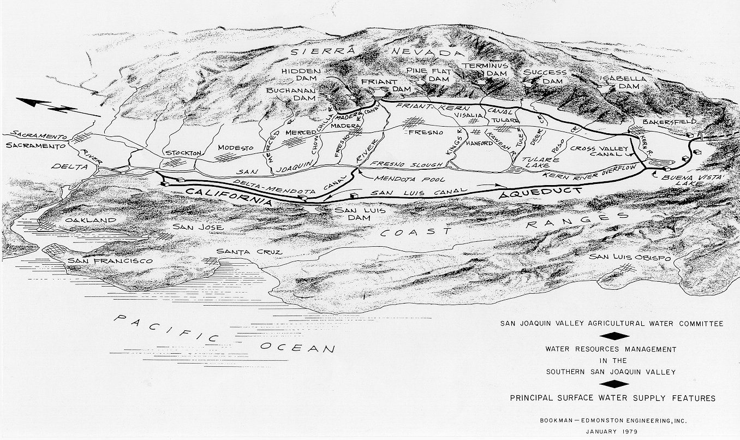
How The Exchange Contract Works
The SJR Exchange Contract
Madera Canal
250,000 AF
Friant-Kern Canal
1,050,000 AF
San Joaquin River
Delta
Exchange
Contractors
Mendota Pool
Cross Valley Canal
128,300 AF
Federal Delta Project Supply
Delta Mendota Canal
840,000 AF

Slide 7
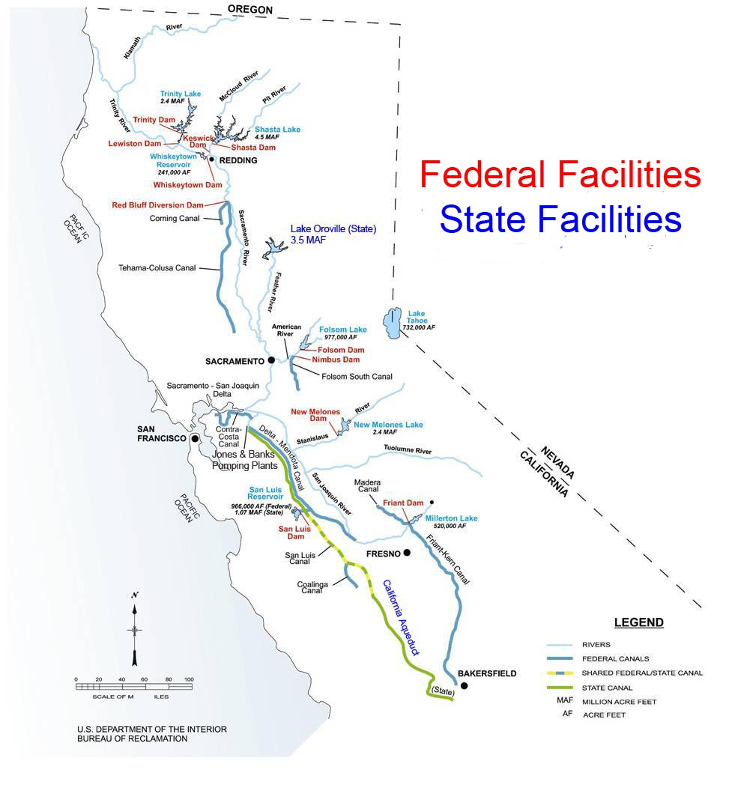
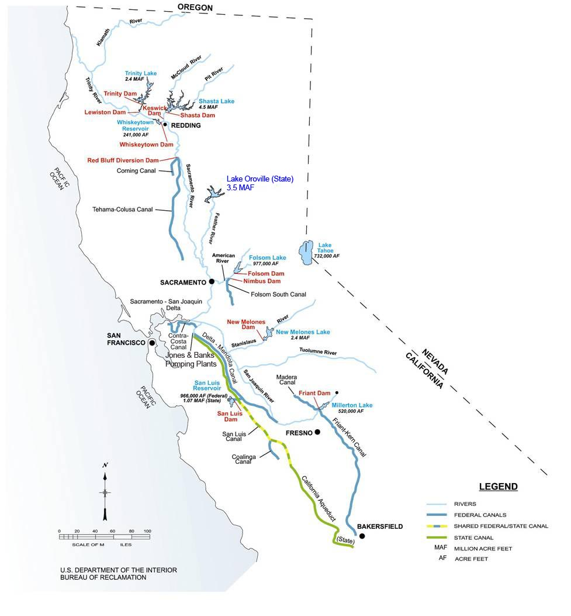
1960s

Slide 8
2014 Operations
The March 1st 2014 Water Supply update has forecasted inflows into Shasta Lake between 2.4 MAF(90%) to 2.8 MAF( 50%) for the year, the Exchange Contract trigger for a 100 % allocation in 2014 is 3.26 MAF. Therefore, we are Critical which means our allocation is 75% or 650,000 af.
  We have been declared a Critical Year only four times before this year (1977, 1991, 1992, 1994)
Neighboring Federal South of Delta Ag Service Water Districts are 0% allocation. Friant Districts are receiving a 0% allocation.

Slide 9
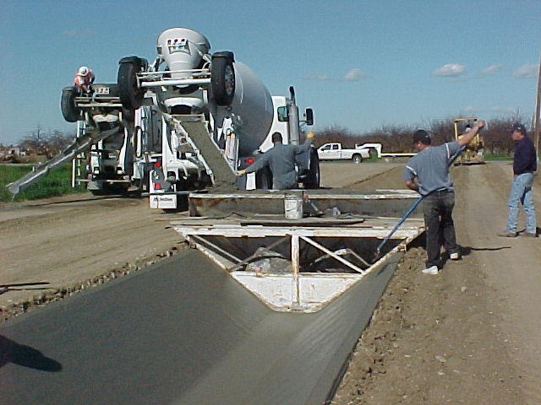
Increased Regional Water Availability
As a result of member agency conservation programs, water service to the growers has improved and the SJRECWA has the ability to redirect water to other local water agencies.
These savings come from large investments in both large district-wide projects and smaller on-farm conservation projects.
Due to high investment costs, we needed an innovative approach to fund these efforts.

Slide 10
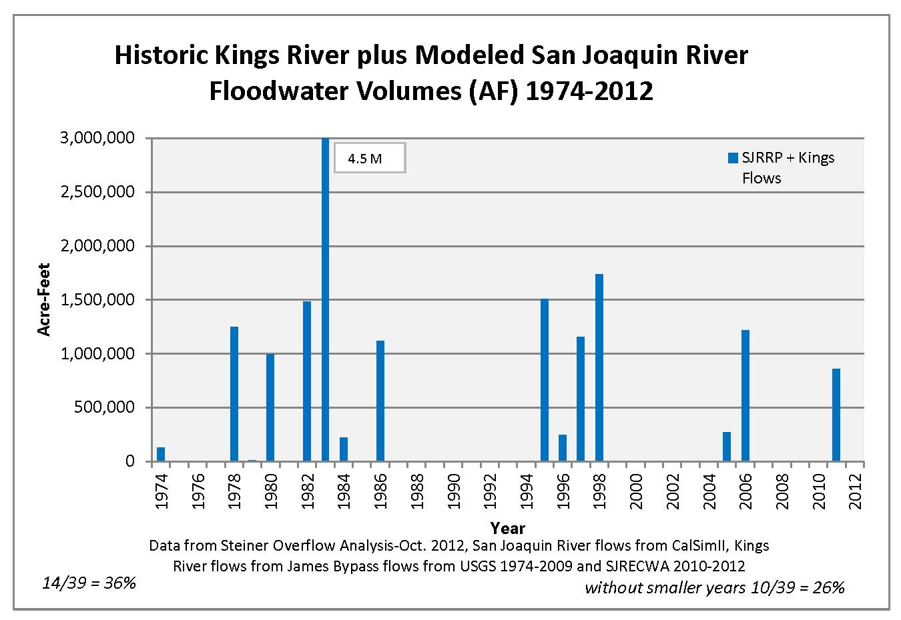
Floodwater Volumes
San Joaquin River flows from CalSimII, Kings River flows from James Bypass flows from USGS 1974-2009 and SJRECWA 2010-2012

Slide 11
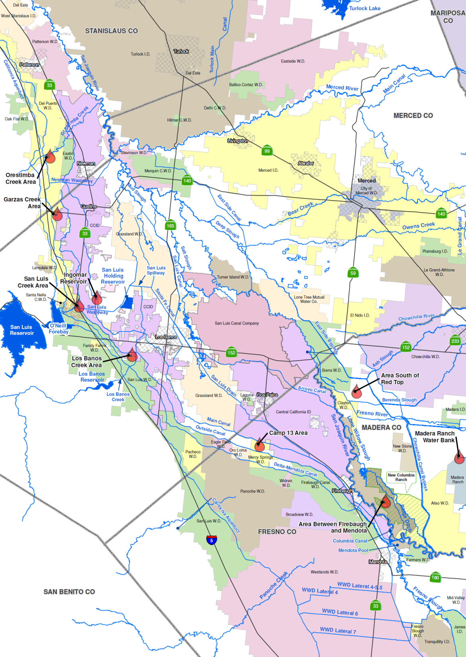
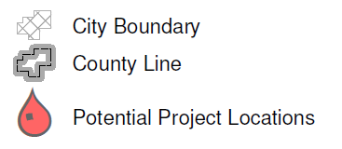

Exchange Contractors & SLDMWA
Projects to Evaluate
SJR to DMC Connections
West Stanislaus Flood Control Projects
Level 2 & Level 4
Refuge Water
Supply Program
San Luis Reservoir
Low-Point
Improvement Project
Los Banos Creek
Conjuctive Use Project
Westside Regional
Drainage Plan
11
Westside Surface Storage Reservoir Project

Slide 12
Exchange Contractors
Water Resources Plan
Exchange Contractor Board commissioned the initial analysis in 2011 and identified several potential projects with the goal to:
  Provide both seasonable and multi-year flexibility.
  Enhance local resources due to delta export reductions or failure.
  Provide reliability if we were to receive a major portion our water from Friant Dam.
12
Notes:
12

Slide 13
Water Resources Plans
Joint Exchange Contractors Projects
  Los Banos Creek WRP
    City of LB, SLWD, GWD, Exchange Contractors
  Various Water Banking Projects
    SLWD, DPWD, Exchange Contractors
  Internal Surface Storage
Joint SL&DMWA Projects

Slide 14
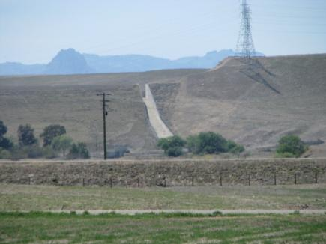
Los Banos Creek Detention Dam
Background
Owned by US Bureau of Reclamation.
Operated by State of California Department of Water Resources.
Operational in 1962.
Normal Gross Area: 470 Acres
Max Storage Capacity: 34,600 AF
Historic Operational Capacity: 20,600 AF

Slide 15
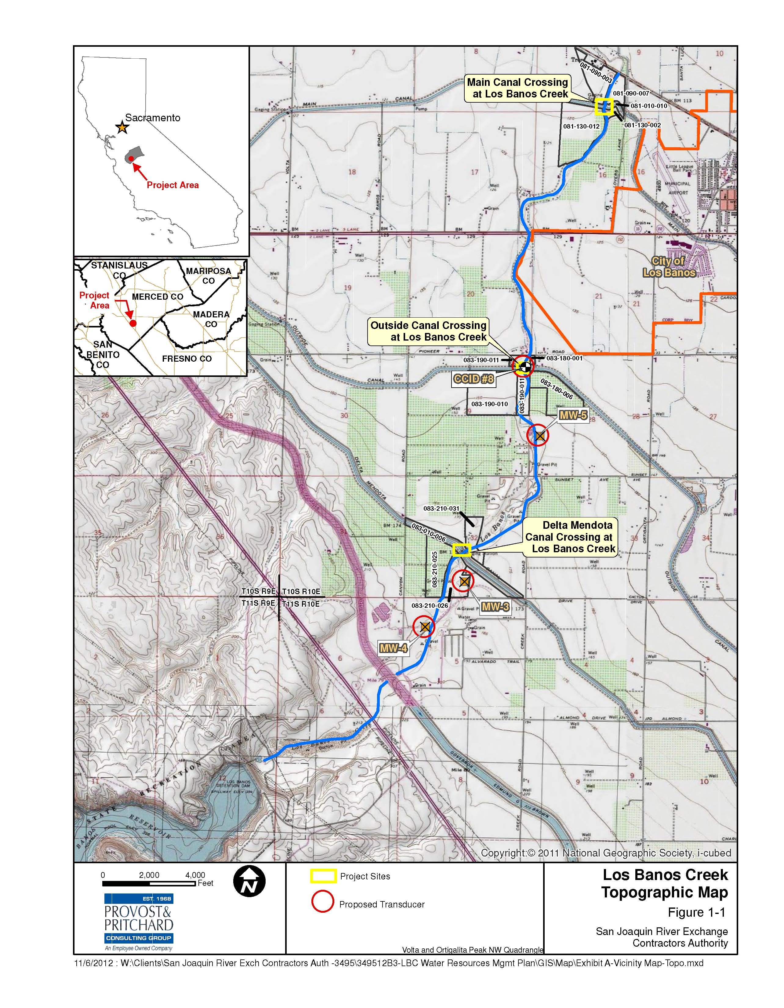
NTS

Slide 16
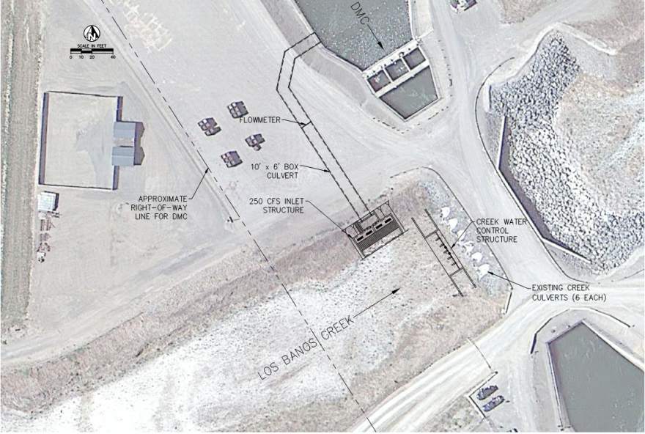
Proposed Project – Average Annual Yield = 6,848 Acre Feet
Range 0 to 30,000 Acre Feet
Max Storage=20,600 AF
250 CFS
6,848 AF/yr
Hwy 152
Bold Numbers are Avg. Annual Volumes
(1995-2011)
Sept. 15 –Mar. 15
200-1,000 CFS
Aqueduct
DMC
DMC Release for recharge 342 AF/yr
Los Banos Creek
Beneficial Recharge
50 CFS
2,792 AF/yr
Los Banos Creek
Project Costs
$2.4 million
LBC Control Weir and Gravity Inlets to capture LBCDR releases into the DMC.
Quantification of Los Banos Creek Channel recharge from LBCDR to Highway 152.
Max. Storage=
20,600→34,600 AF
Approx.
Mar. 15th – End of July
Aqueduct
DMC
Los Banos Creek
Max. Storage
=34,600→20,600 AF
Los Banos Creek
Aug. – Sept.
Aqueduct
DMC
Los Banos Creek
Los Banos Creek

Slide 17
San Joaquin River Exchange Contractors Water Authority
Initial Recharge and Recovery Projects
Summary of Estimated Groundwater Storage Capacity
Kenneth D. Schmidt & Associates – January 2011
Area | Recharge Capacity (AF/yr) |  | Underground Storage Capacity (AF)
 | Intentional Recharge | In-Lieu
Orestimba Creek | 20,000 | 2,000 | 25,000
Garzas Creek | 3,000 | 0 | <10,000
Santa Nella | 5,000 | 0 | 2,500-7,500¹
Los Banos Creek | 10,000 | 10,000 | 15,000-35,000²
B&B Ranch | 5,000 | 0 | 10,000
East of Firebaugh | 3,000 | 0 | <7,000
New Columbia Ranch | 16,000 | 11,000 | 80,000-130,000
Red Top | 3,000 | 0 | 20,000-30-000
Total | 65,000 | 23,000 | 153,000-250,000
¹ Greater space would be available if the shallow groundwater levels were first lowered.
² The available storage space varies considerably, based on depth to water (i.e., wet years versus droughts).

Slide 18
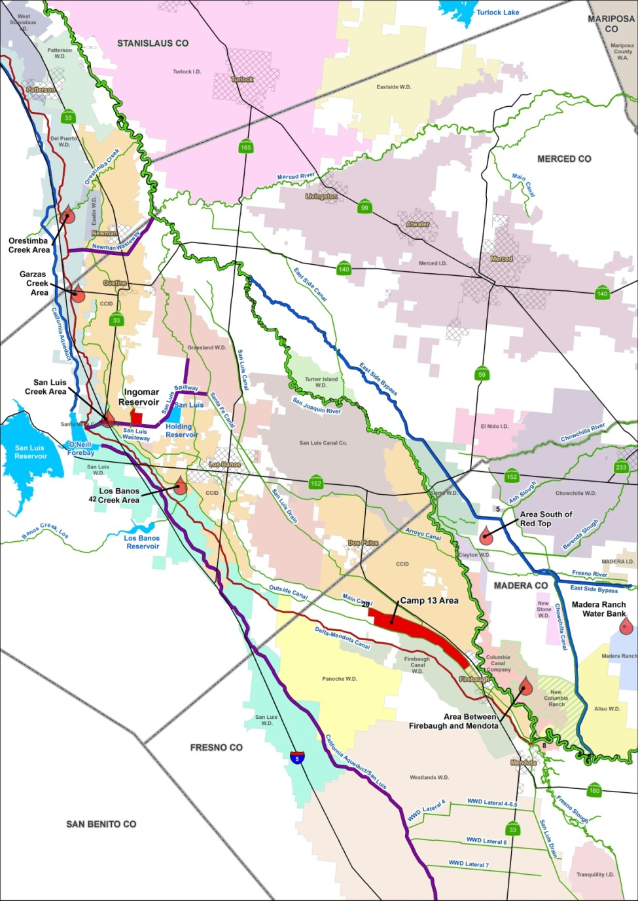
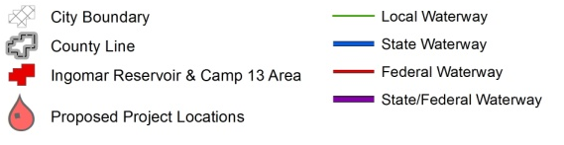

Conceptual Pilot Water Recharge and Recovery/Surface Storage Projects
N⬆

Slide 19
Surface Storage Projects Annual Operations Costs
(P&P Revision of AECOM Original Costs)
Surface Storage Projects
Project Alternative | Estimated Capital Costs | Estimated Capital Annual Costs | Estimated Annual O,M & P Costs | Short Detention Storage (AF) | Long Detention Storage Amount (AF) | Estimated Water Cost Range ($/AF Short-Long Duration)*
Camp 13 (1,800 acre) | $43,867,000 | $2,854,000 | $219,000 | 11,400 AF | 9,300 AF | $269/AF - $332/AF
Camp 13 (1,000 acre) | $27,423,000 | $1,784,000 | $137,000 | 6,600 AF | 5,400 AF | $290/AF - $359/AF
Camp 13 (500 acre) | $15,589,000 | $1,014,000 | $78,000 | 3,300 AF | 2,700 AF | $327/AF - $405/AF
Ingomar (Phase 1) | $7,701,000 | $501,000 | $111,000 | 1,100 AF | 1,100 AF | $551/AF
Ingomar (Phase 2) | $10,561,000 | $687,000 | $187,000 | 2,600 AF | 2,600 AF | $320/AF
Ingomar Combined | $18,262,000 | $1,188,000 | $298,000 | 3,700 AF | 3,700 AF | $388/AF
* Reservoirs assumed to be operated every year

Slide 20
Conceptual Pilot Water Recharge and Recovery/Surface Storage Projects
N⬆

Slide 21
Summary of Recharge and Recovery Project Capacities
1 – Kenneth D. Schmidt & Associates, 2011
Project | Avg. Annual Recharge (AF/yr) | Total Creek Recharge Potential (AF/yr)¹ | Max. Dry Year Recovery (AF/yr) | Total Underground Storage Capacity (AF)¹
Los Banos Creek | - | - | - | -
Northern Site | 1,500 | - | 6,900 | -
Southern Site | 1,500 | - | 6,900 | -
Subtotal | 3,000 | 10,000 | 13,800 | 15-35,000
Orestimba Creek | - | - | - | -
Small Pits | 300 | - | 1,700 | -
Large Pits | 500 | - | 1,700 | -
Riddle (40 ac) | 1,000 | - | 3,300 | -
Subtotal | 1,800 | 20,000 | 6,700 | 25,000
Total (all projects) | 4,800 | 30,000 | 20,500 | 40-60,000

Slide 22
Recharge and Recovery Projects Annual Operations
Recharge/Recovery Projects
Project Alternative | Estimated Capital Costs | Estimated Capital Annual Costs | Estimated Annual O&M Costs | Max. Dry Year Yield (AF)¹ | Average Annual Yield (AF) | Estimated Water Cost ($/AF)²
Los Banos Creek Northern Site | $2,785,000 | $93,000 | $54,000 | 6,900 AF | 1,500 AF | $96/AF
Los Banos Creek Southern Site | $2,241,000 | $75,000 | $54,000 | 6,900 AF | 1,500 AF | $84/AF
Orestimba Riddle (20 ac) | $1,287,000 | $43,000 | $16,000 | 1,700 AF | 500 AF | $131/AF
Orestimba Riddle (40 ac) | $3,411,000 | $114,000 | $35,000 | 3,300 AF | 1,000 AF | $150/AF
Orestimba (small pits) | $2,189,000 | $73,000 | $10,000 | 1,700 AF | 300 AF | $306/AF
Orestimba (17 ac pit) | $1,343,000 | $45,000 | $16,000 | 1,700 AF | 500 AF | $135/AF
TOTAL | $13,256,000 | $443,000 | $185,000 | 22,200 AF | 5,300 AF | Weighted Average $118/AF
1 - Maximum dry year yield based on recovery well capacity, and assumes sufficient water in storage.
2 - Water assumed to be delivered about once every three years. Does not include water purchase or wheeling costs.

Slide 23
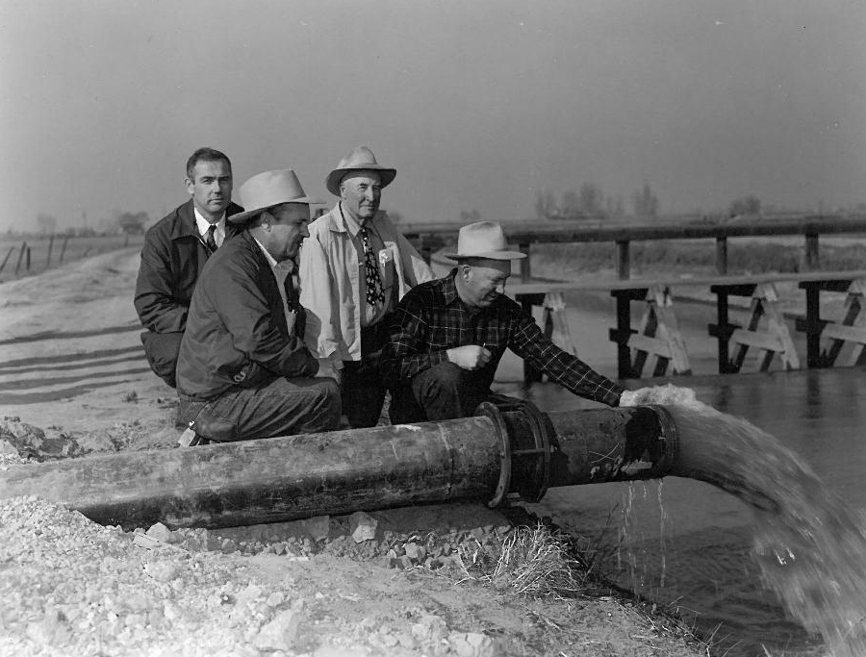
Exchange Contractors
Groundwater Management
Groundwater Management
The member agencies conjunctively manage their surface water and groundwater supplies
The Authority has an approved AB 3030 Groundwater Management Plan since 1997
The Authority strongly believes that local control is the best way to manage our groundwater resources.
Subsidence Issue
23
Notes:
23

Slide 24
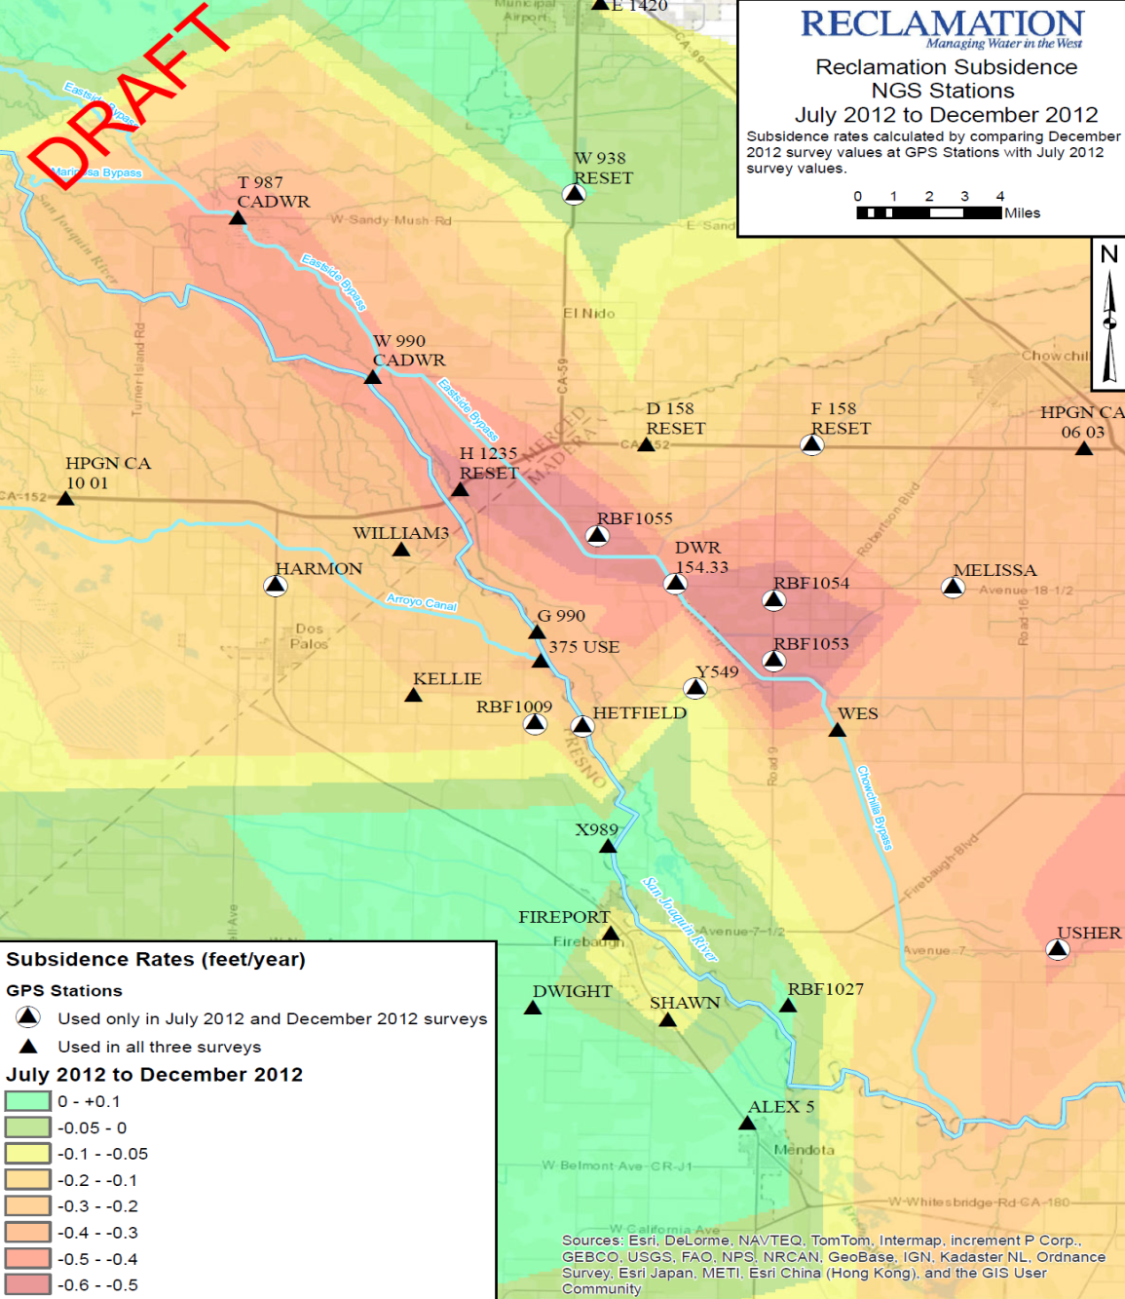
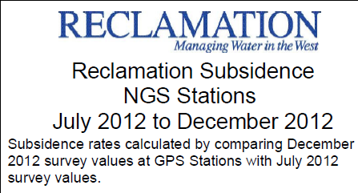
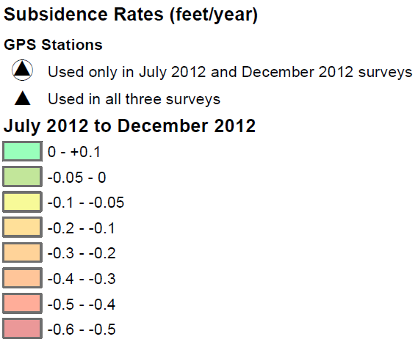

Slide 25
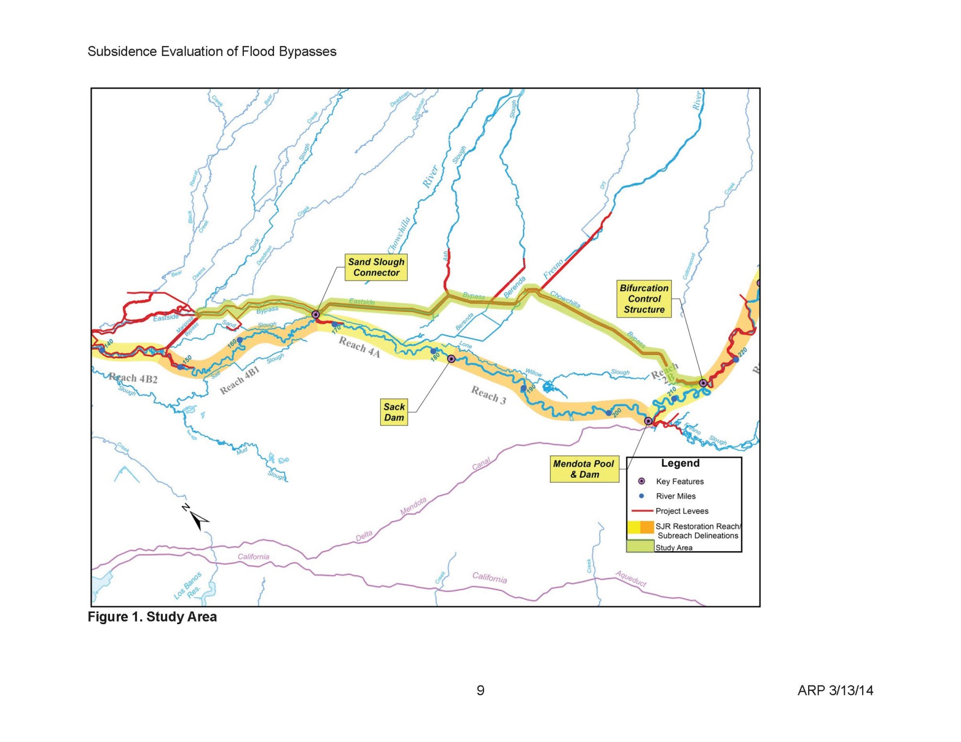

Slide 26
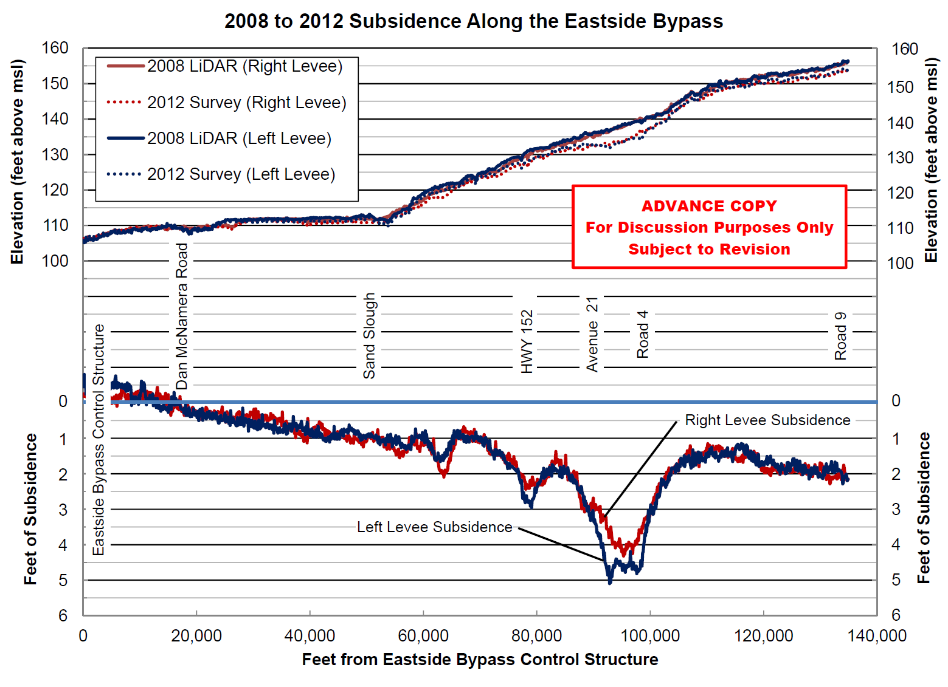


Merced and Madera County

Slide 27
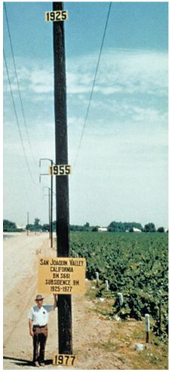
Subsidence, if not stopped, will:
1. Cause flooding in Western Madera & Merced Co.s
Highway 152
Elementary School
City of Dos Palos
Valuable Farmland and Dairies
2. Jeopardize water supply of neighboring districts –
up to 20% reduction in water district conveyance
capacity.
Central California Irrigation District
San Luis Canal Company
3. Jeopardize the San Joaquin River Restoration
Program
Approximate location of maximum subsidence in the United States identified by research efforts of Dr. Joseph F. Poland (pictured). Signs on pole show approximate altitude of land surface in 1925, 1955, and 1977. (28 feet in 50 years, .56 feet/year)
The site is in the San Joaquin Valley southwest of Mendota, California, 15 miles southwest of Sack Dam.

Slide 28
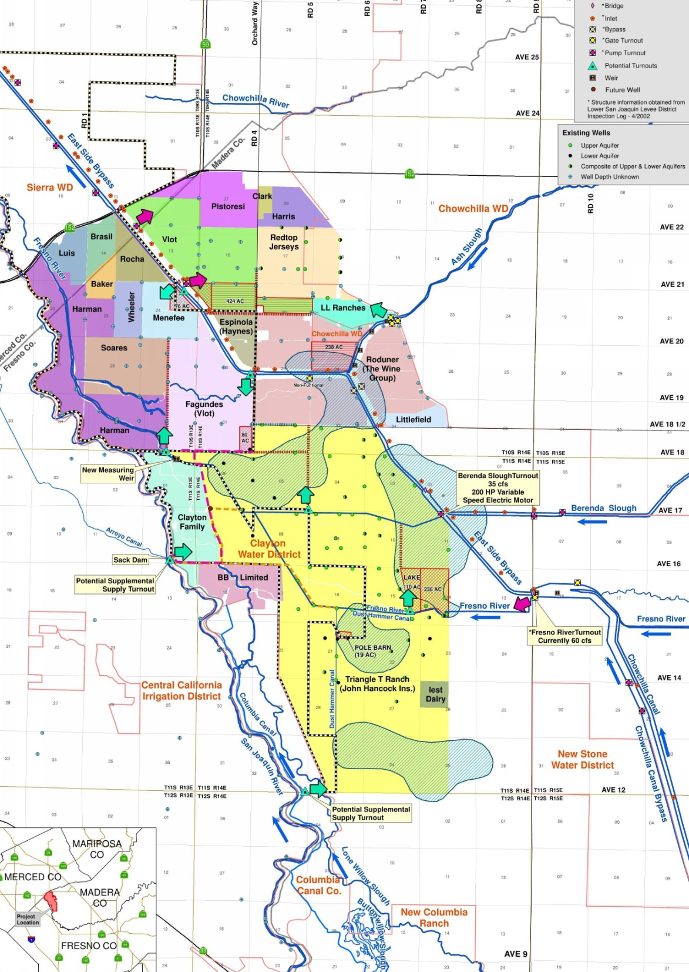
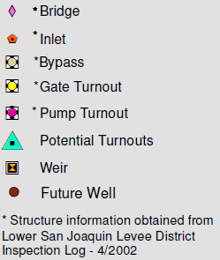
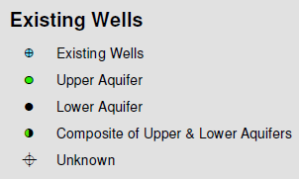
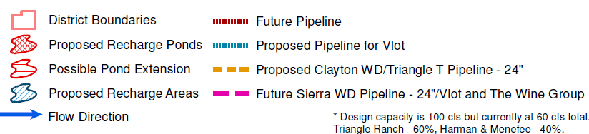
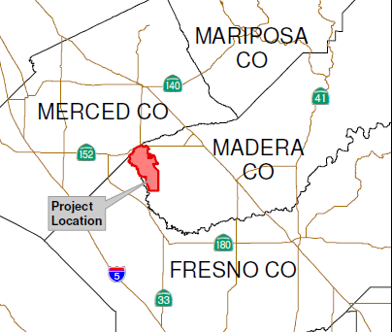

Western Madera County Subsidence Area
Base-map with Recharge Ponds and Conveyance Facilities
In Association with KDS and Associates

Slide 29
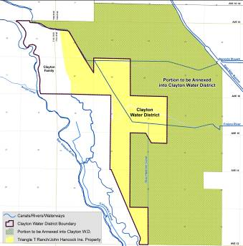
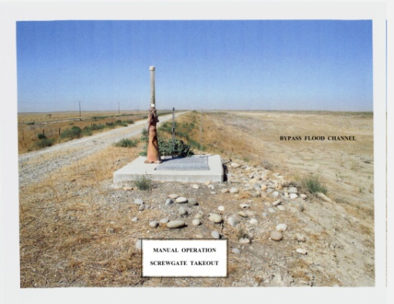
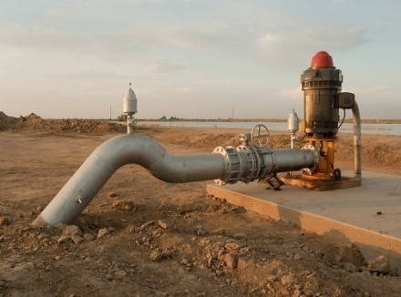
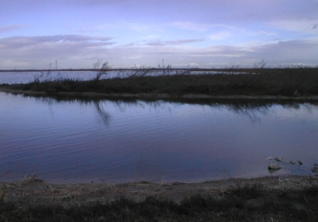
Western Madera and Merced County Subsidence Study
Long Term Solutions
  Import water at Sack Dam.
  Continue grower-driven process to revive existing districts.
  Develop Groundwater Bank for use on overlying land.
  Replace deep wells with shallow aquifer wells.
  Construct internal conveyance infrastructure improvements.
  Keep Merced and Madera Counties, and others informed.

Slide 30
CONTACT INFORMATION:
San Joaquin River Exchange Contractors
Water Authority
541 H Street/P.O. Box 2115
Los Banos, CA 93635
(209) 827-8616
Steve Chedester, Executive Director
Email: schedester@sjrecwa.net
Website: www.sjrecwa.net

