Slide 1

Stress Relief:
Prescriptions for a Healthier Delta Ecosystem
Supported by the S. D. Bechtel, Jr. Foundation

Slide 2
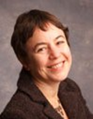
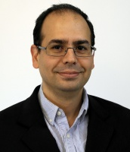

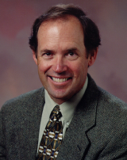
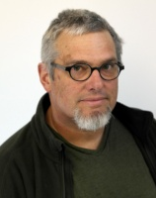
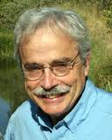
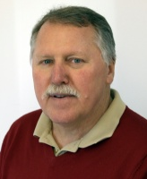
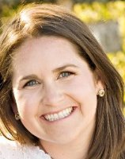
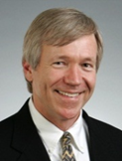

An interdisciplinary study team
Ellen Hanak PPIC Economics | Josué Medellín-Azuara UC Davis Economics
Jay Lund UC Davis Engineering | Jeffrey Mount UC Davis Geology
John Durand UC Davis Ecology | Peter Moyle UC Davis Biology
William Fleenor UC Davis Engineering | Caitrin Chappelle PPIC Public policy
Brian Gray UC Hastings Law | Buzz Thompson Stanford University Law

Slide 3
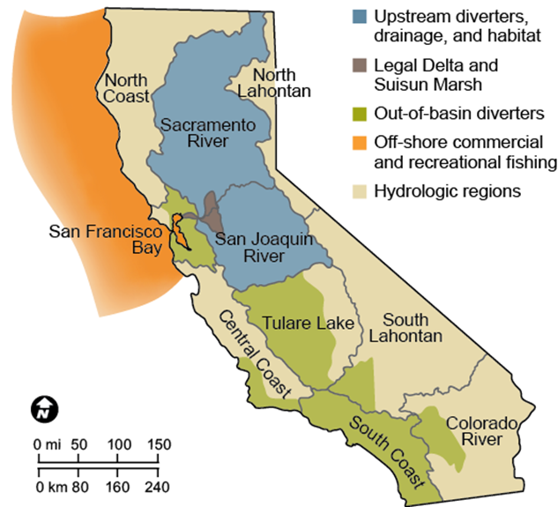
Most Californians use Delta resources

Slide 4
Study focused on improving conditions for native fish
How did we get here?
  Causes of declines
Where might we go?
  A realistic vision
How might we get there?
  Promising actions, institutional solutions
Methods:
  Scientific, economic, and legal analysis
  Small workshops
  Surveys of scientists (122), stakeholders (240)

Slide 5
Outline
Causes of stress
A realistic vision
Promising actions
Prescriptions

Slide 6
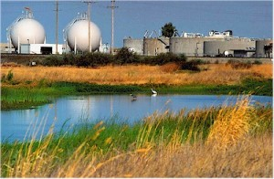
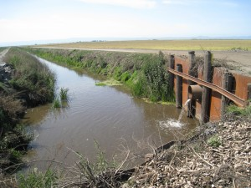
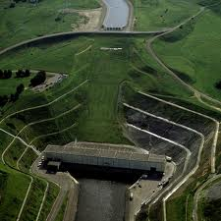
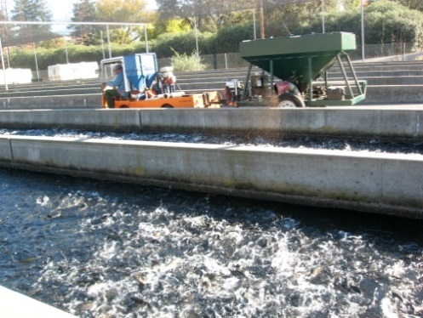
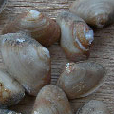
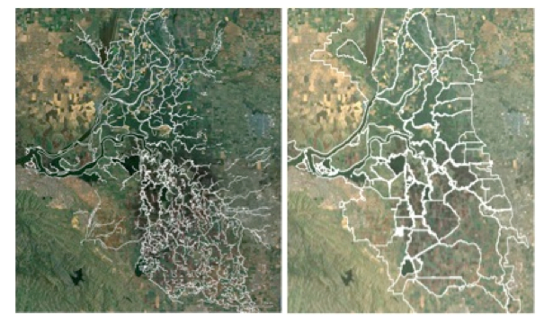
Five broad categories of ecosystem stressors ― all related to human actions
Discharges
Direct fish
management
Flow regime change
Invasive species
Physical habitat loss and alteration

Slide 7
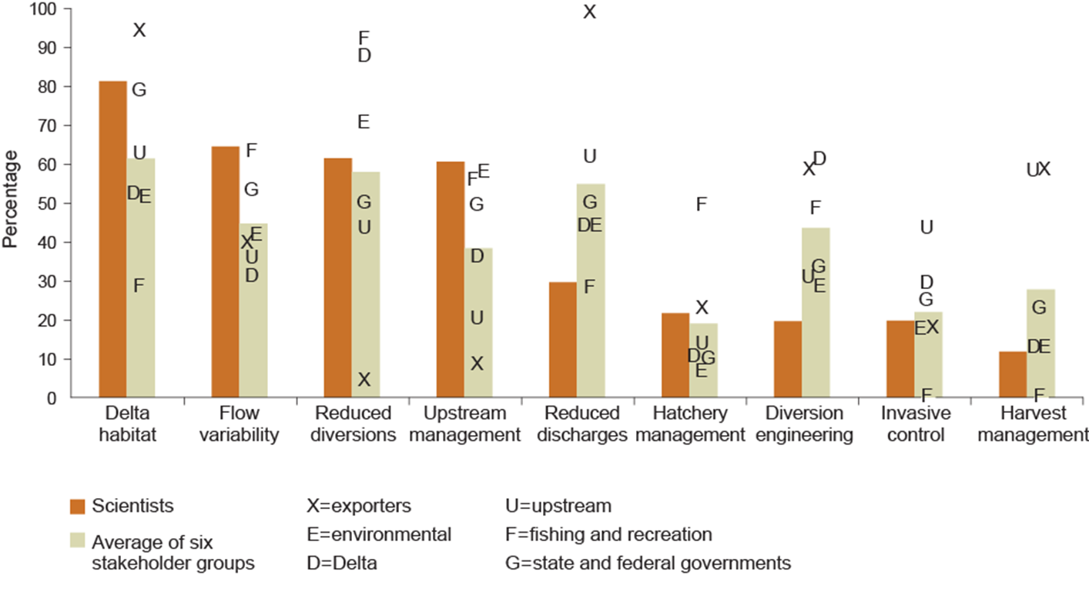
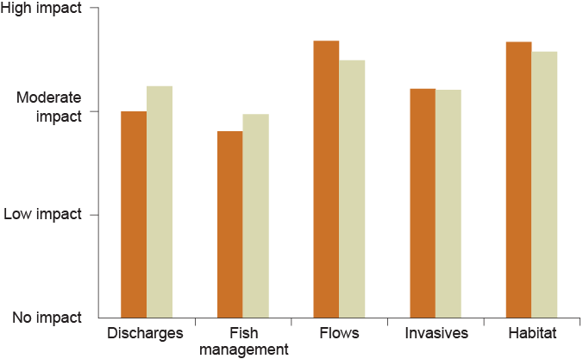
Scientists and stakeholders agree that all five types of stressors matter…

Slide 8
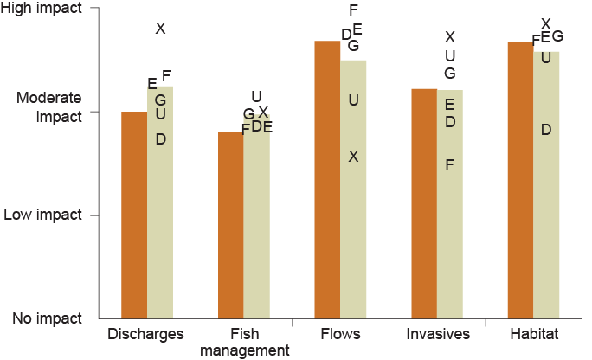
…but groups tend to downplay stressors that benefit them most

Slide 9
…but groups tend to downplay stressors that benefit them most

Slide 10
Outline
Causes of stress
A realistic vision
Promising actions
Prescriptions

Slide 11
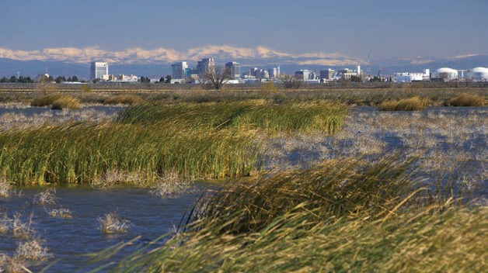
A realistic and hopeful pathway: reconciliation ecology
Support ecosystem alongside continued human use of region’s natural resources (co-equal goals)
Restore natural processes where practical
Infrastructure, technology can also help
Yolo Bypass

Slide 12
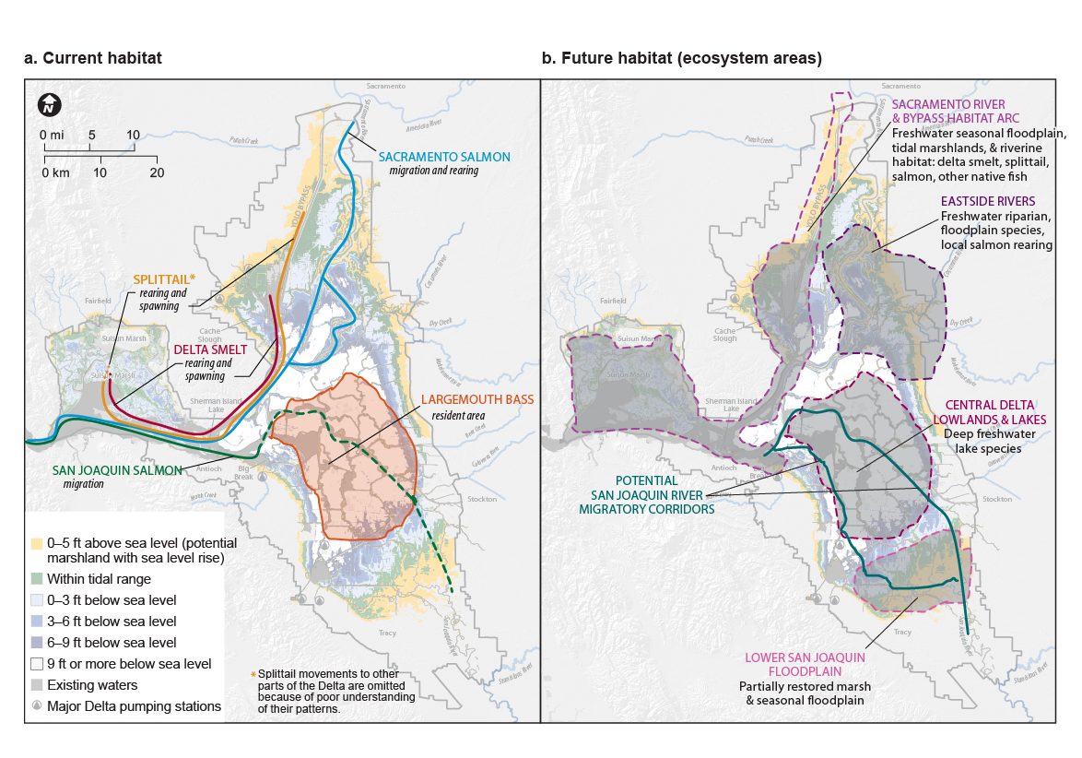
Area specialization will be needed to focus ecosystem efforts
Fish habitat in today’s Delta
Fish habitat in specialized Delta

Slide 13
Outline
Causes of stress
A realistic vision
Promising actions
Prescriptions

Slide 14
Survey sought views on actions to help native fish—some already under way
Discharges | Fish Mgmt | Flow Mgmt | Invasives | Habitat
Reduce toxics | Separate hatcheries | Increase outflows | Control invasive weeds | Tidal marsh, shallow habitat
Reduce farm fertilizers | Use conservation hatcheries | Reduce exports | Control invasive clams | Seasonal floodplains
Reduce farm pesticides | Harvest more predators | Vary flows for native fish | Prevent new invasions | Channel margin habitat
Reduce urban nonpoint | Reduce salmon harvest | Exports with canal/tunnel | Vary salinity | Upstream habitat
Reduce urban point | More fish screens | Use gates to steer fish |  | Increase sediment
Dilute with more flows | Enforce poaching | Improve upstream flows |  | Remove selected dams
 | Truck fish around Delta/dams | Reduce entrainment |  | Deep water habitat
Level of implementation: Under way, Planned, Considered, Conceptual

Slide 15
Scientists agree on high potential for some habitat, flow actions
Discharges | Fish Mgmt | Flow Mgmt | Invasives | Habitat
Reduce toxics | Separate hatcheries | Increase outflows | Control invasive weeds | Tidal marsh, shallow habitat
Reduce farm fertilizers | Use conservation hatcheries | Reduce exports | Control invasive clams | Seasonal floodplains
Reduce farm pesticides | Harvest more predators | Vary flows for native fish | Prevent new invasions | Channel margin habitat
Reduce urban nonpoint | Reduce salmon harvest | Exports with canal/tunnel | Vary salinity | Upstream habitat
Reduce urban point | More fish screens | Use gates to steer fish |  | Increase sediment
Dilute with more flows | Enforce poaching | Improve upstream flows |  | Remove selected dams
 | Truck fish around Delta/dams | Reduce entrainment |  | Deep water habitat
Level of implementation: Under way, Planned, Considered, Conceptual

Slide 16
Scientists disagree on potential of some other, highly uncertain actions
Discharges | Fish Mgmt | Flow Mgmt | Invasives | Habitat
Reduce toxics | Separate hatcheries | Increase outflows | Control invasive weeds | Tidal marsh, shallow habitat
Reduce farm fertilizers | Use conservation hatcheries | Reduce exports | Control invasive clams | Seasonal floodplains
Reduce farm pesticides | Harvest more predators | Vary flows for native fish | Prevent new invasions | Channel margin habitat
Reduce urban nonpoint | Reduce salmon harvest | Exports with canal/tunnel* | Vary salinity | Upstream habitat
Reduce urban point | More fish screens | Use gates to steer fish* |  | Increase sediment*
Dilute with more flows | Enforce poaching | Improve upstream flows |  | Remove selected dams
 | Truck fish around Delta/dams | Reduce entrainment |  | Deep water habitat
Level of implementation: Under way, Planned, Considered, Conceptual
* More than 20% answered “don’t know”

Slide 17
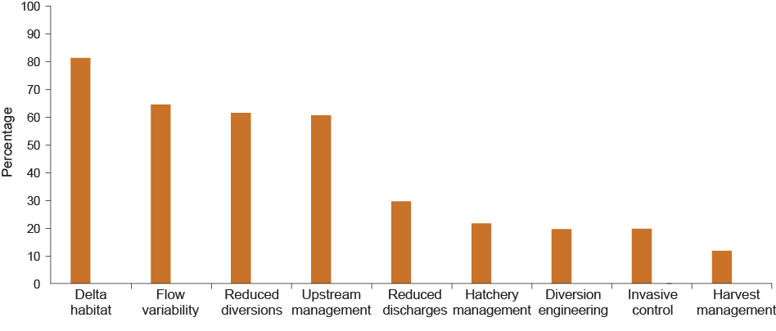
Scientists’ top priorities: restoring natural processes within Delta and upstream
Habitat and flow cluster
82
65
62
61
30
22
20
20
12
Notes:
Instructed NOT to consider costs, just biological potential
Many stressed need for actions along multiple fronts

Slide 18

Again, stakeholder priorities reflect economic interests

Slide 19
Some signs of common ground?

Slide 20
Lack of shared understanding of Delta science is an obstacle to effective policy
Engaged stakeholders consult scientific & gov’t reports regularly…
…but key groups arrive at different conclusions about nature of problems and solutions
Gaps are widest on actions that could be very costly for some stakeholder groups

Slide 21
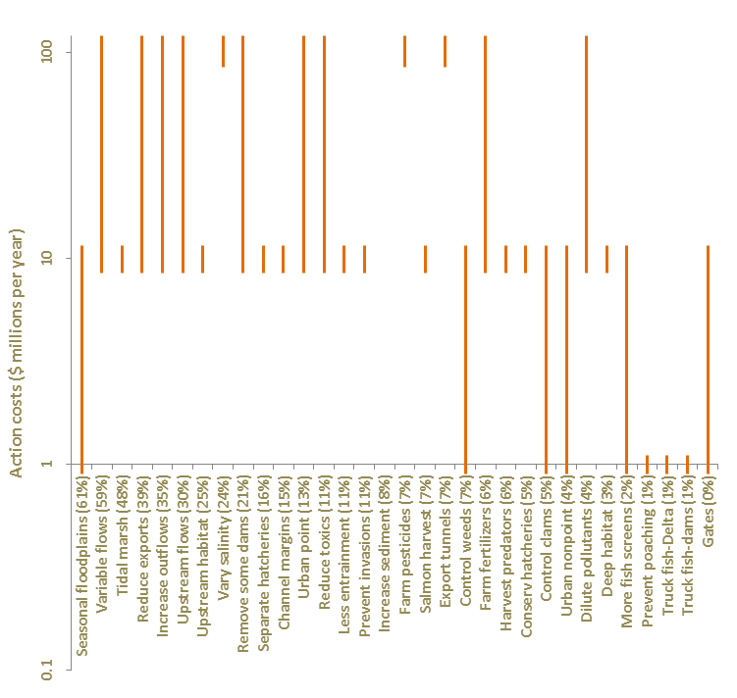
Scientists’ top priorities tend to be the most costly…
‘s
‘s
‘s
Cost estimates from Medellin-Azuara et al. 2013. Numbers in parentheses show share of scientists who chose the action among their “top 5”

Slide 22
Outline
Causes of stress
A realistic vision
Promising actions
Prescriptions

Slide 23
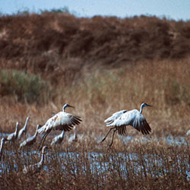
Delta Plan, BDCP contain elements of a reconciled Delta vision
Still weak on adaptive management and integrating science
BDCP is ambitious but narrow: Upstream management and other stressors also matter
And system is still too fragmented

Slide 24




















Institutional fragmentation has created unnecessary barriers to progress
Fragmentation has led to:
Missed opportunities
Oversight gaps
Conflicting mandates
Costly delays
Less reliable science
A simplified model

Slide 25

More effective institutions are needed to implement reconciliation
More integrated
Science
Planning and (adaptive) management
Regulatory oversight

Slide 26
Achieving ecosystem goals will require broad public support
Reconciliation efforts will be costly (at least several hundred million $/year)
Need to communicate the goals and benefits…
…and demonstrate coordinated and cost-effective efforts
Do you support spending to improve conditions for native fish species?
SOURCE: PPIC Statewide Survey (2012)

Slide 27
More information available at www.ppic.org
Stress Relief: Prescriptions for a Healthier Delta Ecosystem (Hanak et al. 2013) (Overview report)
Aquatic Ecosystem Stressors in the Sacramento San-Joaquin Delta (Mount et al. 2012) (Stressor descriptions)
Where the Wild Things Aren’t: Making the Delta a Better Place for Native Species (Moyle et al. 2012) (Reconciled Delta)
Integrated Management of Delta Stressors: Institutional and Legal Options (Gray et al. 2013) (Institutional reforms)
Scientist and Stakeholder Views on the Delta Ecosystem
(Hanak et al. 2013) (Details from the surveys)
Costs of Ecosystem Management Actions for the Sacramento- San Joaquin Delta (Medellín-Azuara et al. 2013) (Cost estimates)

Slide 28
Notes on the use of these slides
These slides were created to accompany a presentation. They do not include full documentation of sources,
data samples, methods, and interpretations. To avoid misinterpretations, please contact:
Caitrin Chappelle, (415) 291- 4435, chappelle@ppic.org
Thank you for your interest in this work.

