Slide 1
Sustainable Groundwater Management Act Activities in Butte County
Water Education Foundation SGMA Tour
October 6, 2016

Slide 2
Overview of Legislation
Recognizes the value of local management of water resources
Requires the development of Groundwater Sustainability Plans (GSPs) in high and medium basins throughout the state
  Groundwater monitoring
  Assessment of basin health
  Water budgets
Goal is to plan for the sustainability of the groundwater resources for future uses
Non-compliance is backstopped by intervention by State Water Board

Slide 3
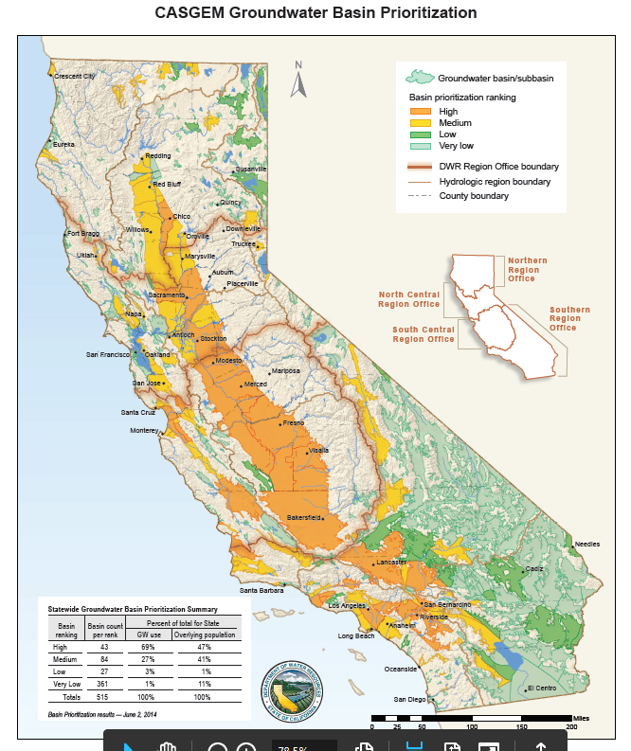

Slide 4
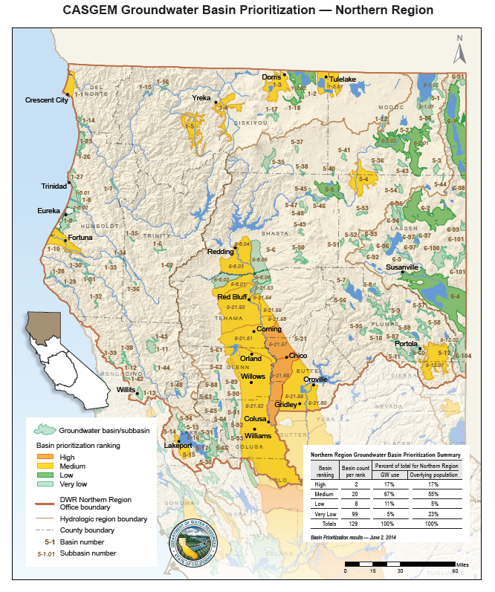

Slide 5
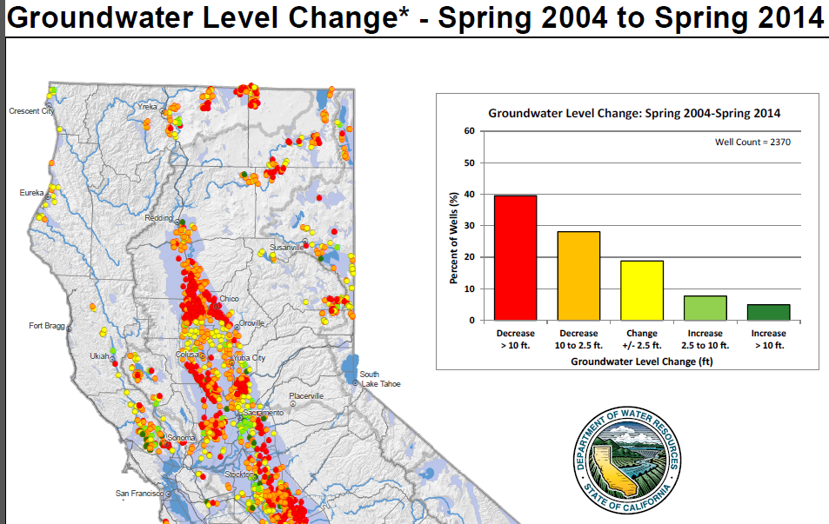

Slide 6
Formation of Groundwater Sustainability Agencies – Requirements:
Land use authority
  Counties
  Cities
Water management authority
  Water and Irrigation Districts
  Special Act Districts managing water

Slide 7
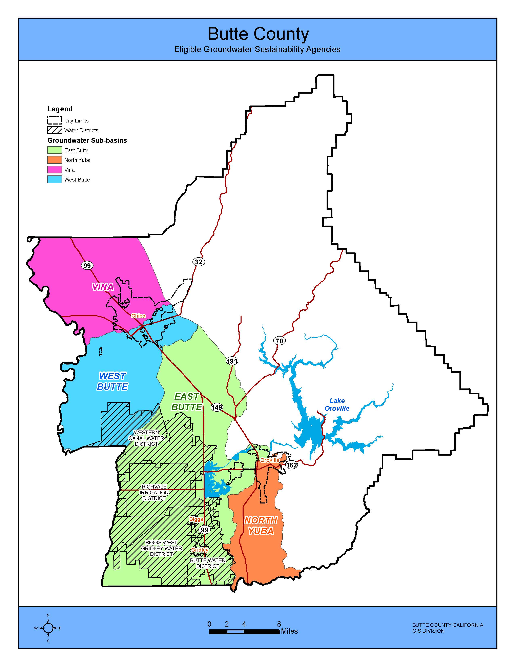
Entities Eligible to Become GSAs Within Butte County
Counties
Cities
Special Districts / Water or Irrigation Districts

Slide 8
Importance of the County and Cities
Involvement in this Process
Local land use authority is not diminished
Water availability and quality should be incorporated or considered in land use decisions

Slide 9
Importance of Other Local Agencies
Involvement in this Process
Benefits to groundwater basin through use of surface water supplies
  Applied water contributes to recharge of groundwater basin
  Less competition for groundwater
Surface water provides the ability to entertain groundwater recharge or conjunctive use projects increasing the sustainability of the groundwater basin
Projects that redistribute surface water supplies has the potential to increase overall water budget within the county

Slide 10
Collaboration is Essential Between Water Management and Land Use Entities to Reach
Sustainability of the Resource
  Land use agencies (local governments)
  Water and Irrigation Districts
  Neighboring counties
  Agricultural groundwater users
  Municipal water purveyors
  Environmental community
  General public

Slide 11
Status Within Butte County of Entities that have Filed to Become a GSA
Water and Irrigation Districts
Cities located within the Basin
County of Butte
  Working to eliminate overlap under SB 13

Slide 12
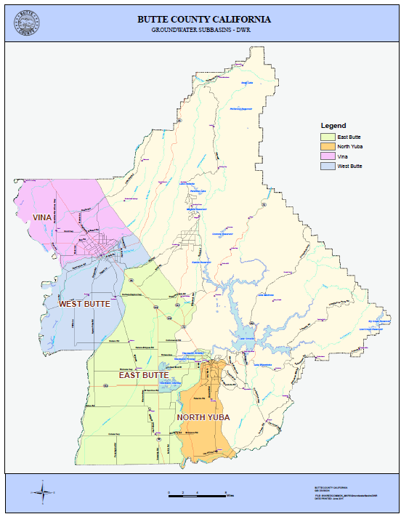
Butte County Groundwater
Basins
Vina
West Butte
East Butte
North Yuba

Slide 13
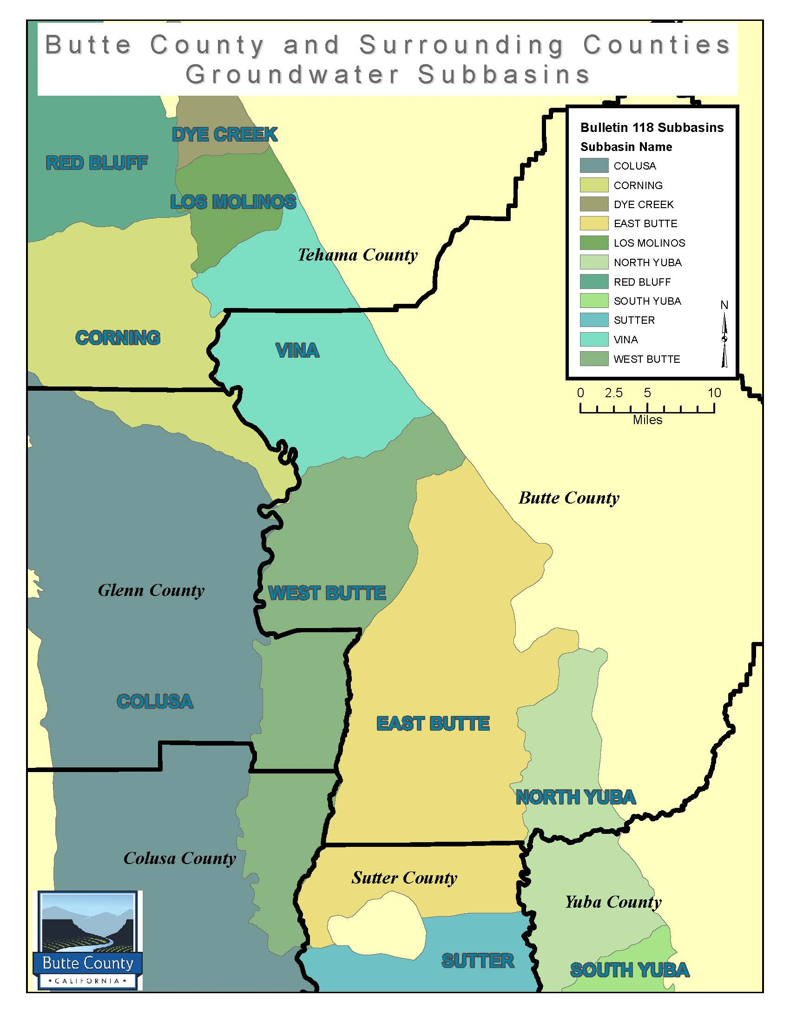
Groundwater Basins Within Butte County
Vina overlaps into Tehama County
West Butte overlaps into Glenn & Colusa
East Butte overlaps into Sutter County
North Yuba overlaps into Yuba County

Slide 14
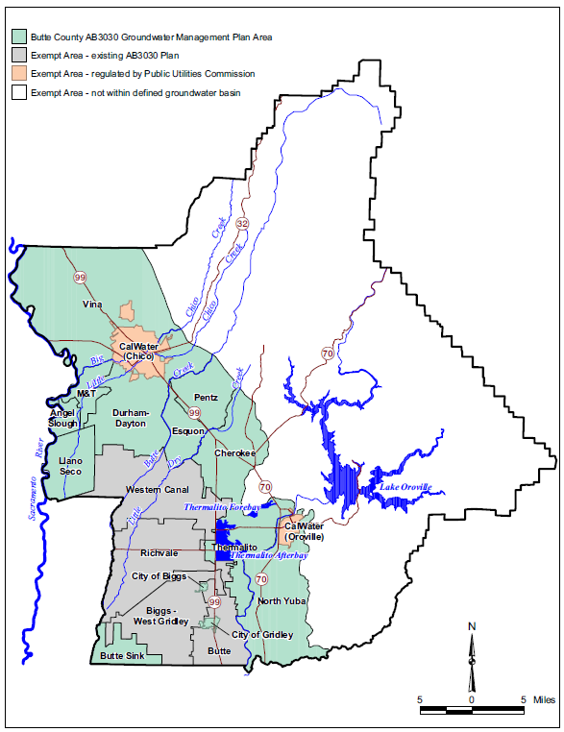
Butte County Groundwater Management Plans
Surface water districts
Butte County: non-district areas
Exempt area: PUC regulated
Exempt area: non basin areas

Slide 15
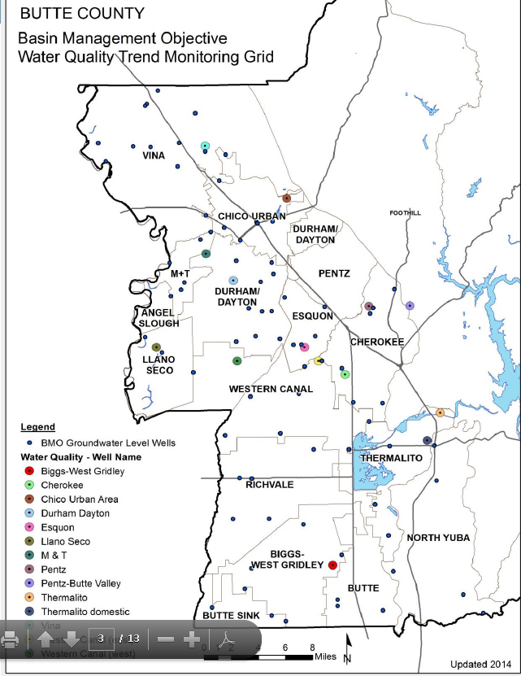
Butte County Groundwater
Monitoring Activities
Water Quality
Water Levels
Subsidence
Annual Report

Slide 16
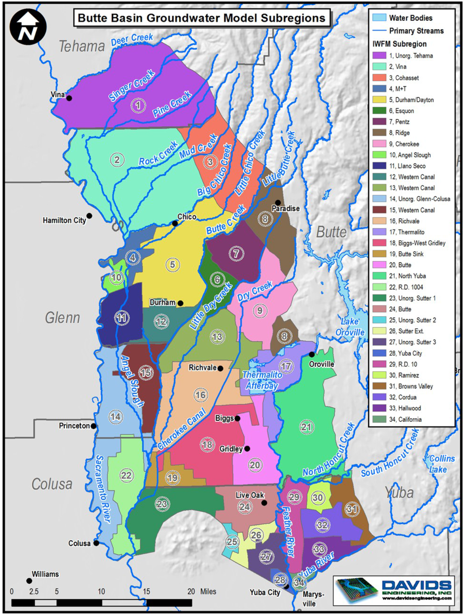
Extent of Groundwater Modeling Efforts
2016 Water Balance – inputs and outputs of groundwater usage
Setting of sustainable groundwater levels
Increased knowledge of resource to assist in management decision-making

Slide 17
Chapter 33 – Groundwater Conservation Ordinance
Permit for groundwater transfer outside of county or for transfer programs with a groundwater component
  Requires annual report
  Requires groundwater level monitoring in July and August (4 times a year)
  Requires subsidence monitoring
  Requires testing for saline intrusion
  Requires water balance

Slide 18
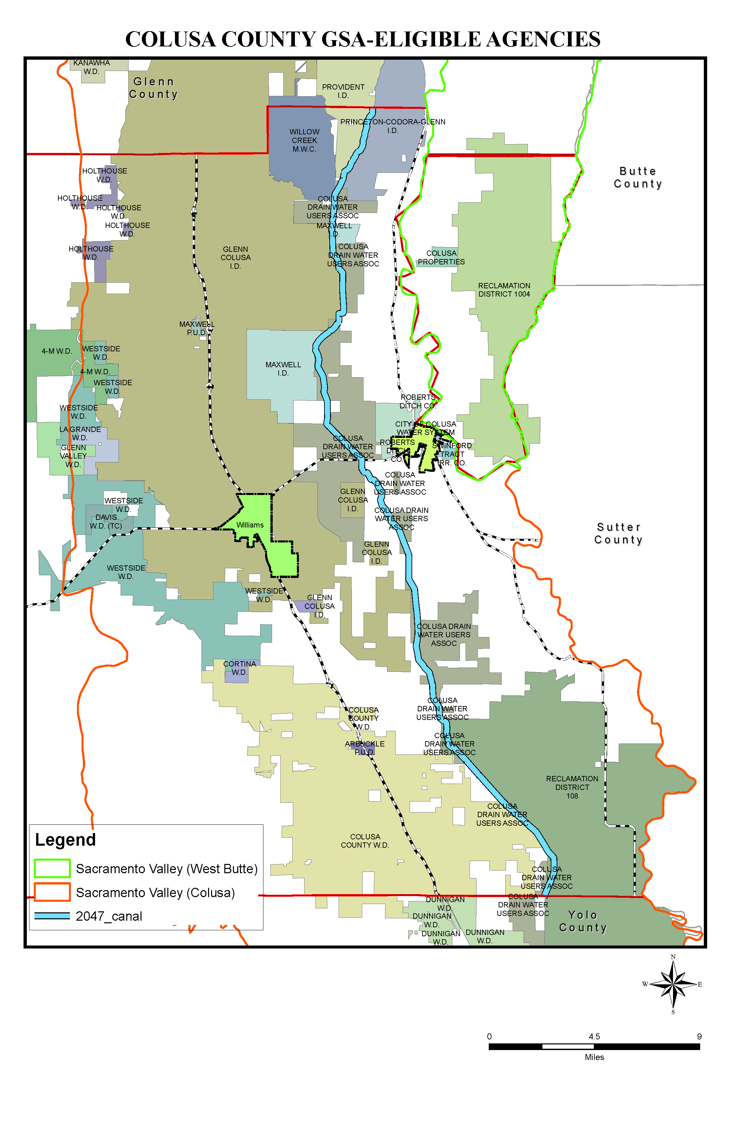
Colusa County Water Districts and Users Areas
GSA-eligible Agencies - 28
• 16 Water Districts
• 4 Reclamation Districts
• 4 Public Water Supply Districts
• 2 Cities
• County
• Resource Conservation District
Others
• 5 Mutual Water Companies
• 50,000+ Acres of “White Areas” (Private Pumpers)
• Potential new Water District formed by Private Pumpers
Tribes and Federal (exempt)
• 2 Tribes
• 3 Federal Wildlife Refuge Complexes
• US Forest Service
• California Fish and Wildlife Service

Slide 20
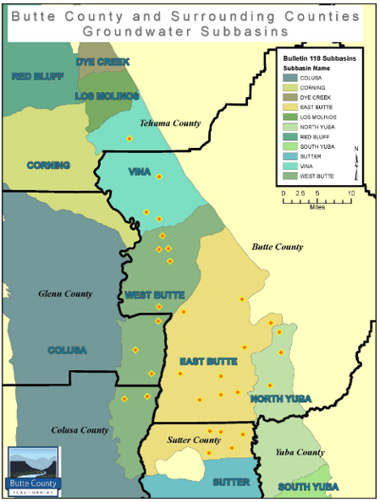

Slide 21
We’re not really better at this…we’ve just been fighting about it a lot longer…
Questions?
Vickie Newlin: (530) 538-2179 vnewlin@buttecounty.net

