Slide 1
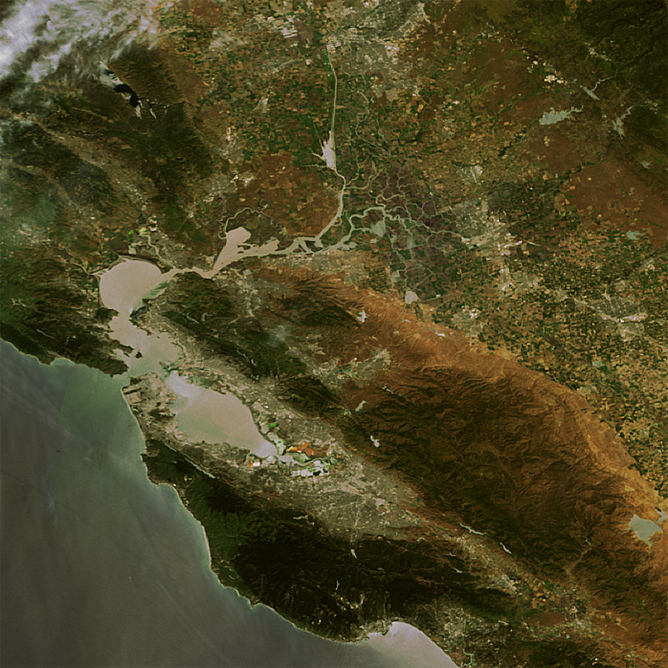
Notes:
Inverted river delta – one of only a few worldwide

Slide 2
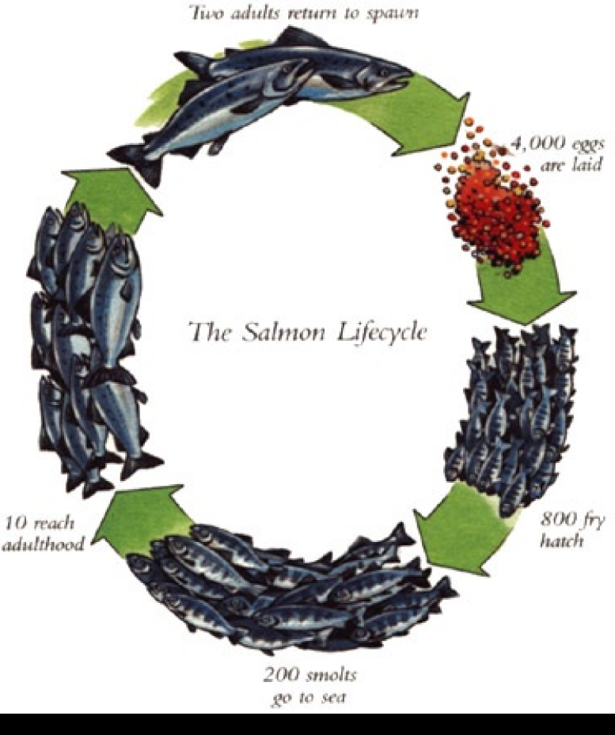
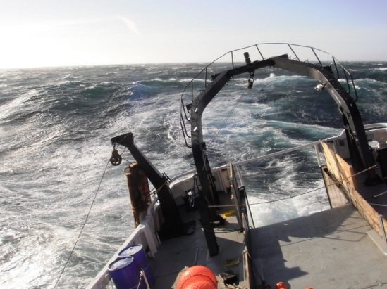
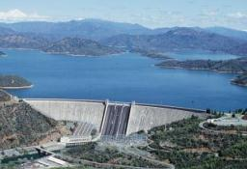
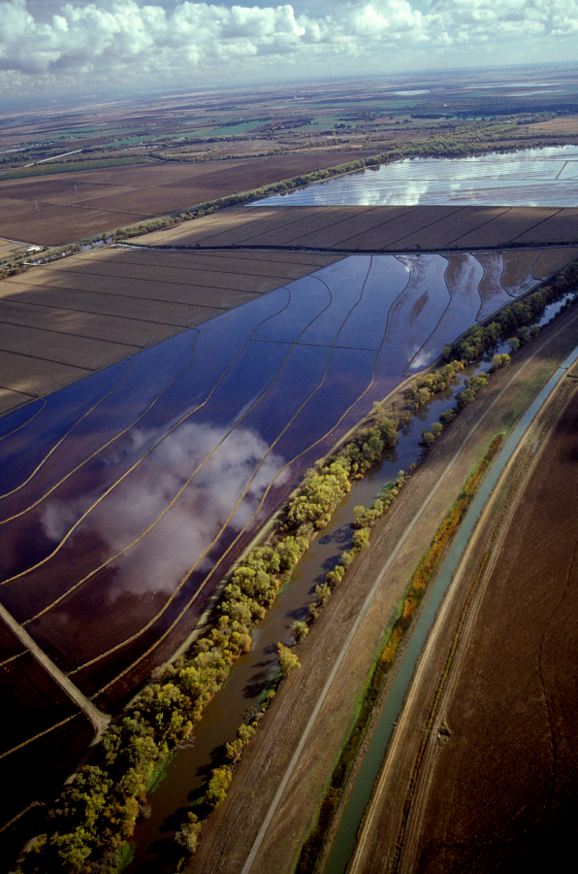
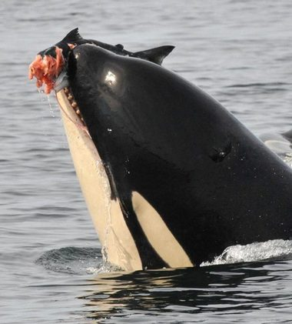

2 adults return to spawn
4,000 eggs laid
Salmon life cycle
Freshwater
Ocean
800 fry hatch
10 reach adulthood
200 smolts go to sea
Estuary

Slide 3
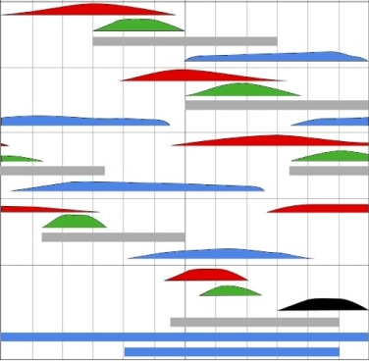
Salmon
Diversity spreads risk in space & time
Adult migration
Fall run
Spawning
Incubation
Rearing & migration
Late Fall run
Winter run
Spring run
Steelhead
J
A
S
O
N
D
J
F
M
A
M
J
Modified from California Rice Promotion Board by CH2MHill
Data sources: Vogel and Marine, 1991; Hallock, 1983; CDFG, 1993

Slide 4
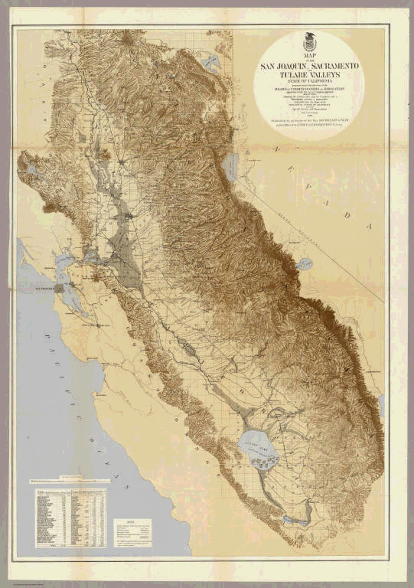

Slide 5
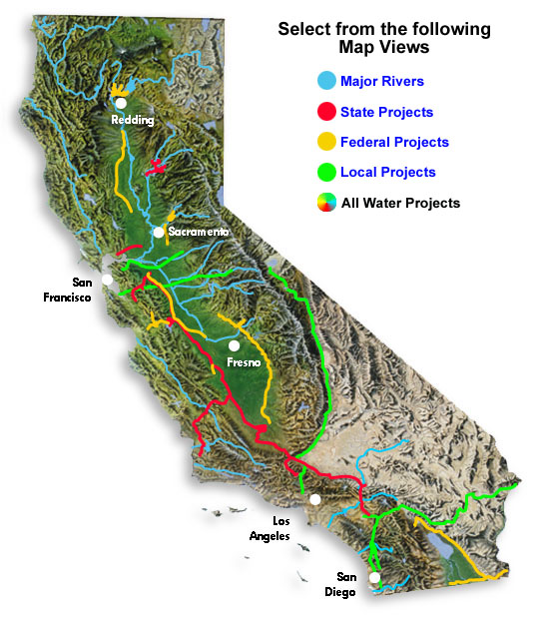

Slide 6
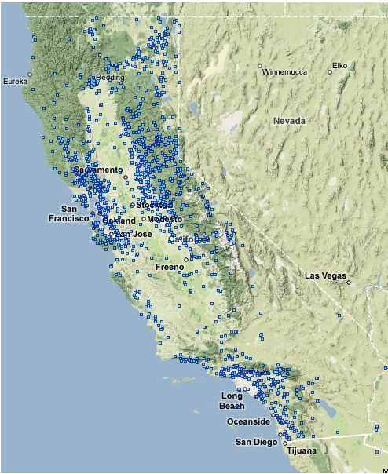
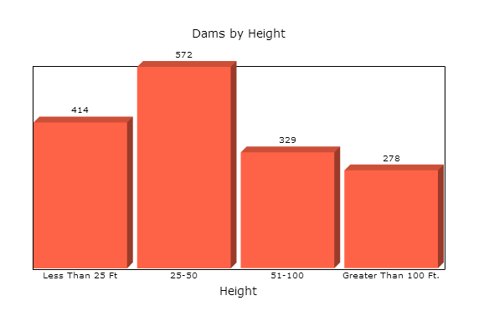
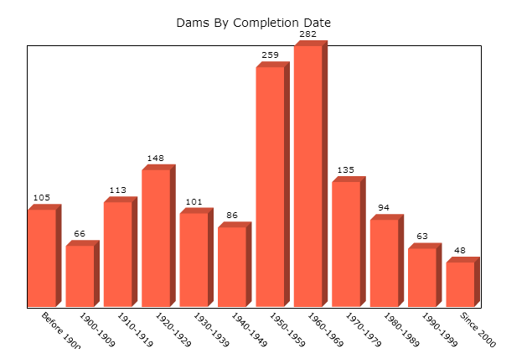
1594 Dams in California
National Inventory of Dams, Army Corps

Slide 7
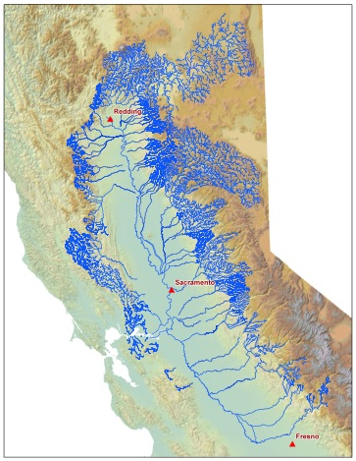
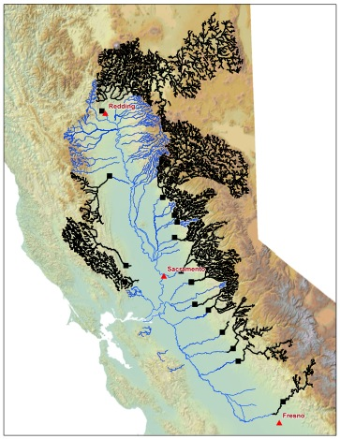
Then
Now
Modified from Lindley et al. 2006
Notes:
Consider the fade to black scene

Slide 8
Central Valley Runoff (MAF)

Slide 9
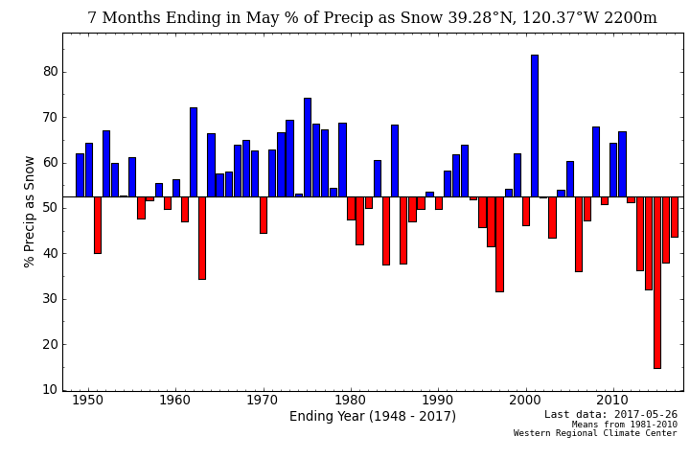

Slide 10
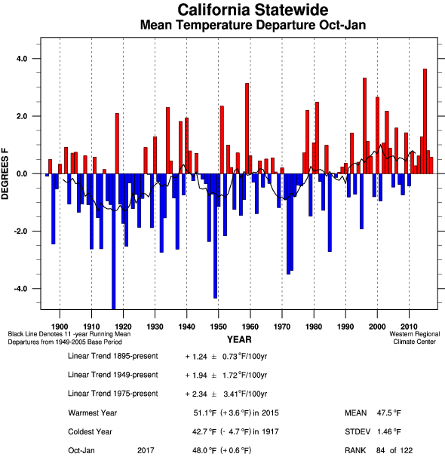

Slide 11
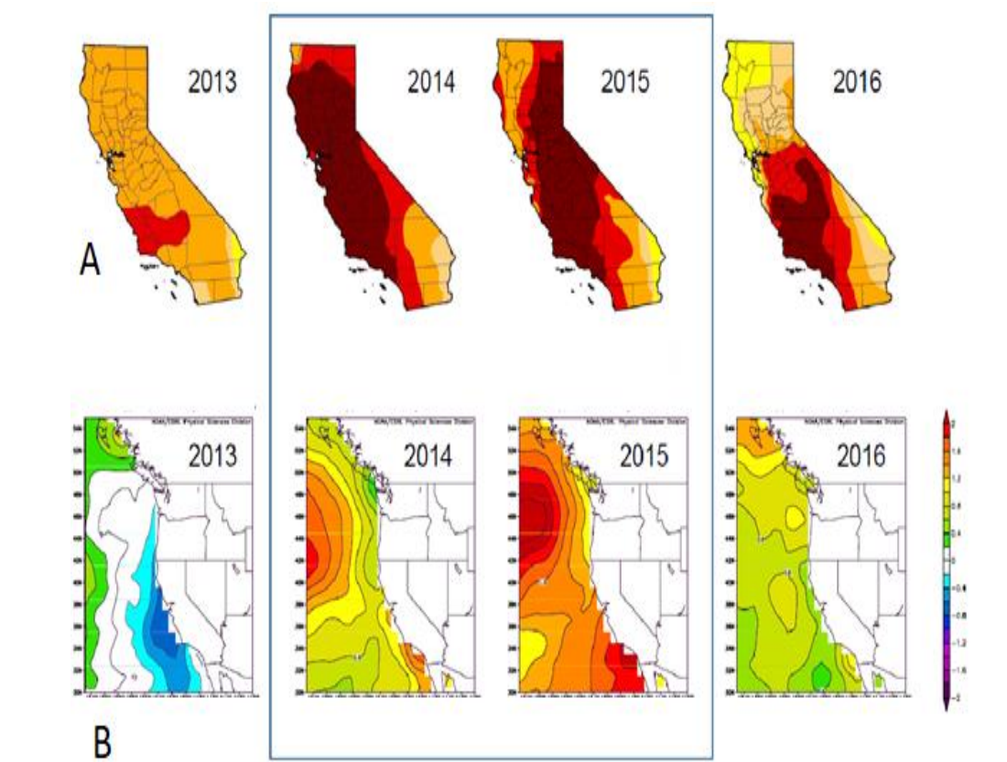

Slide 12
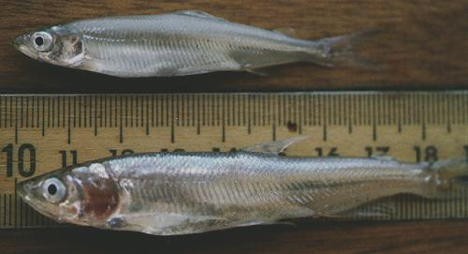
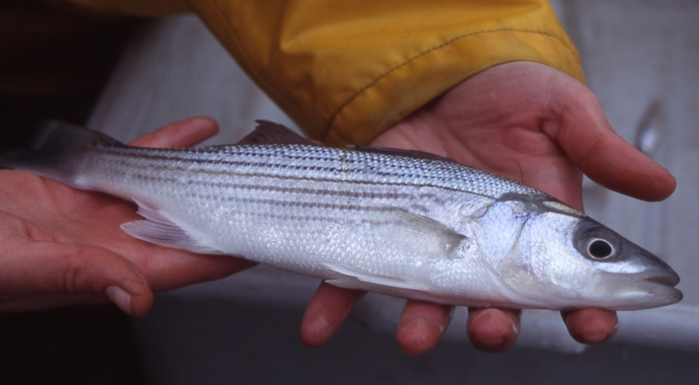
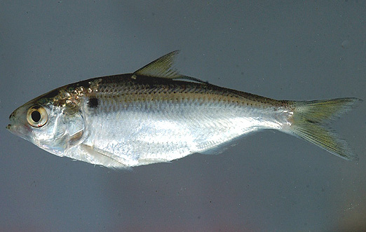
Delta Smelt
Longfin Smelt
Striped Bass
Threadfin Shad

Slide 13
Fall Abundance Indices 1967-2015
Delta Smelt
Longfin Smelt
Striped Bass
Threadfin Shad

Slide 14
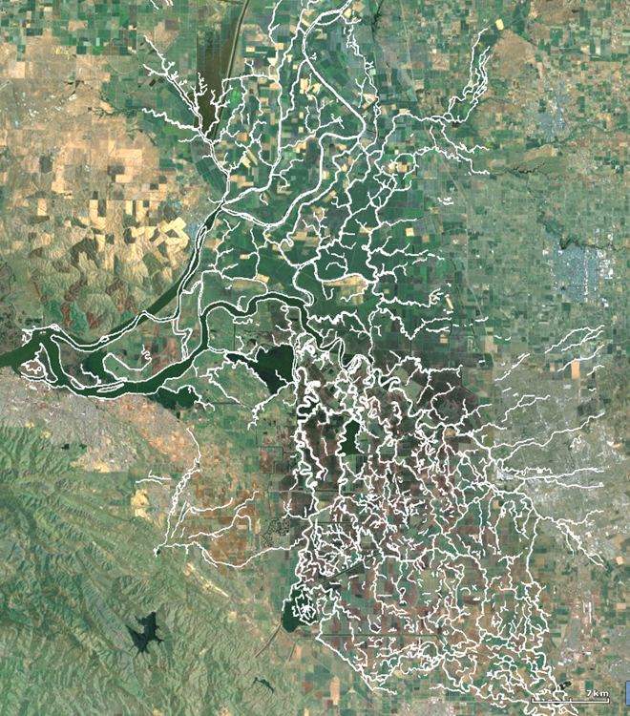
1873 Delta:
Long residence time
Marsh connections
Two rivers connect
to bay
Waterways dendritic

Slide 15
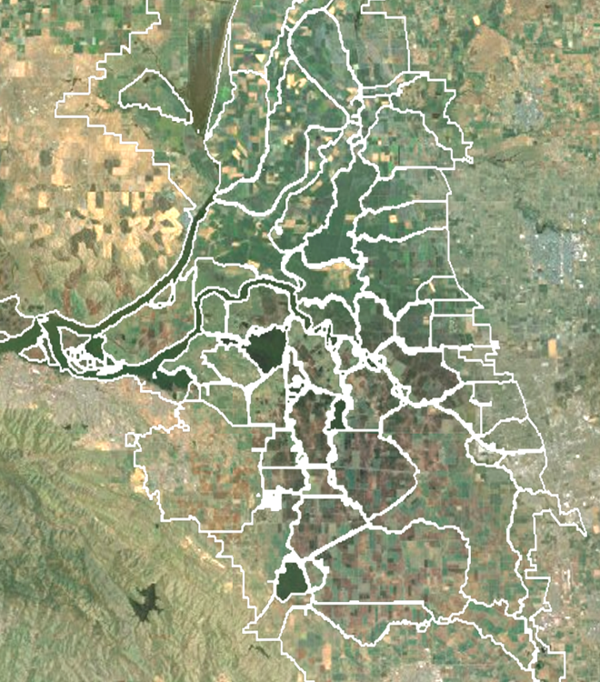
Modern delta
Short residence times
Rip-rapped
Cross Delta flows
Rare San Joaquin
connection to bay
Waterways web-like

Slide 16
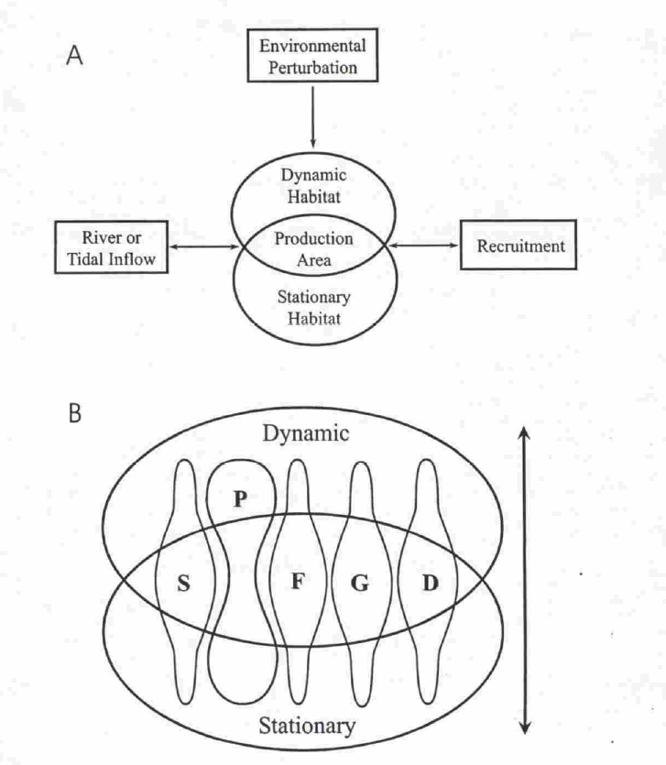
Estuarine habitat conceptual model
(Peterson 2003)
Stationary Habitat
Production Area
Tidal and River Flow
Fish
Recruitment
Dynamic Habitat

Slide 17
Notes:
QoutWet and Dry.OPJ

Slide 18
Most fishes follow salinities
Marine species
Kimmerer 2004

Slide 19
What Changes As Flow Increases?
Salinity and X2
FLOW
Location of
Any Salinity
Range
L
S
Z
stratification
Notes:
1

Slide 20
What Physically Changes As Flow Increases?
Floodplain
inundation
Floodplains
Turbidity
FLOW
River stage and velocity
Upstream bottom current
Delta
Residence Time
Proportion
Diverted
FLOW
Notes:
1

Slide 21
What chemically changes?
Loadings
FLOW
Nutrients
Contaminants
Organic matter
Sediment
Concentrations
FLOW
Notes:
1

Slide 22
What Biologically Changes As Flow Increases?
Adult spawners move up:
Salmon
Green and White Sturgeon
Longfin smelt
Delta smelt
Splittail
American shad
Pacific herring
Young fish move down:
Salmon
Longfin smelt
Delta smelt
Splittail
American shad
Striped bass
Young Marine fish move up:
Starry flounder
White croaker
Pacific halibut
Notes:
1

Slide 23
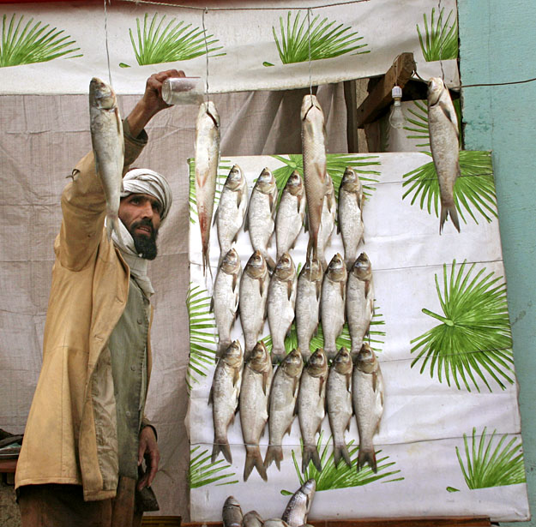
How much water do fish need?

Slide 24
X2

Slide 25
Exports in acre-feet
1 acre-foot =325,851gallons OR 1233 kiloliters OR 1 cfs for 12 hours
SWP
CVP

Slide 26
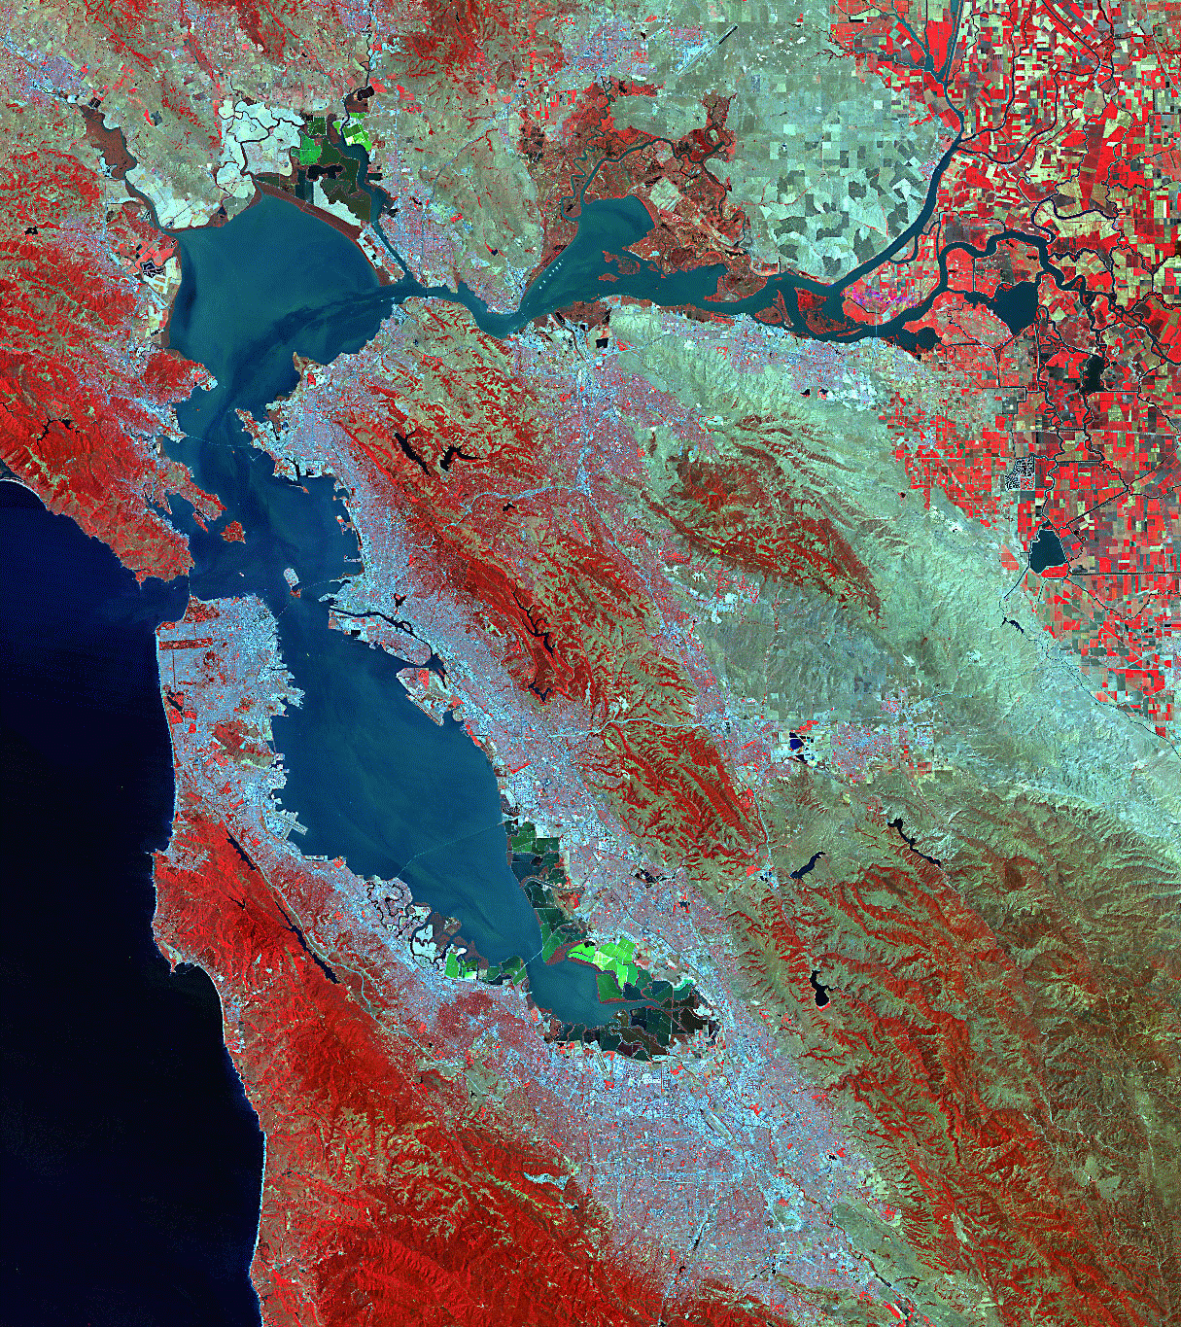
X2
X22
X12
X32

Slide 27
X2
X12
X22
X32

Slide 28
X2=75
X2=45
X2=65
X2=0

Slide 29
Higher trophic levels show many relationships of abundance to X2
1967-87
1988-2000
1982-2000 (DS)
All Years
Source:
Kimmerer 2002MEPS
High Flow
X2 (km)
Low Flow
Notes:
Give brief explanation of the results presented here.

Slide 30
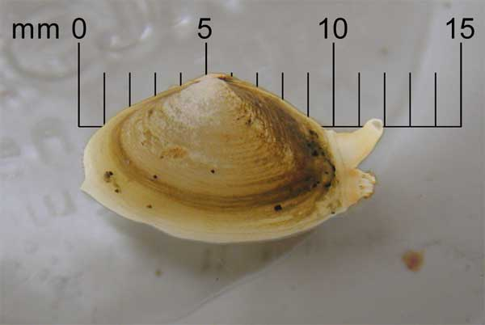

Slide 31
Lower trophic levels show few relationships of abundance to X2
1972-1987
1988-2000
X2 (km)
Source:
Kimmerer 2002 MEPS
High Flow
Low Flow

Slide 32
Fish- X₂
Relationships
From Kimmerer 2002
1967-87
1988-2000
1982-2000 (DS)
All Years

Slide 33
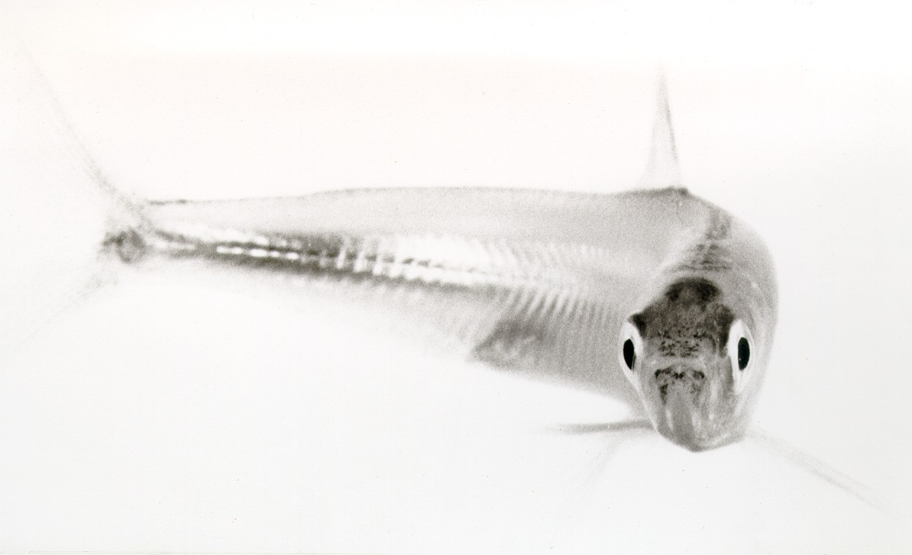
What Next?

Slide 34
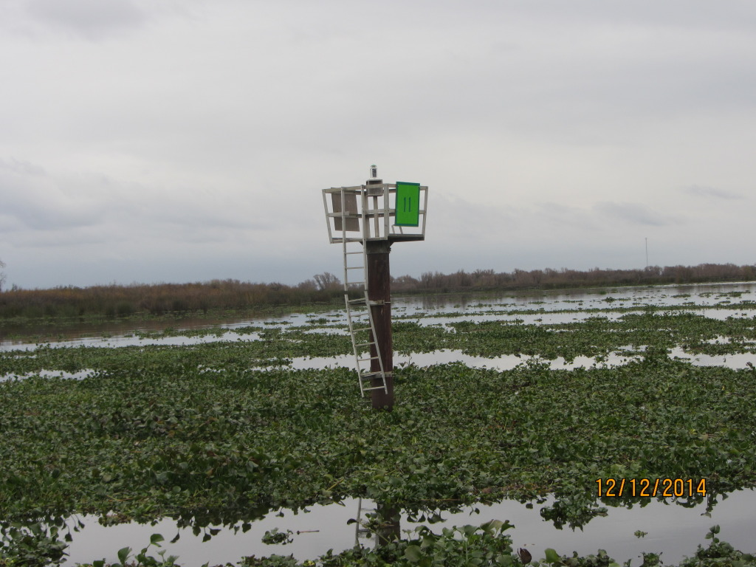
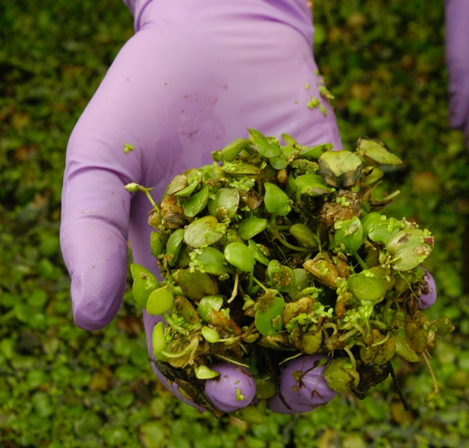
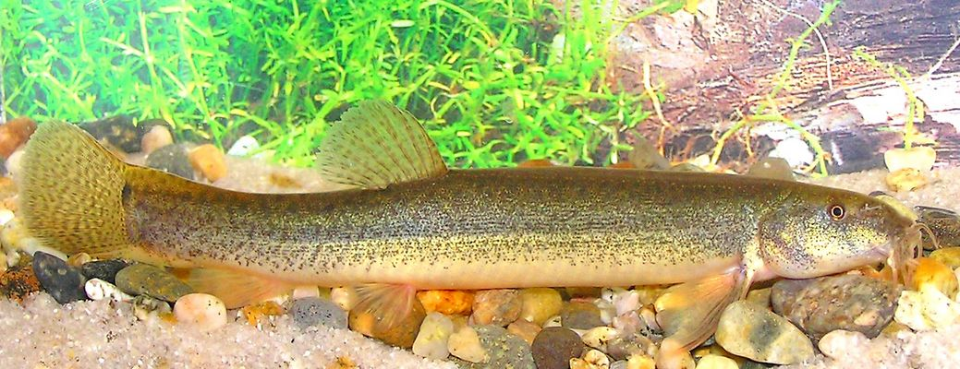
Water Hyacinth, San Joaquin River @ Connection Slough; December 2014.
Photo: Roger Kelly for Bay Nature Magazine
South American Sponge Plant@ Brannon Island
2011 Lars Anderson
Loach: San Joaquin River near Fresno, Fall 2014.
Notes:
We also know that there are aspects not included in the Delta Smelt CM that we should be paying attention to, such as the response of Aquatic Weeds: we know that 2014 was a banner year for water hyacinth. CDFW is contracting with UCDavis to collect aerial imagery of the aquatic weed coverage. This alone is likely have far-reaching impacts on the ecosystem.
As the ecosystem experiences these multiple stresses from drought, it may also become more vulnerable to invasive species. We may already be seeing signs of this, as a species of loach was observed for the first time in the San Joaquin River near Fresno in fall of last year.
As part of the drought synthesis effort, we are also looking to examine these major changes that could have important management applications.

Slide 35
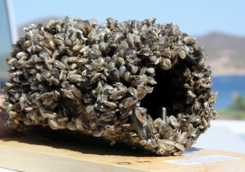
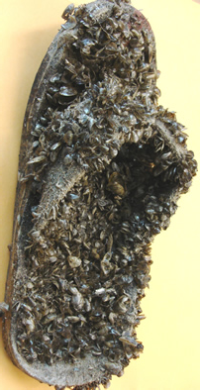
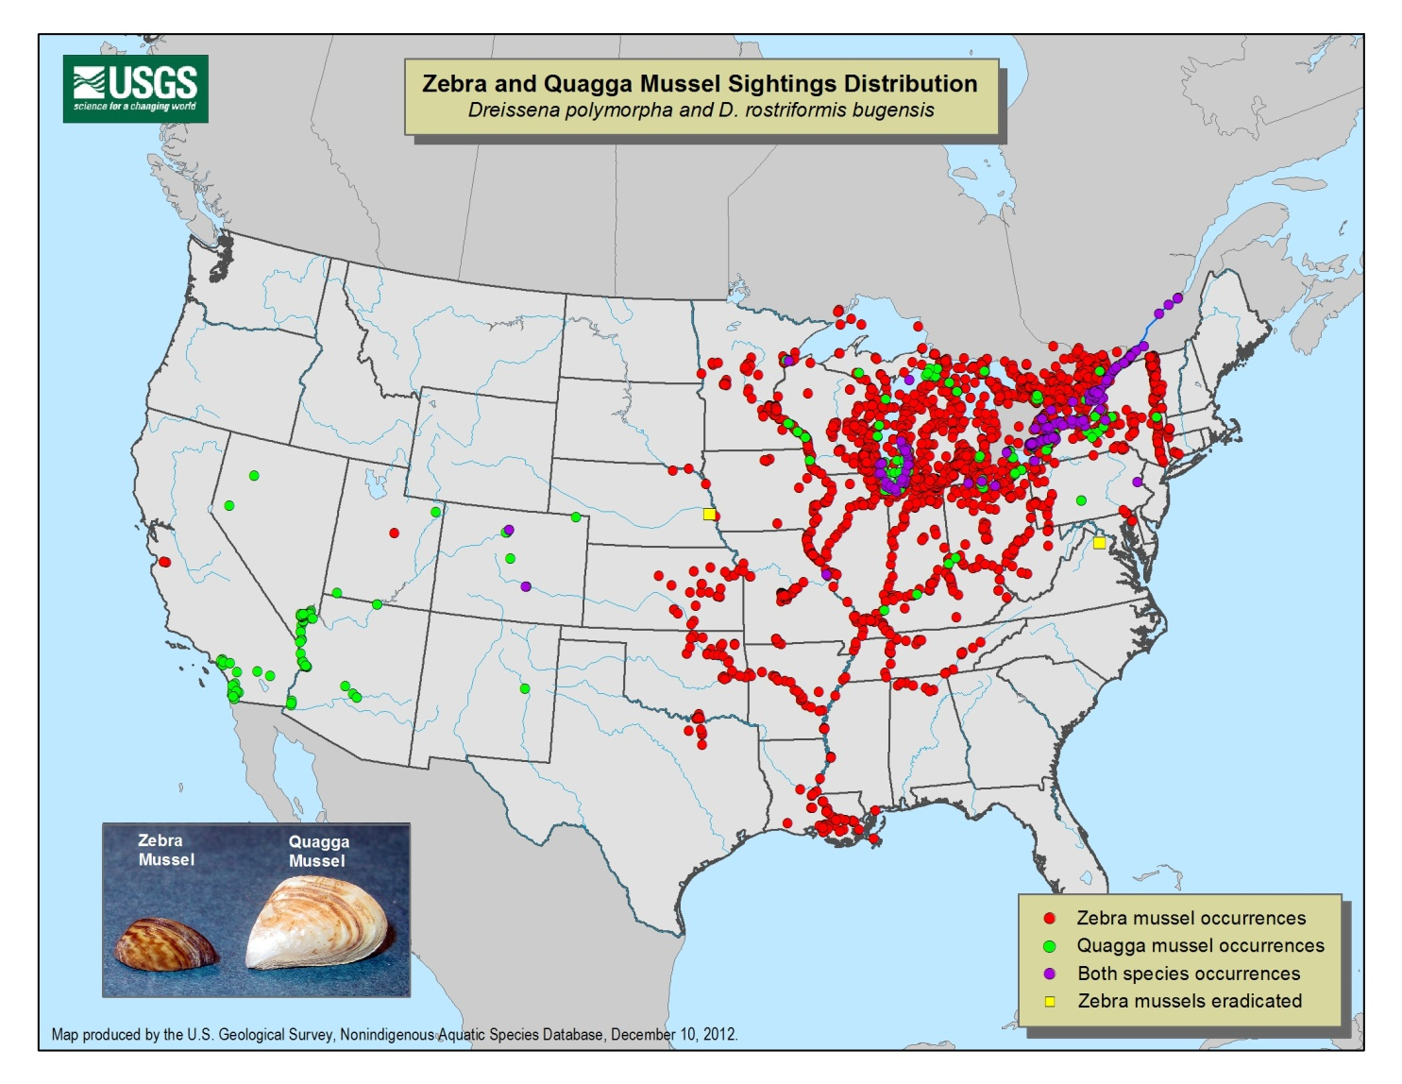
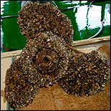
Today?

Slide 36
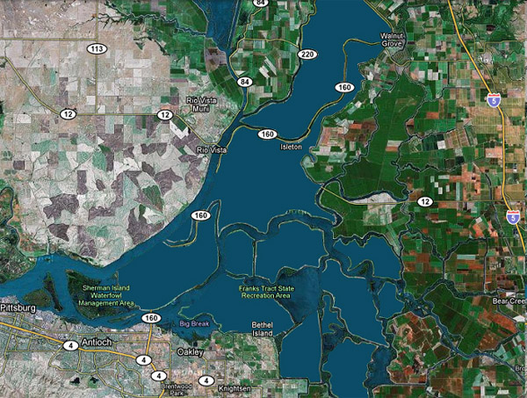
Earthquake or flood

Slide 37
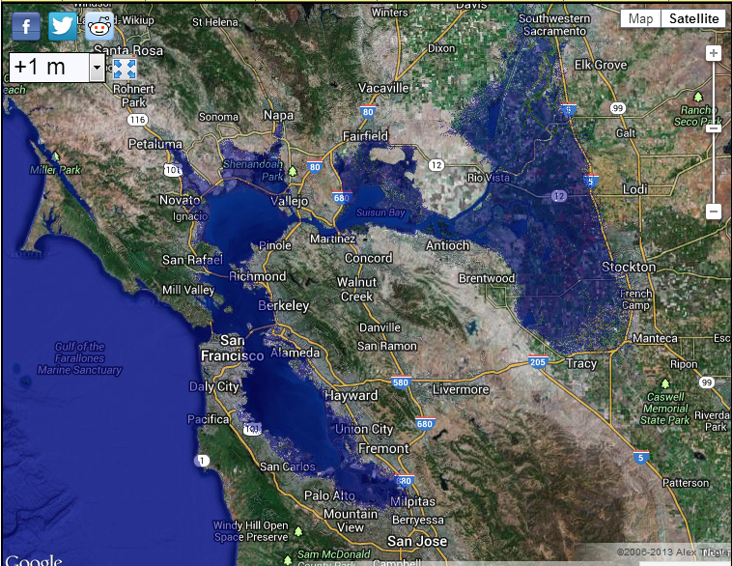
1 M sea level rise (2100?)

Slide 38
Little
Low
Highly variable
Low
Lots
Cool
High
Ammonia
Contaminants
Flow
“Harvest”
Phosphorus
Temperature
Turbidity
Lots
High
Low and Constant
High
Limited
Warm
Low
Diatoms
Pelagic fish
Natives thrive
Resists invasions
Clams
Jellyfish
Edge & benthic fish
Microcystis
Aquatic Weeds
Alternative Stable States

Slide 39
POD---
Pelagic
Organism Decline

Slide 40
Little
Low
Highly variable
Low
Lots
Cool
High
Ammonia
Contaminants
Flow
“Harvest”
Phosphorus
Temperature
Turbidity
Lots
High
Low and Constant
High
Limited
Warm
Low
Diatoms
Pelagic fish
Natives thrive
Resists invasions
Clams
Jellyfish
Edge & benthic fish
Microcystis
Aquatic Weeds
Alternative Stable States

Slide 41
Wha’ Happened?

Slide 42
TOP-DOWN
PHYSICAL & CHEMICAL FISH HABITAT
LOSS
PARENTS
Prior Fish Abundance
FISH ABUNDANCE
HOME
FOOD
BOTTOM-UP

Slide 43
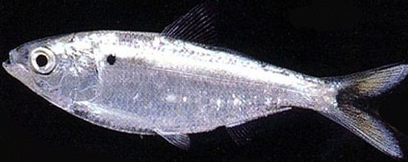
Stock - Recruitment Effects
Threadfin shad
POD Years
Juvenile Production
Delta smelt
Notes:
Low stocks compared to historical values – how about other estuaries?

Slide 44
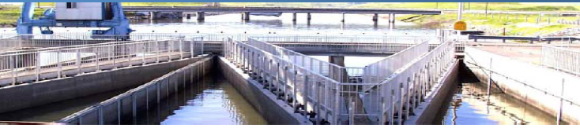
Water Project Losses
Fish Facilities Provide Data on Numbers “Salvaged”

Slide 45
Winter Salvage (Nov-Mar)
Longfin smelt
Delta smelt
Striped Bass
250,000
Threadfin Shad
2,500,000
94
96
98
00
02
04

Slide 46
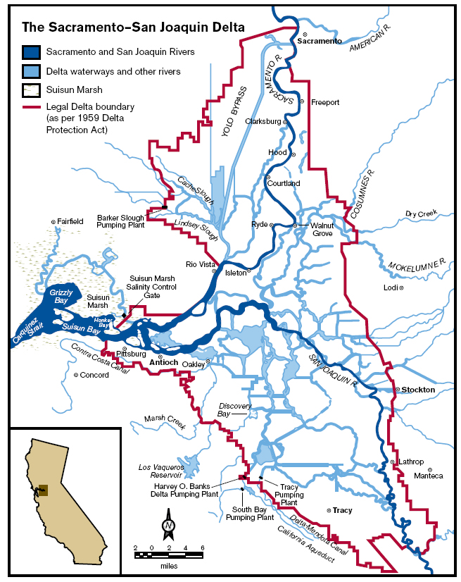
Old and Middle Rivers as an Integrator of Hydrodynamic Effects
OMR = Old and Middle River flows
Old River
Middle River

Slide 47
What Now?

Slide 48

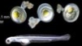

Delta Smelt MAST Report:
Completed January 2015
1 - Landscape
2 – Environmental Drivers
3 – Habitat Attributes
4 - Responses
5 - Seasons
www.water.ca.gov/iep
Notes:
Luckily, we have a tool at our fingertips to help organize our thinking and come up with appropriate variables to consider for our comparison.
The recent Delta Smelt Report published as an IEP Technical Report by the Management, Analysis, and Synthesis Team of IEP presents an updated conceptual model for Delta Smelt biology and the environmental factors influencing its population.
We used the conceptual model from the MAST report to organize our predictions for drought effects. We chose this model not only because it provided a framework to organize our thinking, but also because it provides a series of metrics that are relevant from an ecological and management standpoint. Also, we think it’s not a stretch to assume that many of the factors included in the Delta Smelt CM might also apply to other species of interest, like Longfin Smelt.
This here is just a cartoon of the conceptual model. At first glance, it looks complicated, but it’s actually fairly intuitive when you unpack it.

Slide 49
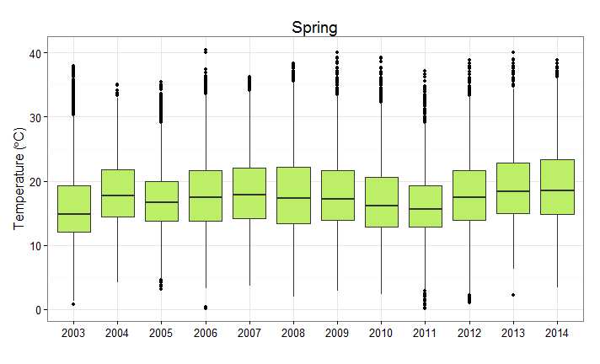
Warmer Air Temperatures During Drought
 | Jan - Mar | Apr - Jun | July - Aug | Sept - Dec
Results
Air Temperature
April –June
18.3 ˚C
16.7 ˚C
Air temperature station data pooled from: Lodi, Mossdale Bridge, Mallard , Rio Vista
Notes:
Starting with Air temperature, here is an example of the type of boxplots we looked at to compare current drought conditions to the last decade. Several people on the team created large numbers of these plots, to look at different variables through all 4 seasons.
This is the April – June air temperature plot, with pooled data from Lodi, Mossdale Bridge, Mallard Island, and RioVista. Dark horizontal lines present the median values for each year. In fact these median values for 2013-14 are warmer at 18.3 deg C, compared to an overall median of 16.7 deg C for 2003 – 2012.
Warmer air temperatures were also the case in winter and fall months, but interestingly, there was no major uptick in temperature during the summer compared to previous years.

Slide 50
Microcystis More Prevalent
 | Jan - Mar | Apr - Jun | Jul - Aug | Sept - Dec
Results
Harmful Algae Bloom
% Stations Microcystis Present
Notes:
We simply looked at the visual scores for Microcystis recorded during the Summer Townet and FMWT and compared the % of stations in the low salinity zone with Microcystis present since the observations started in 2008.
In the summer, the LSZ stations have had increased Microcystis presence since 2012, with over 60% of stations with presence in 2012 and 2014.
In the fall, 2014 stands out with over 80% of stations with Microcystis presence. In the fall, it’s possible that conditions during the drought might allow Microcystis to persist later year, with similar results between 2014 and 2008, also a critically dry year. But not always (note 2013). We have more to learn about the conditions that produce strong Microcystis blooms. Peggy will give us more details next about Microcystis in drought.
Overall, we look at this and conclude that in general, Microcystis is more prevalent during drought- particularly in 2014.

Slide 51
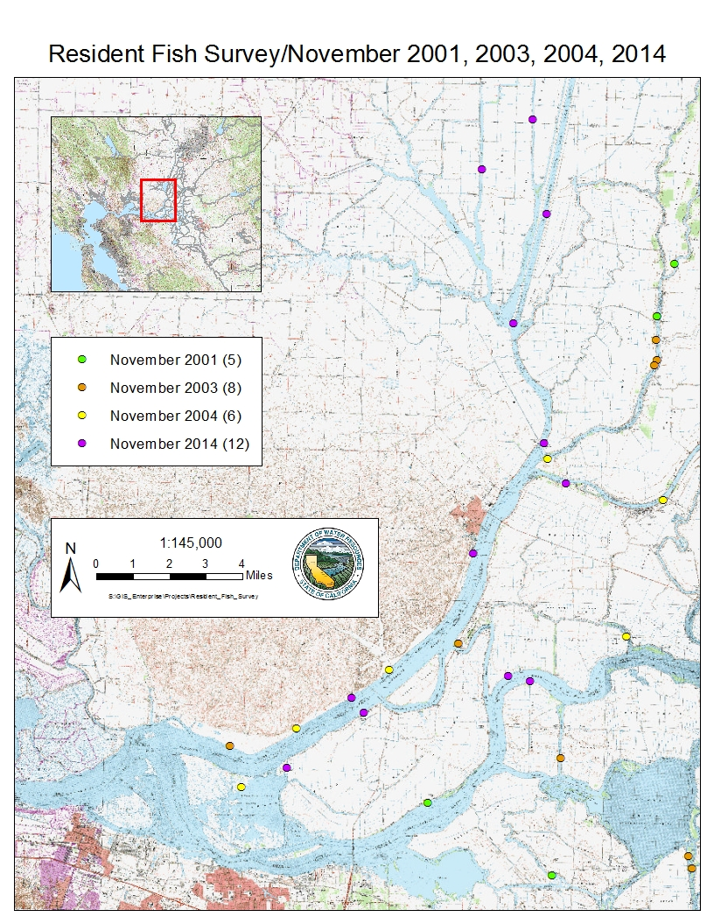
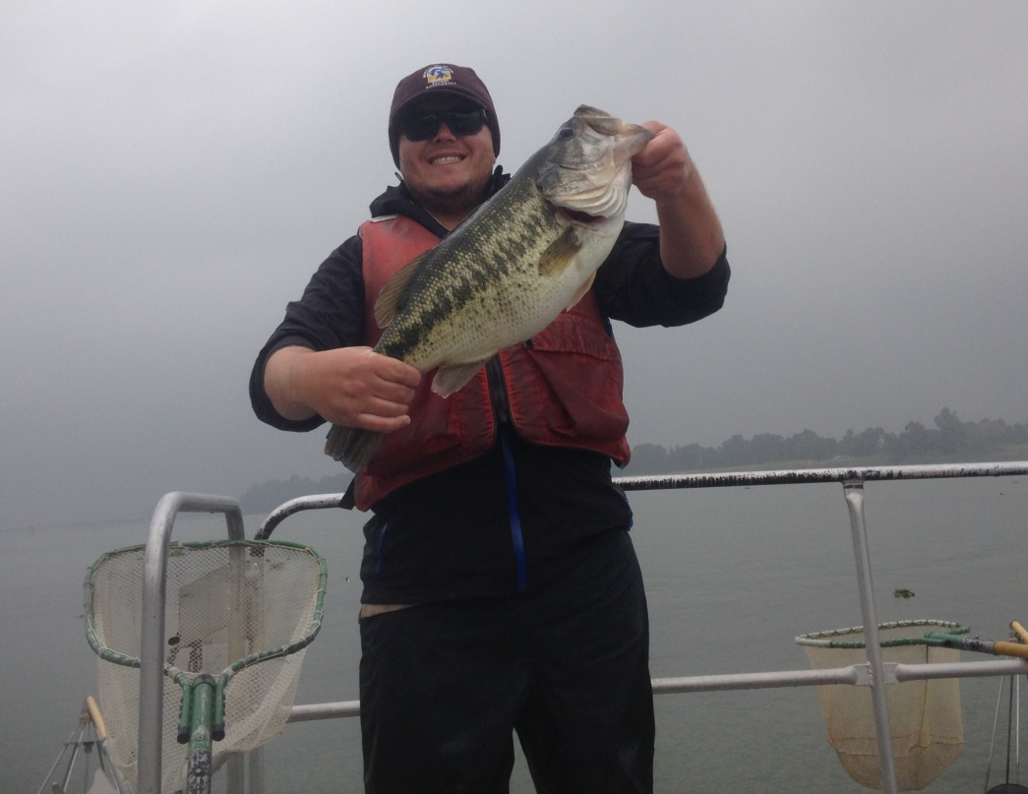
November 2014: Boat Electrofishing Drought Survey
Western and northern Delta
November 2001 (5)
November 2003 (8)
November 2004 (6)
November 2014 (12)
1:145,000
0 1 2 3 4
Miles
Slide courtesy of Denise Barnard, FWS
Notes:
The CDFW Resident Fish Survey was sporoadic (few data points), and did not occur during drought conditions. To complement this work we did a short supplemental pilot project last November
Outline scale: extent and resolution
Limited time and resources meant that we had to focus our efforts
The concentrated on the western and northern regions of the Delta because these are the areas with the most substantial variation in salinity between the current drought and previous Resident Fish sampling years.
In addition, these regions encompass the area of the interior Delta where Delta Smelt are most likely to be present during upstream migration – we’re only talking about this life stage of DSM, also why we looked at fall/ winter period, when adults are migrating (question: it appears that they are in the LSZ during fall, and migrate upstream in the winter [Bennett 2005]. Think about how to say this a little more)
The last two weeks of November 2014
Figure 11. Resident Fish Survey sampling locations in north and western Delta regions in November of 2001, 2003, 2004, and 2014.
While the historical Resident Fish Survey sampled throughout the Delta, the 2-14 effort was limited to northern and western regions of the Delta because this was the main area with evident salinity intrusion
This only includes the north and west sampling locations of the historical resident fish survey
I only see 4 green circles, when there should be 5?

Slide 52
Summer Growth Reduced
Slide courtesy of Jim Hobbs, UC Davis
Notes:
Growth rate in the green box plots. These data come from otolith analysis done by Jim Hobbs at UC Davis.
In 2014, we start to see what looks like a decline in growth rate. These values of growth rate are not unprecedented in the time series Jim is showing here, but they fit in with a general trend of slower growth when water temperatures are elevated. For example, we saw much higher growth rates in 2011 when water temperatures were much cooler. 2014 had the highest June water temperatures in this time series, and saw some of the lowest growth as well.
So, at least for these summer months, drought is not favorable for summer growth rates, which may have impacts later to fecundity.

Slide 53
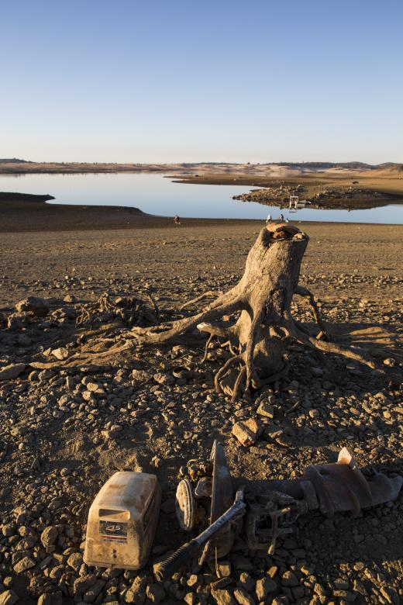
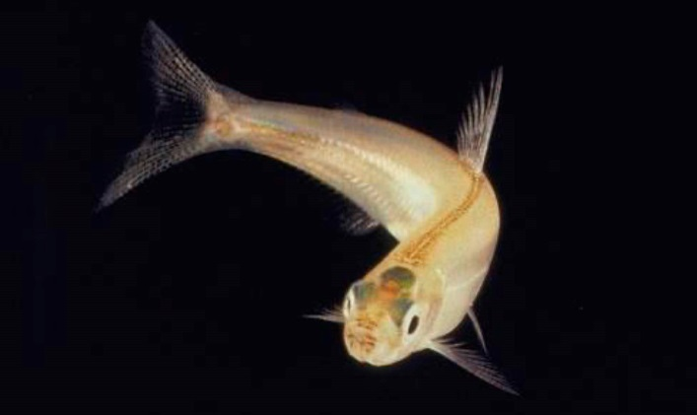
Drought Effects on Fish
Time Series: 1993 - 2014
Palmer Drought Severity Index
Griffin & Anchukaitis, 2014
Geophysical Research Letters , 41: 1-7.
Thanks to Louise Conrad, DWR
Notes:
I am going to “set the stage” for how we are approaching our assessment of drought effects with a general overview and some early results of what we have learned so far- and in the rest of this session, you’ll hear from Peggy and Denise and Jim more in detail about specific drought stories.

Slide 54
Tier 1 - Landscape Attributes
Erodible Sediment Supply, Proximity to Ocean, Proximity to Discharges,
Proximity to Diversions, Bathymetry (Proximity to and Extent of Shallow Areas)
Tier 2 - Environmental Drivers
Air Temperature, Flows, Turbidity, Contaminant Loading, Water Diversions
Weather, Exports, Hydrology,
Turbidity, Contaminants
Tier 3 - Habitat Attributes
Food, Predation, Temperature, Entrainment, Toxicity
Food, Predation, Temperature, Transport, Entrainment, Toxicity
Tier 4 - Delta Smelt Responses
Spawning
Eggs & Larvae
Adults
Tier 5 - Life Stage Seasons
Survival
December-May (Winter)
March-June (Spring)
Growth
September-December (Fall)
June-September (Summer)
Survival
Subadults
Juveniles
Survival
Growth
Food, Predation, Size and Location of LSZ, Toxicity
Food, Predation, Temperature
Harmful Algal Blooms, Toxicity
Weather, Outflow, Turbidity, Clam Grazing, Nutrients, Contaminants
Weather, Hydrology, Turbidity, Clam Grazing, Nutrients, Contaminants
Notes:
We start at the center of model, where we simply divided the generally annual life cycle of the Delta Smelt into 4 non-discrete seasons,
which correspond to four different life stages of the Delta Smelt:
eggs & larvae in the spring, which must survive to become
Juveniles, that become
Subadults in the Fall,
Which finally become adults in the winter months.
We used this seasonal breakdown to think about what specific aspects of habitat affect the Delta Smelt responses throughout the year. These factors are given in the light blue area, and are aspects of the environment that are immediately and directly relevant to Delta Smelt- like water temperature and food availability.
Behind the Habitat Attributes, are the Environmental Drivers, which are the factors that influence and drive what the habitat attributes. For example, clam grazing in the fall does not directly affect Delta Smelt, but it does affect their food supply.
The final tier is the Landscape attribute, to describe how the geographic placement of Delta Smelt habitat at any given time of the year (say the low salinity zone) affects environmental drivers and habitat. For example, the proximity of habitat to the ocean could affect the extent of tidal influence on habitat and other factors like air temperature.
This conceptual model provided a tiered list of factors that are important to look at when considering drought effects. We used this list to make predictions about each factor.

Slide 55
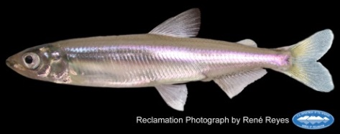



Abundance Indices at Historic Lows
Winter
Spring
Summer
Fall
2015 Index = 7
Lowest on Record
Notes:
Abundance estimated from indices from IEP surveys throughout the year have been fairly abysmal. This is the full record of Delta Smelt indices for the FMWT. 2014 produced the lowest index on record. The story of very low abundance was fairly consistent throughout the year. The news we have so far on the 2015 adult abundance is also very poor, to the point that the “e-word” is now being mentioned as an imminent possibility. Time will tell.

Slide 56
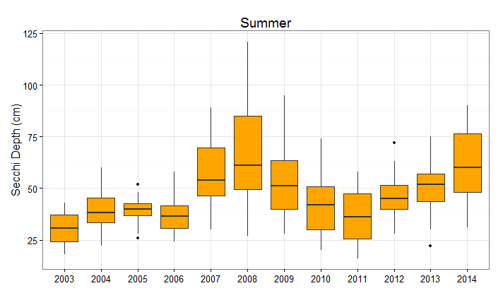
Seasonally Clearer Water…
 | Jan - Mar | Apr - Jun | July - Aug | Sept - Dec
Results
Water Clarity
July – August, Summer Townet Survey, 1-6ppt
53 cm
42 cm
CDFW Summer Townet Survey
Notes:
Seasonally, the current drought shows evidence of clearer water compared to the last decade overall. This is the box plot for Secchi depth data taken from the LSZ stations during the Summer Townet survey since 2003. There is a marked rise in the median Secchi Depth during 2013 and 2014, but it isn’t unprecedented: note the previous spike water clarity during the 2007-2009 period, which was also a drought period.
This difference increase in water clarity was not evident for all the seasons- for spring and fall months, there was no clear signal of change. This might be because of wind-driven turbidity, which may not be as affected by the drought.

Slide 57
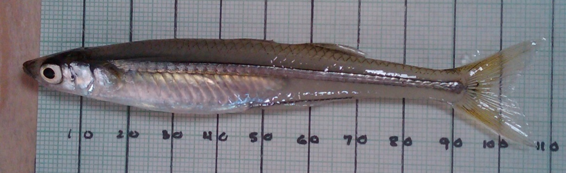
Sharp Increase in Mississippi Silverside Abundance
 | Jan - Mar | Apr - Jun | July - Aug | Sept - Dec
Results
Mississippi Silverside
Data Source: USFWS Beach Seine
Notes:
We looked at Mississippi Silverside abundance only for Spring months when they are likely to be predators of Delta Smelt eggs and larvae. Abundance in the USFWS beach seine survey not very different from previous years in 2013, but was notably higher in 2014.

Slide 58
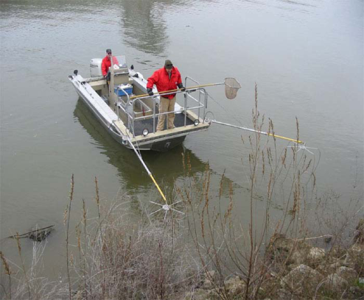
Black bass densities increased in 2014
 | Jan - Mar | Apr - Jun | July - Aug | Sept - Dec
Results
Black Bass
N
Mean black bass CPUE
(fish / meter of shoreline)
W
W
N
W
N
N
W
Slide courtesy of Denise Barnard, FWS
Notes:
Sharp increase in black bass densities in NOVEMBER in 2014 relative to previous years
Make sure to thoroughly explain the potential or non-evident shift in distribution. The hypothesis is about distribution, so you need to tie everything into that
Figure 12. Mean CPUE of black bass (Micropterus spp.) for Resident Fish Study samples collected within the west and north Delta regions during the month of November. Vertical lines represent 95% confidence intervals.

Slide 59
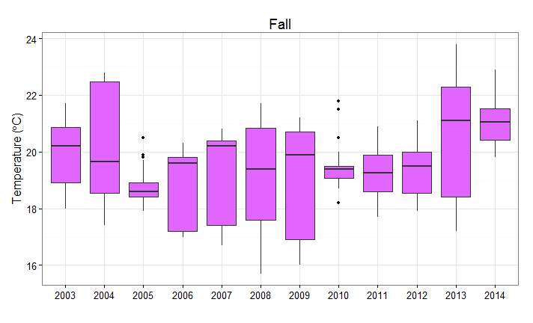
Water Temperatures Warmer All Year Long
 | Jan - Mar | Apr - Jun | Jul - Aug | Sept - Dec
Results
Water Temp
September – October only, Fall Midwater Trawl, 1-6 ppt
21 ˚C
19 ˚C
Notes:
Water temperature, on the whole, was indeed warmer in the fall months. This boxplot shows Sept – October water temperature measurements taken in the low salinity zone during the FMWT since 2003. Two-degree difference in the median temperature between the current drought and the previous 10 years. Note that median water temperatures for these months was warmer even than the previous drought in 2007-09. This apparent increase in temperature was true in 2014 for all seasons.

