Slide 1
EBMUD,
Oursan Ridge and Carr Ranch
May 17, 2018
Alison A. Kastama
Manager of Public Affairs
Notes:
Notes for Directors Linney and Patterson
Intros etc.

Slide 2
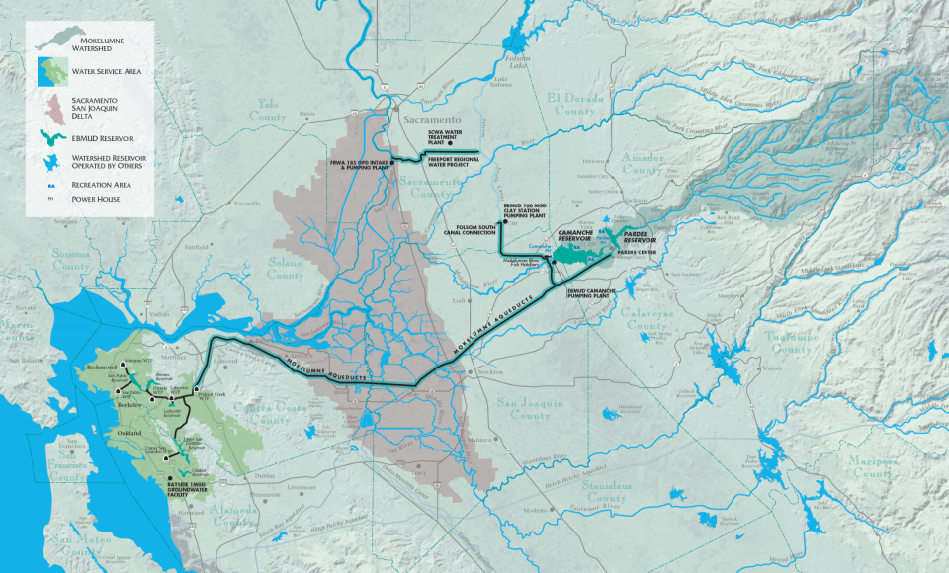

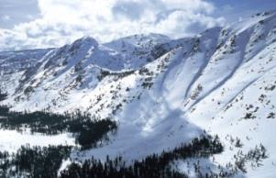
EBMUD Water System
Notes:
Before I delve into our water supply, let me tell you a little bit about our water system. Most EBMUD water begins as snowmelt into the Mokelumne River in the Western Sierra.
The water is stored at Pardee Reservoir before traversing 90 miles of pipeline to the East Bay’s reservoirs.
EBMUD water serves more than 1.4 million people, in a 325-square mile area, in parts of Alameda and Contra Costa Counties.

Slide 3
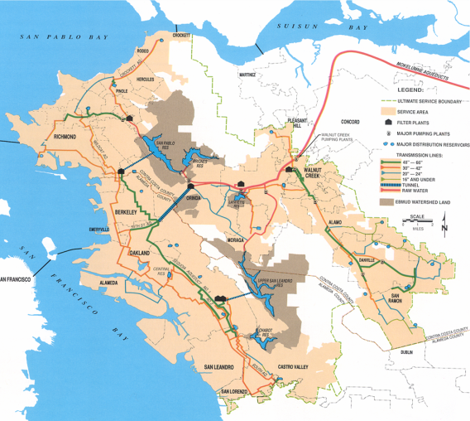
EBMUD System & Service Area
Raw Water System
5 local reservoirs
Treatment System
3 inline WTPs
3 conventional WTPs
Distribution System
4,200 miles of pipeline
122 pressure zones
164 reservoirs
135 pumping plants
100 regulators/RCS
Notes:
Our complex distribution system includes:
5 local reservoirs
6 water treatment plants
122 pressure zones
164 reservoir tanks
135 pumping plants
over 4,200 miles of pipelines
EBMUD has almost 2,000 skilled employees who keep these facilities running every day.

Slide 4
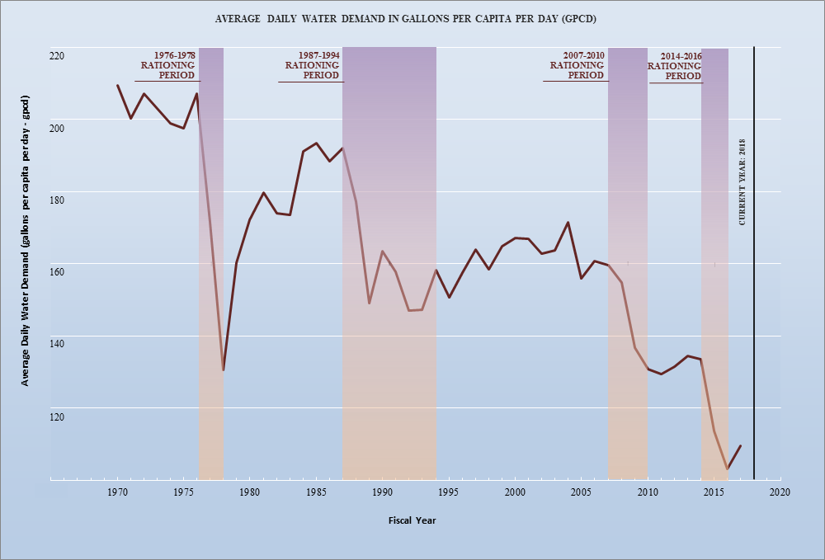
Total Per Capita Water Use
(1970-2017)
Update in progress
Notes:
4
EBMUD will implement conservation and recycled water programs to achieve 2020 goals, which surpass the 2020 water use target

Slide 5
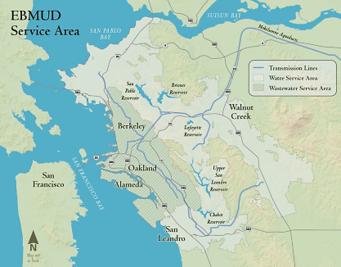
Wastewater System Overview
EBMUD provides wastewater services for 680,000 residents in the East Bay
      Average, Peak Flow:
      50 million gallons per day (MGD) up to 320 MGD (in rain)
Three wet weather facilities
15 pumping stations
29 miles of gravity sewer
interceptors
8 miles of sewer force mains
EBMUD owns large interceptor
sewers; communities own
their collection systems
Resource recovery
Main Wastewater Treatment Plant

Slide 6
Biennial Budget – FY18 & FY19
$2.03 Billion over two years
Capital
Budget
41%
Operations
Budget
35%
Water
85%
Wastewater
15%
Debt Service
24%
65% of budget is capital investment-related
Notes:
6
6
6
Capital Investments
The percentage of the FY18 & FY19 Capital Improvement Program that is attributable to District labor, both direct and supporting labor, is approximately 46 percent for water.
O&M
All labor accounts including benefits represent approximately 67 percent of the ‘operations’ budget.

Slide 7
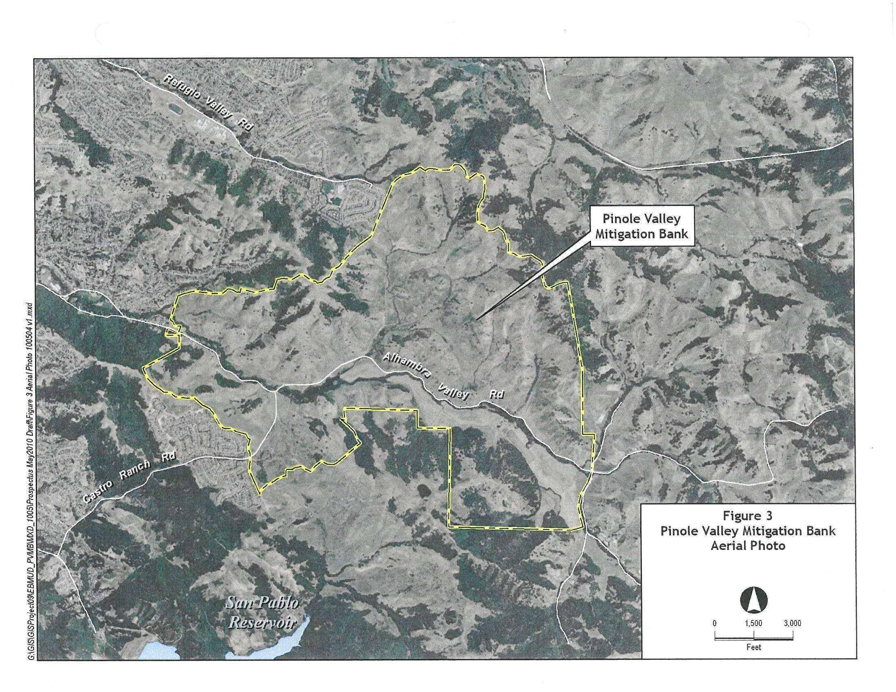

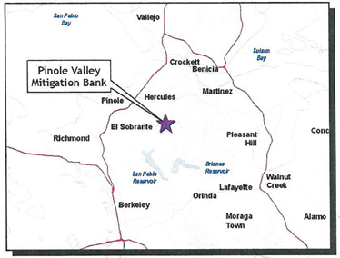
Oursan Ridge
Conservation Bank
Pinole Valley
Contra Costa Co.
Approx. 430 acres
Conservation credits
Credit types:
California red-legged frog
Alameda whipsnake
Oursan Ridge Conservation Bank
Notes:
The District owns approximately 3,700 acres of property in the Pinole Valley.
The property was originally intended for development of a water supply reservoir; however, the District has determined that the land is not suitable for any current or planned water supply. The land is currently leased for grazing and agriculture.
The PVMB concept was developed as a means to preserve this property as open space while maximizing the benefit to EBMUD by generating revenue through sales of mitigation credits to public or private entities.
Upon assessing the costs to develop the PVMB, staff began to investigate the feasibility of developing the ORCB, a smaller, less expensive option. Credit sales from the ORCB would help fund further PVMB development.

Slide 8
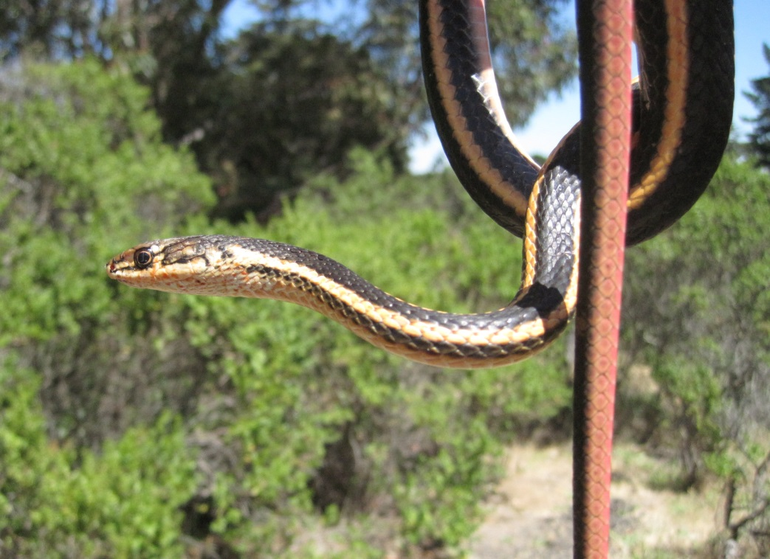
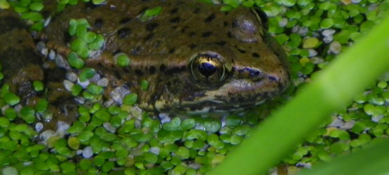
Oursan Ridge
Conservation Bank

Slide 9
ORCB Financial Projections
Low/$15K per credit; High/$25K per credit

Slide 10
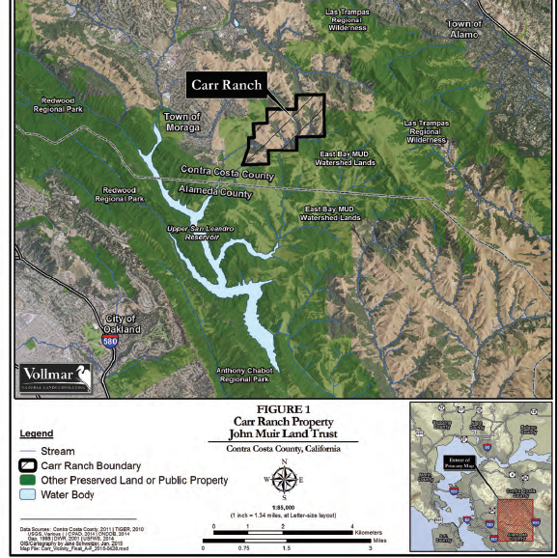
Carr Ranch
604 acres surrounded by EBMUD watershed
Protects biodiversity and water quality
John Muir Land Trust partnership
EBMUD owns property, JMLT to provide limited public access

Slide 11
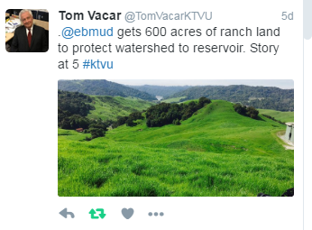
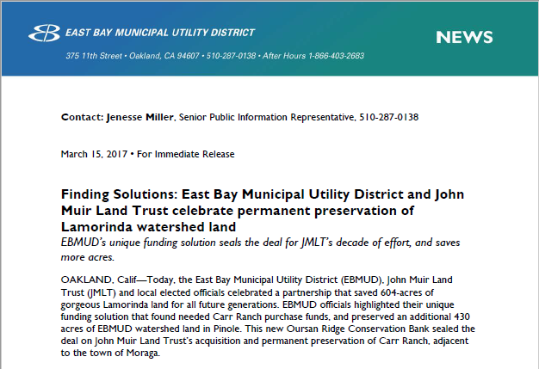

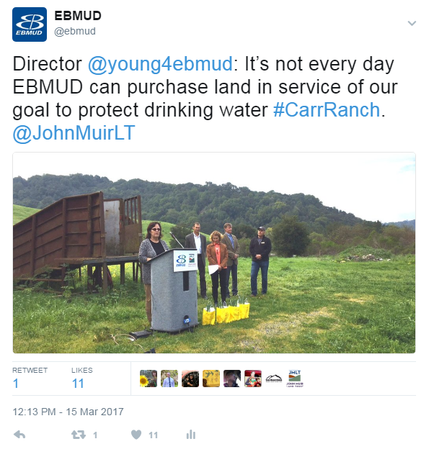
March: Finding Solutions
Carr Ranch

Slide 12
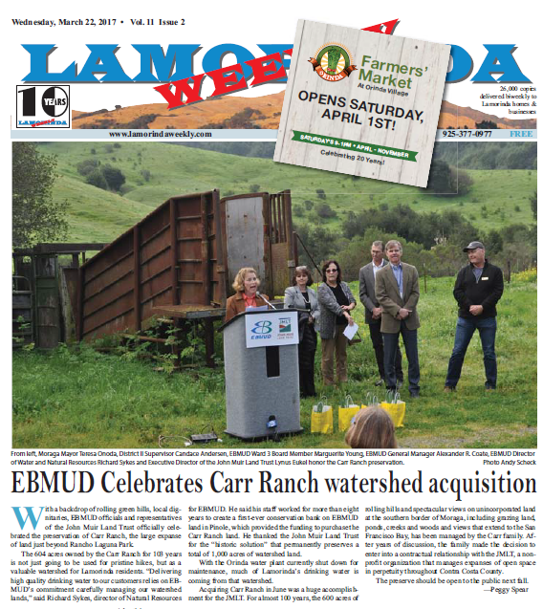


March: Finding Solutions
Carr Ranch

Slide 13


Questions?
More information at:
www.ebmud.com
Construction at
www.ebmud.com/construction
We also post on:
Twitter @ebmud
Working Every Minute
Notes:
Water continues to be the best value around and EBMUD’s water is some of the best in the state.
For more information, visit us on EBMUD.com, follow us on Twitter or as always, you can reach out to me directly.

Slide 14
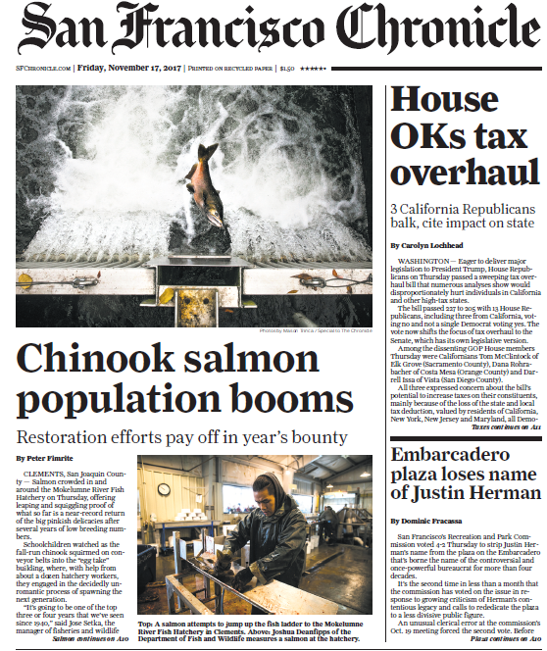

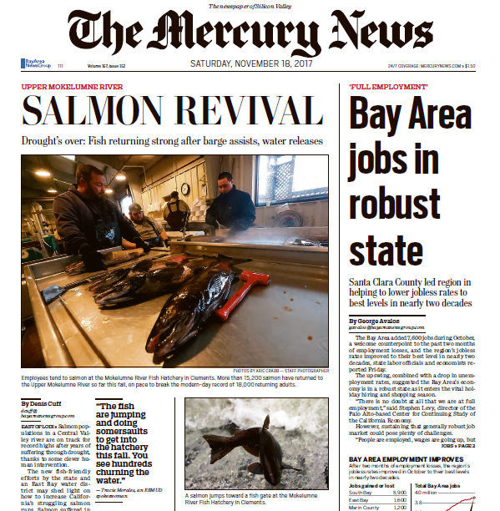
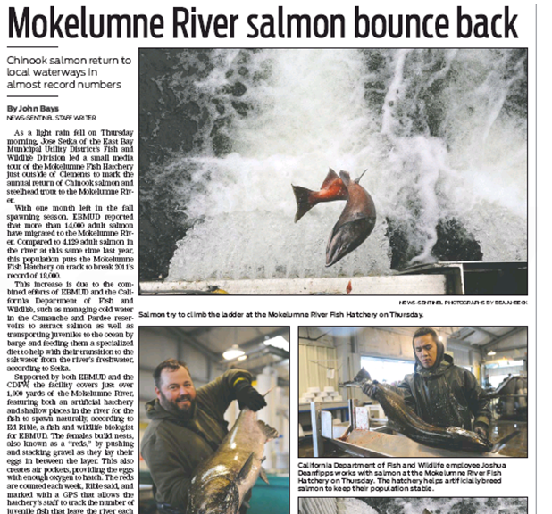
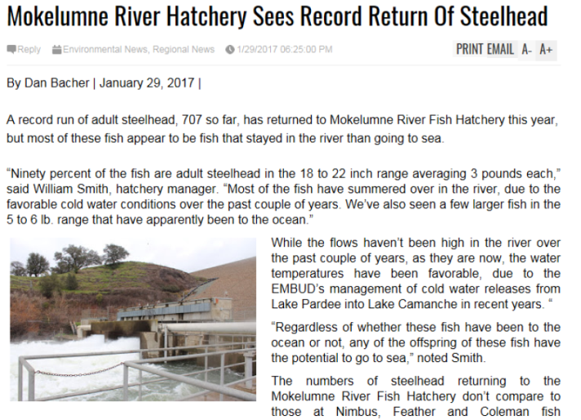

2017 Salmon Returns

Slide 15
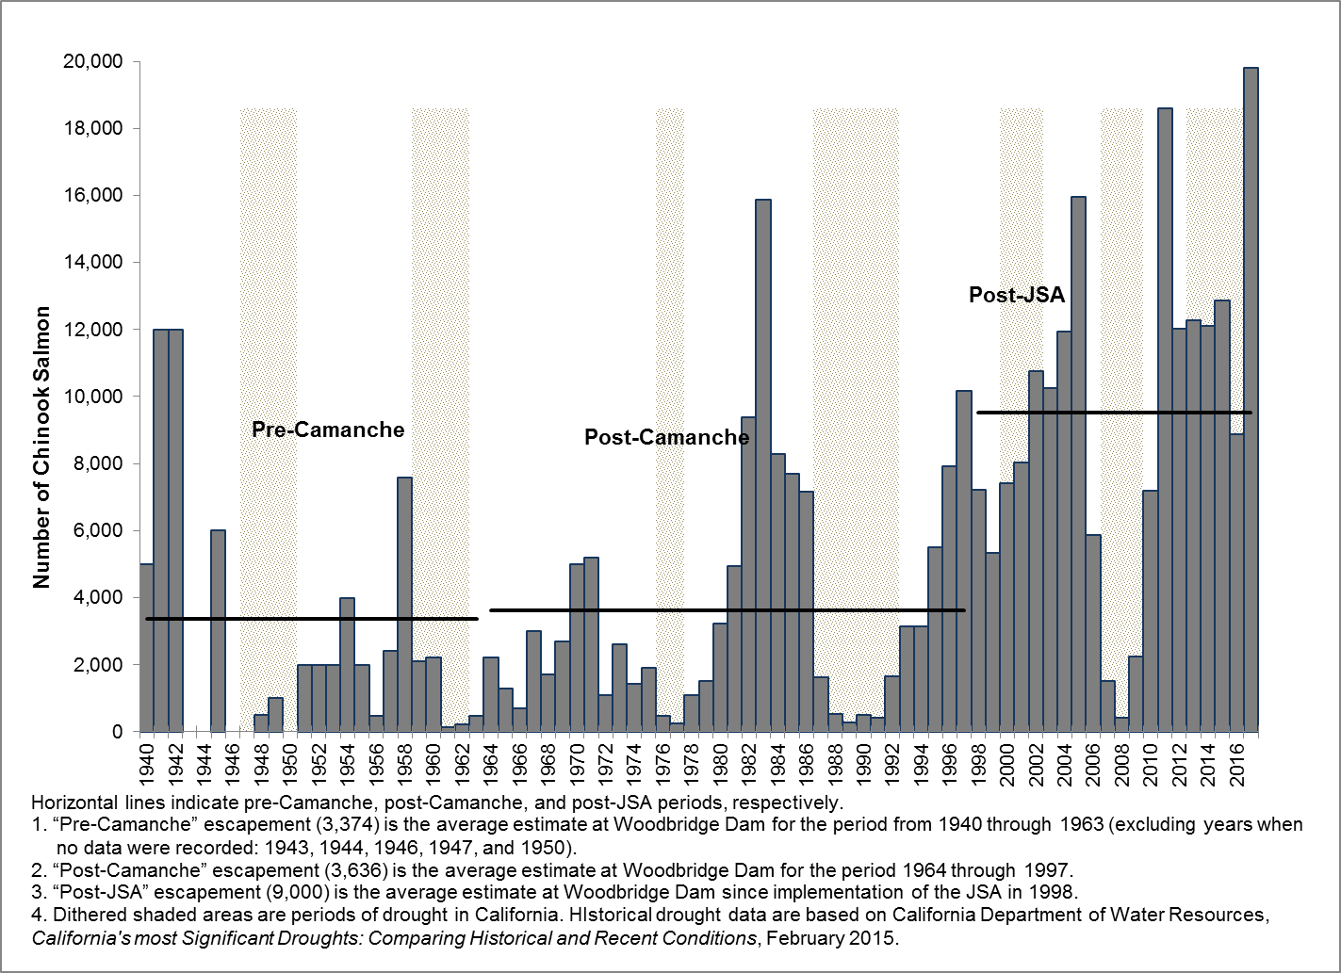
Historical Salmon Count

Slide 16
Biennial Budget – FY18 & FY19
FY18 & FY19 APPROPRIATIONS ($ Millions)
 | FY18 |  |  | FY19 |  |  | FY18 & FY19
 | Water | Wastewater | Total | Water | Wastewater | Total | Grand Total
Operations | 277.9 | 70.6 | 348.5 | 292.5 | 73.1 | 365.6 | 714.1
Debt Service | 199.6 | 34.7 | 234.2 | 210.0 | 31.9 | 242.0 | 476.2
Capital Appropriation | 386.5 | 34.4 | 420.8 | 367.5 | 51.1 | 418.6 | 839.4
Total | 863.9 | 139.6 | 1,003.5 | 869.9 | 156.2 | 1,026.1 | 2,029.7
Notes:
Debt Service
We issued more bonds this year, making it less likely that we will issue bonds next year
Not issuing bonds will save the District $700,000
Additionally, due to refinancing bonds in the upcoming bond sale, we expect (based on current market conditions) to have roughly $23.1 million in present value debt service savings on the Water side and $7.2 million in present value debt service savings on the Wastewater side over the remaining life of the bonds.

Slide 17
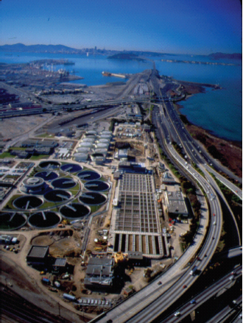
Main Wastewater
Treatment Plant
Unique Conditions
Excess solids digestion capacity
Strong support from Board of Directors for renewable energy infrastructure and initiatives
Organizational focus on cost recovery and continuous improvement
Institutional capacity to develop and test innovative processes
Result: EBMUD is now operating a mature trucked waste program (started in 2002)
We are reinventing our plant as a “Green Factory”
Plant Flows
Annual average daily: 50 MGD
Secondary capacity: 168 MGD
Primary capacity: 320 MGD
Oakland, California
Notes:
Digestion Capacity: Due to the loss of industrial dischargers in our service area in the 1990s and early 2000s, significant excess capacity and underutilized infrastructure existed at the MWWTP.
Board Policy: EBMUD has established Board policies for both Sustainability and Renewable Energy to help guide project decision-making and reinforce the commitment to green infrastructure.
Innovation: A key component to the success of EBMUD’s renewable energy program has been in-house development of technical approaches and solutions to problems in uncharted territory.

Slide 18
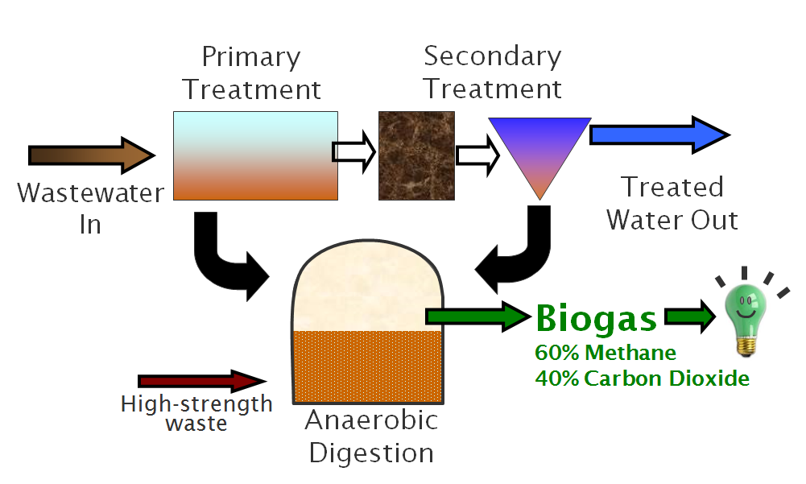
Renewable Energy Program Benefits
Cost savings through use of biogas for energy generation
Greenhouse gas reduction
  Diversion of organics from landfill
  Generation of renewable energy
Air Quality
  Low emission turbine reduces harmful air emissions
Reliability
  Onsite generation provides increased reliability for wastewater treatment (e.g., during power outage)
Efficiency
  Producing onsite reduces line losses
  Utilizing “waste” heat from electricity generation (doubles efficiency)
  Turbine uses a “recuperator” to increase electrical efficiency

Slide 19
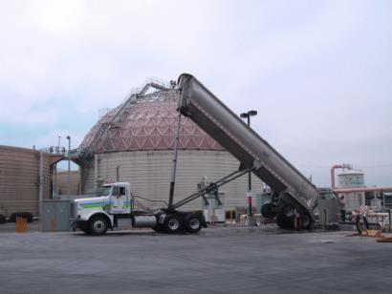
Recource Recovery and
Food Waste Update
We have offset operational costs by generating:
  130% of the plant’s energy needs,
  plus tip fee and surplus energy revenues
Current program utilizes:
Liquid Waste: Liquid organics, brine
Food Waste:
RecycleSmart (Pleasanton)
Recology pilot (San Francisco)
Focus on off-site preprocessing
State organics diversion
mandate is likely to
create more favorable
economics in the future
Notes:
EILEEN – please emphasize how attendees can engage in this process – bring greater regional focus on local disposal and GHG-free energy generation, etc.
An Emerging Role for WWTPs
Historically: A protector
New Role: A provider
Driving Forces
Sustainability focus
Environmental stewardship
Economic benefits
Climate change impacts
Producing green products can help reduce a WWTP’s carbon footprint
Utilizing existing capacity at EBMUD’s Main Wastewater Plant to locally dispose of regional non-sewage waste and generate renewable energy from biogas.
Program offsets treatment plant costs with tip fees, reduced operational energy costs, and surplus energy sales.
Liquid Waste: Liquid organics, brine
Food Waste
Large-scale (200 tons/day) food waste facility is on hold
Insufficient project revenues under current market conditions to offset capital investment
EBMUD is focusing on off-site preprocessing by others
State organics diversion mandate is likely to create more favorable economics in the future

