Slide 1
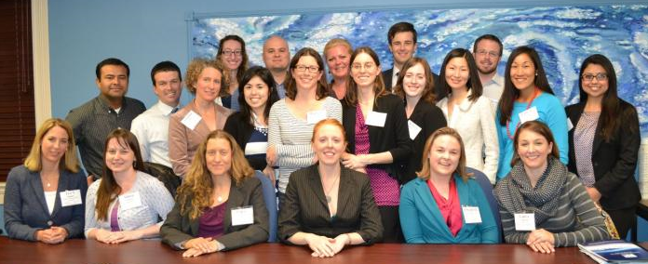
Water Leaders Class Presentation
2014

Slide 2
The Water Leaders' Experience

Slide 3
Water Leaders & Mentors
Water Leader & Affiliation |  | Mentor & Affiliation
Chris Alford | American Rivers | Vicki Kretsinger | Luhdorff and Scalmanini
Eleanor Bartolomeo | State Water Resources Control Board | Lester Snow | California Water Foundation
Amanda Bohl | Sacramento-San Joaquin Delta Conservancy | Steve Phillips | US Geological Survey
Holly Canada | California Department of Water Resources | Tina Cannon-Leahy | Assembly Water, Parks and Wildlife Committee
Laura Carpenter | Brown and Caldwell | Roy Herndon | Orange County Water District
Omar Carrillo | Community Water Center | Chris Petersen | West Yost & Associates
Lindsay Correa | Delta Stewardship Council | Jason Gianquinto | Semitropic Water Storage District
Roberto C. Cortez | East Bay Municipal Utility District | Chase Hurley | San Luis Canal Company/Henry Miller Reclamation District
Rebecca Crebbin-Coates | Planning and Conservation League | Rob Swartz | Regional Water Authority
Kristina Donnelly | Pacific Institute | Danielle Blacet | Association of California Water Agencies
Rebecca K Guo | MWH Americas | Caren Trgovicich | State Water Resources Control Board
Trudi Hughes | California League of Food Processors | Thomas Harter | University of California
Minta Konieczki | ESA | Mark Larsen | Kaweah Delta Water Conservation District
Elizabeth Leeper | Kronick Moskovitz Tiedemann & Girard | Jay Lund | UC Davis
Sean Maguire | Kennedy/Jenks Consultants | Daniel Wendell | The Nature Conservancy
Maureen Martin | Contra Costa Water District | Sarah Raker | AMEC
Aubrey Mescher | Aspen Environmental Group | Brad Herrema | Brownstein Hyatt Farber Schreck, LLP
Christopher Park | CDM Smith | Robert Van Valer | Roscoe Moss Company
Susan Reyes | Office of Senator Ed Hernandez, O.D. | Ted Johnson | Water Replenishment District of Southern California
Erin Rice | Bureau of Reclamation | Tim Parker | Parker Groundwater
Elizabeth Sarine | Remy Moose Manley, LLP | Dan McManus | California Department of Water Resources

Slide 4
Water Leaders: Diverse Affiliations
Notes:
21 participants
Diverse professional experience

Slide 5
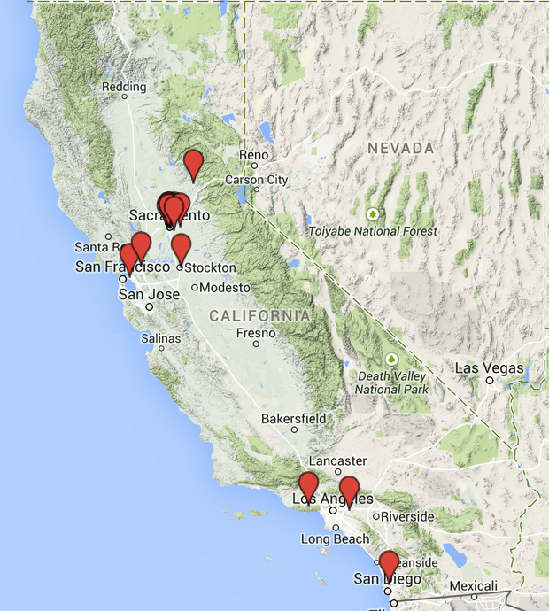
Water Leaders: Broad Geographic Representation

Slide 6
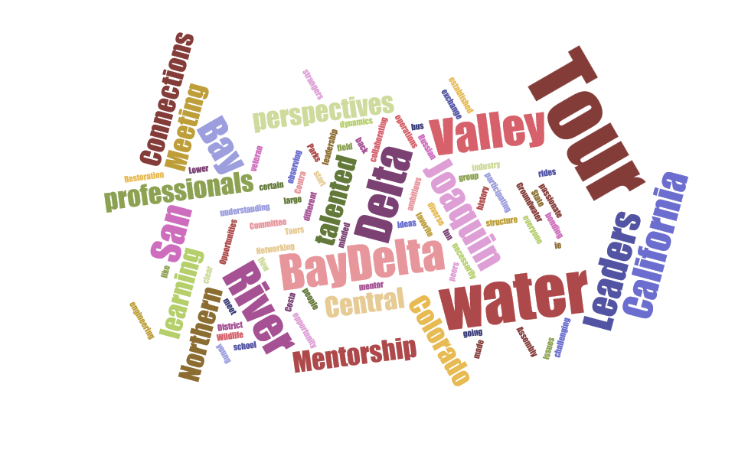
Water Leader Experience

Slide 7
2014 Sustainable Groundwater Management Act:
Opportunities and Challenges
The Water Leaders’ Report

Slide 8
Groundwater Conditions & MANAGEMENT ISSUES

Slide 9
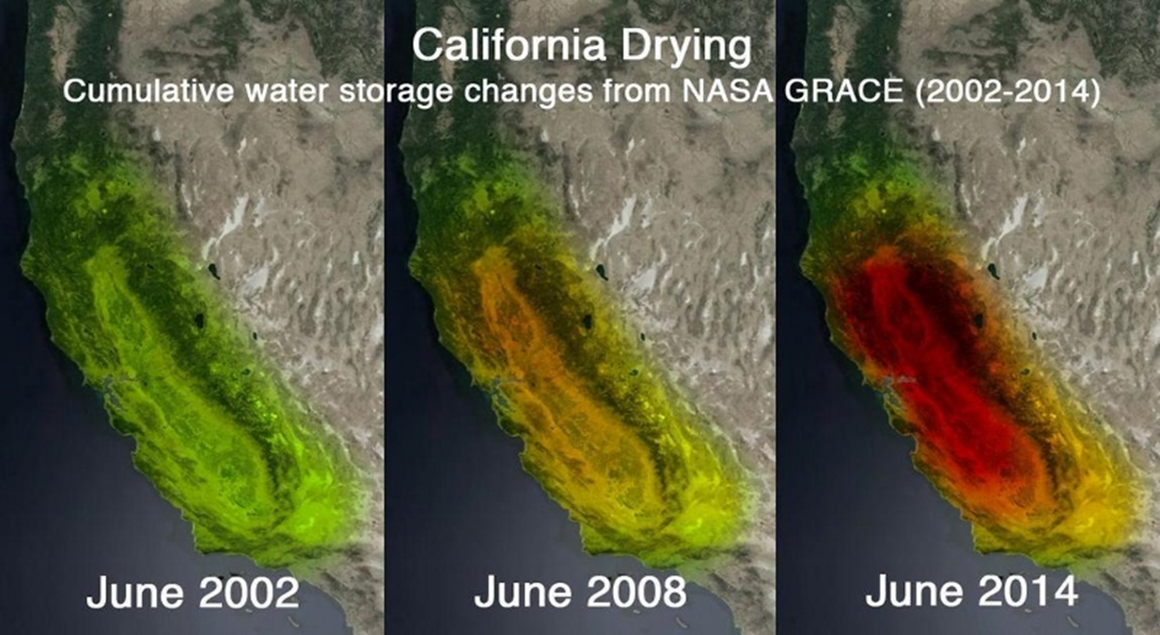
Groundwater Reliance & Conditions
State Water Supply: ~40% in average year; ~60% in drought
Drinking Water: 40-50% of Californians partially dependent, some regions completely dependent
Declining Levels: 100 feet below historical lows in some regions

Slide 10
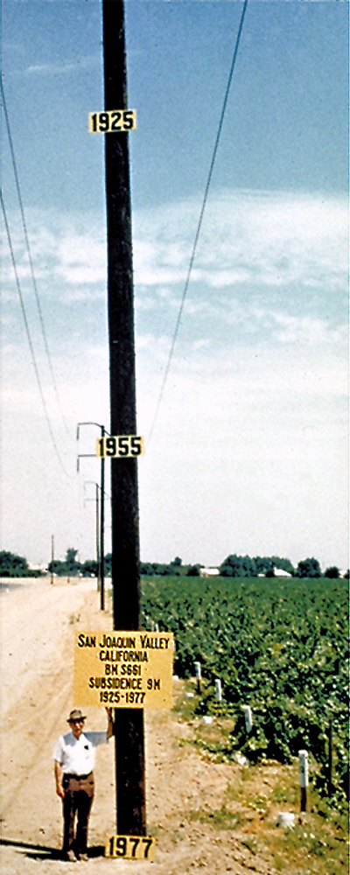
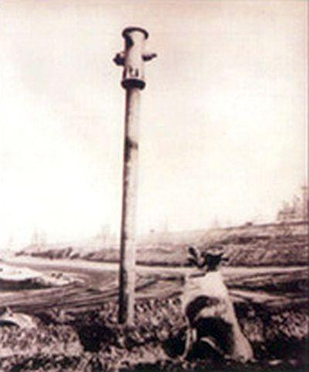
Overdraft & Subsidence
Notes:
Section 2

Slide 11
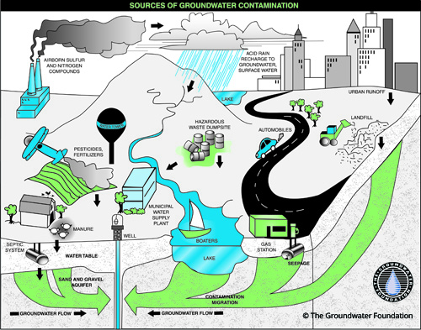
Salinity Intrusion & Contamination
Source:
Source:
Notes:
Section 2

Slide 12

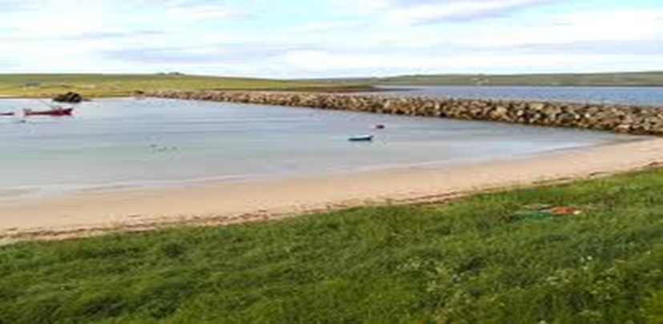

Barriers to effective groundwater management

Slide 13
Barriers to Effective Groundwater Management (Pre-2014)
Funding
Data management and accessibility
Governance, regulatory oversight, and enforcement
California water management system
Education and communication
Water demand pressures
Notes:
Given the challenges that we’ve just heard about, effective groundwater management is complex and proposed solutions often run up against some obstacles.
As Elizabeth mentioned, we were all able to interview our mentors about their perspectives on groundwater management. Afterwards, we compiled all of the responses, and among other things, we ended up with a list of common barriers to effective groundwater management. Many of these barriers were mentioned by multiple mentors.
I should note that this list describes the barriers in place before the 2014 Sustainable Groundwater Management Act.

Slide 14
Barriers to Effective Groundwater Management (Pre-2014)
Funding
Data management and accessibility
Governance, regulatory oversight, and enforcement
California water management system
Education and communication
Water demand pressures
Notes:
The first barrier is funding for groundwater management programs, which has historically been dependent on voter-approved bonds or local tax revenue. Currently, it is uncommon to charge groundwater pumping fees or replenishment fees. Less than half of the groundwater management agencies that were created by special acts actually charge pumping fees.

Slide 15
Barriers to Effective Groundwater Management (Pre-2014)
Funding
Data management and accessibility
Governance, regulatory oversight, and enforcement
California water management system
Education and communication
Water demand pressures
Notes:
Data management and accessibility is a huge barrier due to the lack of data that is: comprehensive, state-side, high-quality and readily-available. 40 of the 126 high- and medium- priority basins identified under the 2014 Sustainable Groundwater Management Act, are not currently monitored under CASGEM.

Slide 16
Barriers to Effective Groundwater Management (Pre-2014)
Funding
Data management and accessibility
Governance, regulatory oversight, and enforcement
California water management system
Education and communication
Water demand pressures
Notes:
Prior to the 2014 Act, California was the only Western state without state-wide groundwater regulation. According to our mentors, many groundwater users are aware that their current pumping rates are unsustainable, but without incentive or regulation, a reduction in pumping is unlikely.

Slide 17
Barriers to Effective Groundwater Management (Pre-2014)
Funding
Data management and accessibility
Governance, regulatory oversight, and enforcement
California water management system
Education and communication
Water demand pressures
Notes:
Another barrier is created by the nature of the California water system. Surface water and groundwater are both physically and operationally linked, so that the reliability of surface water affects the reliability of groundwater and visa versa. Historically, these surface water – groundwater interactions have not been acknowledged, and this has made it impossible to effectively manage groundwater.

Slide 18
Barriers to Effective Groundwater Management (Pre-2014)
Funding
Data management and accessibility
Governance, regulatory oversight, and enforcement
California water management system
Education and communication
Water demand pressures
Notes:
As you all are aware, there are many stakeholders in the CA groundwater game, each with different objectives and interests. These differences often present challenges to developing a basin-wide approach to groundwater management and can be exasperated by a lack of communication. Sometimes, there is also insufficient information, education, and outreach of basin characteristics, scope of groundwater use, and challenges facing different stakeholders.

Slide 19
Barriers to Effective Groundwater Management (Pre-2014)
Funding
Data management and accessibility
Governance, regulatory oversight, and enforcement
California water management system
Education and communication
Water demand pressures
Notes:
And lastly, groundwater is facing increasing water demand pressures from: a growing state-wide population; a more highly variable climate; and changing agricultural patterns, such as an increase in permanent crops like almonds, or an expansion into former rangeland that is dependent on groundwater irrigation systems.

Slide 20

Overcoming Management barriers: Basin examples

Slide 21
    What Makes Groundwater Management Effective at the Basin Level?
Creation or designation of a local agency with clear responsibility for basin groundwater management
Good communication, active involvement, and inclusive processes
Conjunctive use and replenishment programs
Groundwater management as part of more integrated water management at the local scale
Regulatory authority and tools for management
Extensive collection of groundwater data
Financial mechanisms for management
Public education
Notes:
Section 3.2

Slide 22
Overcoming Barriers:
Santa Clara Valley Water District
Source:
Notes:
Section 3.2
Special Act District. Reversed overdraft through conjunctive use and recharge. Large data collection. Excellent public communication. Quantitative metrics for evaluating success. Fee authority to fund program.

Slide 23
Overcoming Barriers:
Main San Gabriel Basin
Provided by: Ted Johnson, Chief Hydrogeologist, Water Replenishment District of Southern California
Notes:
Section 3.2

Slide 24
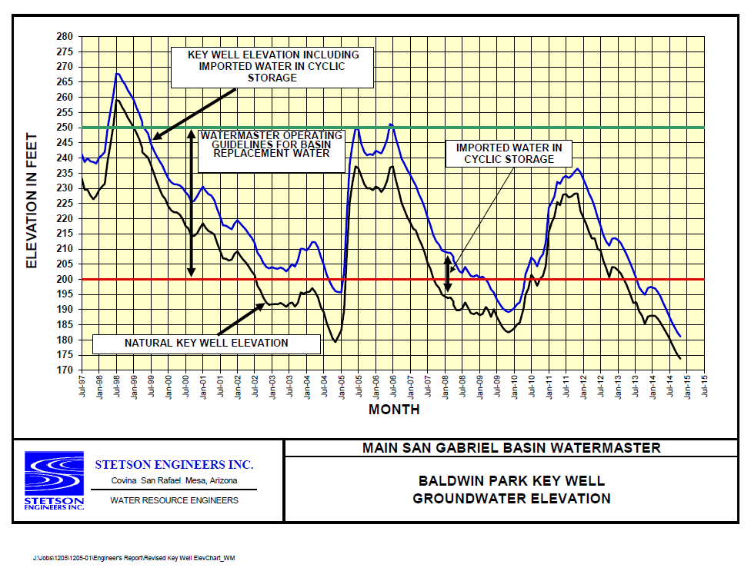
Overcoming Barriers:
The Importance of Monitoring Data
Source: San Gabriel Valley Municipal Water District www.sgvmwd.org

Slide 25

2014 Sustainable Groundwater Management Act

Slide 26
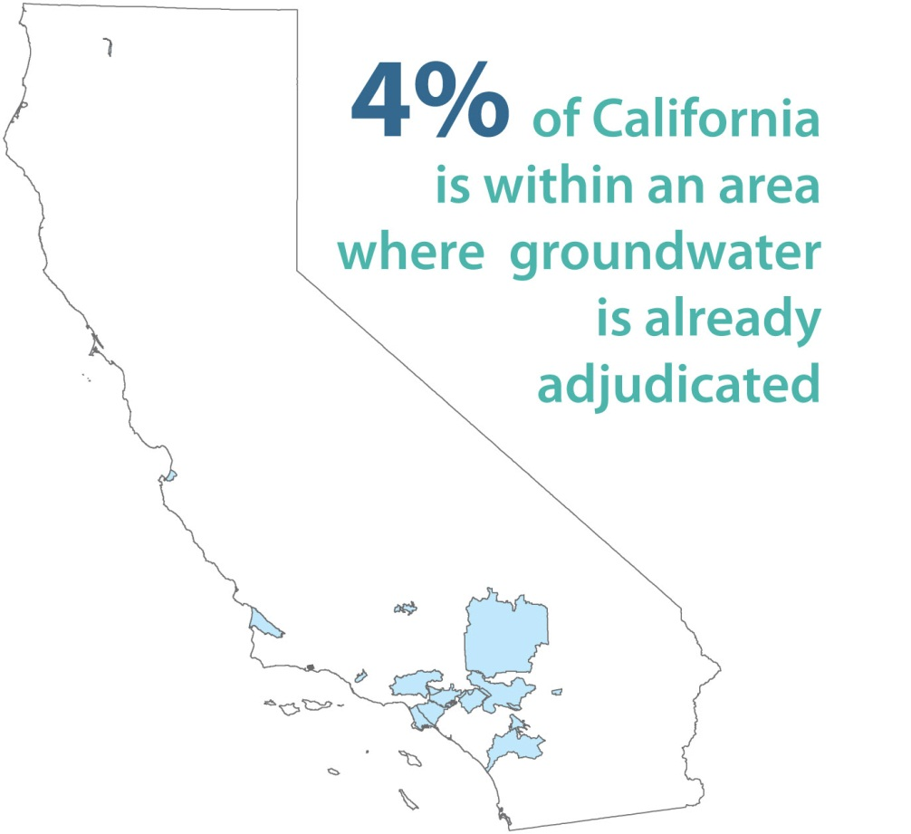
In accordance with the Act, these areas are required to provide basic reporting information to DWR annually.

Slide 27
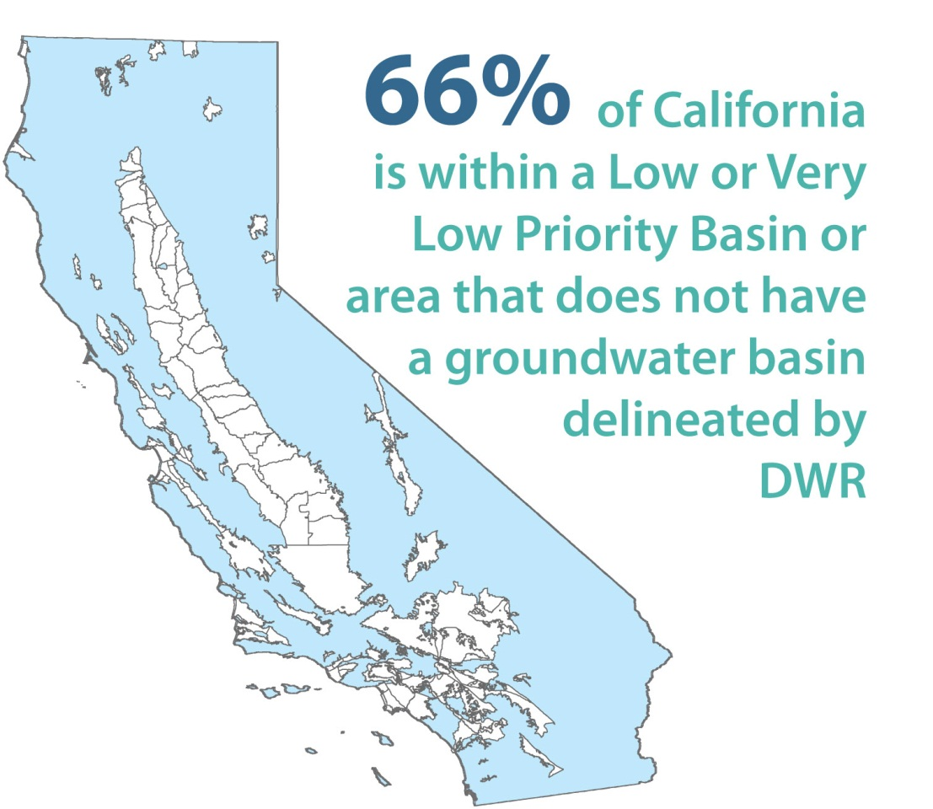
These areas are encouraged, but not required to develop groundwater sustainability plans.

Slide 28
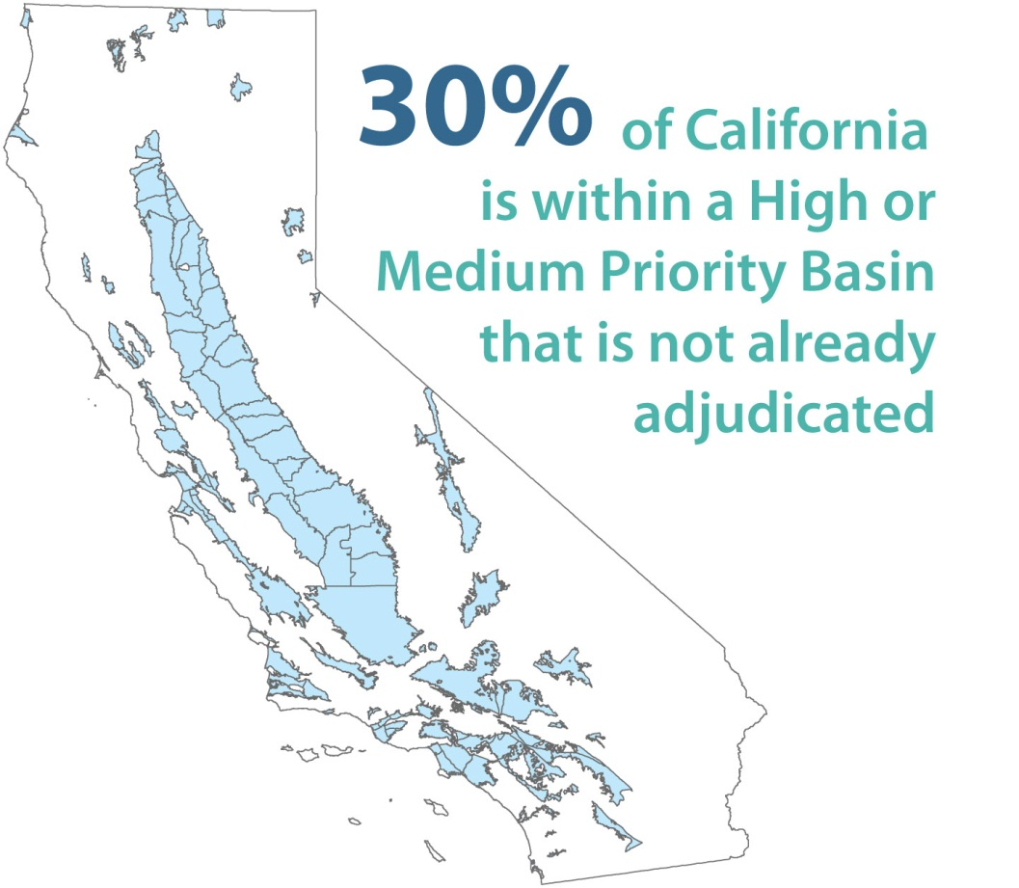
In accordance with the Act, these areas are required to identify a local groundwater management entity that will develop and implement a groundwater sustainability plan for the basin

Slide 29
Key Elements of Legislation
    Focus on “high-priority” and “medium-priority” groundwater basins
    Groundwater Sustainability Agency (GSA) formation by 2017
    GSA must develop a Groundwater Sustainability Plan (GSP) by 2020 (if basin in overdraft) or 2022 (all other medium- or high-priority basins)
    Achieve “sustainability” within 20 years
    State oversight by Department of Water Resources and State Water Resources Control Board

Slide 30
  New GSA Compliance Tools (Discretionary)
Fees (some exempt from Prop 218)
Investigations
Well extraction limits
Well permit restrictions
Well metering/reporting
Water management projects
Land use

Slide 31
    State Role - DWR
Technical Assistance
Best management practices for sustainable groundwater management (January 1, 2017)
Proposition 1 - $100 million to assist in the implementation
Assessment of Groundwater Sustainability Plans
Initially within 2 years and every 5 years
Assess the impact of a GSP on an adjacent basin >> interbasin sustainability
Corrective actions for deficiencies

Slide 32
State Role - SWRCB
May intervene if GSA not formed or fails to adopt / implement compliant GSP by certain dates
Designate basin as “probationary”
Create interim plan until GSA formed and develops compliant GSP

Slide 33

Evaluation of THE MANAGEMENT Act
Notes:
Section 5

Slide 34

Evaluation of Responsiveness to Mentor-identified Issues

Slide 35
Responsiveness to Issues Identified By Water Leaders Mentors
All of the issues associated with groundwater management that the mentors identified during their interviews were compared to the content of the SGMA
Identified issues fell into 5 general categories
  Funding
  Data management and accessibility
  Water management
  Governance, regulatory oversight, and enforcement
  Education and communication

Slide 36
Funding
The SGMA does:
  authorize a GSA to impose fees to cover the cost of the preparation, adoption, and amendment of a GSP; program administration; investigations; inspections; compliance assistance; and enforcement
The SGMA does not directly:
  address whether GSAs will be able to raise enough money through fees to effectively implement and enforce the SGMA
  reform State taxes to keep more money at the local level
  increase eligibility for/availability of grant funds

Slide 37
Data Management and Accessibility
The SGMA does:
  authorize GSAs to monitor water withdrawals, track the location of wells, and may adopt rules, regulations, ordinances, and resolutions for the purposes of implementing the legislation, including those related to data collection
  require every GSP to describe historical data, groundwater levels, ground water quality, subsidence, ground-water surface water interactions, and historical and projected water demands and supplies
The SGMA does not directly:
  address the need for data to be formatted consistently, respect privacy, and be stored and managed so that they are easily accessible in a centralized location
  address the need for comprehensive basin studies
  require the installation of monitoring wells
Notes:
Based on the requirements of the SGMA, it is reasonable to assume that the data listed below will be collected.
There is a lack of high-quality data for:
quantifying groundwater demand/use;
characterizing groundwater quality;
groundwater aquifer characterization: size, composition and recharge area delineation, water elevation, age of the water, and hydraulic parameters such as conductivity;
determining the location of wells, but with consideration of property rights; and
characterizing land surface compaction and subsidence on a regional scale.
There is a lack of understanding of:
what datasets currently exist;
how improved agricultural efficiency will affect recharge; and
how climate change will effect surface and groundwater quantity and timing of availability

Slide 38
Water Management
The SGMA does:
  establish a framework for sustainable groundwater management in California
The SGMA does not:
  stipulate that wet year groundwater storage be maximized
  identify recharge projects and “new sources of water”
  require implementation of surface water management strategies to reduce demand on groundwater
  establish short- and long-term planning programs that allow agencies to be poised to implement new ideas as they develop
  establish rules for a streamlined basin adjudication process
Notes:
Bullets 1 through 3 were unlikely to be included in the legislation because the idea is for the GSAs to define the measures that will lead their basin to sustainable management.
GSAs will need to set themselves up to be poised and nimble to implement new ideas as they develop.
A streamlined basin adjudication process is the focus of one of the clean-up bills that we’ll discuss later in this presentation.

Slide 39
Governance, Regulatory Oversight, and Enforcement
The SGMA does:
  establish a framework for the regulation of groundwater in California
The SGMA does not:
  provide for safe drinking water by investing in treatment technologies and new wells, instead of creating new anti-degradation policies
  encourage the State to establish non-subsidized water rates
  impose tiered pricing as a means to curtail demand
  provide flexibility on NEPA and CEQA regulations to expedite approval of cross-boundary water transfers during drought
  establish groundwater recharge as a beneficial use to avoid water rights vulnerabilities associated with recharge projects
  set predefined drought buffers for compliance
  allow some level of groundwater degradation, but impose fees for it
  establish ‘soft’ thresholds with an understanding that those thresholds will become hard thresholds with time to comply
Notes:
Apologize for severely breaking the rule of limiting text on slides!

Slide 40
Education and Communication
The SGMA does:
  require the development of Groundwater Sustainability Plans, which will educate the parties involved
The SGMA does not directly:
  fund community outreach and education
  address fragmentation of water users across a groundwater basin
Notes:
There will be an initial “learning curve” as GSAs form and start to develop their GSPs.
If the GSP development process has a public outreach component, it will serve to educate the members of the public who choose to participate.
However, a more focus effort is needed. Funding will be a challenge.

Slide 41

Opportunities and Challenges with Implementation

Slide 42
Management Act Implementation
Short-Term Issues
Long-Term Issues
GSA formation
Stakeholder outreach
Regional coordination
Defining sustainability
GSP development
Enforcement powers & water rights
Funding
Achieving sustainability
Drought response

Slide 43


Potential future actions

Slide 44
Potential Clean-up Bills
    Expedited and streamlined adjudication process
    Refine public access to data
    Refinements on functional equivalency definition

Slide 45
Other Potential Future Actions
Collaboration and Coordination
- in designating GSA(s)
- in developing GSP(s)
Facilitating Conjunctive Use
  - providing rules and guidance
  - increasing flexibility in water use
  Planning for Climate Change and Droughts
      - anticipating hydrologic changes
      - planning for prolonged droughts

Slide 46
THANK YOU
Questions or Comments?

