Slide 1
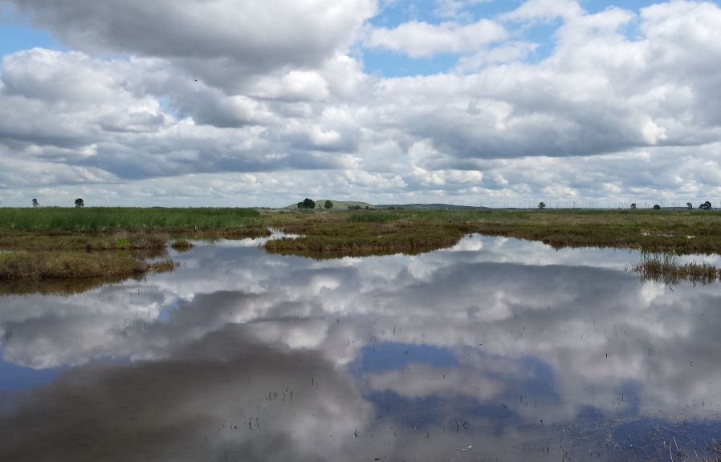
Restoration and the Delta Landscape
Water Education Foundation
May 18, 2018
Ramona Swenson, Ph.D.

Slide 2
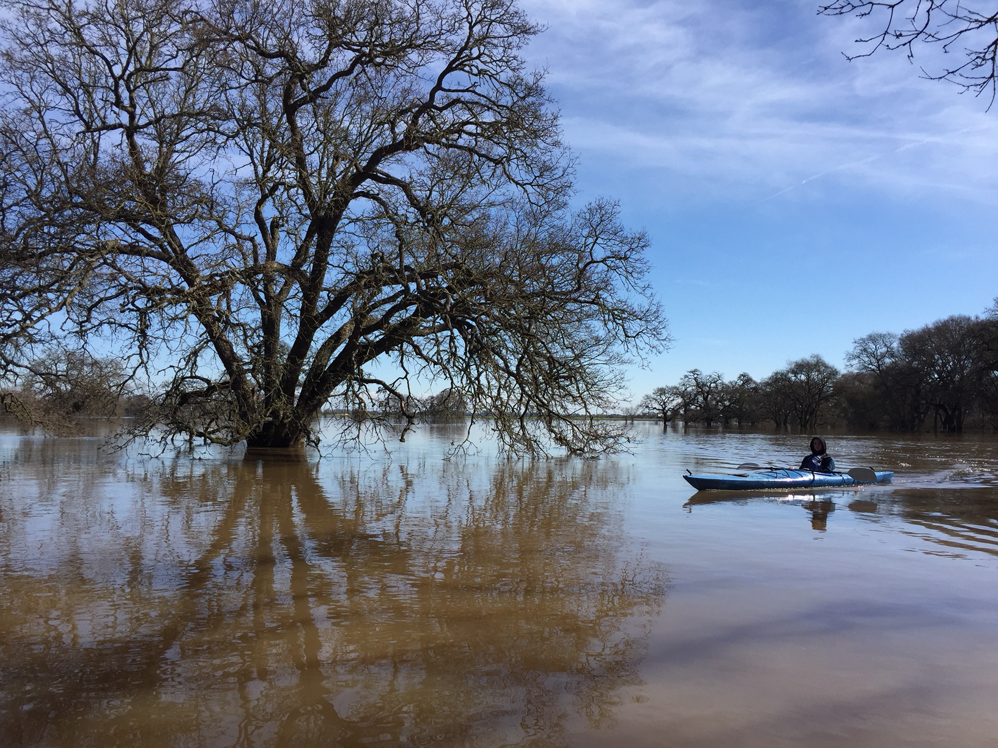
Restoration goals
Delta Landscape(s)
Restoration Examples around the Delta
  Floodplain - Cosumnes, Grizzly Slough
  Tidal Marsh – Tule Red, Dutch Slough
  South Delta – Paradise Cut

Slide 3
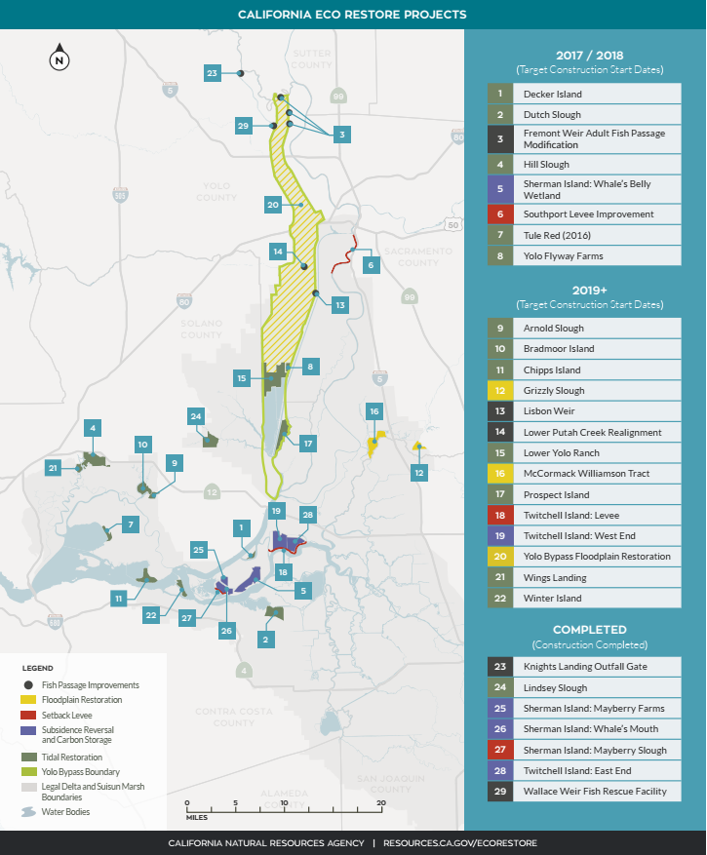
Eco-Restore
30,000+ acres of Delta habitat restoration in 5 years
Includes 8,000 ac of tidal marsh for compliance with USFWS and NMFS BiOps and CDFW ITP for Coordinated Operations of CVP and SWP
Suisun Marsh Plan
5,000 – 7,000 acres tidal marsh restoration
Notes:
Diverse habitats and ecosystem processes
Functional corridors for migratory species
Recover salmon and listed species
Restore habitat for migratory birds
Restore large areas of interconnected habitats
Restore Delta flows and channels to support a healthy estuary and other ecosystems
Reduced threats and stresses on the Delta ecosystem
Reduce impacts from invasive species
Improve water quality

Slide 4
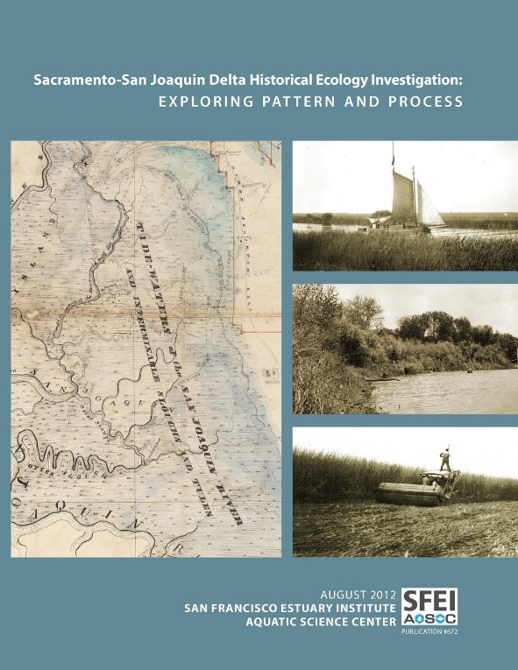
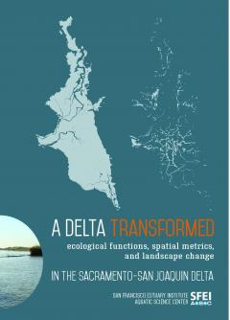
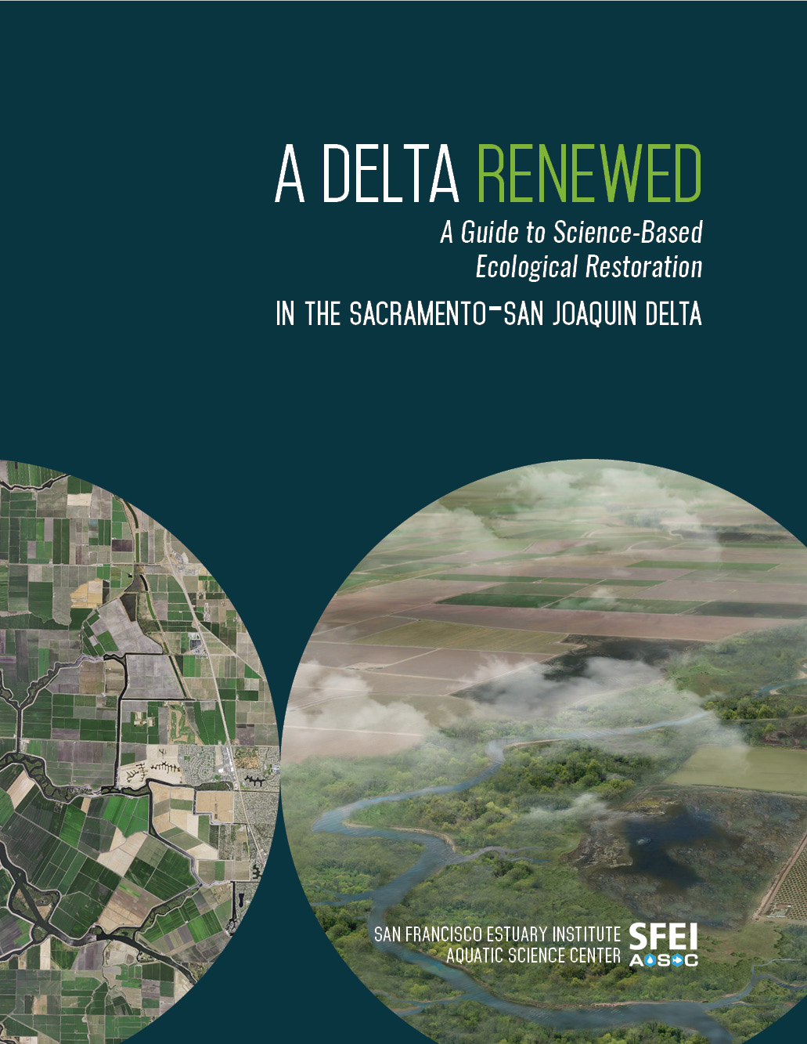
Delta Landscapes Project
San Francisco Estuary Institute (SFEI)

Slide 5
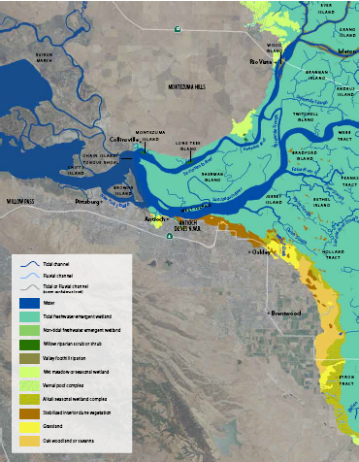
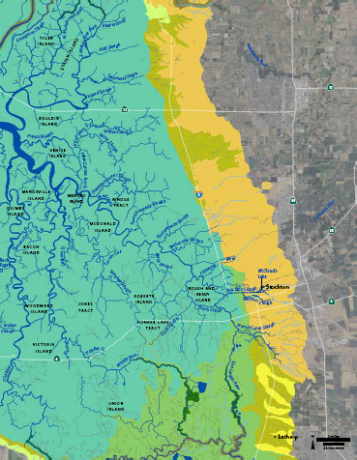
Landscape Context - Historic Delta 1800s
From: Whipple et al. 2012, SFEI

Slide 6
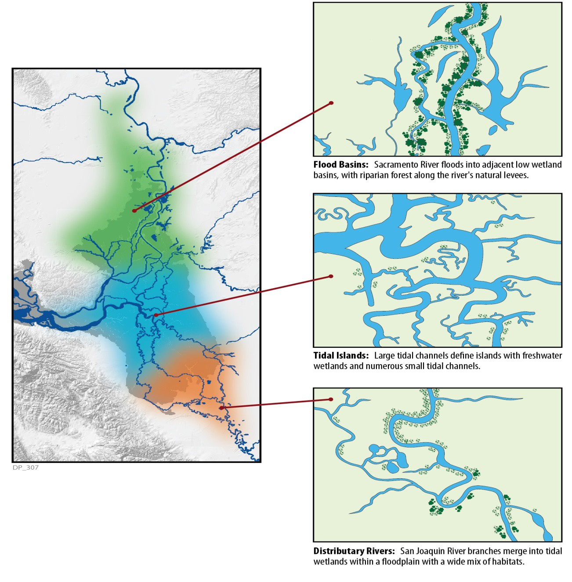
Primary Landscapes of the Historical Delta (1800’s)
Flood Basins
  Sacramento River floods low wetland basins, riparian forest along natural levees
Tidal Islands
  Large tidal channels
  Islands of freshwater wetlands and small tidal channels
Distributary Rivers
  San Joaquin River floodplain, habitat mix
  Merge into tidal wetlands
Source: Delta Plan 2013 as adapted from SFEI Delta Landscapes Project (Whipple et al., 2011)
Notes:
The historical Delta of 1800’s can be divided into three primary landscapes: flood basins in the north Delta, tidal islands in the central Delta, and distributary rivers (rivers with multiple branches flowing away from main channels) in the south Delta. Transitions between these landscapes occurred gradually, across broad areas. Though these landscapes held many habitat types in common, characteristics and spatial patterns varied greatly—these large-scale patterns are what helped define the landscapes, which in turn provided different functions for native species. Understanding these major landscape types is a valuable framework for evaluating current and future restoration strategies in the Delta, providing a baseline between the current landscapes and the long-established historical patterns.

Slide 7
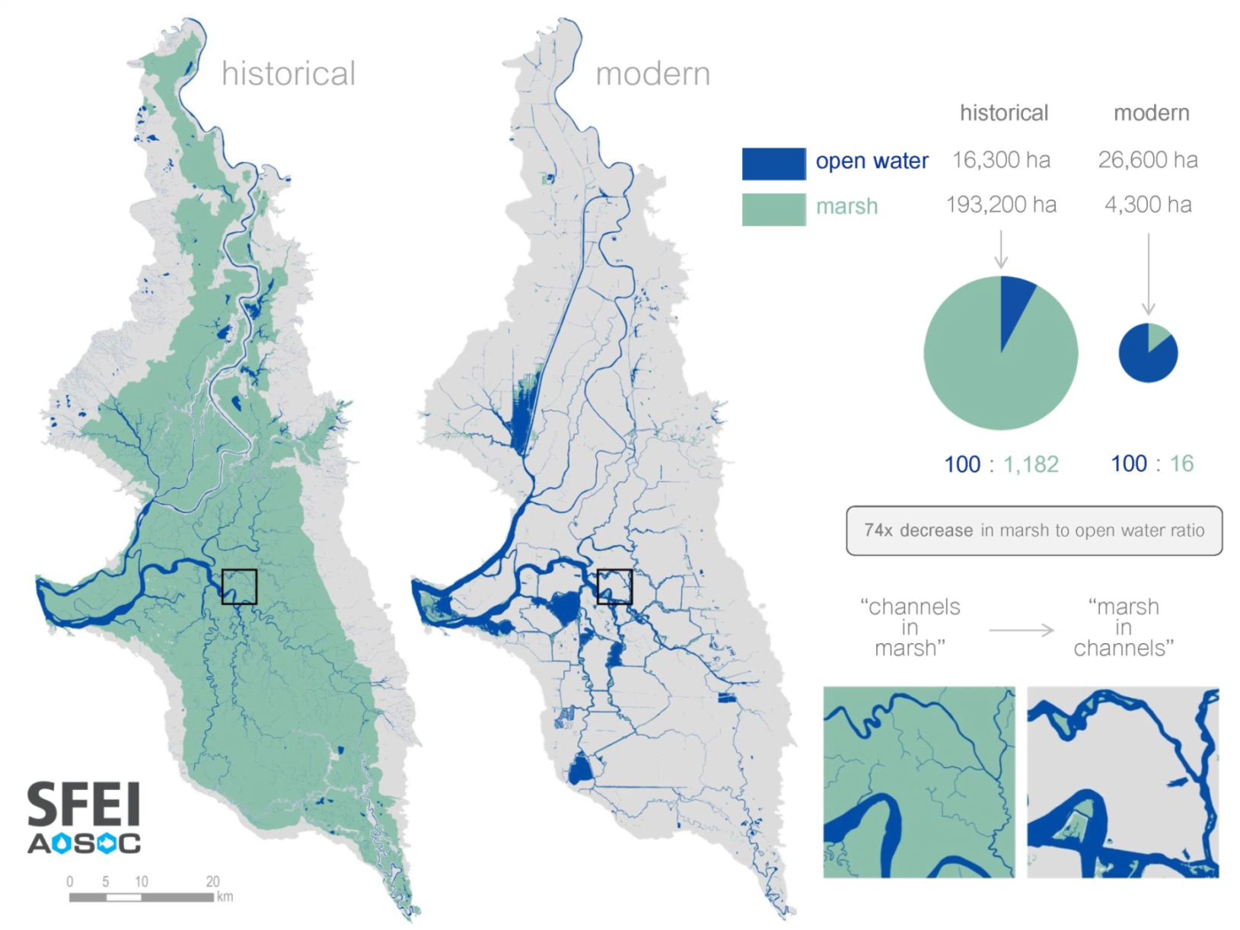
From Marshes… to Channels

Slide 8
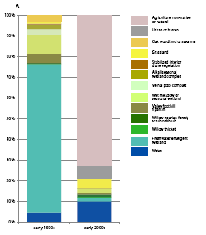
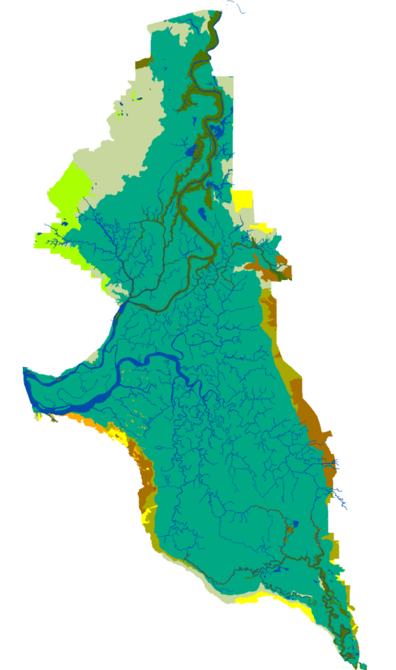
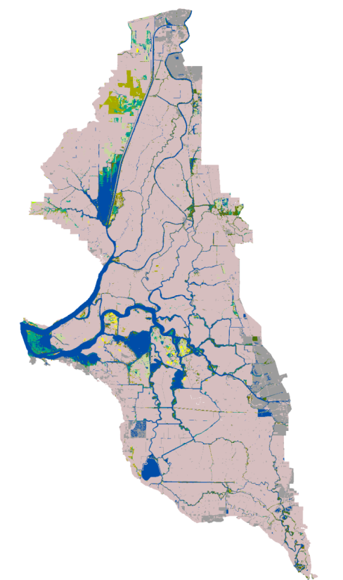
Land Cover - 1800s… to 2000s
Riparian
Seasonal wetland
Agriculture
Agriculture
Freshwater emergent wetlands
Urban
Open Water
Open Water
Freshwater emergent wetlands
Whipple et al. 2012, SFEI
Notes:
In the 1860s, a new era of reclamation began in the Delta as local reclamation districts were formed. Levees in the central Delta were built, often using the surrounding peat soils, to cut the wetlands off from tidal waters. Along the rivers to the north and south, the levees held back floods that historically filled the basins. Dense stands of tules were flattened and burned to make way for farmland.
In the early decades, the grueling work was mostly done by hand by Chinese laborers, as seen in this drawing.
Later, steam-powered dredgers sped up the work, like this clam-shell dredge, shown building up the height of an artificial levee around 1910. By 1890, the majority of the Delta had been leveed and by 1930, it was virtually entirely reclaimed. The levees continued to break, requiring costly work to repair them and drain the land, something that still happens today.

Slide 9
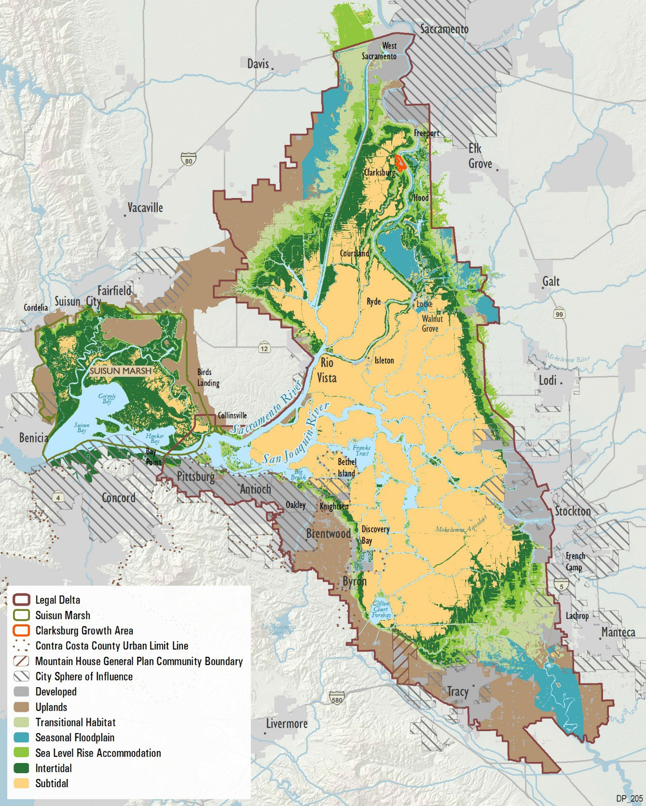
“Elevation is destiny”
Habitat potential affected by elevation
Central delta is too subsided to become intertidal wetlands
Sea level rise will submerge current intertidal
Source: Delta Plan 2013 (adapted from CDFG Conservation Strategy 2011)

Slide 10
First questions to ask
Landscape context
  Elevation and topography
  Placement in estuary
Dynamic processes
  Tides
  Flows
  Sediment
Scale
  Big enough
Connectivity

Slide 11
Restoration Project Examples
Cosumnes River/Grizzly Slough Floodplain (DWR)
Dutch Slough Tidal Marsh Restoration Project (DWR)
Tule Red Tidal Restoration Project (SFCWA / Westervelt Ecological Services)
Paradise Cut Flood Bypass (San Joaquin County RCD)
Grizzly Slough
Tule Red
Dutch Slough
Paradise Cut
Source (map): Delta Plan

Slide 12
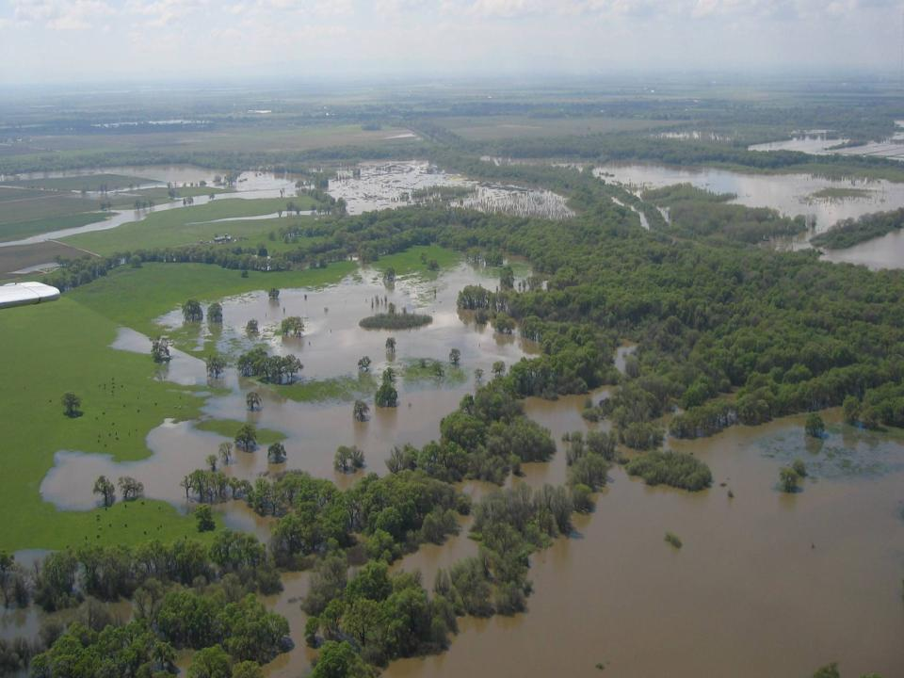
Cosumnes River Floodplain

Slide 13
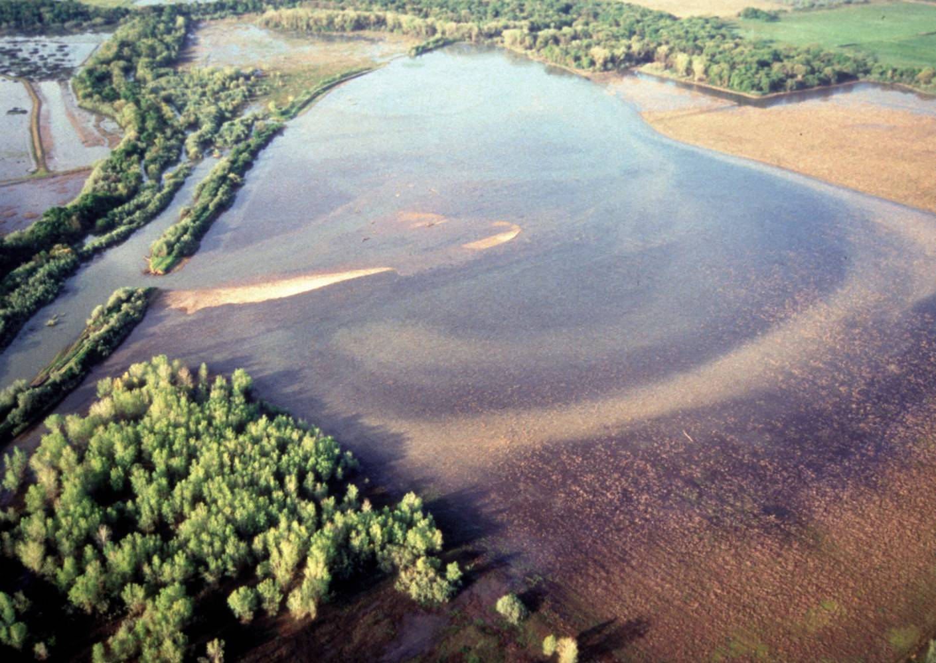
Flooding Restored
Photo: TNC

Slide 14
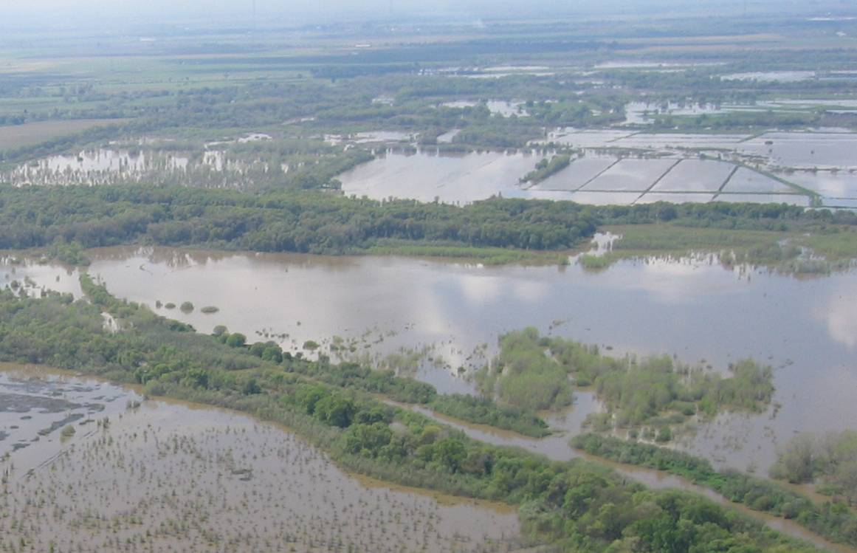
Restored floodplain – 9 years
March 2005

Slide 15
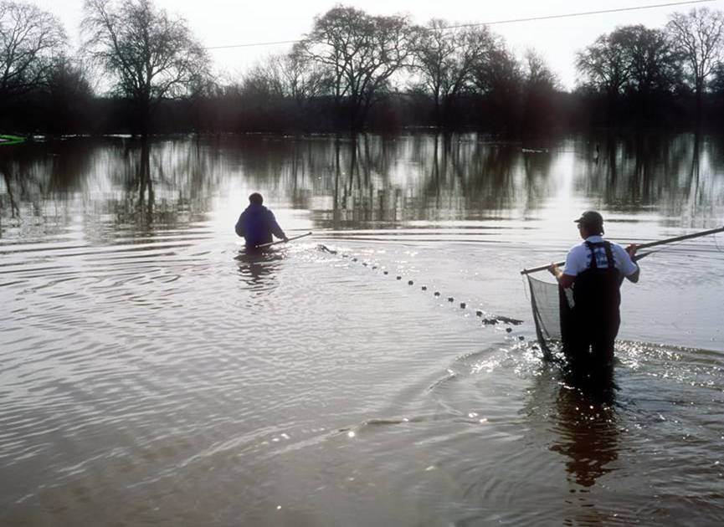
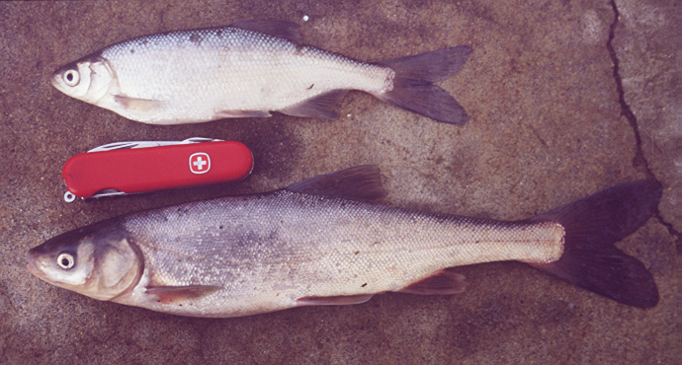
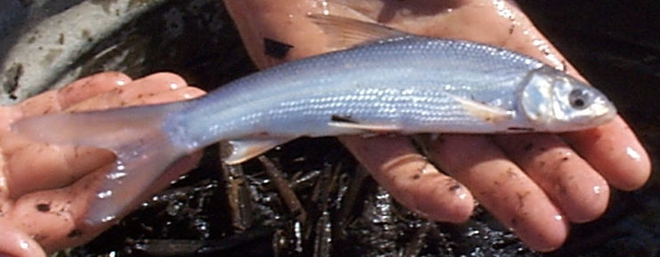
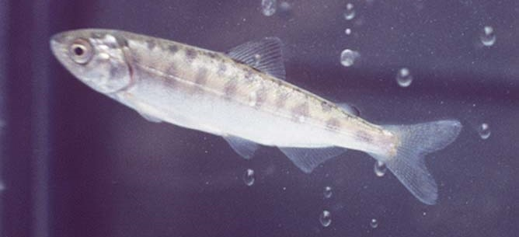
hitch
Sacramento blackfish
Sacramento splittail
Chinook salmon juvenile
Fish photos: P. Moyle

Slide 16
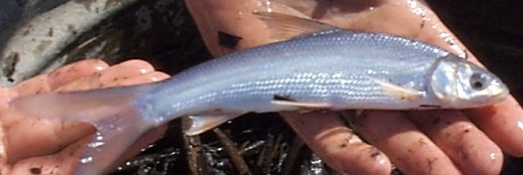
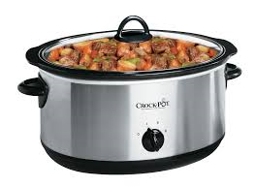
Floodplains Grow Fish
Sacramento splittail
How it works
  Small floods bring nutrients onto floodplain
  Shallow water + sunlight + nutrients = plankton bloom!
  Fish come onto floodplain to spawn and eat
  Draining water exports food resources into channels
Recipe for aquatic food web
  Small flood pulses every 2-3 weeks
  Inundate at least 9 days to stimulate algae bloom
  Then Zooplankton grow ~3 weeks
  Ideally inundate 30+ days January-March
Ahearn, Viers, Mount & Dahlgren. 2006. Freshwater Biology 51:1417–1433
Grosholz & Gallo. 2006. Hydrobiologia 568:91-109.

Slide 17
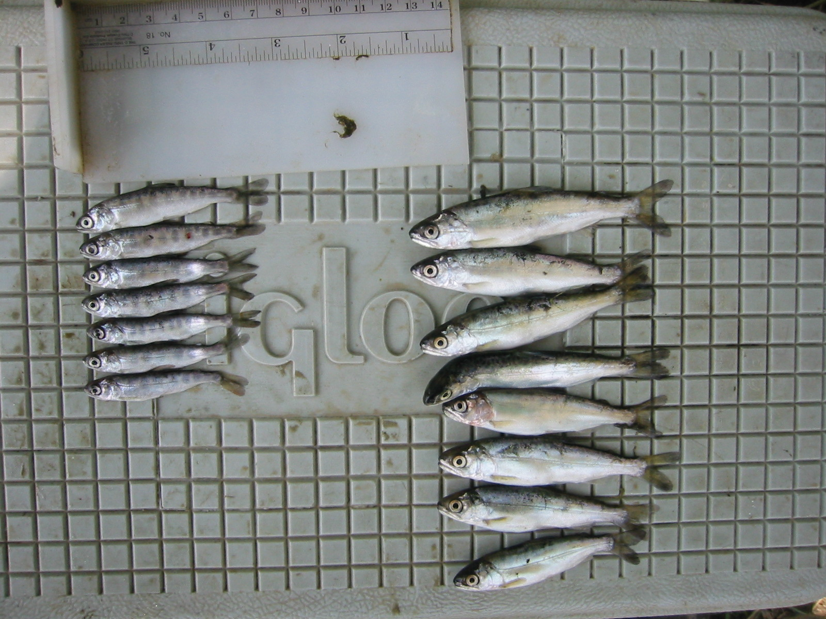
Cosumnes River Floodplain Experiment
River-raised chinook salmon
Floodplain-raised chinook salmon
2017 – Fish still using floodplain
Source: Carson A. Jeffres, Peter B. Moyle, & Jeffrey J. Opperman
Notes:
17
The implication is that likelihood of out migration, ocean rearing, and in migration success is positively correlated with size at out migration. Primary reasons for size difference is increased productivity on the floodplain, slower moving water (ability to prey), & ability to avoid predators in the shallows.

Slide 18
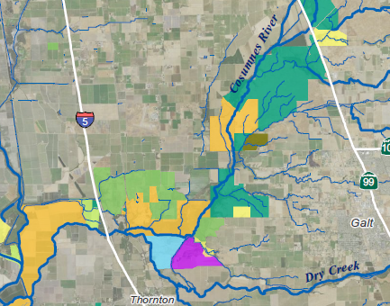
Let’s go breach!
Oneto/ Denier
TNC
McCormack-Williamson
TNC
Grizzly Slough DWR
Cosumnes Floodplain MB
Westervelt
SFEI 2012

Slide 19
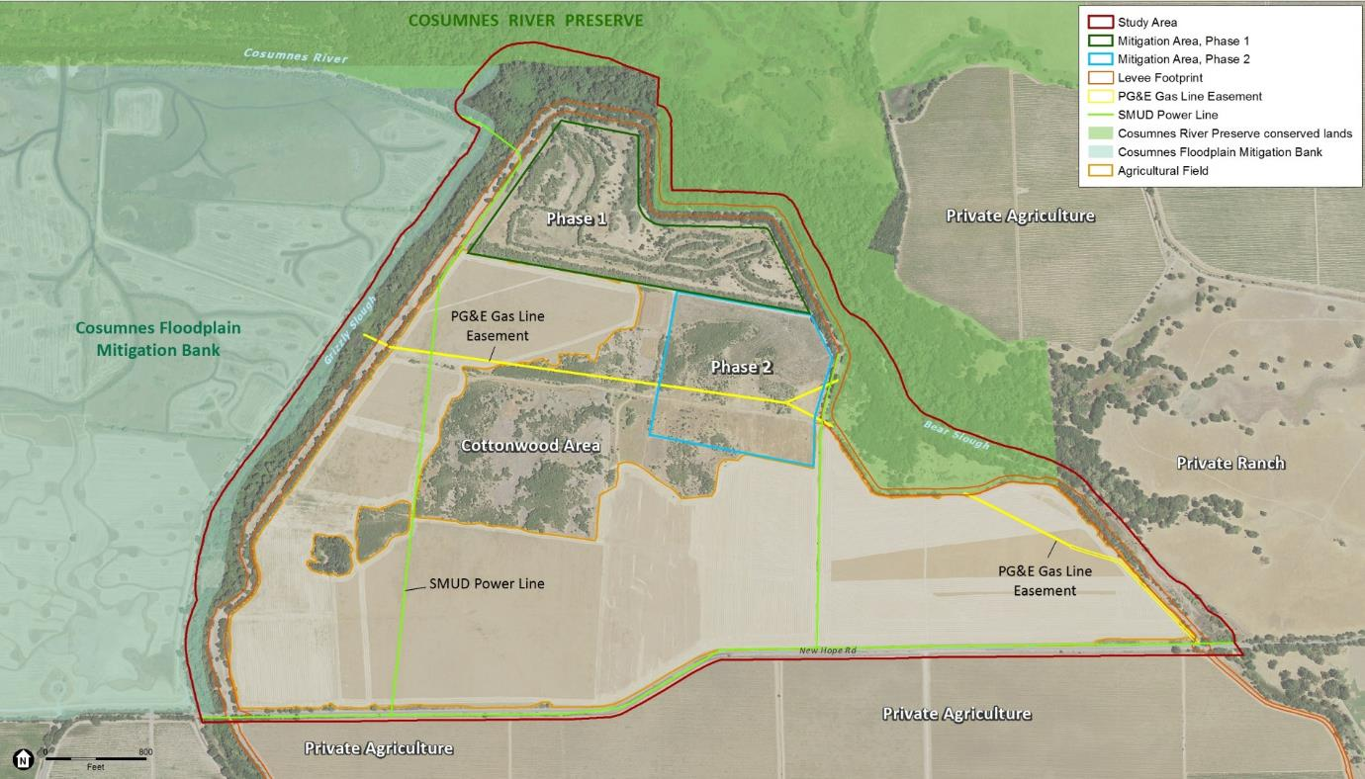
Grizzly Slough Floodplain Restoration - DWR
Notes:
ANITRA
Mention – utilities/easements as constraints
MENTION PHASE I and II AREAS – need to continue to meet these site’s obligations; or further enhance

Slide 20
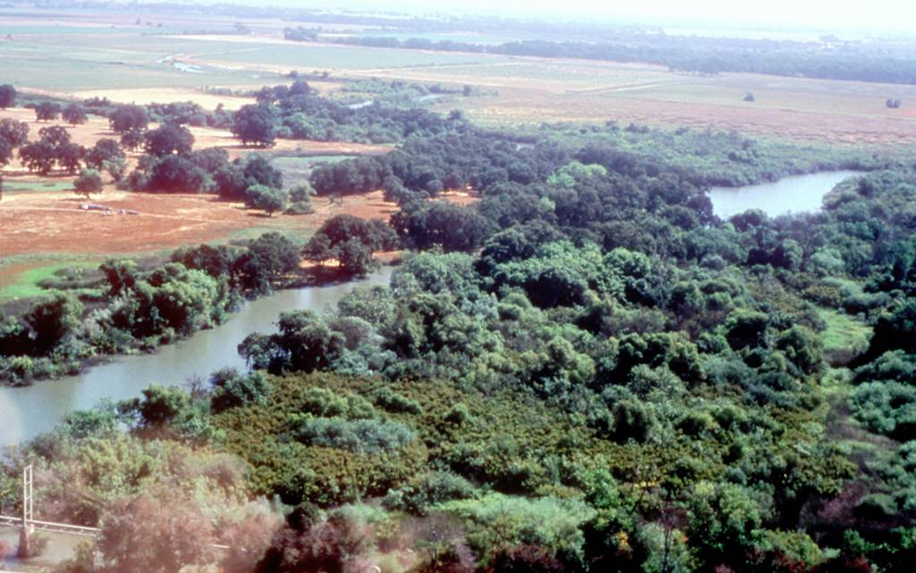
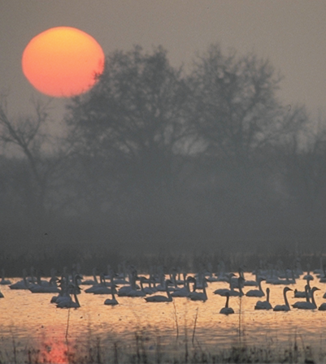
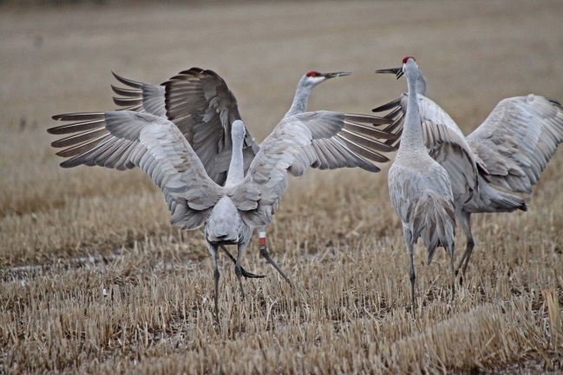
Grizzly Slough Floodplain Restoration - DWR
Goal: To restore and enhance riparian and wetland habitats to benefit native fish and wildlife
Recreate a frequently flooded riparian woodland and tidal wetlands to provide habitat for native fish and wildlife
Reconnect nearby waterways to the floodplain to restore natural hydrologic and geomorphic processes.
Enhance agriculture that supports wildlife, as possible

Slide 21
Elevation and topography
Tidal Datum | Elevation (ft NAVD88)
MHHW | 5.8
Mean Tide Level | 4.4
MLLW | 2.8
Mokelumne River at Benson’s Ferry
Notes:
ANITRA
Mention – utilities/easements as constraints
MENTION PHASE I and II AREAS – need to continue to meet these site’s obligations; or further enhance

Slide 22
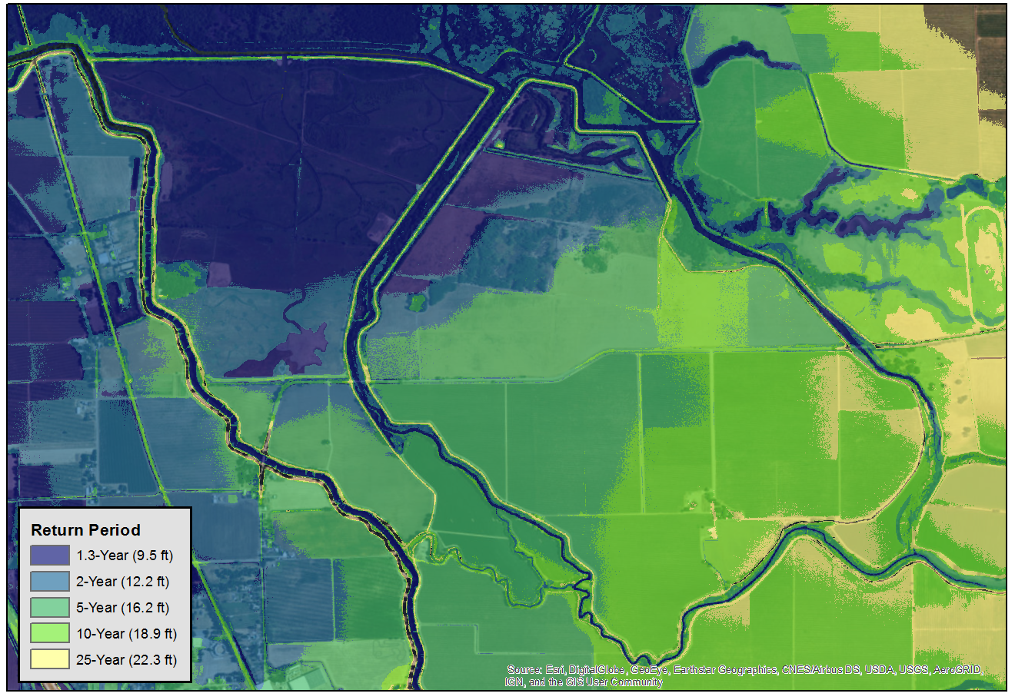
Flood Recurrence (modeled)
Cosumnes R.
Grizzly Slough
Mokelumne R.
Bear Slough
Dry Creek
Notes:
ANITRA (MICHELLE SUPPORT IF NEEDED)
**Keep quick
Note the different flood frequencies onsite.
Current flood frequency: the green is 10-year protection
2017 flooding: onsite levees overtopped (>10 year event occurred multiple times), breached to the south and flooded from the south. The whole area ponded water.

Slide 23
Restoration design
Breach
Irrigated Agriculture
Riparian forest
Notes:
MICHELLE
Key Features
Create a permanent breach in the levee at the north to allow natural flooding from Grizzly Slough
Grade small channels from the breach to improve flow exchange, increase habitat diversity, and ensure complete drainage to avoid fish stranding
Construct a new levee with one-directional flow culverts along New Hope Road to maintain existing levels of flood protection (same as previous concept). Considering a design option on the levee location.
Create an agricultural zone that sets aside 100-180 acres along the southern part of the site for agriculture to benefit wildlife and provide income for long-term management.
Implement a revegetation plan to jumpstart recruitment of native riparian species
Avoidance/minimization
waters, wetlands
high value habitats
known cultural resources
utilities
Describe the value of agriculture. Some net loss.
Facilitates public access. (optional)
Restored habitats
freshwater emergent tidal wetlands - 3 ac
~3000 lf tidal channels
seasonal wetland - 12 ac
valley foothill riparian - 91 ac
Enhanced
Existing riparian vegetation (71 ac)
Wildlife-friendly agriculture (157 ac)
Prior riparian mitigation areas (~70 ac) incidental benefit
Species benefits
Juvenile Chinook salmon and Sacramento splittail rearing
Swainson’s hawk nesting
Sandhill cranes and wintering waterfowl foraging

Slide 24
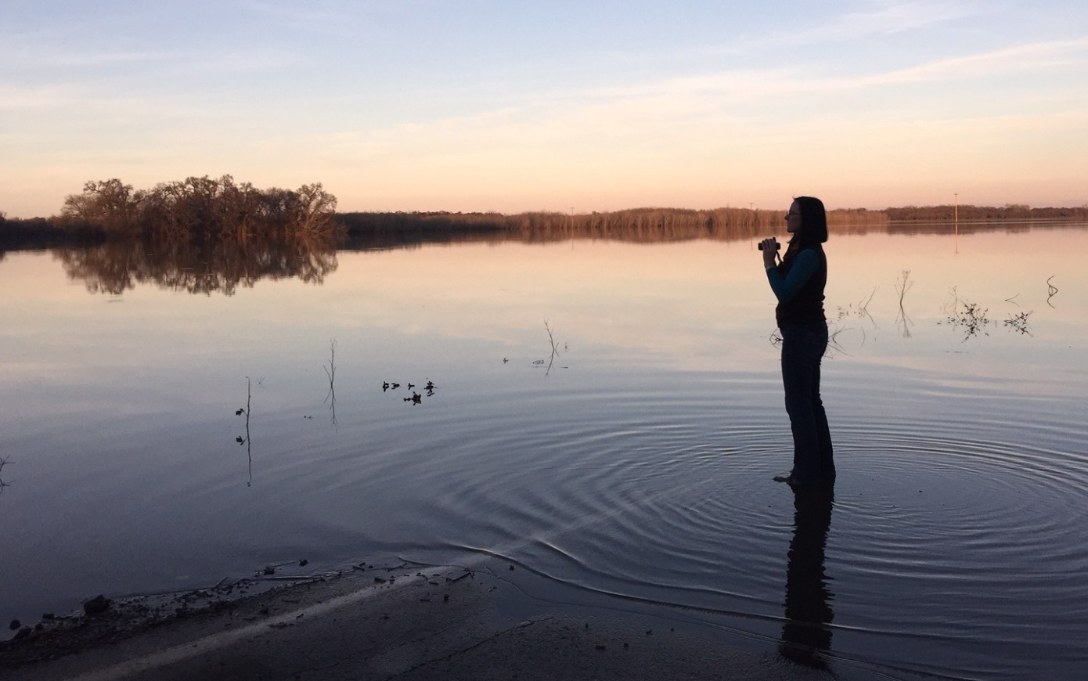
Grizzly Slough Floodplain Restoration
Next Steps
Final Design and Permitting 2018
Received Prop 1 funding for implementation
Construction to commence in 2019

Slide 25
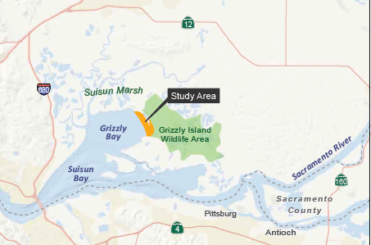
Suisun Marsh - Tule Red Tidal Restoration Project
Suisun Marsh

Slide 26
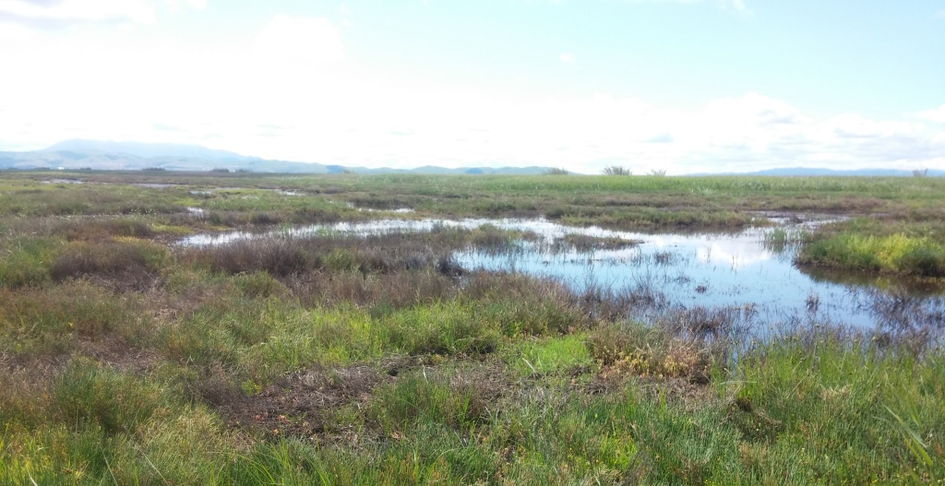
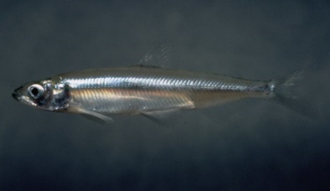
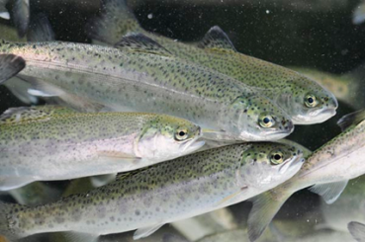
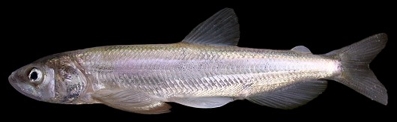
From duck club… to tidal marsh to benefit fish

Slide 27
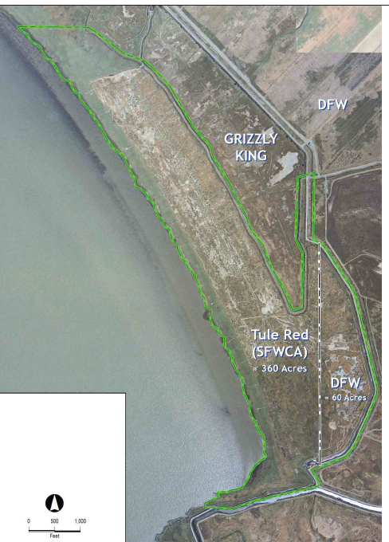
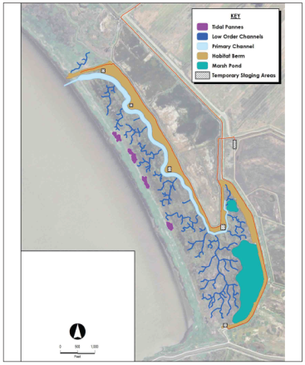
Tule Red Tidal Restoration Project
Duck Club – Managed Wetlands
Project – Tidal Wetland
377 ac tidal wetlands
30 ac tidal channels & ponds
Source: SFCWA/Westervelt Ecological Services 2016

Slide 28
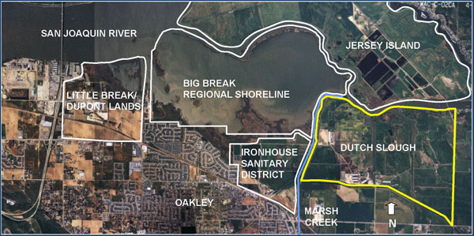
Dutch Slough
2003 DWR purchased (1,166 acres)
2008 EIR and Adaptive Management Plan
2014 Supplemental EIR
2015 update of Adaptive Management Plan
2016 Start implementation
Notes:
Objectives
Project Construction 2016
Excavate and import fill materia
Grading to elevations, excavate channels
Vegetation pre-establishment of tules
Levee breaching once tules are growing well

Slide 29
Objectives
Benefit native species by re-establishing natural ecological process and habitats.
Scientific understanding of Delta habitat restoration.
Shoreline access , educational and recreational opportunities.
Uncertainties → Hypotheses
Marsh plain elevation
  Fish survival and growth
  Food production and transport
Channel Planform and Scale
  Rearing and foraging habitat for salmon, splittail
  Predation by fish and birds

Slide 30
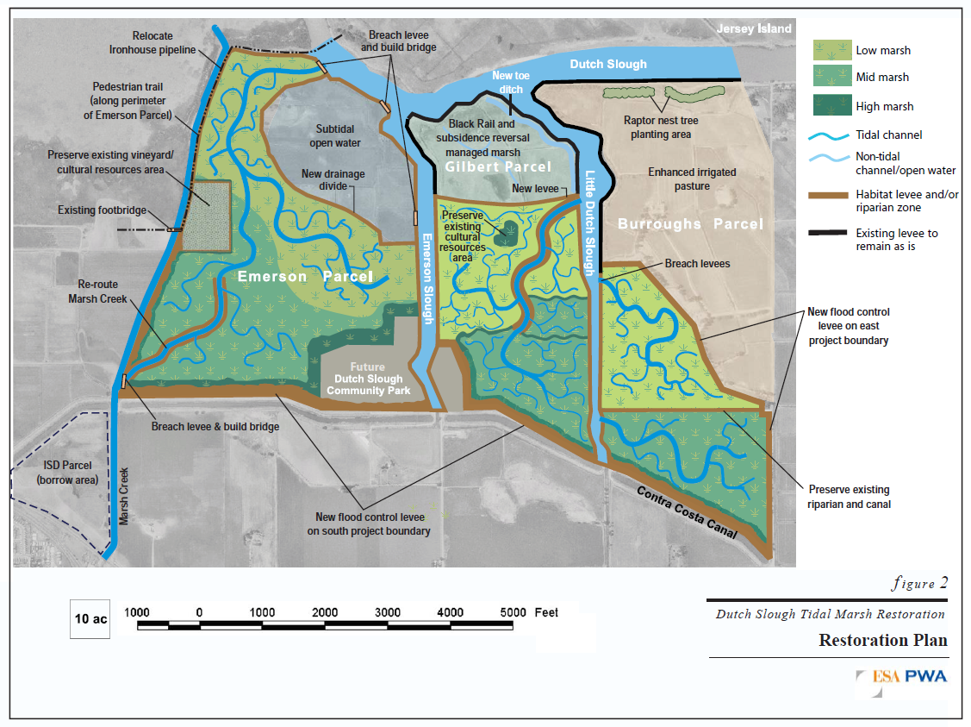
Dutch Slough Tidal Marsh Restoration Project

Slide 31
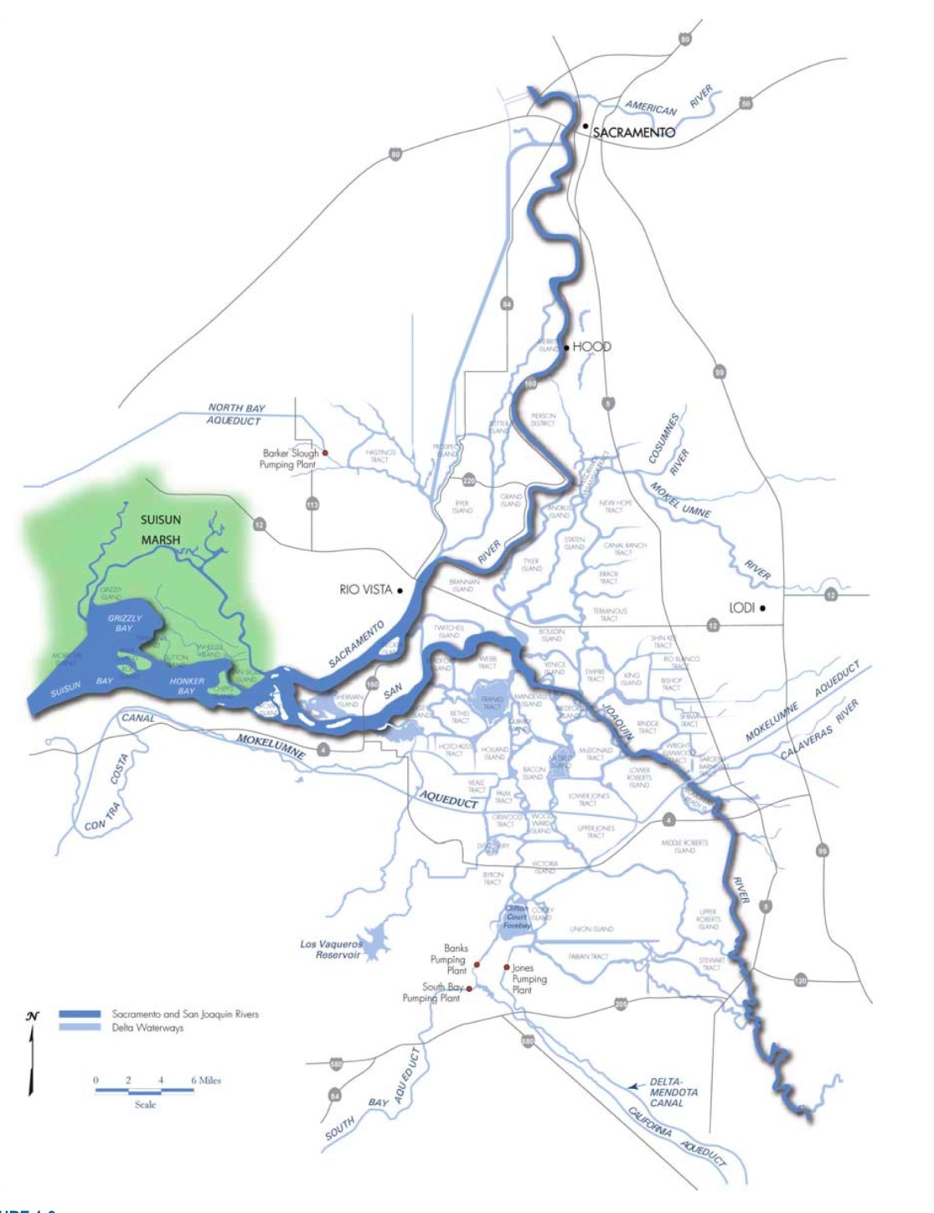
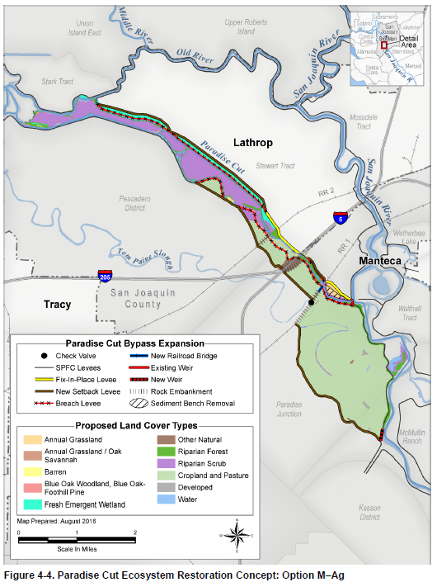
Paradise Cut Bypass Expansion Project
Lathrop
Flow direction
Tom Paine Slough

Slide 32
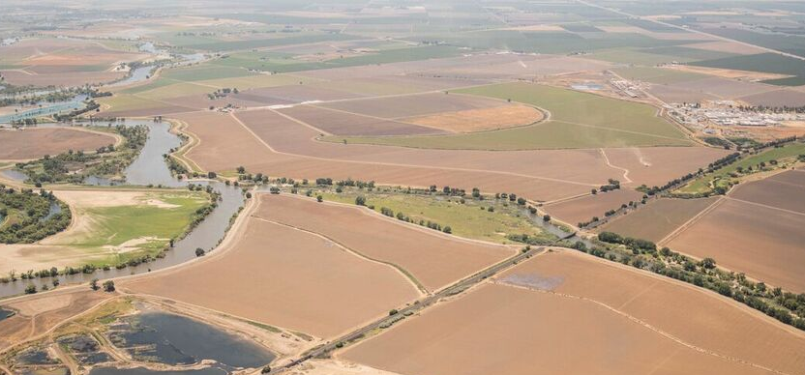
Paradise Cut Bypass Expansion Project
Looking South up the San Joaquin River. Photo by Daniel Nylen, American Rivers.

Slide 33
Project Description
Paradise Cut
DWR 2016
Conceptual Model Option M-ag
Existing Paradise Cut
Existing Weir
Add flood easement to agricultural fields
Flow direction
Tom Paine Slough
Create setback levees
Add new weir
Less than 10% chance of flooding in any given year.

Slide 34
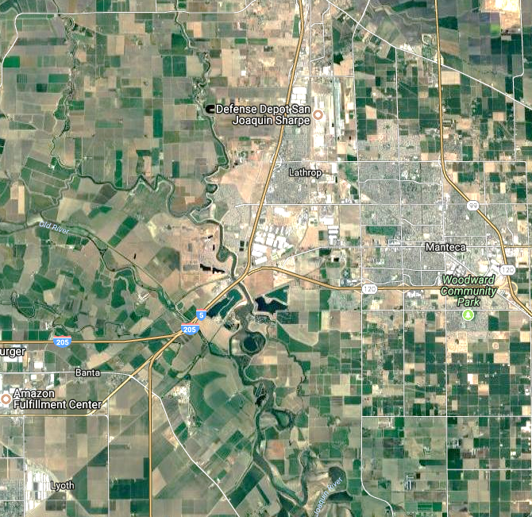
Directs water away from urban areas
Paradise Cut - Flood Risk Reduction Benefits
Safer controlled flooding
Dangerous flood waters

Slide 35
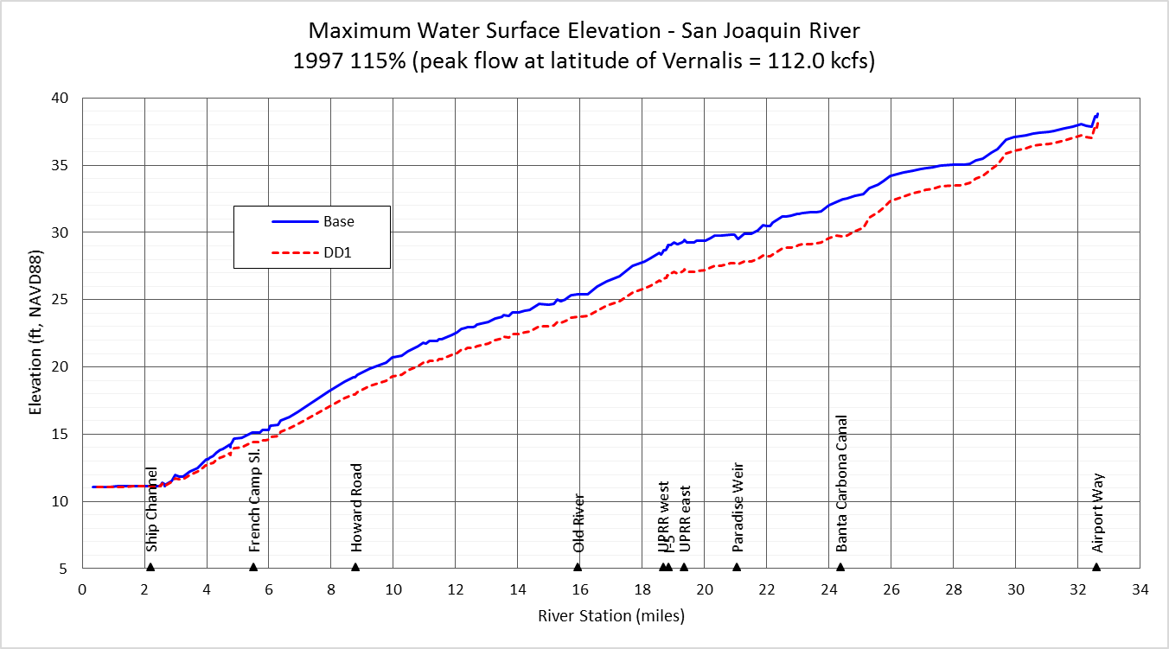
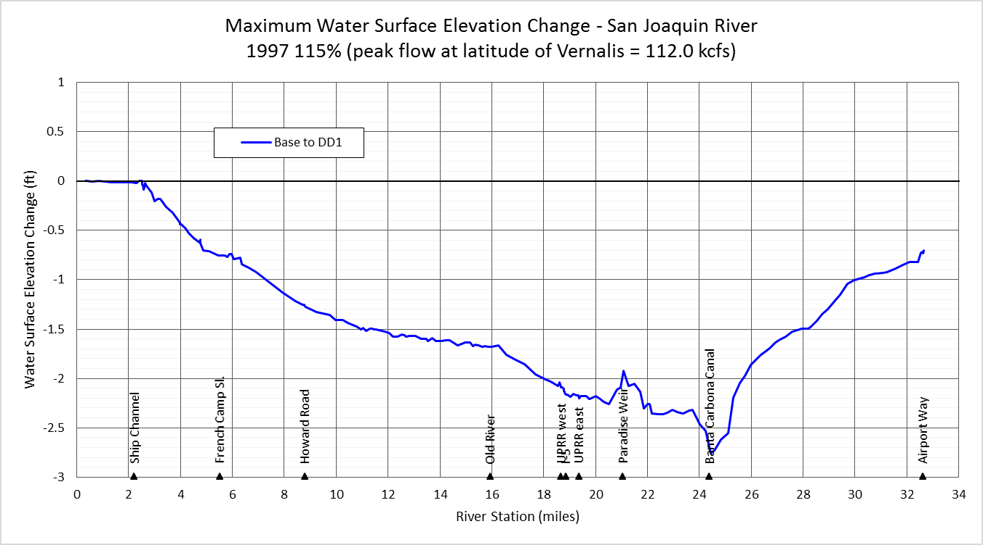
Paradise Cut - Flood Risk Reduction Benefits
Reduces river flood stage on San Joaquin River
Hydraulic Performance
200-year event (0.5% chance that flood of that magnitude or greater will occur in any given year)
~ 3ft reduction
San Joaquin River

Slide 36
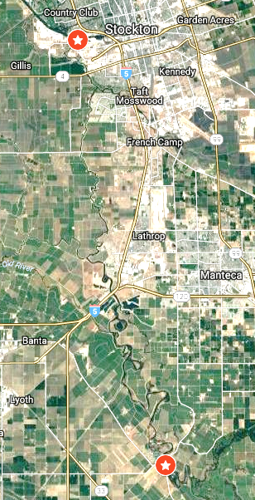
Reduces flood risk along >20 miles of river bank and thousands of acres of farmland
Paradise Cut - Agricultural Benefits
Lower reach of influence: Stockton
Confluence of San Joaquin with Ship Channel
Upper reach of influence:
Confluence of Stanislaus with San Joaquin

Slide 37
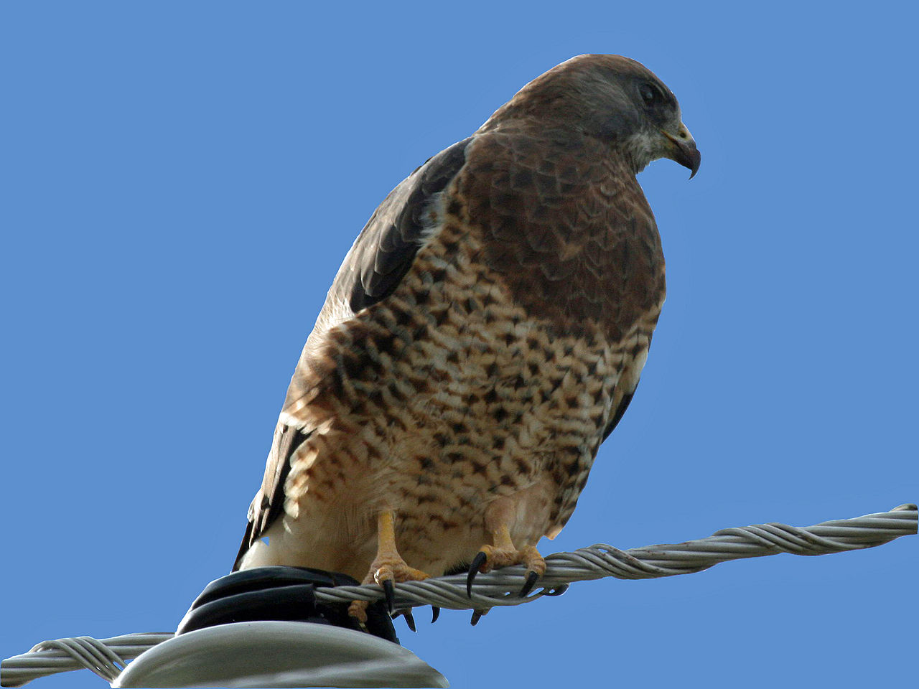
Annual agriculture is good for Swainson’s hawk
Paradise Cut - Ecosystem Benefits
Photo by Dick Daniels. Wikipedia.

Slide 38
Guiding Principles for Restoration
Consider landscape context
Restore critical physical and biological processes
Restore appropriate landscape connectivity
Focus on complexity and diversity
Create redundancy of key landscape elements, populations, and habitat types
Restore at large scales, with a long time horizon in mind
SFEI 2016
Physical
Elevation
Topography
Channels
Geomorphology
Hydrological Processes
Tidal
River Flows
Groundwater
Surface Runoff
Vegetation
Aquatic
Wetland
Forest

Slide 39
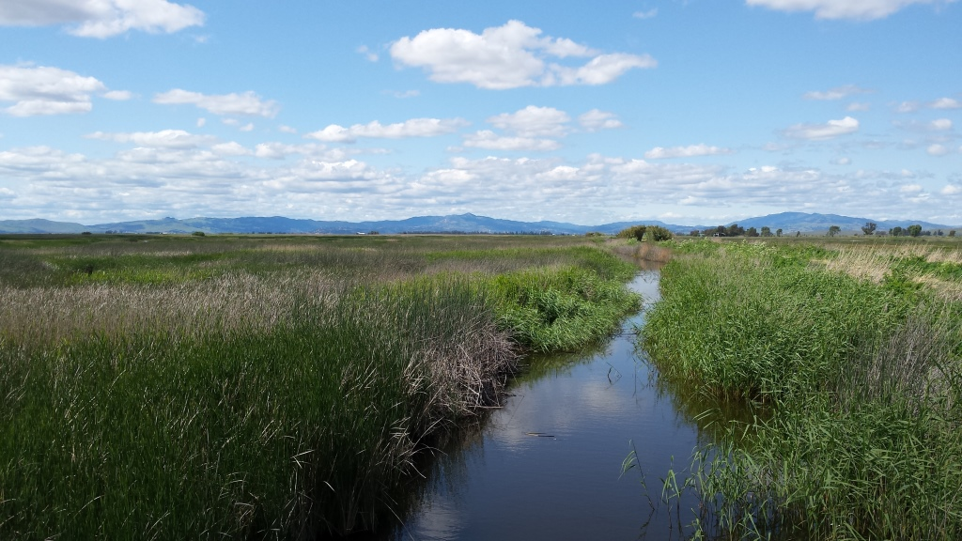
Thank you!

Slide 40
Looking to the future …..
How to measure success?
Species, community, or trajectory
Diverse Portfolio
Spatial - mosaic, patches
Temporal - successional stage, age
Long-Term Management
Invasive species
Surrounding land conversion
Compatible agriculture
Trespass
$$$
Climate change
Grizzly Slough property, Jan 28, 2017

Slide 41
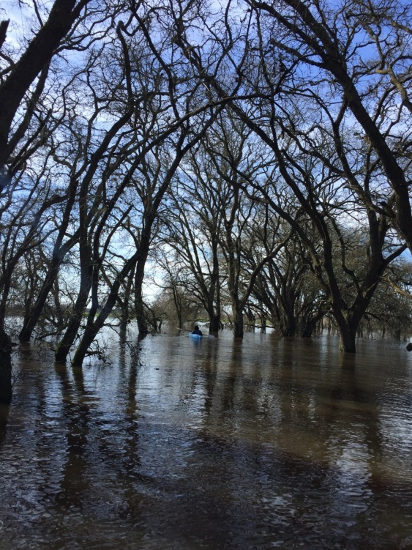

Slide 42

Cosumnes River floodplain
10,000 cfs, March 25, 2006
10,000 cfs, March 25, 2006
Photo: TNC
Notes:
Ecosystem restoration , which strives to restore the structure and functions of damaged ecosystems and/or protect existing functioning ecosystems from future losses.
What’s the goal?
Habitat?
Species?
Fixed endpoint/structure, or trajectory
Climax or mosaic?
What’s the method?
Process-based restoration
Elevation is destiny
What’s next?
Management
Exotics
$$$

Slide 43

Why Restore?

Slide 44

Cosumnes River Floodplain,
spring flood 2005 TNC photo
Notes:
Floodplains are among the most productive and diverse ecosystems on Earth.
Naturally-functioning floodplains provide a wide variety of ecosystem services (habitat, water supply, flood retention, water quality enhancement, groundwater recharge)
But floodplain ecosystems are also some of the most impacted and at risk ecosystems globally.
Nationally, there is an increasing focus upon ecosystem restoration, which strives to protect existing ecosystems, and restore the structure and functions of damaged ecosystems. Billions of dollars are being invested in ecosystem restoration.
Protect natural biodiversity.
Provide spawning, nesting, and feeding habitat for fish and waterfowl.
Store flood waters and slowly release them.
Enhance ground water recharge.
Improve water quality by filtering pollutants
Reduce erosion.
Trap sediments.
Enhance scenic beauty and
Provide recreation.

Slide 45


Accidental Forest
33 years (2017)
Cottonwood, oak coming in
13 yr old cottonwood forest (1997)

Slide 46

Process Restoration
Allow flooding and natural succession to restore floodplain ecosystem.
1995 – Intentional breach, 180 acres
1997 – Floods cause breach. Protect infrastructure and restore 94 acres
Notes:
46

Slide 47
Eco-Restore
Yolo Bypass
Suisun Marsh
Cosumnes River
30,000+ acres of Delta habitat restoration in 5 years
Includes 8,000 ac of tidal marsh for compliance with USFWS and NMFS BiOps and CDFW ITP for Coordinated Operations of CVP and SWP
Liberty Island
Grizzly Slough
Mokelumne R.
Tule Red
Dutch Slough

Slide 48
Ecosystem Goals of Restoration
Diverse habitats and ecosystem processes
Functional corridors for migratory species
Recover salmon and listed species
Restore habitat for migratory birds
Restore large areas of interconnected habitats
Restore Delta flows and channels to support a healthy estuary and other ecosystems
Reduced threats and stresses on the Delta ecosystem
Reduce impacts from invasive species
Improve water quality
Delta Reform Act
Notes:
Restoring physical, chemical, and biological processes that create and maintain
habitat requirements, rather than creating just the habitat requirements,
can prove more sustainable and beneficial for ecological functioning, and
potentially require less management in the long term

Slide 49

Sediment Deposition
Photo: TNC
Notes:
In the first few years, the floodplain experienced rapid accretion of sediment and subsequent scour of channels. This restored topographic heterogeneity to the formerly leveled farm field.

Slide 50


Staten Island
SFEI 2012

Slide 51


Cosumnes River: Floodplains and Riparian Forest
Historic Habitat
Current
Cosumnes R.
Sacramento River
Mokelumne R.
Source: SFEI 2012

Slide 52

Flood Types - Cosumnes
1908-2014
Floodplain inundation 812 cfs
Whipple, Viers, Dahlke. 2017. Flood regime typology for floodplain ecosystem management as applied to the unregulated Cosumnes River. March 2017. Ecohydrology
Notes:
Floodplain inundation at 812 cfs Michigan Bar gage (23m³/s)

Slide 53


Hydrology
Large and Long
Jan 1997 93,000 cfs
Mar 2005 10,000 cfs
  Very Large Floods
Notes:
Flooding is the physical process that shapes and sustains these ecosystems.
Natural floodplain ecosystems are adapted to highly variable hydrologic regimes, which include periodic droughts, infrequent catastrophic floods, and relatively frequent periods of inundation

Slide 54

Reference Site
Tall Forest
“Accidental” Forest
13 yr old cottonwood forest (1997?)
Notes:
Check the date on this photo. Had said 1993, but that’s not 13 years old if the breach was in 1985-6.

Slide 55



Levee Breached October 1995
Photos and handiwork: R. Reiner TNC

Slide 56




Before
5/22/1993
7 years
4/30/2002
15 years
9/19/2010
21 years
10/25/2016
Photos: Google Earth
Notes:
5/22/1993
4/30/2002
6/30/2006
9/19/2010
10/25/2016

Slide 57



Habitat Mosaic
Oregon Ash
Diverse vegetation
Supports diverse nesting birds
J. Wood, J. Hammond et al. PRBO
Cottonwood & willow on sand splay
Herbaceous vegetation
2m
Photos: R. Swenson

Slide 58
hitch
Sacramento blackfish
Sacramento splittail
Chinook salmon juvenile
Fish photos: P. Moyle

Slide 59
Floodplains Grow Fish
Sacramento splittail
How it works
  Small floods bring nutrients onto floodplain
  Shallow water + sunlight + nutrients = plankton bloom!
  Fish come onto floodplain to spawn and eat
  Draining water exports food resources into channels
Recipe for aquatic food web
  Small flood pulses every 2-3 weeks
  Inundate at least 9 days to stimulate algae bloom
  Then Zooplankton grow ~3 weeks
  Ideally inundate 30+ days January-March
Ahearn, Viers, Mount & Dahlgren. 2006. Freshwater Biology 51:1417–1433
Grosholz & Gallo. 2006. Hydrobiologia 568:91-109.

Slide 60
Cosumnes River Floodplain Experiment
River-raised chinook salmon
Floodplain-raised chinook salmon
2017 – Fish still using floodplain
Source: Carson A. Jeffres, Peter B. Moyle, & Jeffrey J. Opperman
Notes:
60
The implication is that likelihood of out migration, ocean rearing, and in migration success is positively correlated with size at out migration. Primary reasons for size difference is increased productivity on the floodplain, slower moving water (ability to prey), & ability to avoid predators in the shallows.

Slide 61
Ecological Outcomes of Process-Based Floodplain Restoration
Hydrologic connectivity
Sediment deposition and scour
Topographic complexity
Seed dispersal and cuttings for recruitment
Riparian forest establishment and succession
Native fish spawning and rearing
Aquatic productivity boost
Greater ecological function when restore processes

