Slide 1
Lake Havasu City Water Supply
A Small Fish in the Big Ocean of Water Policy - At the Front Line of Colorado River Shortages

Slide 2
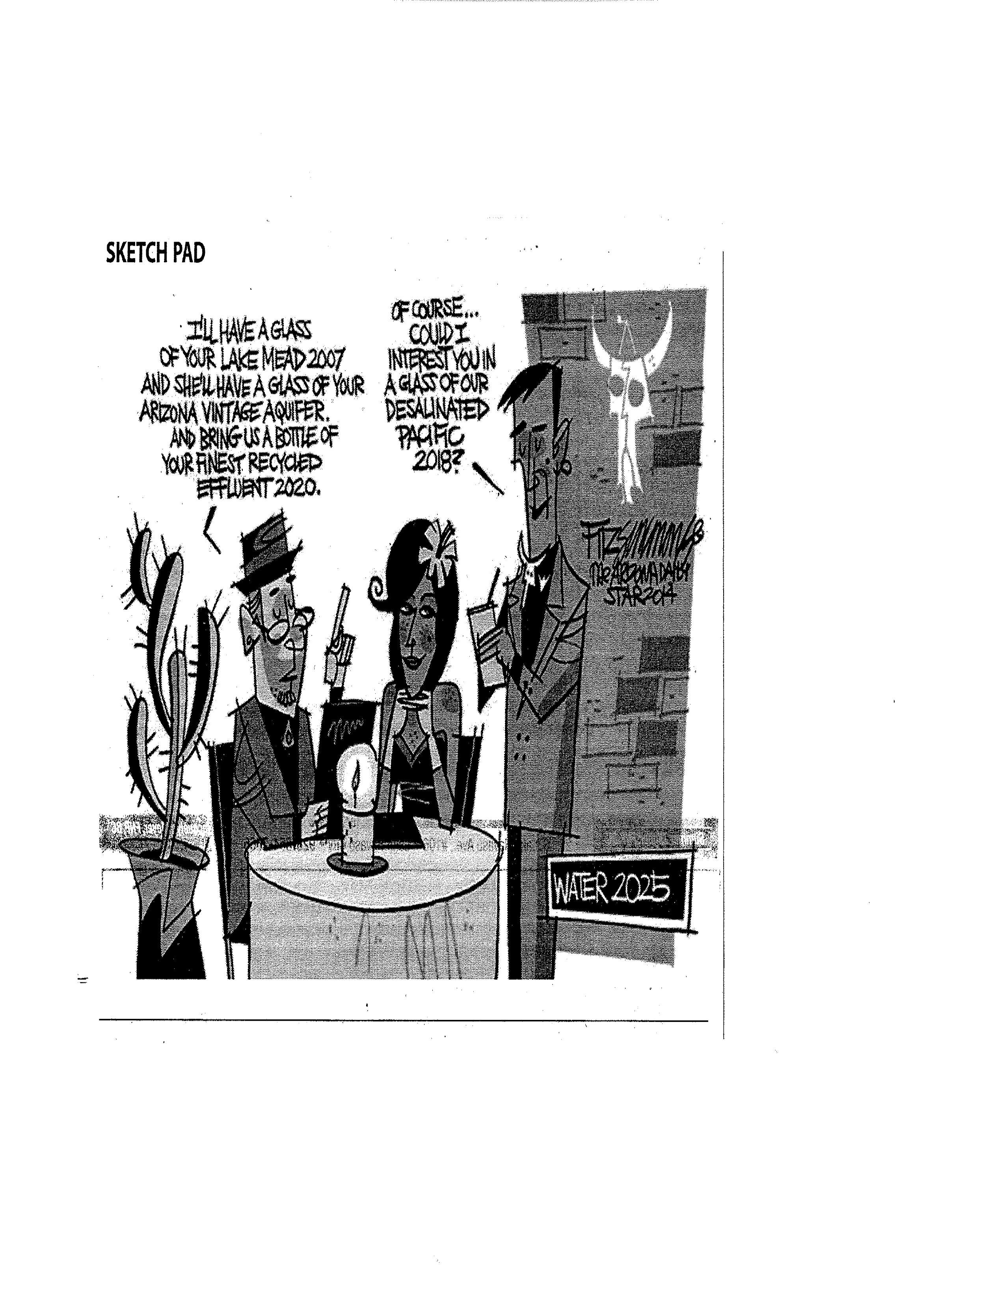
…
…and lastly, how about a savory appetizer of bacon-wrapped Lake Havasu quagga mussels??

Slide 3
Presentation Outline
Lake Havasu City Water Diversion, Water & Wastewater Treatment, and Reuse
Current Colorado River Basin Conditions
How Shortages will Affect LHC?

Slide 4
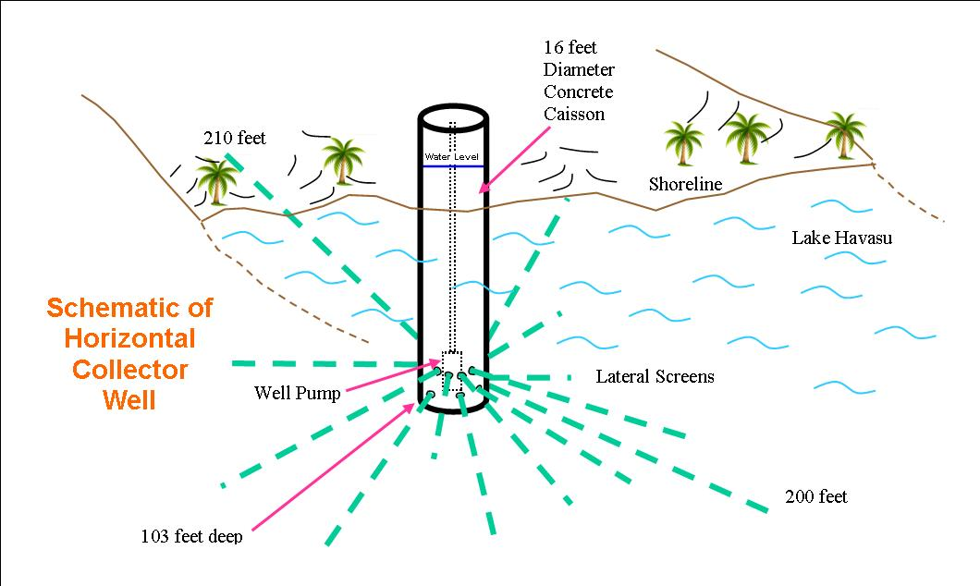
Horizontal Collector Well
26 mgpd Capacity = 98% of all water for the city

Slide 5
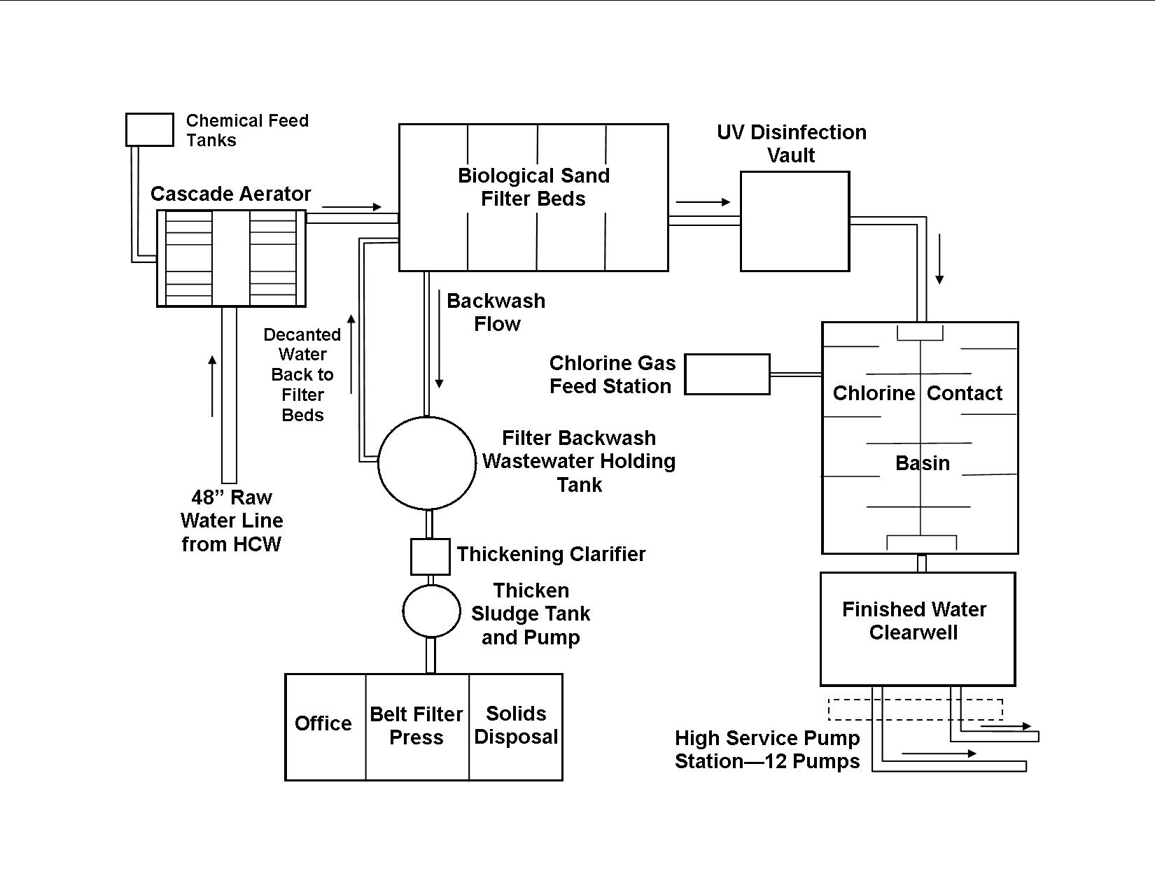
Water Treatment Plant
Capacity – 26 mgpd
FeCl₃ – coagulation and As removal

Slide 6
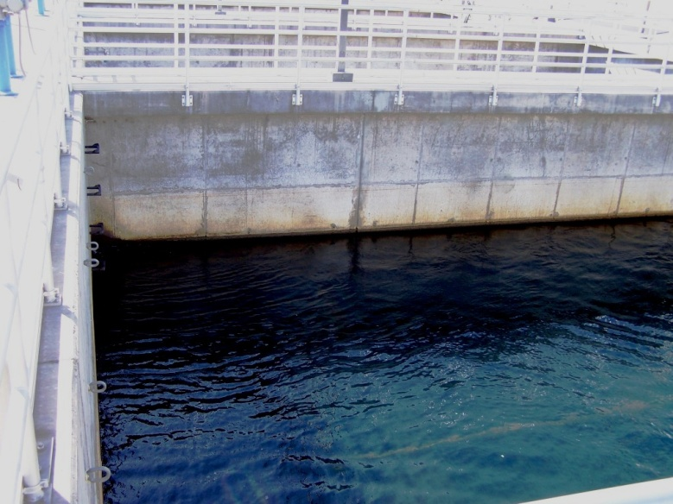
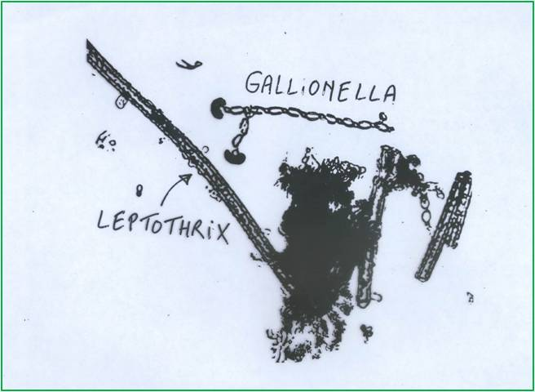
Biological Filtration fo Manganese Removal
- Four filter bed basins that are 46' long x 31' wide x 18' deep carry seven feet deep of sand containing filamentous bacteria, such as those in genera of Leptothrix, Gallionelle, Crenothrix, Hyphomicrobium, Siderocapsacaes, Siderocystis, Metallagenium and Pseudomonas manganoxid.
The bacteria metabolize manganese and iron to separate those elements from the water in the form of iron hydroxide and manganese dioxide, both that remain in the filter media until the filter is backwashed.
The microbes need no special nutrients added to the water to help them grow, but need to have the water with a pH higher than 7.4 in order to best remove the manganese.
Colorado River water is above this mark and it is oxygenated, which keeps chemicals such as hydrogen sulfide and ammonia out of the water that could kill bacteria.
As = 5,900
Ba = 860
Cr = 200
Co = 66
Cu = 89
Fe = 370,000
Mg = 3,600
Mn = 54,000
Ni = 70
Na = 1,000
Sr = 950
V = 1,000
Solids Assaymg/kg
dry

Slide 7
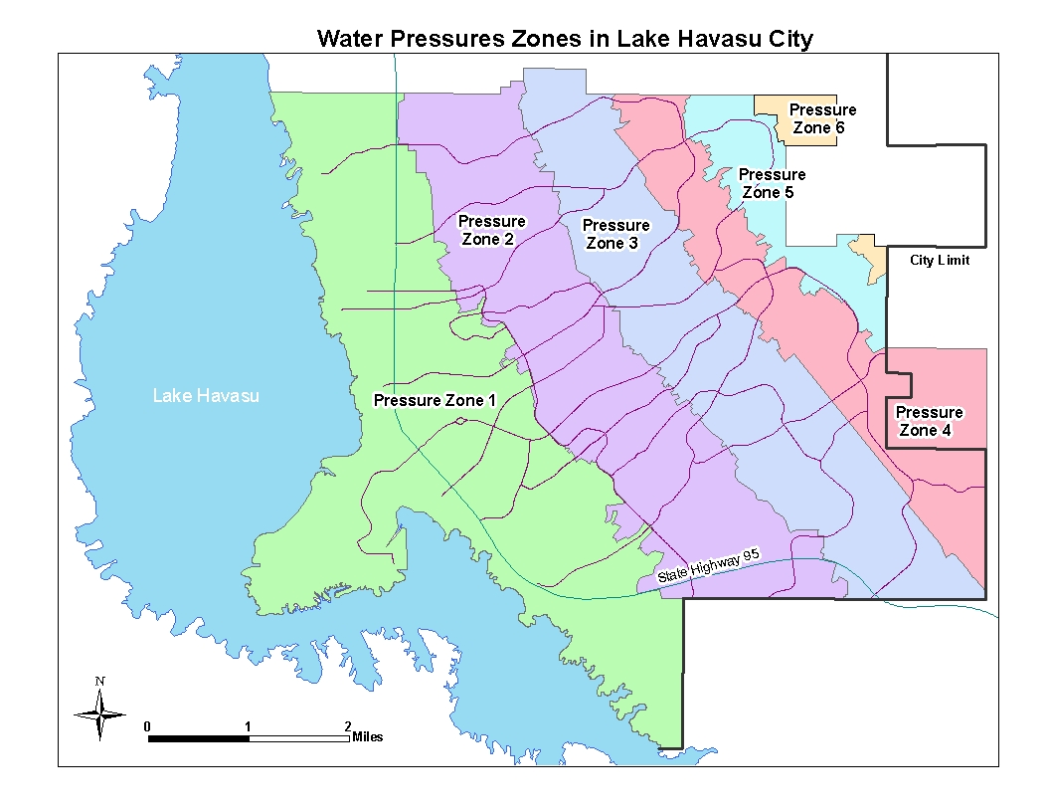
Water Distribution & Return
WWP
WTP
WWP
WWP
Recently finished (2011) wastewater expansion program sewered ~85% of the City. ~3.5MGD ave.

Slide 8
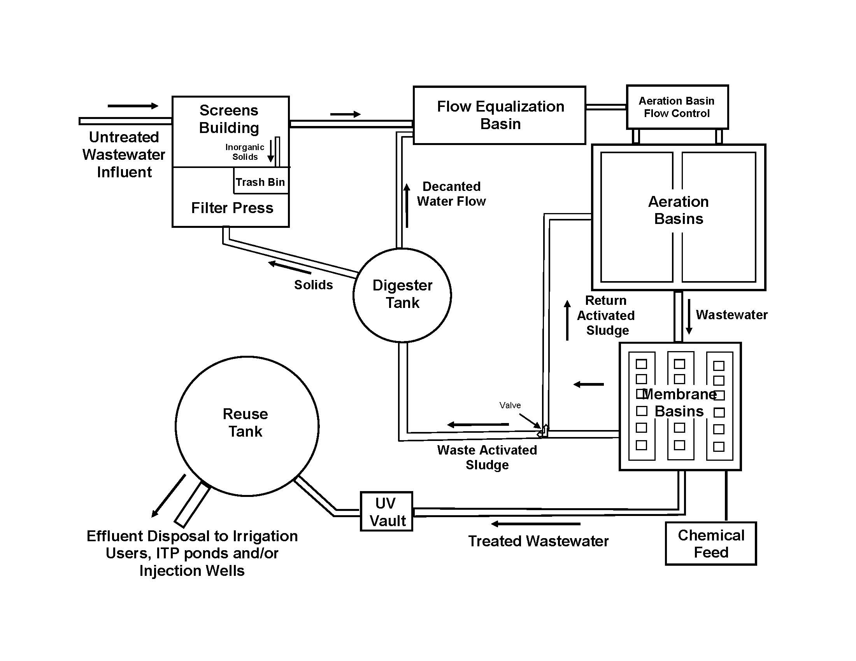
Wastewater Treatment
Three total Plants – 2 are Standard Activated Sludge Aeration Plants and one that includes an ultra (0.04µm) Membrane Bioreactor After Aeration.
North Regional WWTP

Slide 9
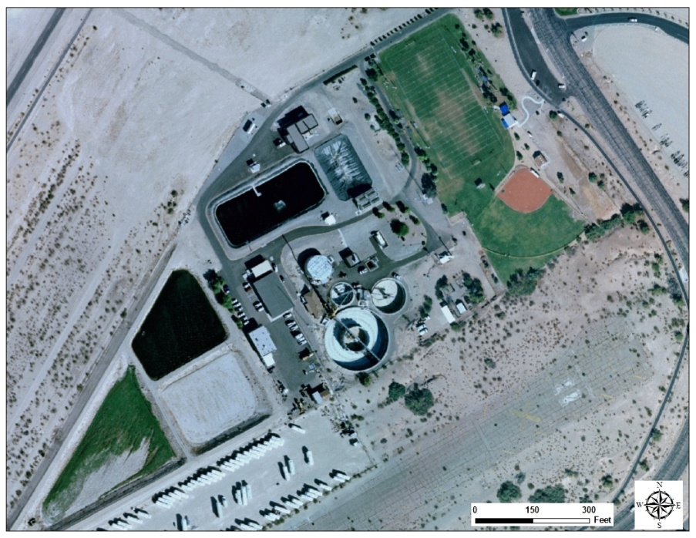
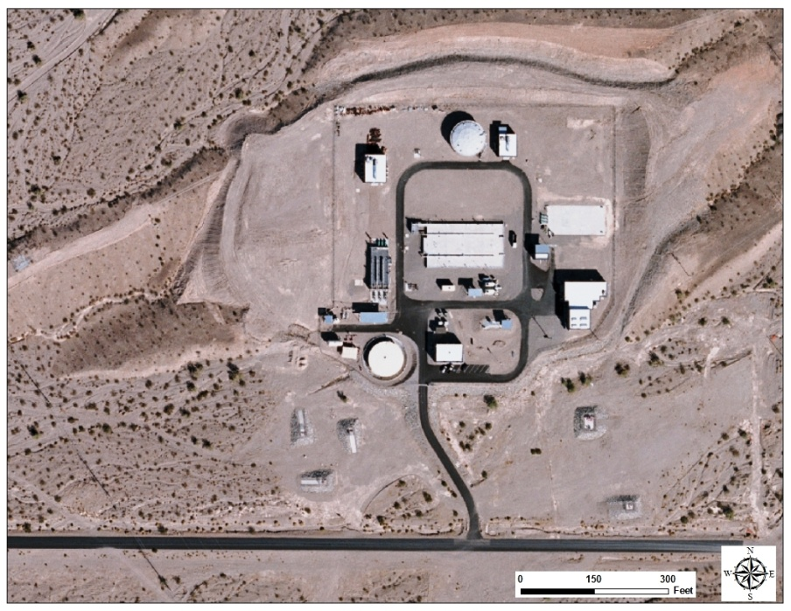
Reclaimed Water Reuse
Close to ½ of Total Effluent Generated Goes to Irrigating 4 Golf Courses and a handful of smaller irrigators (~2,000 ac-ft/year).
The Rest is Either Currently Percolated and is Considered Return Flow to the River or is Injected into the Subsurface for Storage.
The City is Planning to Expand its Reclaimed Water Reuse for Irrigation to Replace at Least Another 1000 ac-ft of Colorado River Used Today.
IWWTP
NRWWTP
Vadose Injection Wells

Slide 10
Current Lower Colorado River Basin Conditions

Slide 11
Current Lakes Mead and Powell Volumes as of 2-24-2014
Lake Mead Level and % Capacity
Lake Powell Level and % Capacity
Capacity Current
Elevation: 1219.6’ 1108’
Volume: 26.12 Mac-ft 12.52 Mac-ft
~48% full
Capacity Current
Elevation: 3700’ 3577’
Capacity: 24.322 Mac-ft 9.877 Mac-ft
~41% full
1108’
3576’
1075’

Slide 12
CR Interim Guidelines for Shortages and Coordinated Operations for Lakes Mead and Powell
Equalization of reservoir storage in Lake Mead and Lake Powell.
In effect to 2026 – negotiations to extend this strategy or develop a new plan will begin much sooner.
Shortage declaration tiers if forecast Lake Mead elevation reaches a trigger elevation in January.
* Minute 319 with Mexico will expire at the end of 2017, if not extended to 2026.
If lake level falls below 1025 ft, then renegotiation with the Seven Basin states.
Shortage Stage | Lake Mead Trigger Elevation (feet amsl) | Volume of Total U.S. Shortage (ac-ft) | Arizona’s Entitlement with Shortage (Mac-ft) | Nevada’s Entitlement with Shortage (ac-ft) | Water Delivery Reduction to Mexico (ac-ft)*
Tier I | 1075’ | 333,000 | 2.48 | 287,000 | 50,000
Tier II | 1050’ | 417,000 | 2.40 | 283,000 | 75,000
Tier III | 1025’ | 500,000 | 2.32 | 280,000 | 125,000

Slide 13
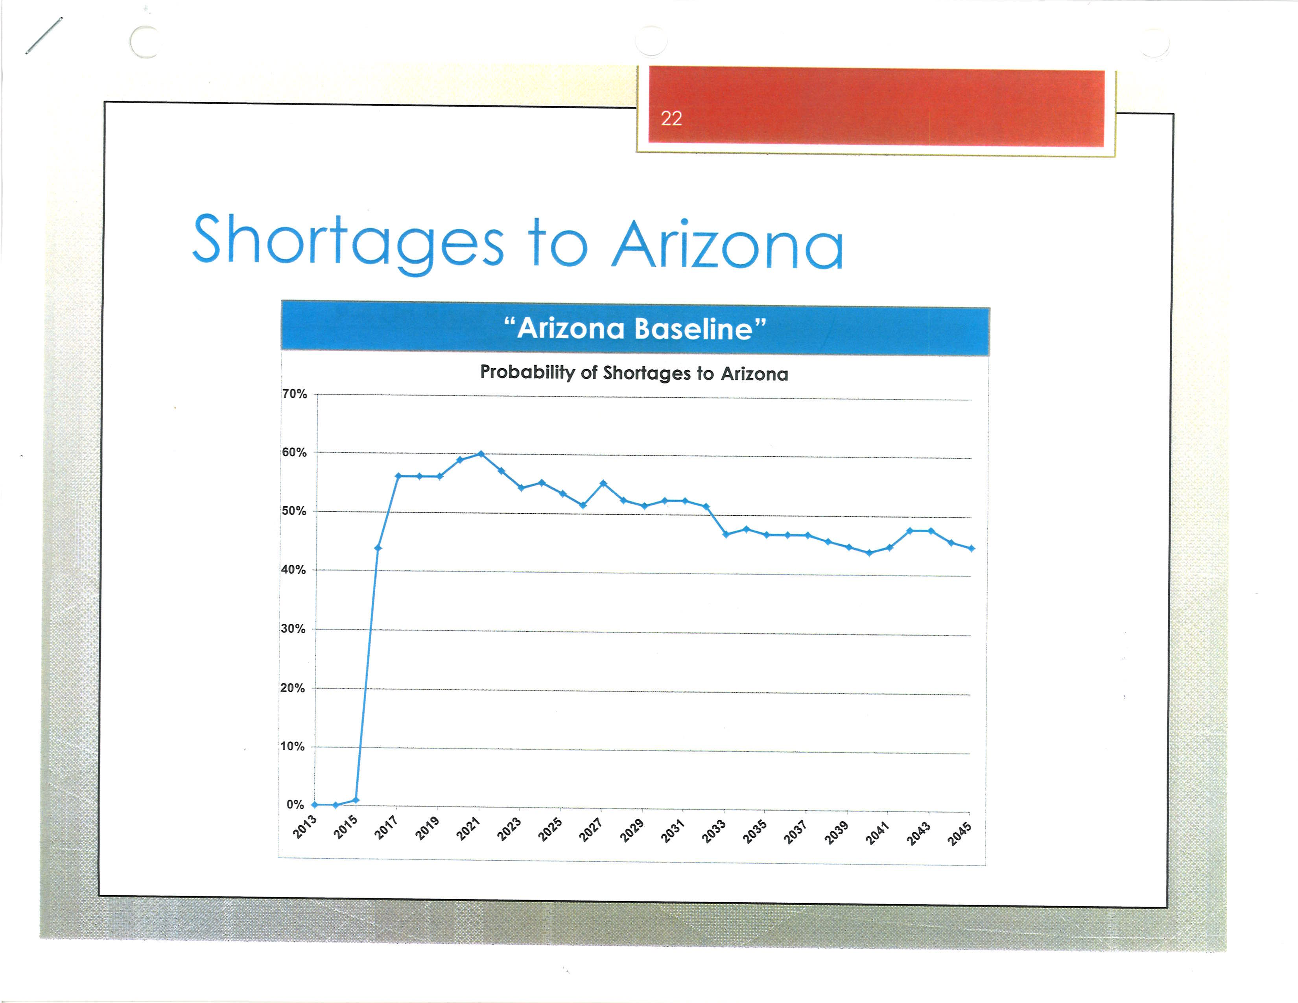
Central Arizona Project CR Shortage Declaration Probabilities
60%
50%
40%
2016
2045
2026

Slide 14
Bureau of Reclamation February 2014 24-Month Study
Bureau of Reclamation Operation Plan For Lake Mead - Most Probable Flows
 | Date | Lake Mead Elevations (feet amsl)
 | February 1, 2014 | 1108.40
 | March 1, 2014 | 1103.40
 | April 1, 2014 | 1096.90
 | May 1, 2014 | 1091.13
 | June 1, 2014 | 1086.74
 | July 1, 2014 | 1084.86
 | August 1, 2014 | 1084.61
 | September 1, 2014 | 1083.74
 | October 1, 2014 | 1084.06
 | November 1, 2014 | 1083.66
 | December 1, 2014 | 1086.79
 | January 1, 2015 | 1088.00
 | February 1, 2015 | 1088.04
 | March 1, 2015 | 1083.97
 | April 1, 2015 | 1078.31
 | May 1, 2015 | 1074.07
 | June 1, 2015 | 1071.78
 | July 1, 2015 | 1072.78
 | August 1, 2015 | 1075.41
 | September 1, 2015 | 1077.25
 | October 1, 2015 | 1078.61
 | November 1, 2015 | 1078.16
 | December 1, 2015 | 1081.99
 | January 1, 2016 | 1084.28
1075

Slide 15
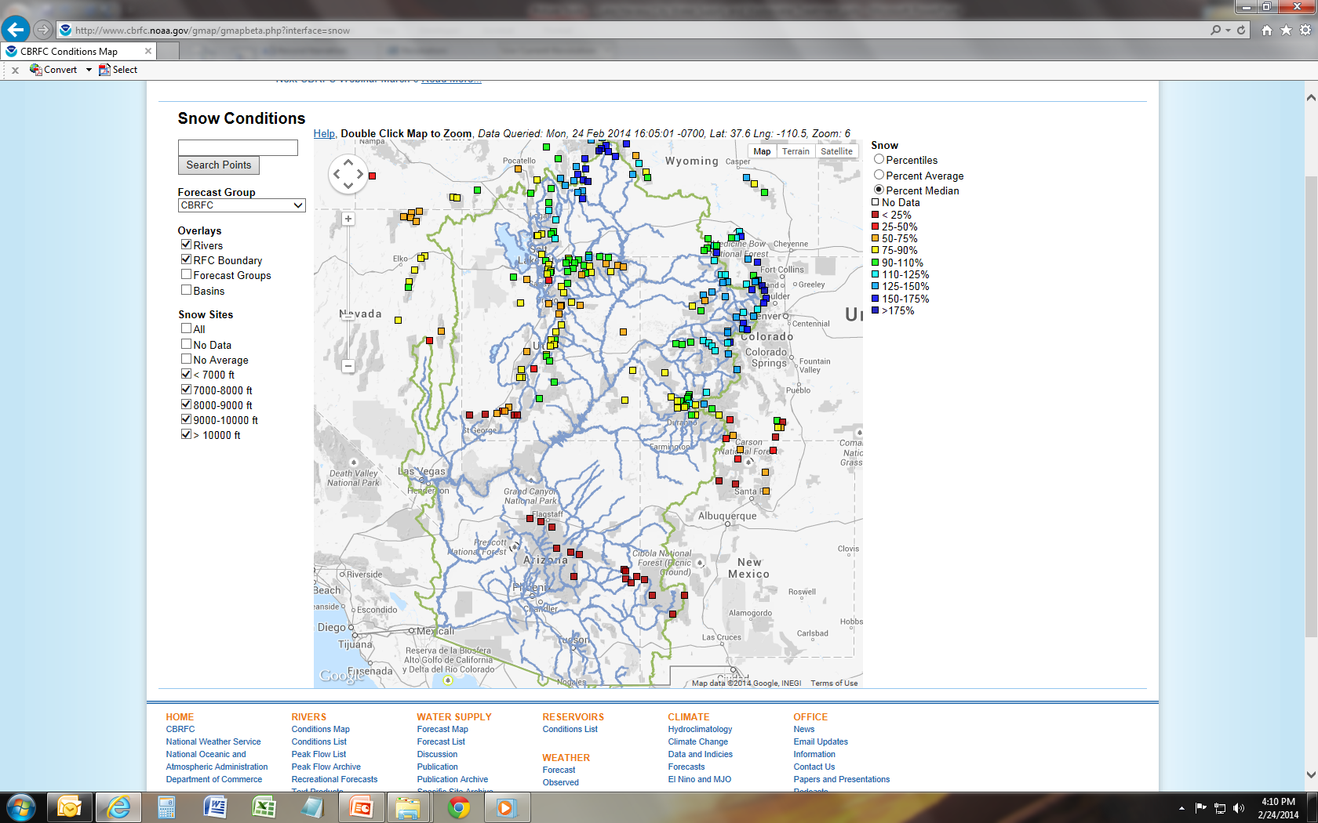
February 24th 2014

Slide 16
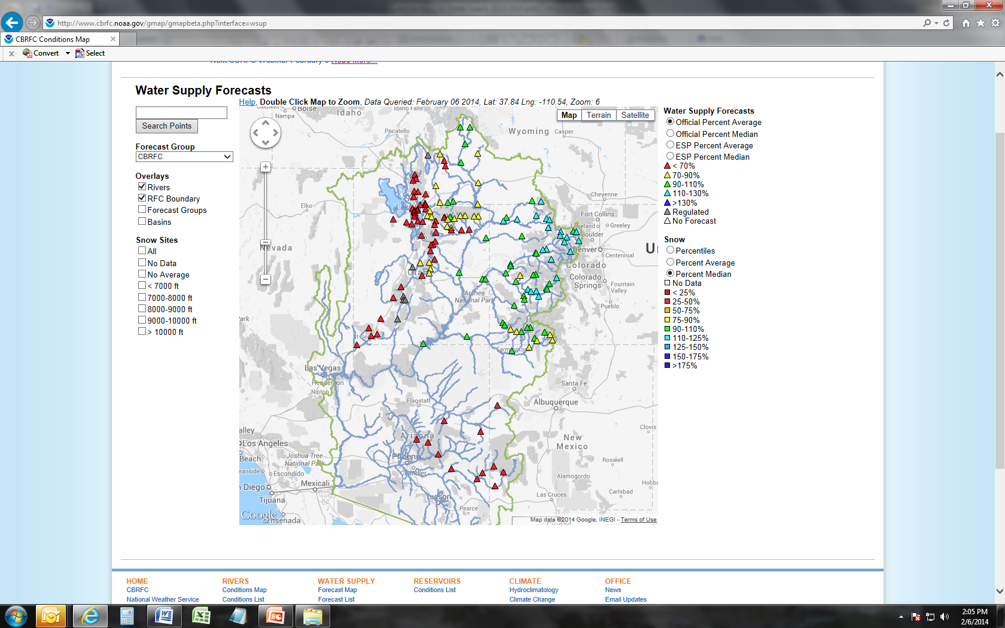
February 6th 2014

Slide 17
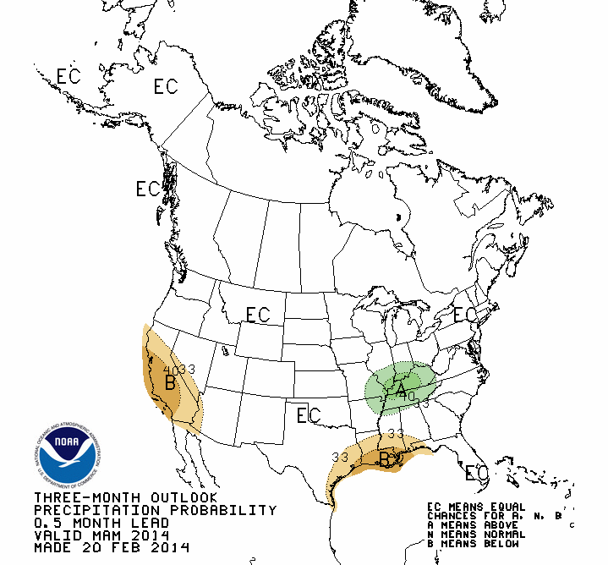
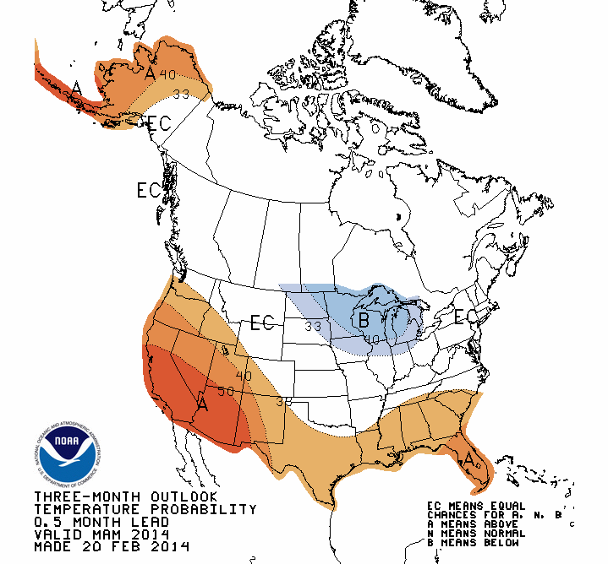
March through May 2014
Temperature Chances
Precipitation Chances

Slide 18
What Declared Shortages mean to One Little Fish on the River

Slide 19
Lake Havasu City Colorado River Water Supply and Demand
Entitlement = 28,331 ac-ft – all 4th Priority
_________________________________________________________________
Firmed water banked through the Arizona Water Banking Authority =
~126,000 ac-ft – good for withdrawal until 2096
______________________________________________
Approximate Consumption Demand in 2013 =
13,000 ac-ft. LHC was at ~18,000 ac-ft/year in 2006.
______________________________________________
Intrastate Shortage Sharing Agreement that Reductions will come from the Contract Entitlement

Slide 20
How Will Reductions to 4th Priority Entitlements be Determined?
ADWR outlined to Reclamation, a five step Recommendation:
2.8 Mac-ft - AZ P1-3 demand = P4 Availability
P4 Availability - AZ Shortage Reduction = P4 Available after Shortage Reduction
164,652 ac-ft / P4 Availability = P4 Mainstream Shortage %
P4 Available after Shortage Reduction x P4 Mainstream Shortage % = P4 Mainstream Shortage Reduced Supply
Remainder of P4 Available after Shortage Reduction goes to CAP.
Exact water allocated to P4 contracts depends on the P1-3 demand at the time and discretion of the Interior Secretary.

Slide 21
Estimated Range of Reductions to LHC Entitlement
Arizona Reduction Lake Havasu City Reduction¹ Resulting Entitlement
320 KAF ~5300 - 6200 AF ~23,031 - 22,131 AF
18.7% - 21.8%
400 KAF ~6700 - 7700 AF ~21,631 - 20,631 AF
23.6% - 24.7%
480 KAF ~8000 - 9200 AF ~20,331 - 19,131 AF
28.2% - 32.3%
¹Based on calculations given in the last slide and given 1.3 to 1.1 Mac-ft P1-3 demand.

Slide 22
These Calculations are Dependent on Several Factors – There are Wild Cards to Consider
Mexico’s shortage share could disappear very soon (2017). – w/o Mexico’s contribution, the tier 3 shortage could lower to 16,710 ac-ft.
“…the Secretary will have considerable discretion to distribute Colorado River water during shortage.” - from BOR
Reclamation’s interim management period is only guaranteed for another 12 years.
Same is true for the intrastate shortage agreement between Mohave County Water Authority and central Arizona.
PLUS: How quickly will the succession of shortages take place?
The weather is at best a question mark and Lake Mead has been known to drop by more than 20 feet in one year. (i.e. 2001, 2002)

Slide 23
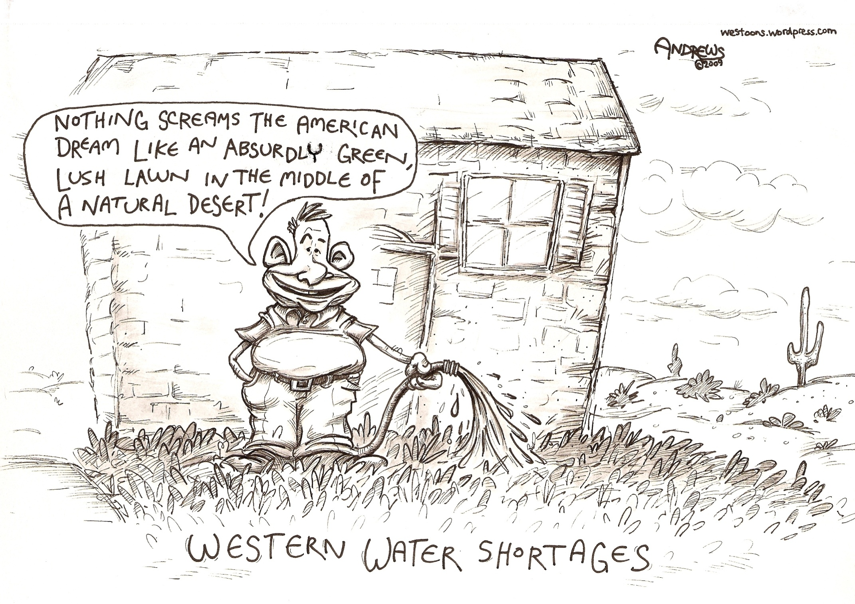
Questions??

