Slide 1
Why is the Delta so Important – and Why Can’t we Fix It?
Keith Coolidge
Delta Stewardship Council
Notes:
I’m going to provide you with an overview of some of California’s water and environmental challenges.
Specifically my talk will focus on the Sacramento-San Joaquin Delta –
The Delta is an area of significant ecological importance and the “ground zero” for California’s water supply and distribution network. I will highlight challenges to the sustainability of this region, and explain what my state government agency and the state of CA as a whole is trying to do to protect the ecosystem and protect CA’s water supply for businesses, especially agriculture, and for rural and urban citizens, today and for the future.

Slide 2
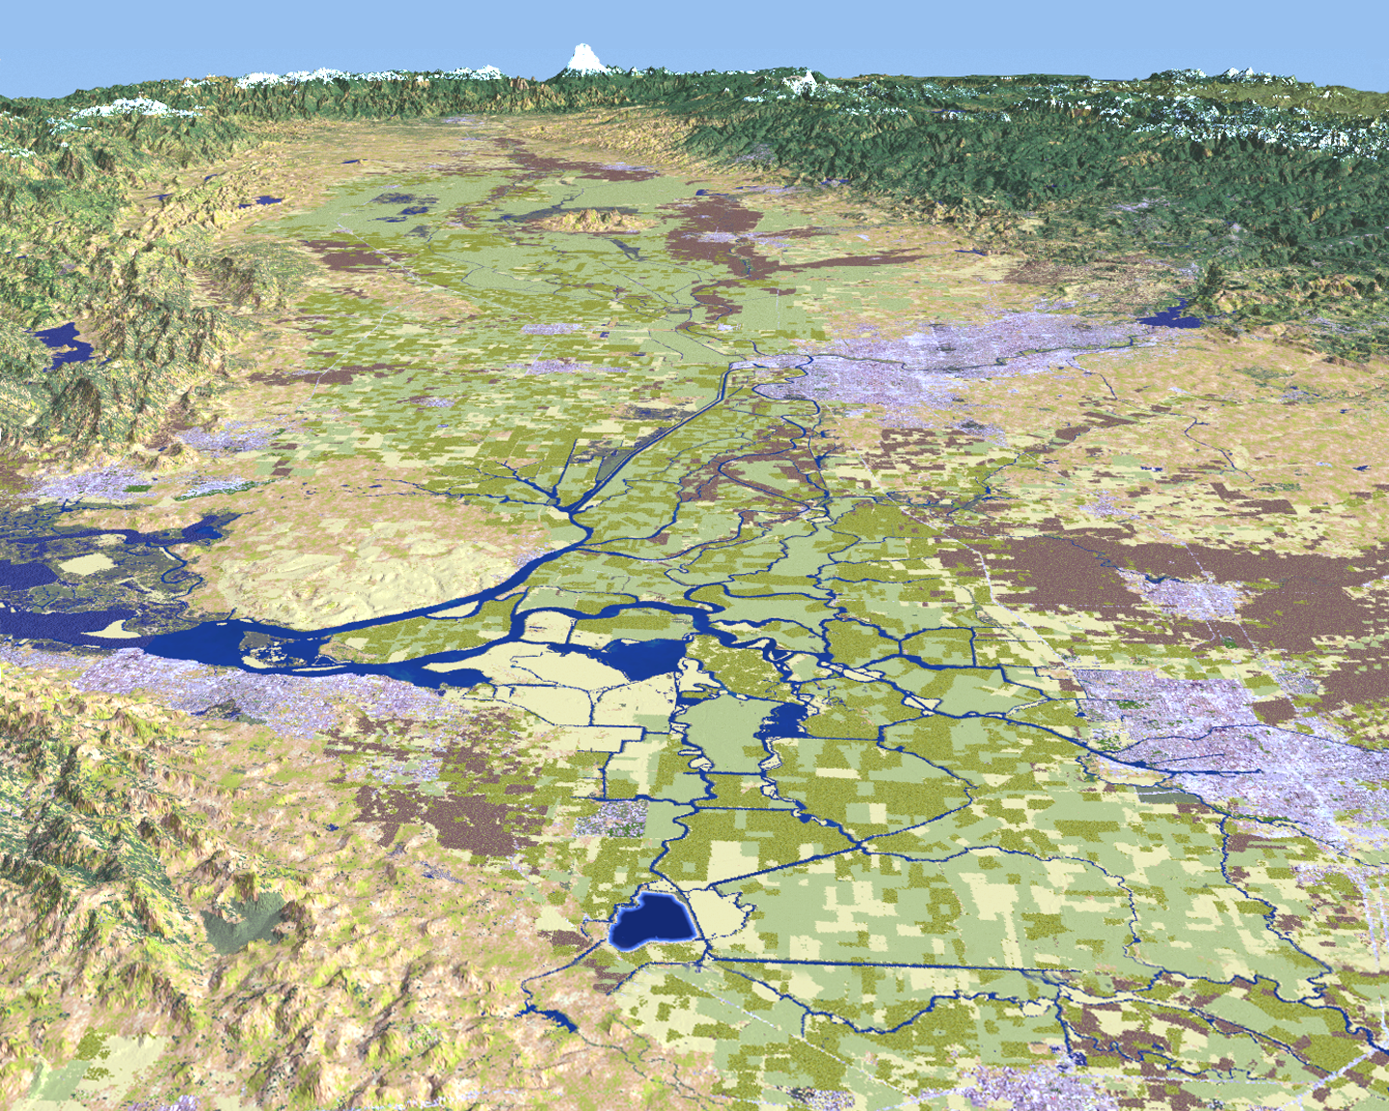
You are here
Sacramento
Fairfield
Pittsburg/Antioch
Stockton
Tracy
Notes:
2
use

Slide 3
Today’s talk
Overview of the Delta and why it is so important
How the Delta has changed – consequences of policy choices over time
Multi-agency approach – opportunities and challenges
Dialogue – things to think about

Slide 4
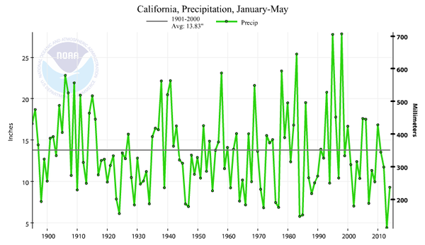
California precipitation variability
(wet season)
Notes:
California has extremely variable rainfall/precipitation.
There is never an “average” water year for our state – We get nearly all of our annual precipitation in 3-5 large storm events.
We historically have multiple dry years and wet years in a row
Our water infrastructure system was designed generally to deal with variability, although we expect the extreme events to get more extreme with climate change in the form of droughts, flooding
We are entering the 5th year of drought right now

Slide 5
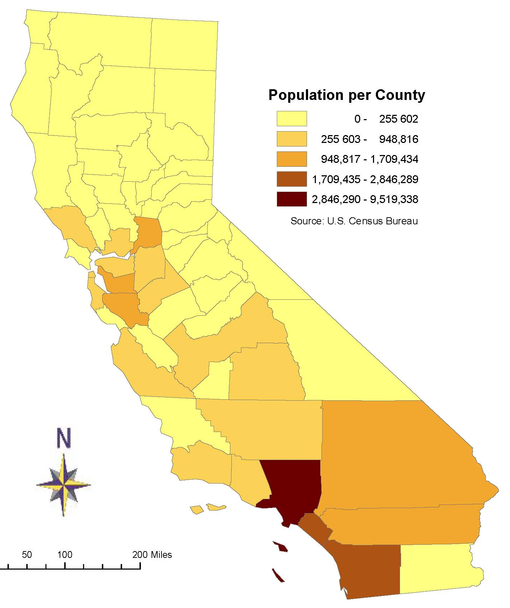
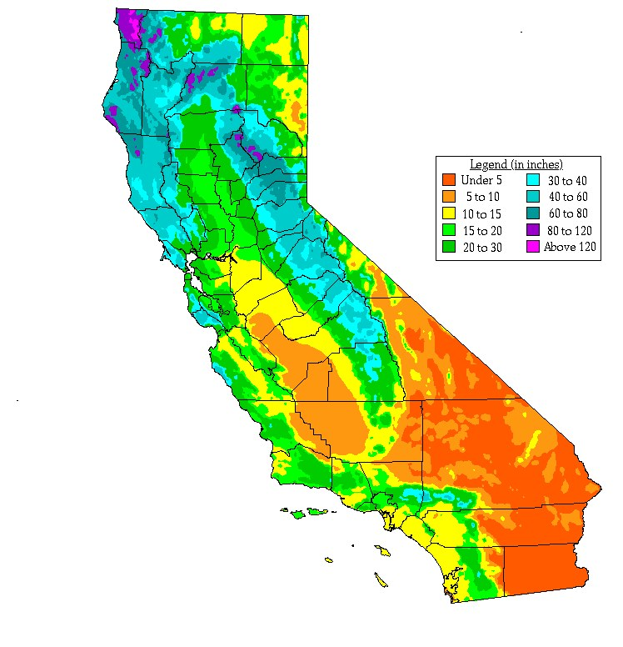
Population vs. Precipitation …
Notes:
In California most people live in the South and on the Coast, while most rain and snow falls in the North. There is a geographic disconnect between where demand is high and where water is available.
Los Angeles and San Francisco Bay Area (19 million and 7 million)
Some of your countries may have have similar challenges
California produces much of the nation’s fruits and vegetables, and also exports internationally. This produce is largely grown in the inland valleys, including the San Joaquin Valley, which often has critical water shortages.
CA has built an elaborate storage and conveyance system to distribute water to where the population is and where the agricultural demand is, and to even out across extreme wet/dry periods.
California water managers must manage around this situation.

Slide 6
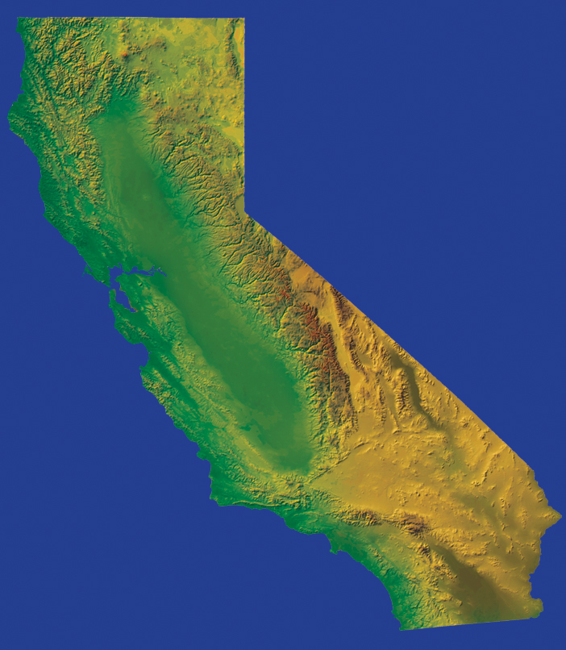
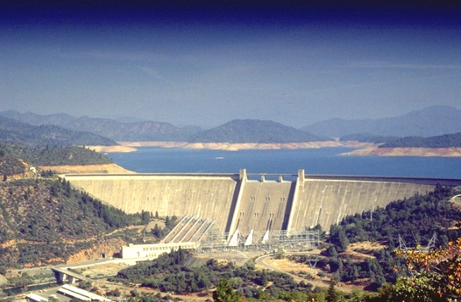
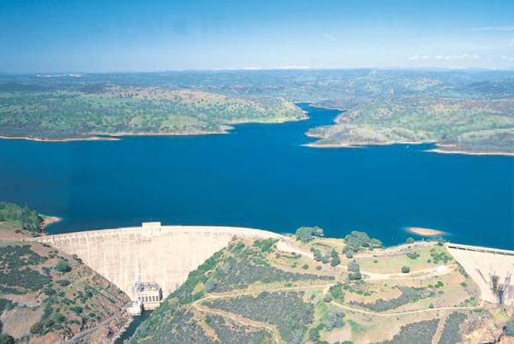
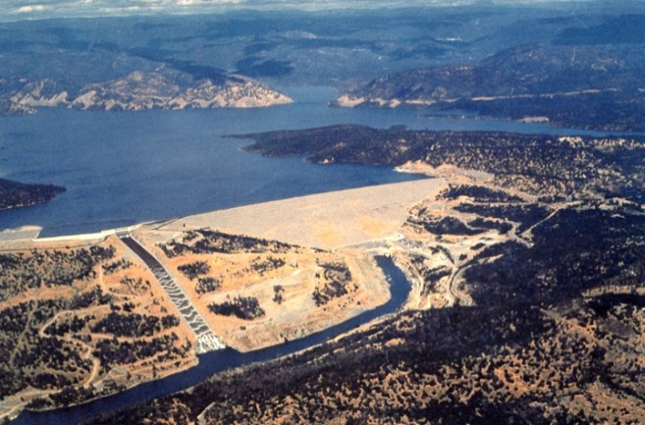
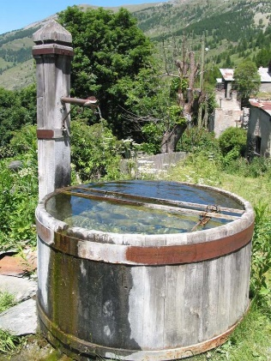
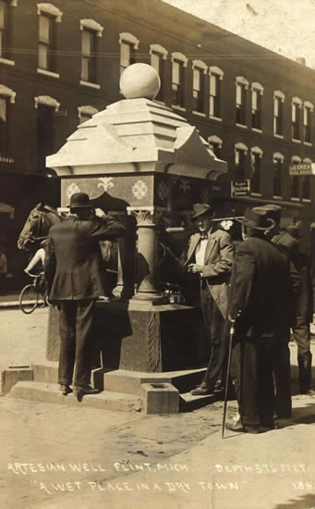
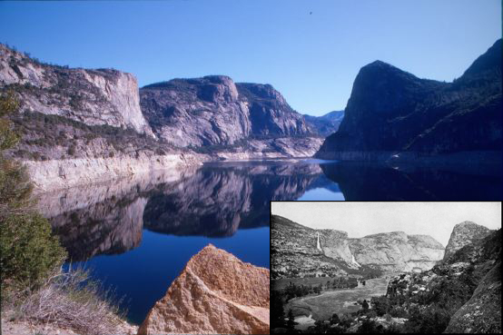
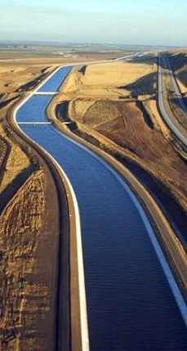
… Drives Water Development
Hetch Hetchy Reservoir
Pardee Reservoir
Shasta Dam
Oroville Dam
CVP
Mokelumne River Aqueduct
California Aqueduct
Hetch Hetchy System
SWP
Groundwater, Local
Resources & Conservation
CA Dept. of Water Resources
State Water Project
1960 - Burns Porter Act
1973 - 1st water to So.Cal.
US Bureau of Reclamation
Central Valley Project
1940 - 1st water delivered (Contra Costa Canal)
San Francisco Public Utilities Commission
Hetch Hetchy System
1913 - Raker Act
East Bay Municipal Utility District
Mokelumne River Aqueduct
1929

Slide 7
How water gets across the Delta
1
Sacramento River
San Francisco Bay
San
Joaquin River
2
SWP Pumps
CVP Pumps
Notes:
7
Water mostly falls in northern California mountains/Sierra Nevada as rain or snow, is stored in reservoirs, and released into the Delta.
Large pumping plants in the south of the Delta reverse water flows to pull water across the Delta
Water releases from reservoirs must also help repel intruding seawater - manage tidal influence
Pre pumps and reservoirs there were seasonal floods, dry periods. Now it is a human-managed freshwater system year round.
It is a constant balance between fresh and salt water, especially during droughts
ALL OF THIS IS HAPPENING IN AN ESTUARY, HOME TO 750 types of Bird and Fish Species

Slide 8
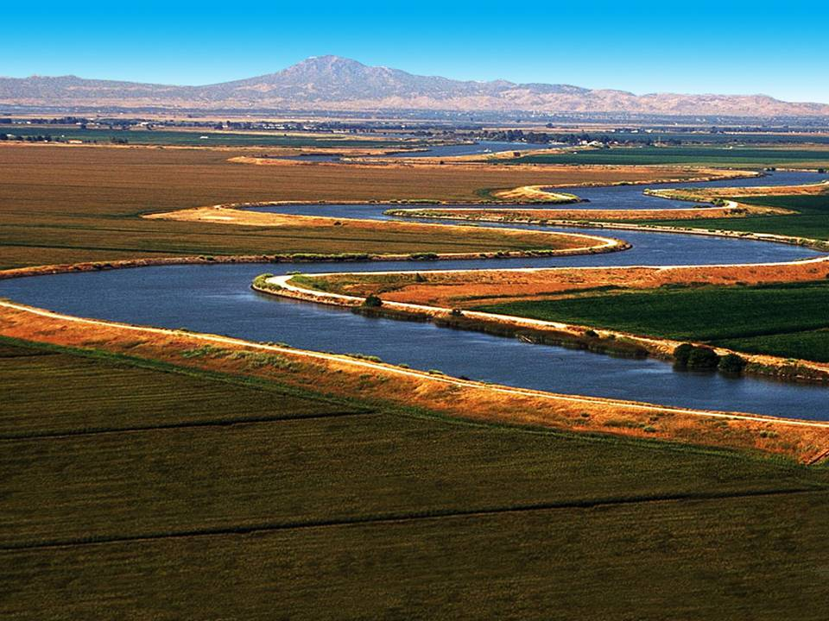
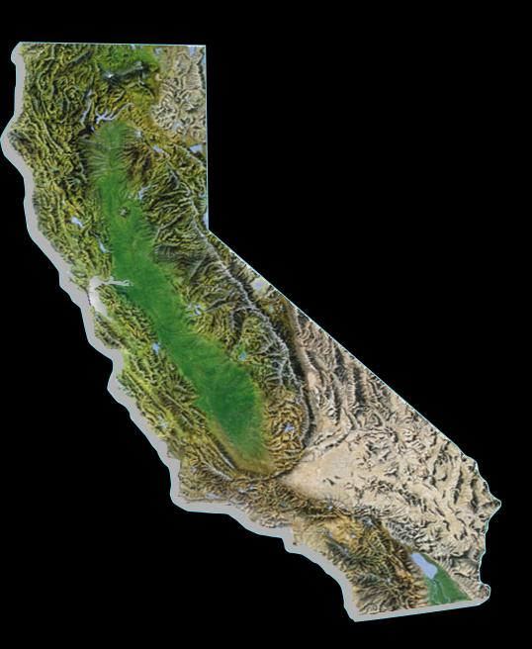
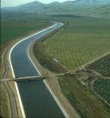
Importance of the Bay-Delta
Supplies Bay Area, Central Valley, Coastal areas & Southern Cal
Some regions up to 100% dependent
Bay Area – 33%
Central Valley – 23 to 90%
Central Coast
2 – 30%
Southern Cal – 30%
Notes:
8

Slide 9
The Delta is a critical hub

Slide 10
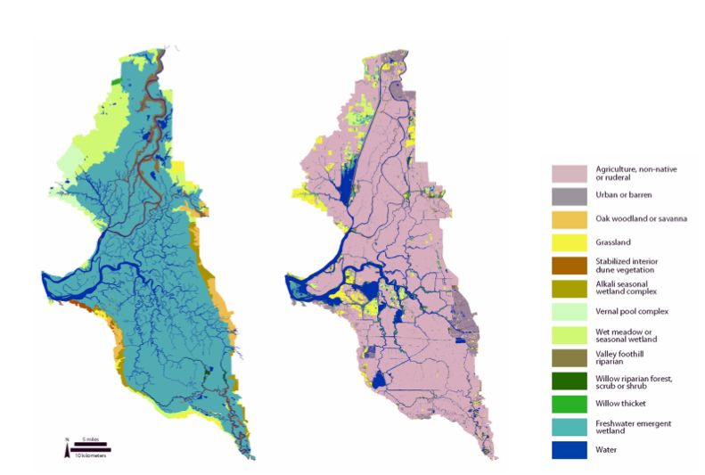
Many forces shaped the Delta
Change in Delta land cover, early 1800s to early 2000s. Graphic by SFEI-ASC
Notes:
Before all of the development of the 20th Century the Delta was a vibrant ecological region with many different types of habitats and thriving native species, including salmon, water fowl, etc.
Federal government gave swampland away in late 19th/early 20th century, allowed people to “reclaim” (drain) it for agricultural use –
This government policy significantly changed the Delta from a seasonally flooded marsh to a system of drained islands, surrounded by earthen dikes. Much of the Delta land today is farmed.
Only about 10% of natural/native species habitat remains, several species are endangered – salmon, delta smelt, sturgeon, etc.
It is a highly altered system that requires it to be highly managed – and we’re all collectively trying to figure out how to do that.

Slide 11
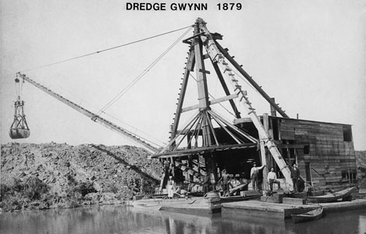
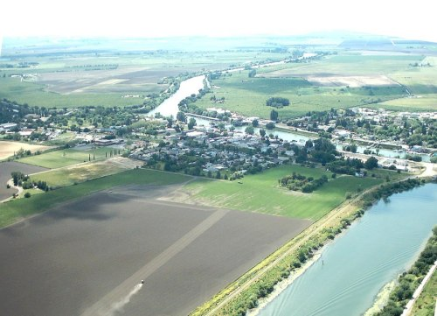
The Changing Delta
1850s settlers drained ‘swampland’, eliminating largest wetlands on Pacific Coast Flyway
Flood projects dredged waterways & straightened channels at cost to riparian habitat
Upstream reservoirs added hydropower, flood control and water supply, but blocked fish spawning and changed flow patterns
Deep-water ship channels opened Central Valley to commerce but led to invasive species through ballast water
Growth of farming and upstream cities led to increased agricultural and urban pollution

Slide 12
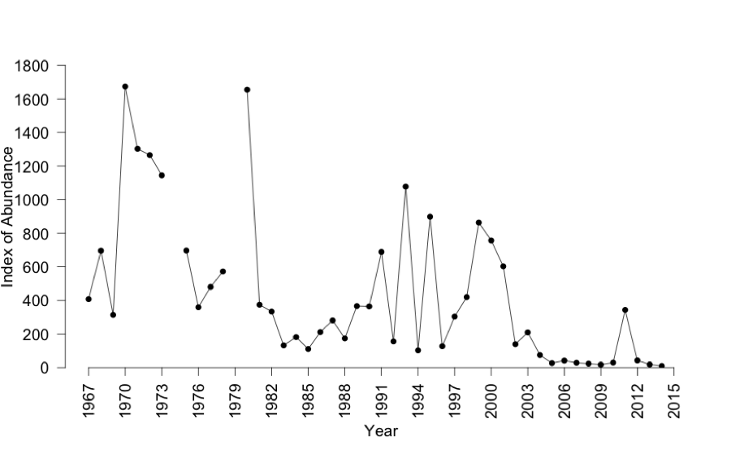
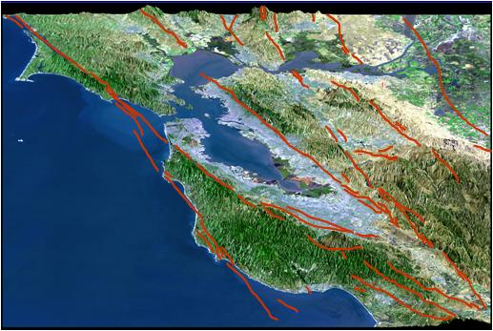
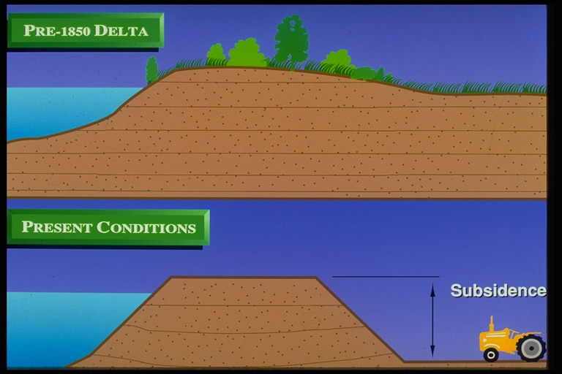
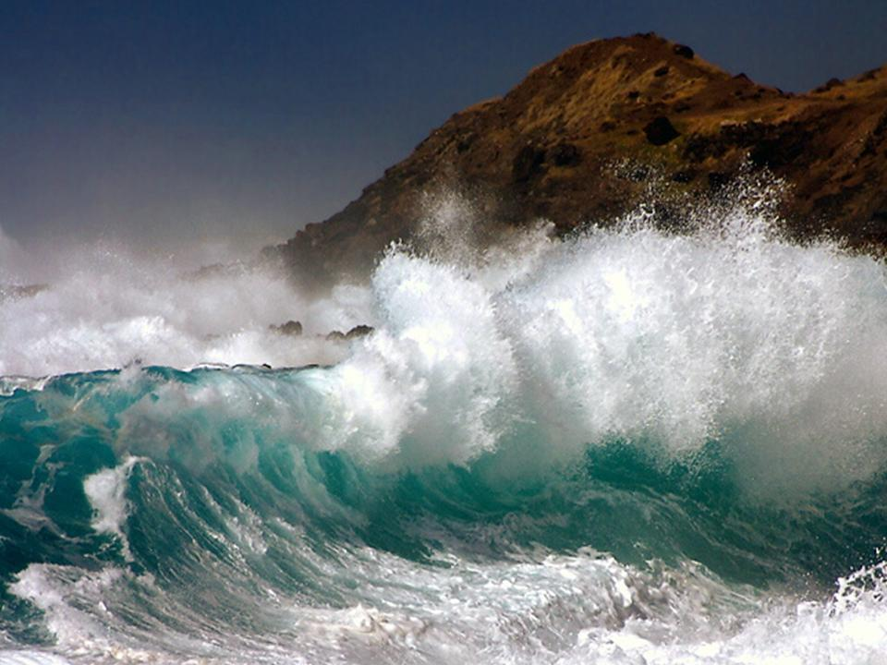
Key Delta risks
Fishery Declines (Delta smelt)
Seismic Risk
Bay Area Faults
Sea Level Rise
Subsidence
Notes:
The Delta, and the many assets it provides, face numerous risks/threats.
The Delta’s rivers and waterways are home to native fish, including Smelt and Salmon. These native fish are in severe decline due to many different factors, mostly human-caused: pollution, separation of land and water, reverse water flows, increasing temperatures
People live and farm in the Delta, mostly rural, islands are protected by earthen levees or dikes, which are unstable in the face of rising sea levels and earthquakes.
The act of farming on Delta islands also causes the islands to slowly sink, or subside
While fish suffer and their populations decrease dramatically this means water supplies face increasing restriction due to enforcement of environmental protection laws. (CA Endangered Species Act, 1970, Federal ESA 1973) thereby reducing water supplies through the Delta – highly uncertain, angering farmers and businesses
Other problems include:
Loss of wetlands / riparian habitat
Increase in invasive nonnative species
Increase in urban runoff (wastewater discharges) pollution from urban sources

Slide 13
Water Supply Implications
Delta Cross
Channel
1
2
1
3
CVP Pumps
SWP Pumps
Notes:
13

Slide 14
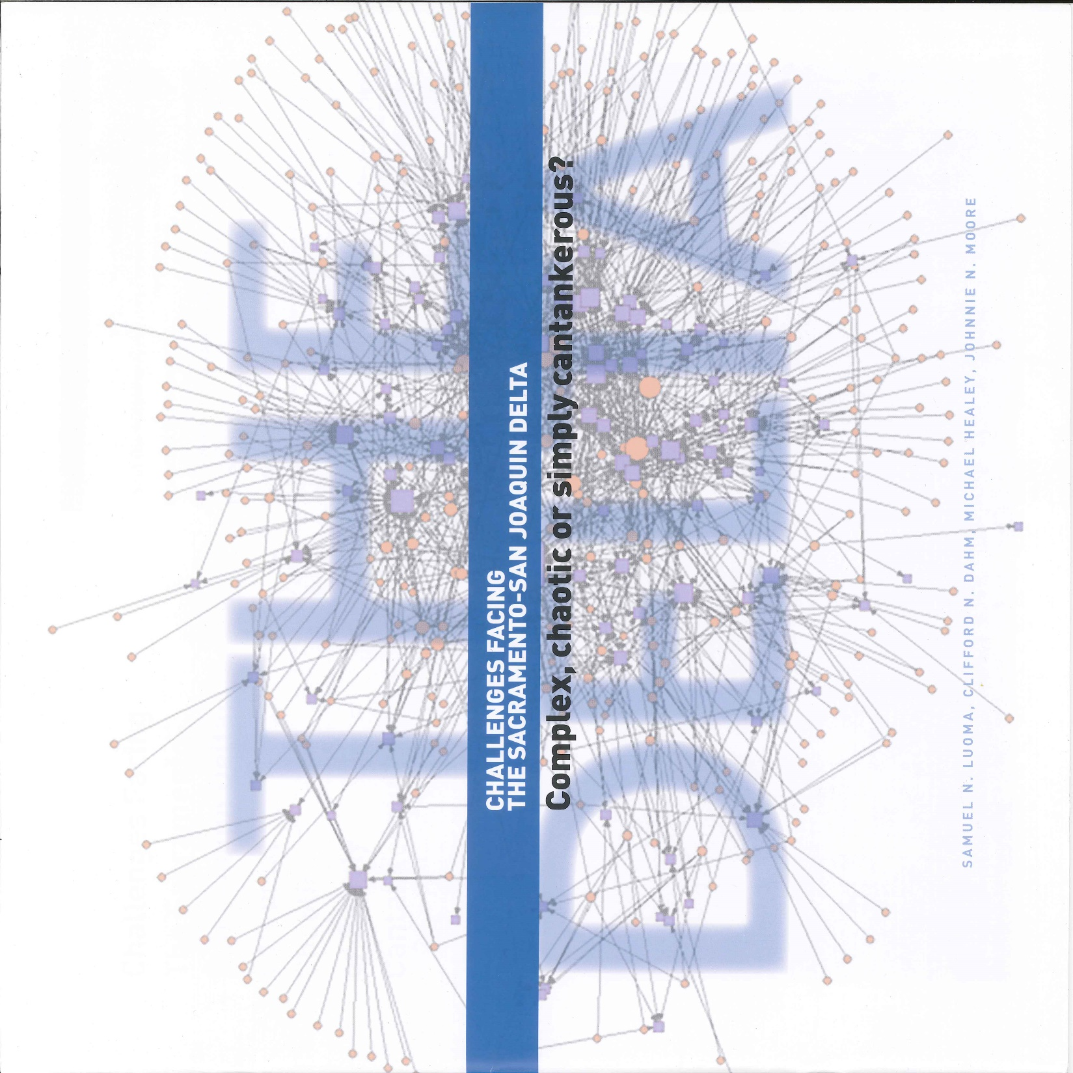


If the problem were just about allocating freshwater flows, it might be solvable
Add in the complexity of moving water through a hydrologically and hydro- dynamically complex Delta and it becomes complicated
Add the uncertainty of ecological responses and the institutional complexity of many actors with many visions and the problem becomes wicked
Then add the ever-changing water supply and ecological and economic contexts within which decisions must be made, and the problem becomes devilishly wicked
Notes:
If the problem was about allocating freshwater flows, it might be solvable.
Add in the complexity of moving water through a hydrologically and hydro- dynamically complex Delta and it becomes complicated.
Add the uncertainty of ecological responses and the institutional complexity of many actors with many visions and the problem becomes wicked.
Then add the ever-changing water supply and ecological and economic contexts within which decisions must be made, and the problem becomes devilishly wicked.

Slide 15
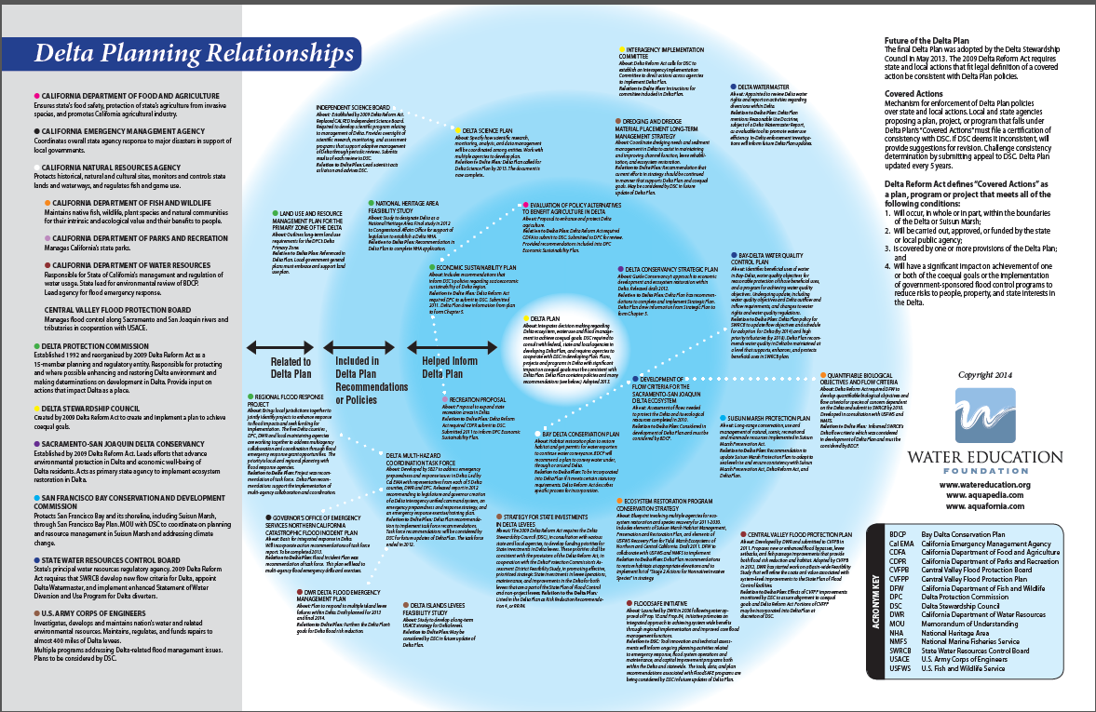
Institutional Complexity
The Delta Plan
Notes:
We are just one player on the Delta scene. State level governance is complex: This diagram is simply intended to show you how complicated the governance system is for the Delta. Each blurb of text represents one of the many different plans or programs that are related to the Delta Plan, included in part, or helped inform it. Along the left side is a list of 13 agencies that plays some role in managing some aspect of the Delta including:
Flood protection for communities in the delta
Fish and Wildlife Protection for endangered and native species
Water Quality control
This diagram –kindly produced by the Water Education Foundation – this is a simplifed versión –
The Delta Plan, at the center of it all is the master plan for the Delta. It is in fact intended – and supported by law - to influence all other agencies and activities in the Delta
There are 13 agencies that are identified on this diagram.

Slide 16
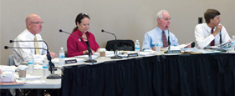
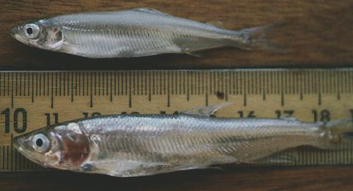
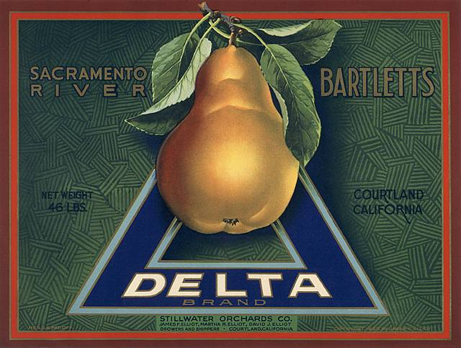
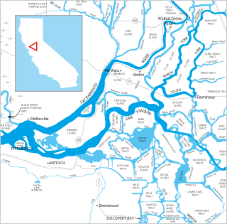

Delta Stewardship Council :
Notes:
Chair of DPC
Senate Appointee
Speaker Appointee
4 Gov’s Appointees
Lead Scientist employed by the USGS
House the IEP Lead Scientist
the Delta Stewardship Council, was created in law in 2009 to provide direction for the long-term future of the Delta. Our role is to:
Set a long-term vision for the Delta that will achieve the coequal goals ecosystem protection and water supply reliability - develop a “master plan” Delta Plan
Provide leadership, coordination and also some regulation of projects in the Delta
We are governed by a 7 member council, ~65 person staff
My staff include a well-respected Science Program – whose job is to synthesize and communicate best available science to decision makers
Our agency was established with the intention of tackling controversial issues with independence (levee investment, performance measures, etc.)
Develop enforceable plan to achieve coequal goals of ecosystem restoration and statewide water supply reliability
Ensure progress towards those goals through coordination and regulation
Inform decision-making with best available independent science

Slide 17
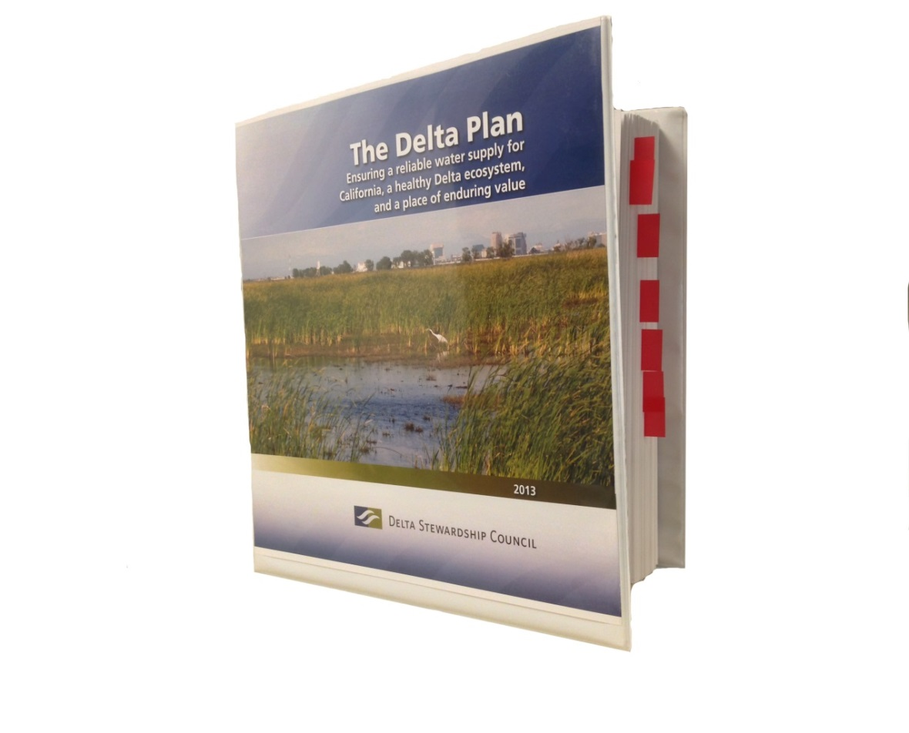
What is the Delta Plan?
Recommendations, regulations, and performance measures for:
Water Conservation & Efficiency
Flood Risk Reduction
Ecosystem Restoration
Water Supply Reliability & Water Storage
Protect the Delta as a Unique Place
Ensure Best Available Science & Adaptive Management
Notes:
There is no single answer to the solving CA’s water and environmental problems in the Delta.
Our Delta Plan includes recommendations and regulations and calls for a comprehensive approach:
More efficient use of water by urban and agricultural users
Maximum development of local supplies, including recycled water, smaller water storage projects, sustainable groundwater use – to reduce pressure on delta.
Improvements to emergency planning and response and strategic investments in flood protection
Investments to protect the local economies in the Delta
Improved reliance on science for decision making to reduce controversy and minimize bad decisions
Restoration of large areas of habitat to aide in the recovery of native species
Improvements to the way the state stores and moves water across the Delta so that we are able to restore some natural function to the estuary – more natural water flows. Pump more during big storms and wet years, pump less rest of the time.
Governor brown has been a leader on water issues – we achieved an 25% reduction in water use during the drought in urban areas. He provided leadership to accomplish new groundwater regulation for the state, which previously went un-regulated.
2009 law that created our Council changed the way we think about CA water policy and launched another new era – a requirement to treat the environment and ecosystem with equal attention as water supplies.

Slide 18
Council’s Key Roles/Projects
Implementing the Delta Plan
  Covered Action authority
  Delta Plan Interagency Implementation Committee
  Measuring performance
Connecting the best science with decision-makers
  Synthesis, peer review, identifying and funding high-priority science
Amending the Delta Plan
  Setting priorities for state investment in Delta levees
  Promoting options for conveyance, storage, operations
  Weaving together a plan for ecosystem enhancement
Notes:
Changed the way projects are done in the Delta – fundamentally – by using our regulatory authority and influential delta science program to institutionalizing AM and documentation of how decisions are based on BAS
This is important because in the past we built things and did things with incomplete understanding of effects and clearly, with unintended consequences, no we can learn from our mistakes and our successes so we can avoid or replicate them in the future, respectively.
Support for advancing ecosystem restoration projects in the Delta:
X eco projects prior to 2013 in the Delta?
EcoRestore jumpstarted, our role in developing an AM program for those projects, advice and guidance via our planning and science staff.
DLIS – prioritize state’s investment in Delta levees in a way that best protects the state’s interests
Working with CDFW to develop a Delta Plan amendment that will pick up the conservation measures in the BDCP that no longer have a program or funding source to ensure they have life beyond BDCP
Accountability: perf measures, 5 year review, annual report, DPIIC
Long term vision – big picture – setting goals and evaluating progress

Slide 19
Today’s Takeaways
Delta’s challenges direct/indirect results of past policy decisions
Looking ahead: Uncertainty is the only certainty
Any resolution will require tradeoffs – and trust
The Council’s comprehensive approach
  Use science to increase likelihood of success
  Landscape scale restoration & planning
  Reduce reliance on the Delta
  ‘Portfolio’ approach to water management

Slide 20
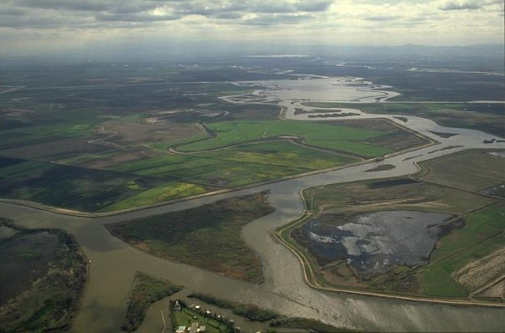
Questions?
Keith Coolidge
Delta Stewardship Council
keithc@deltacouncil.ca.gov
www.deltacouncil.ca.gov

Slide 21
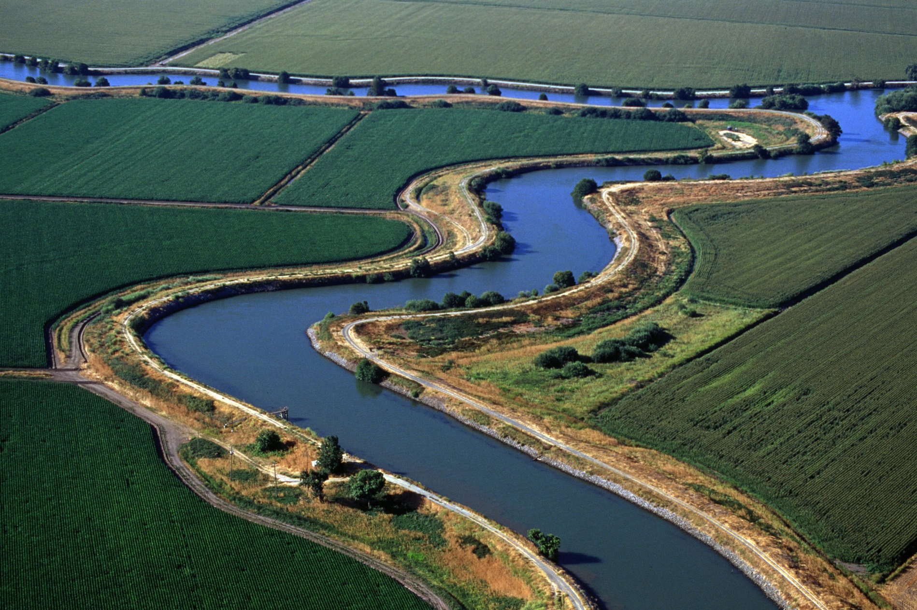
Notes:
In conclusion …
CA Delta is at the literal center or heart of these issues, but plagued by many problems
My agency advocates a comprehensive approach and provides leadership for others to achieve dual goals of reliable water and a healthy ecosystem based on science.

Slide 22
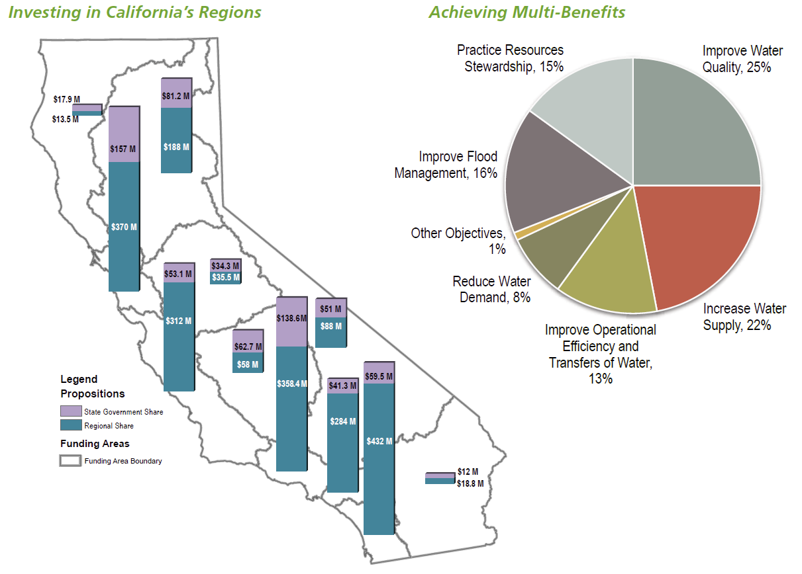
A Decade of Regional Investment
[ 22 ]

Slide 23
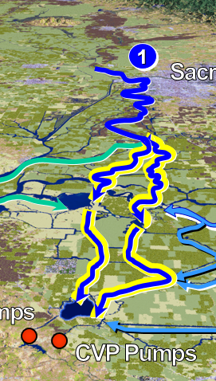
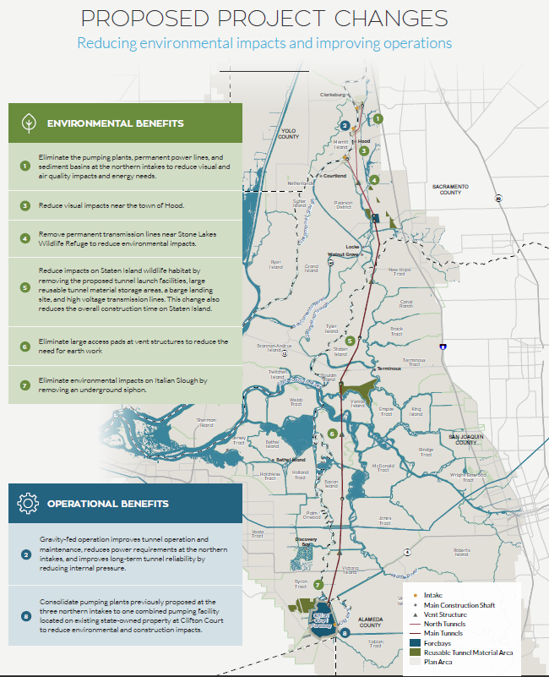
In the News – Twin Tunnels

Slide 24
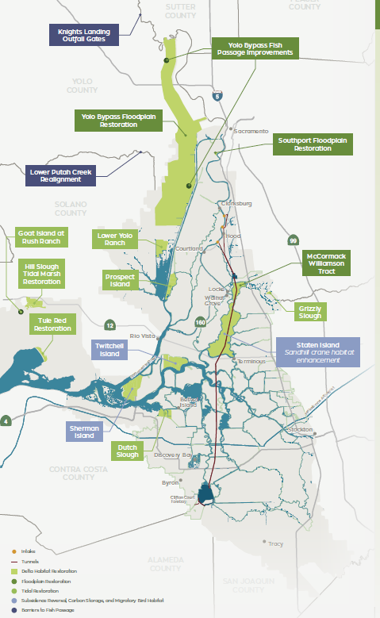
In the News – EcoRestore

Slide 25
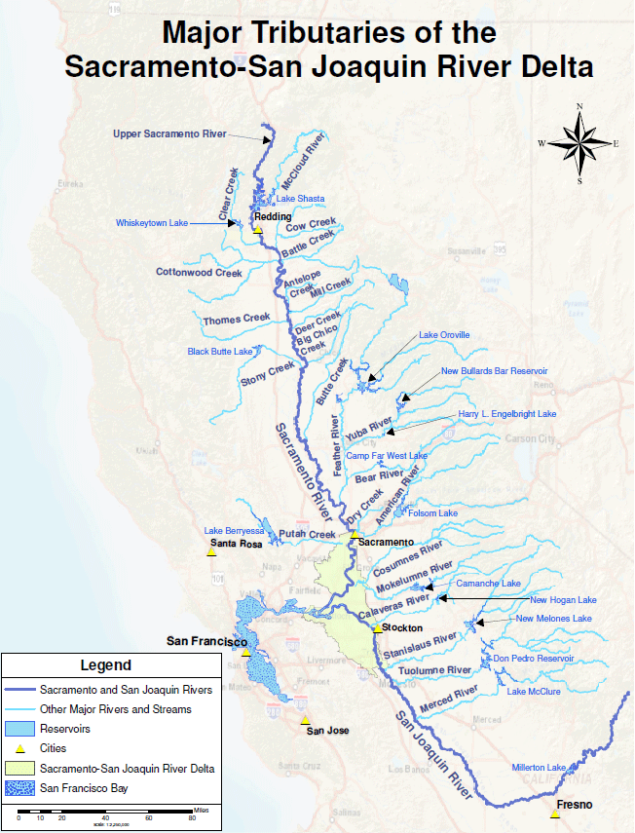
In the News
– Flow
Standards
Rethinking how we allocate our water
Implications for water rights

Slide 26
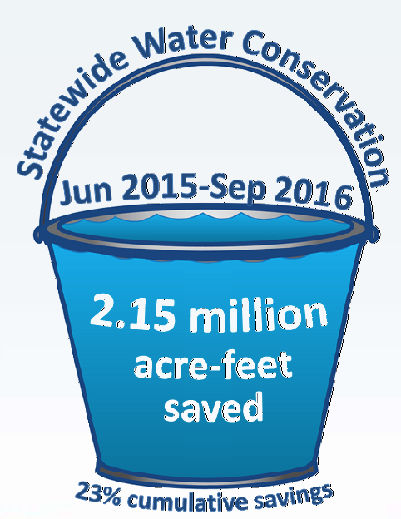

In the News – Conservation
Mandatory or voluntary approach to make conservation a California way of life?

