Slide 1
Water Symposium
Subsidence Monitoring and Response in San Joaquin River Exchange Contracts Area
A Local Perspective
Presented by Chris White, Manager
Central California Irrigation District
Water Education Foundation
March 14, 2018

Slide 2
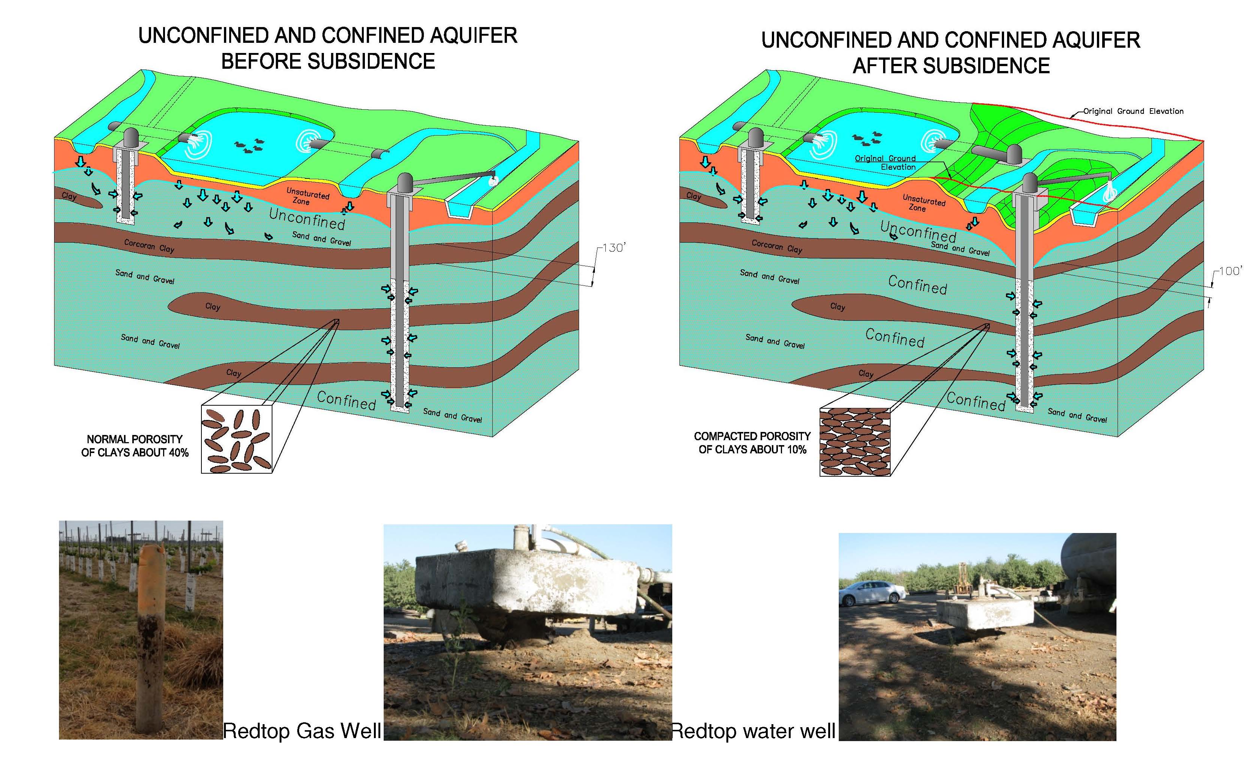

Subsidence Monitoring
Document the Signs

Slide 3
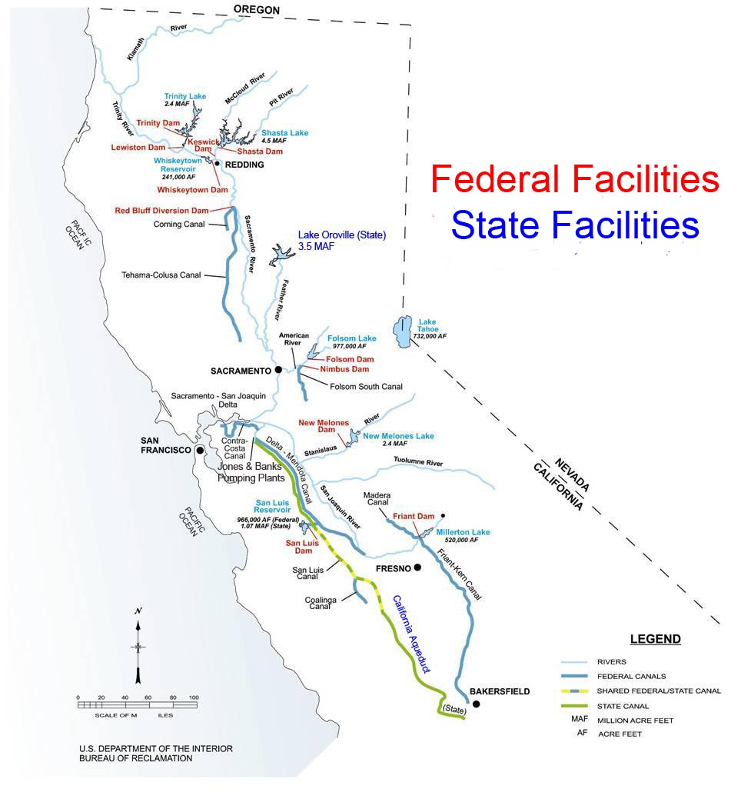
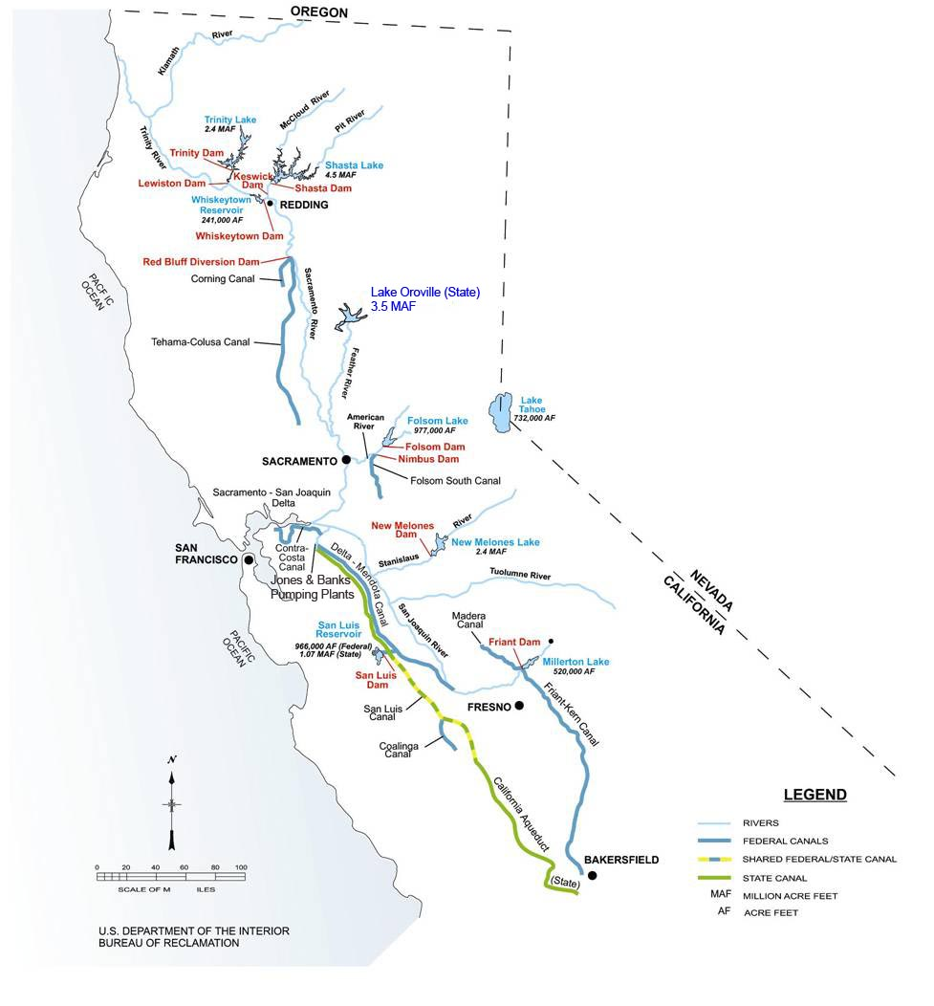
1960s

Slide 4
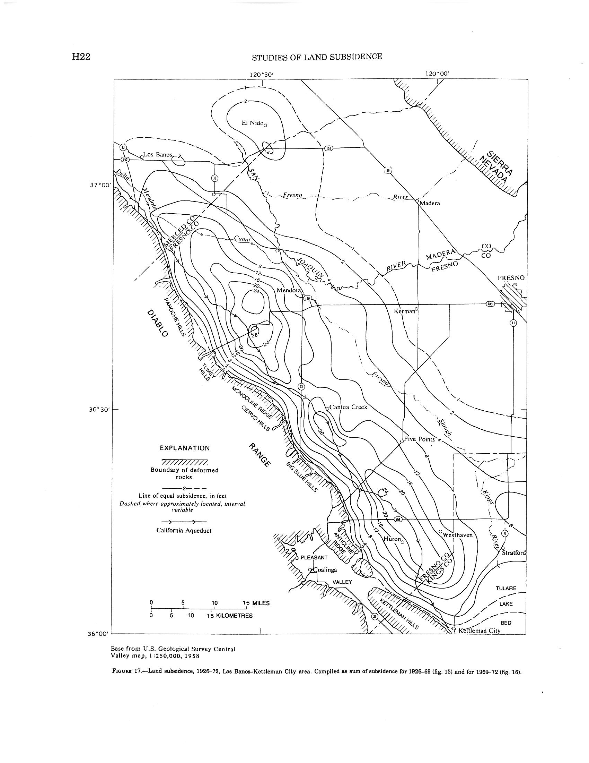

Slide 5
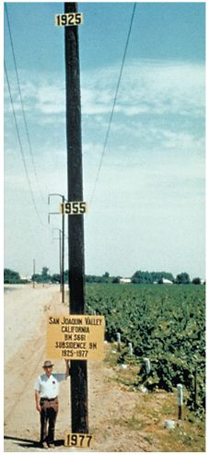
Land Subsidence
How bad can it get?
Approximate location of maximum subsidence in the United States identified by research efforts of Dr. Joseph F. Poland (pictured). Signs on pole show approximate altitude of land surface in 1925, 1955, and 1977. (28 feet in 50 years, .56 feet/year)
The site is in the San Joaquin Valley southwest of Mendota, California, 15 miles southwest of Sack Dam.

Slide 6
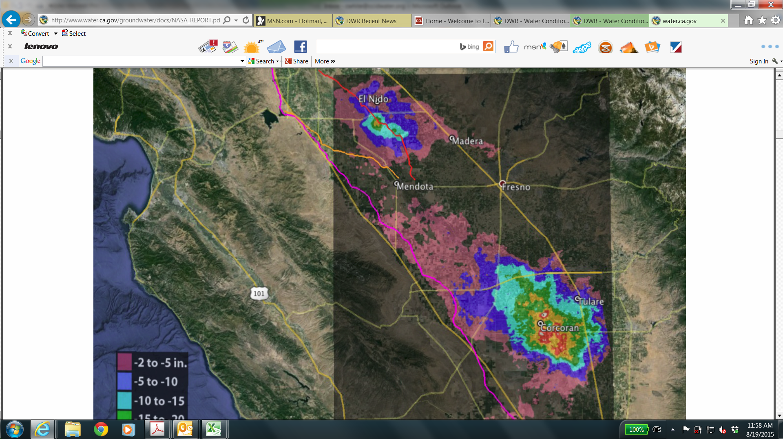
Recent NASA Data

Slide 7
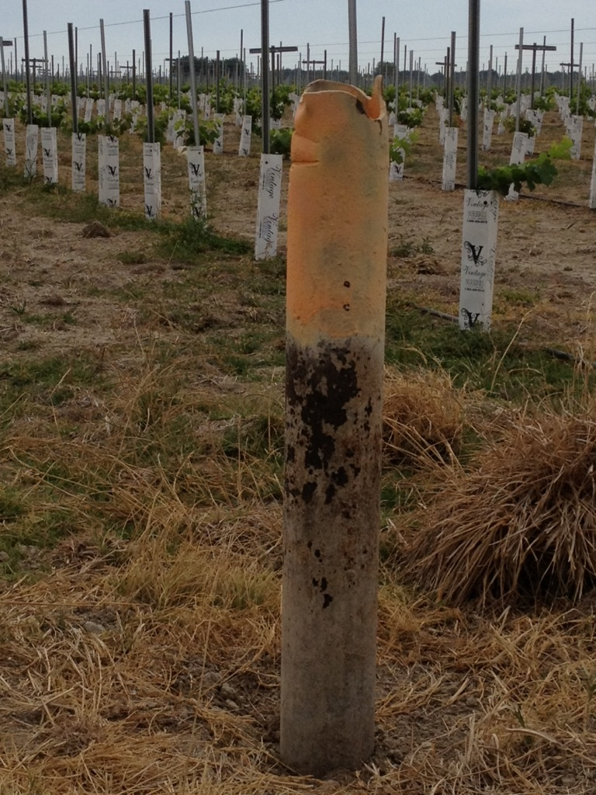

Slide 8
Subsidence, if not stopped, will…
Cause flooding in Western Madera & Merced counties
  Highway 152
  Elementary school
  City of Dos Palos
  Valuable farmland and dairies
Jeopardize water supply of neighboring districts – up to 20% reduction in water district conveyance capacity
  Central California Irrigation District
  San Luis Canal Company
Jeopardize the San Joaquin River Restoration Program

Slide 9
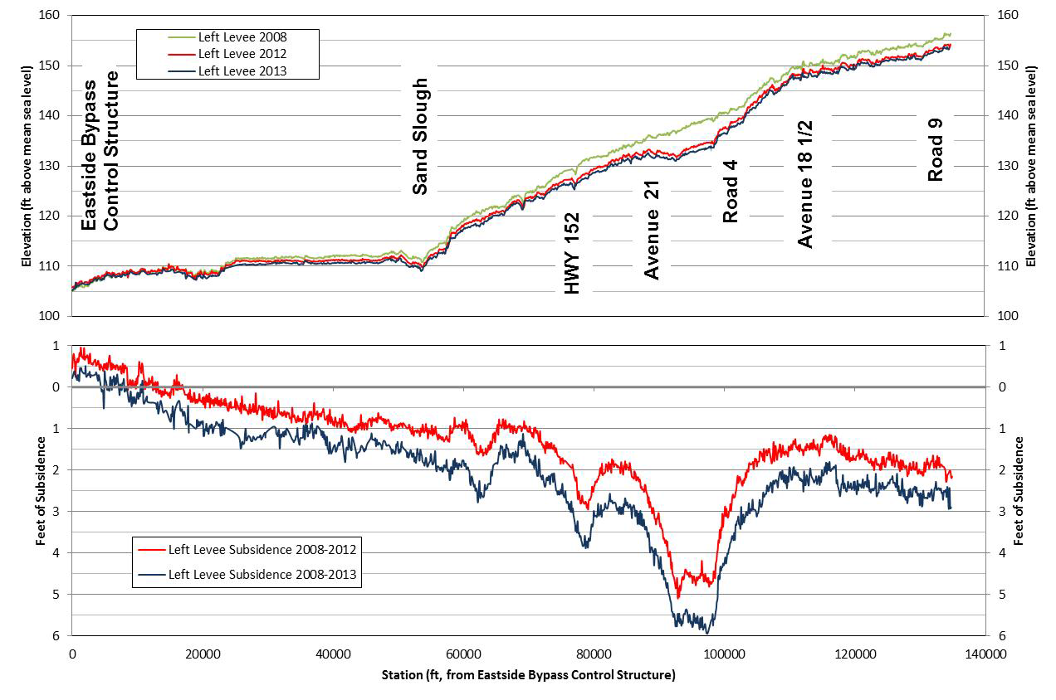
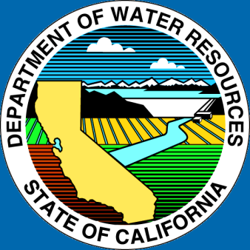
Ground Subsidence along the left levee in the Upper and Middle Eastside Bypasses
Merced and Madera County

Slide 10
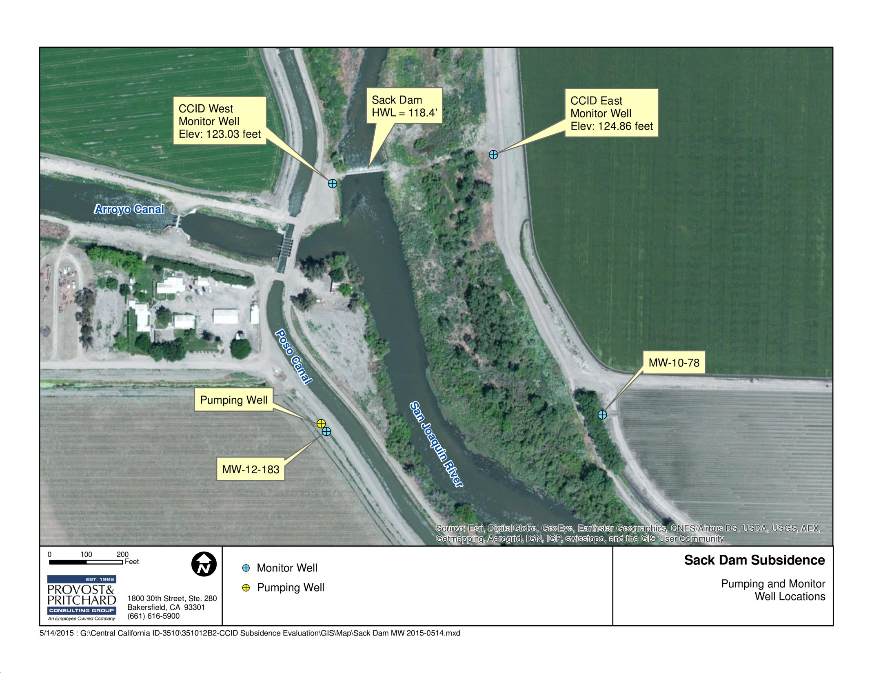

Slide 11
Additional Costs to Arroyo Canal Screening and Sack Dam replacement project
Add pumping plant to deliver water to San Luis Canal Company (Currently a gravity diversion) - $30m
Increase height of Sack Dam – Not yet designed - original costs of the project is $35m.

Slide 12
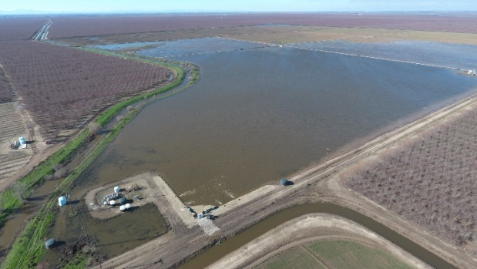
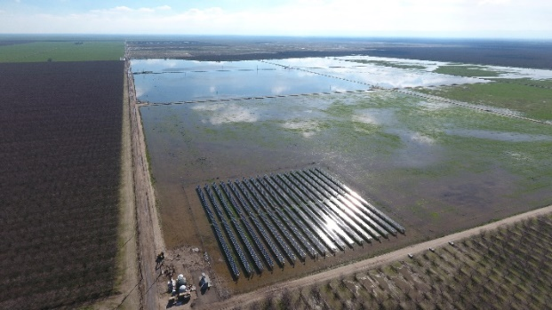
Progress on Solutions
Triangle T (Tri T) is a 12,000-acre property, with 11,300 acres planted to Almonds and Pistachios. 530 acres are farmed to dryland crops in dry years, and groundwater recharge in wet years.
  In 2017 approximately 37,000 acre feet of surface water was recharged in Triangle T; groundwater level (gwl) rise of 60 feet at ponds
  Just as importantly, flood water was used to irrigate the almond and pistachio orchards, offsetting 10,000 acre feet of groundwater pumping; regional gwl rise 20 feet by summer 2017, 2018 measurements underway.
  In 2017 it is estimated that 65,000 acre feet of recharge occurred in the Eastside Bypass from Road 9 to Hwy 152, while running for 192 days.
Long term monitoring and technical review committee established; Cross River Pipeline built and operational; Tri T and Vlot formed Water District; Neighbors wanting to join; Grant application submitted in January 2018 for Cal OES and FEMA Hazard Mitigation Program.

Slide 13
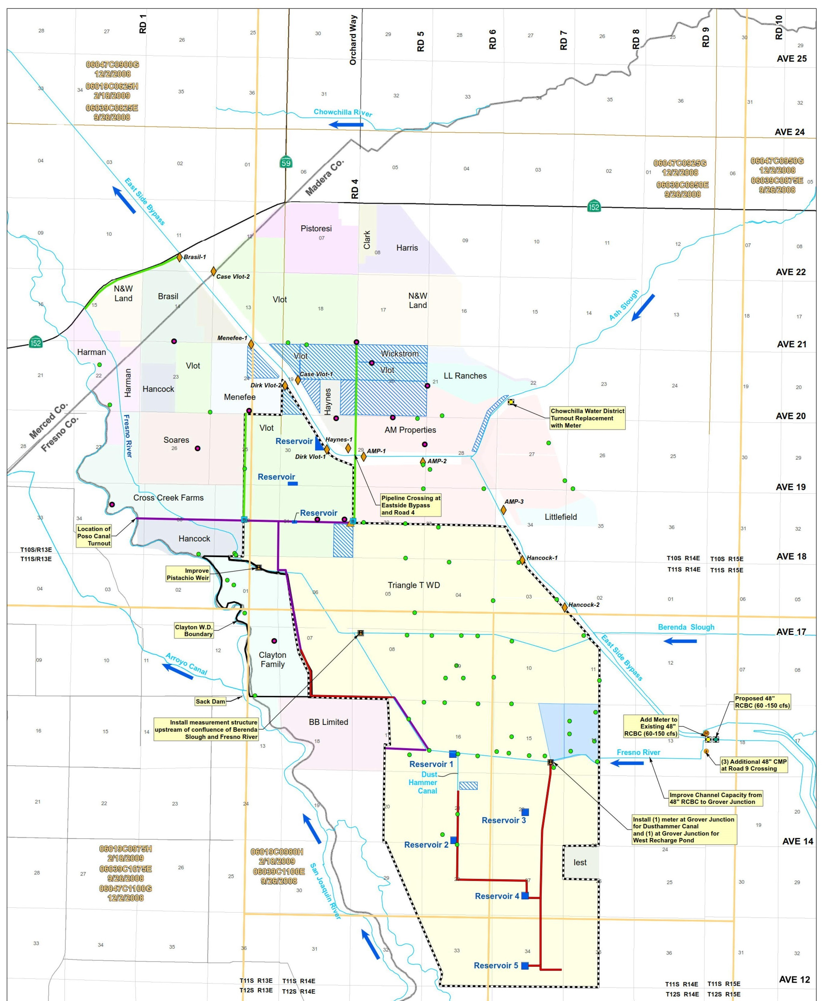
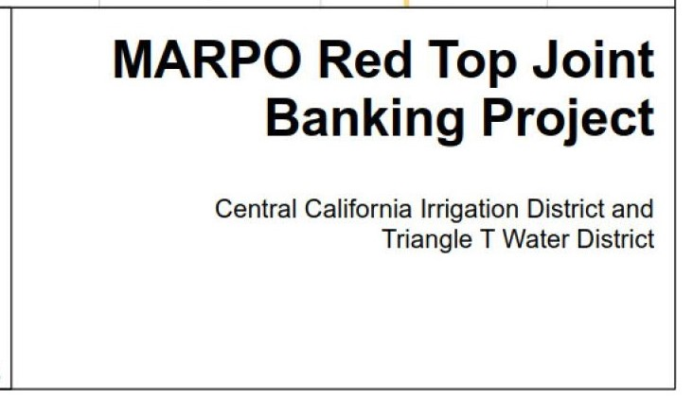
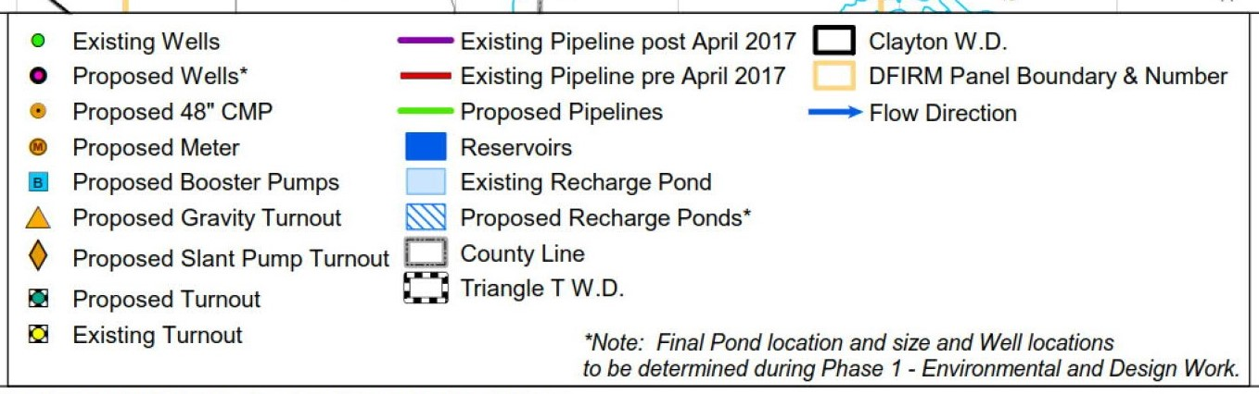
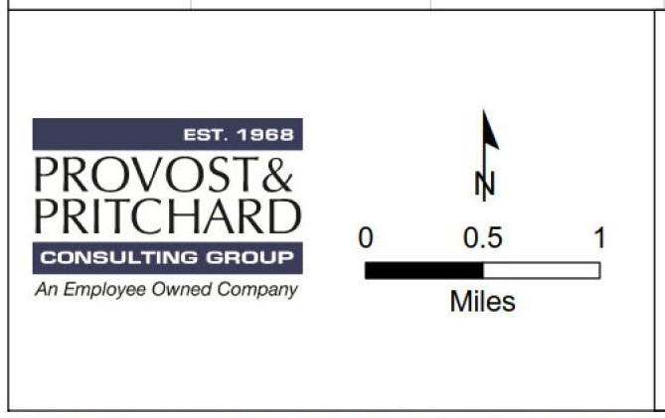

Slide 14
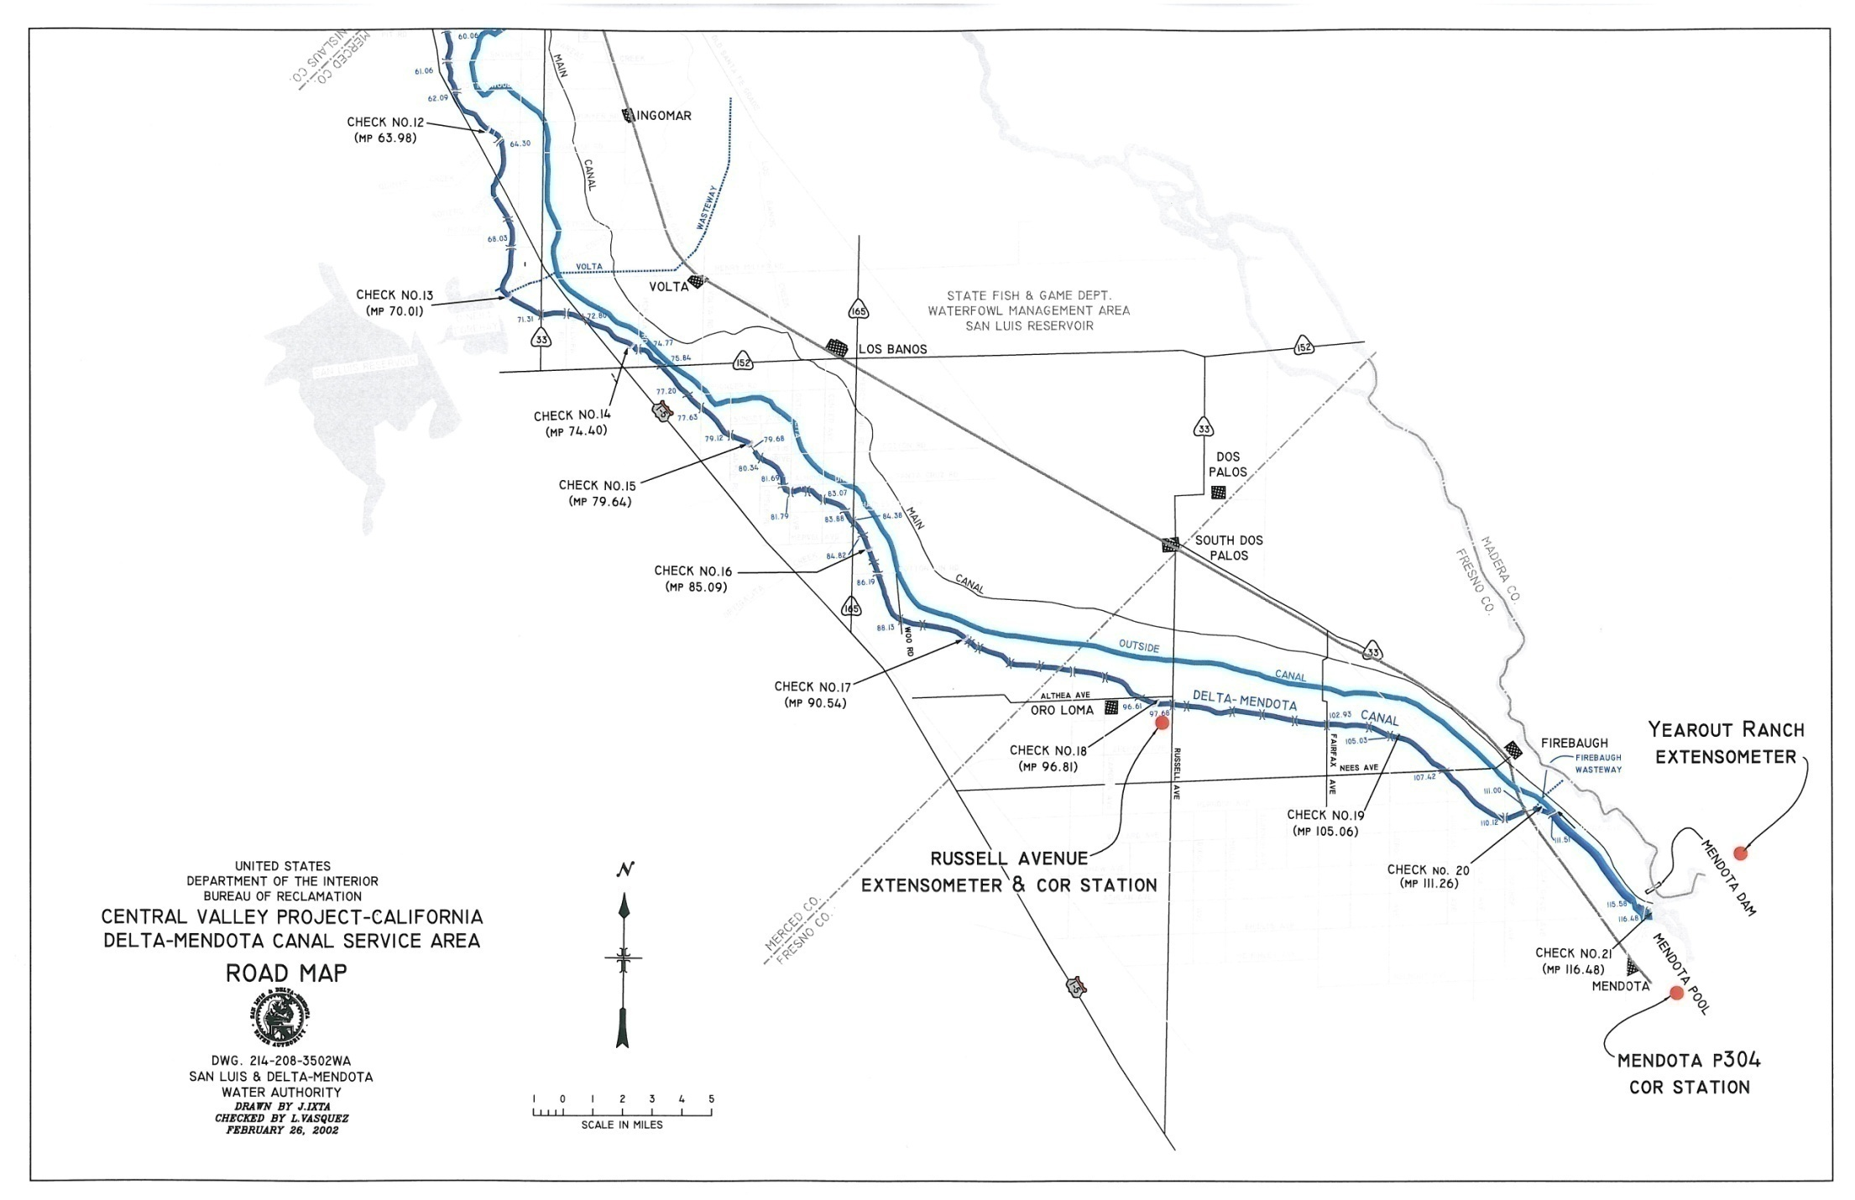

Slide 15
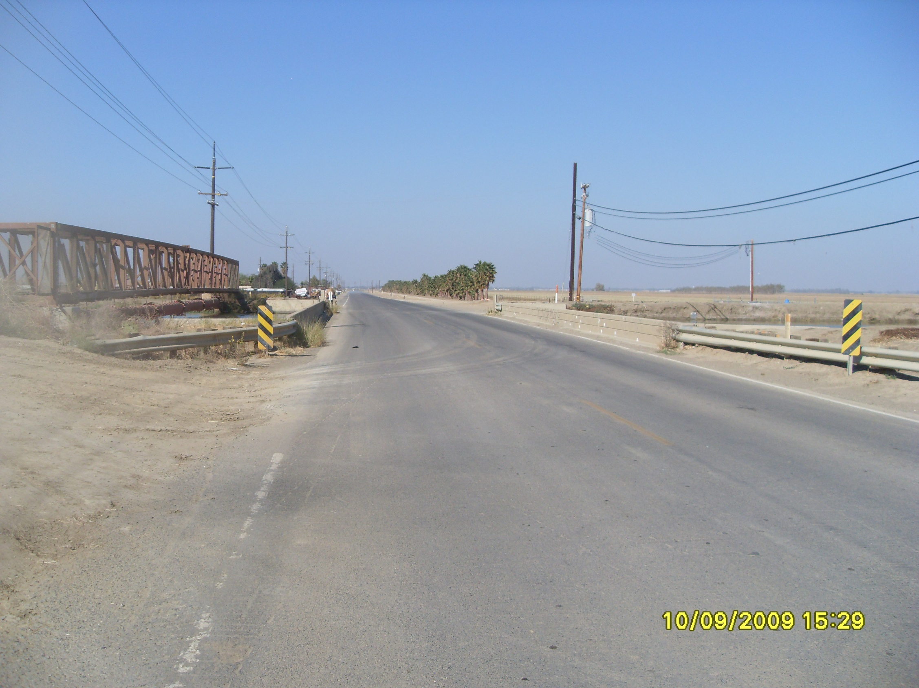

Slide 16
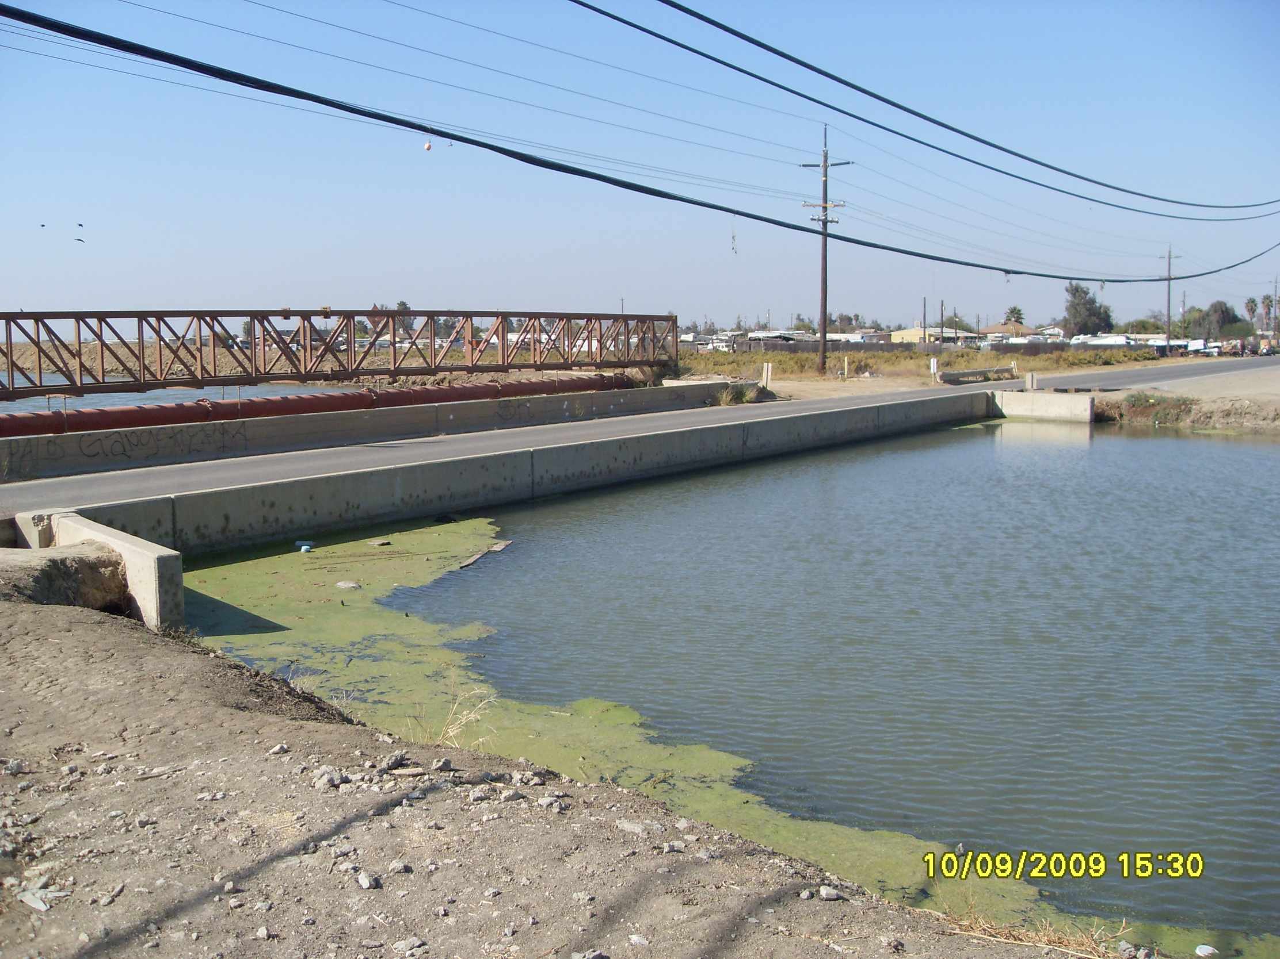

Slide 17
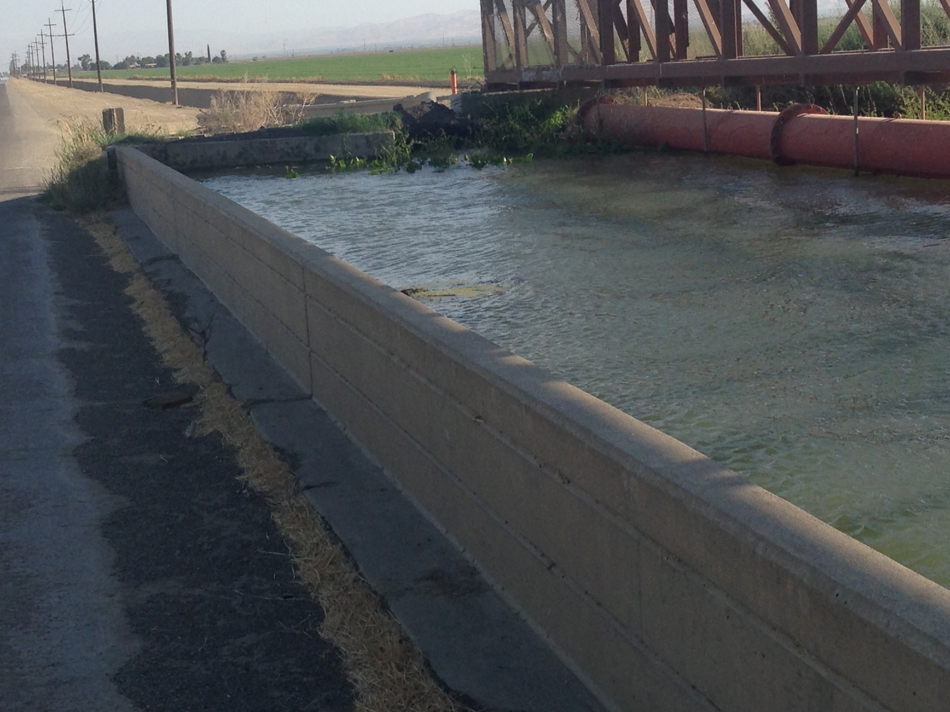

Slide 18
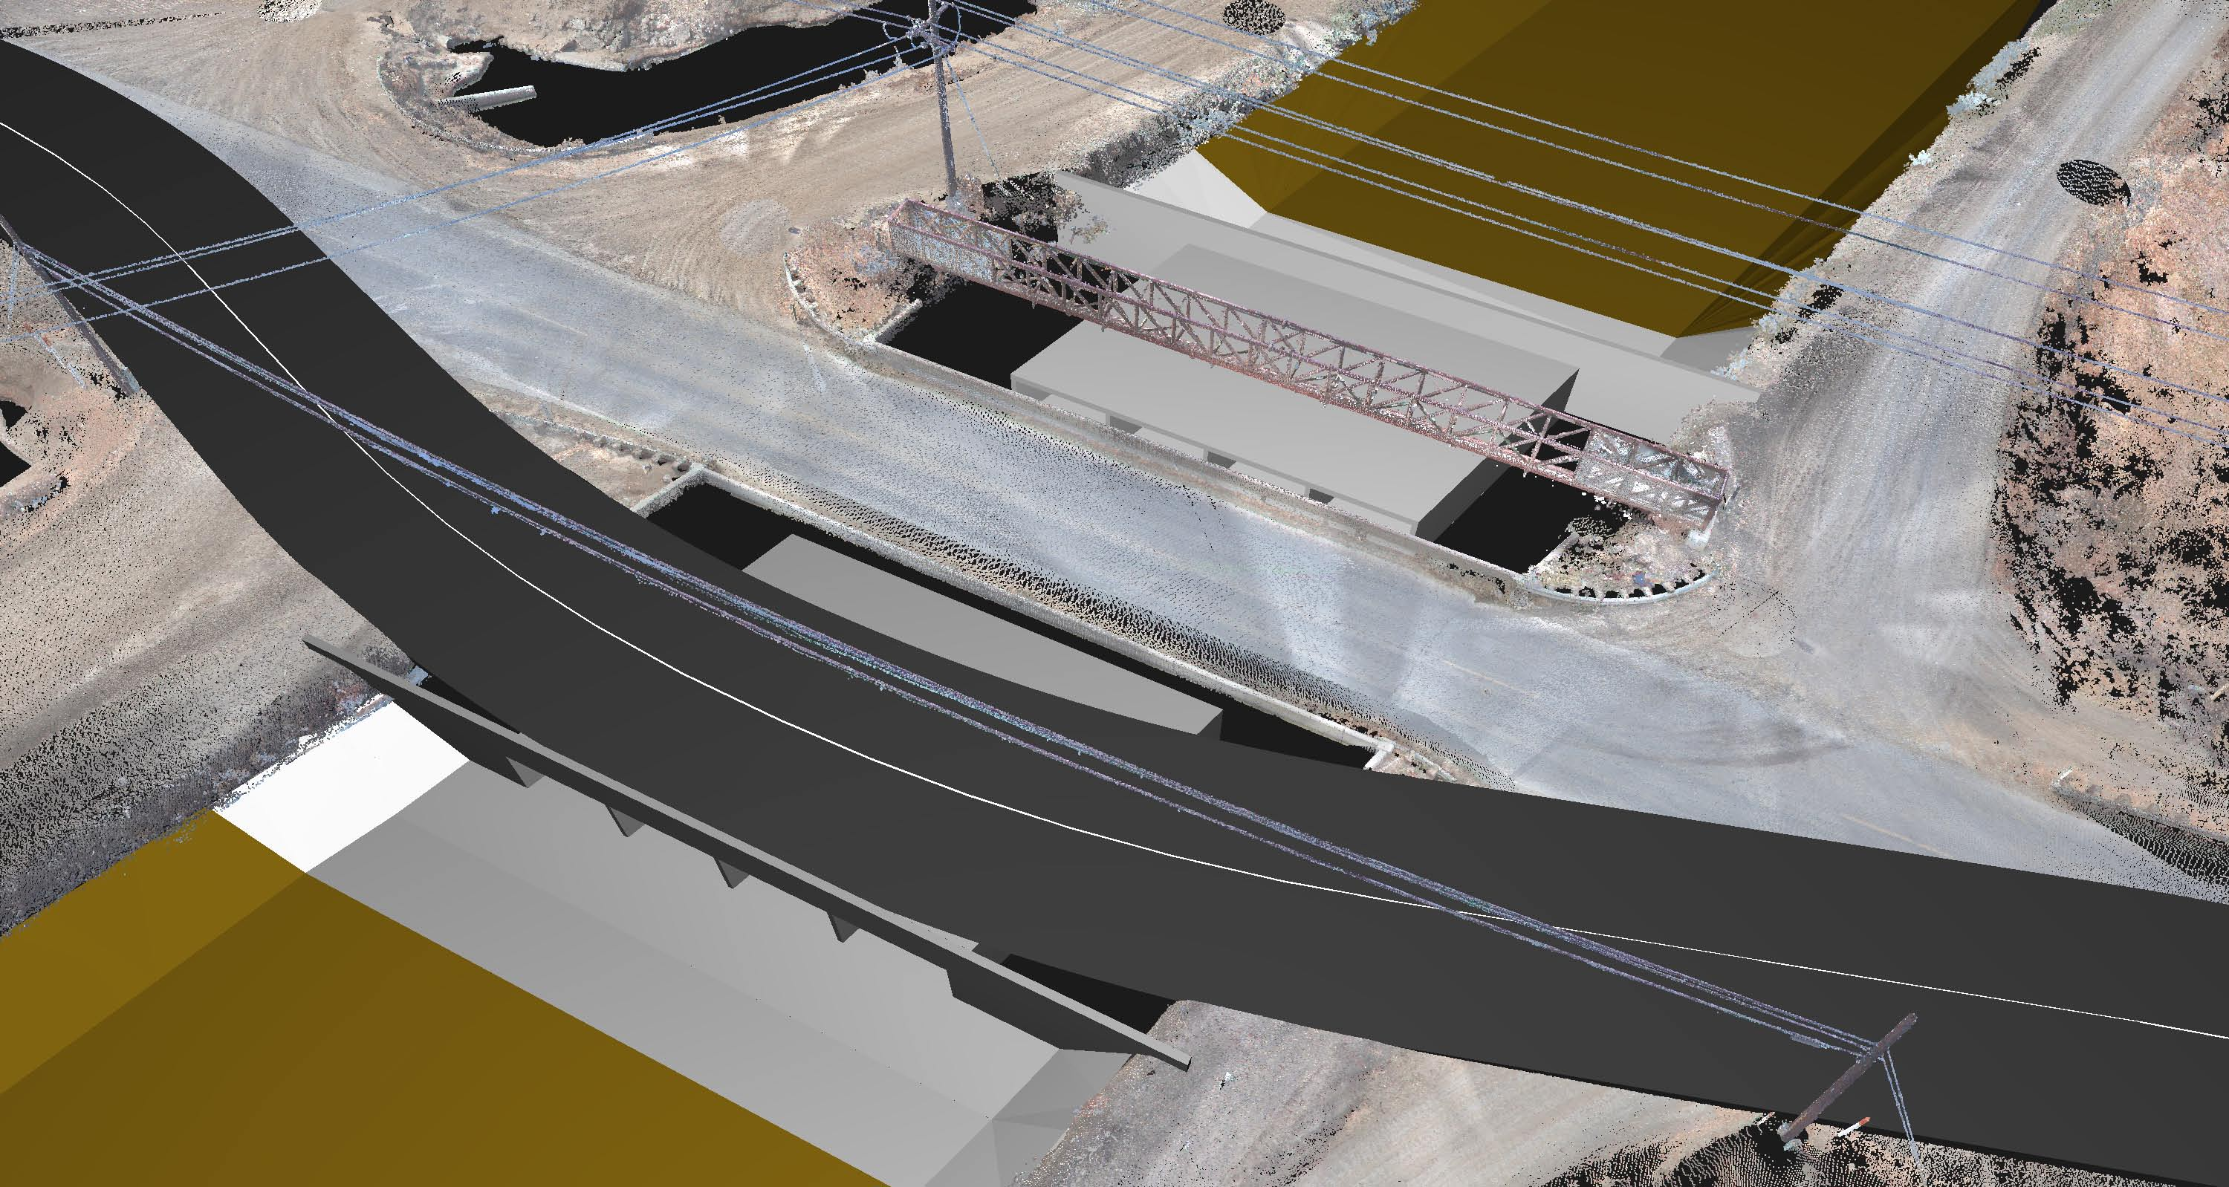
$5.2 Million Russell Ave Bridge

Slide 19
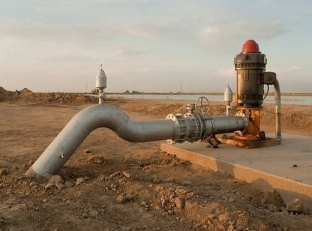
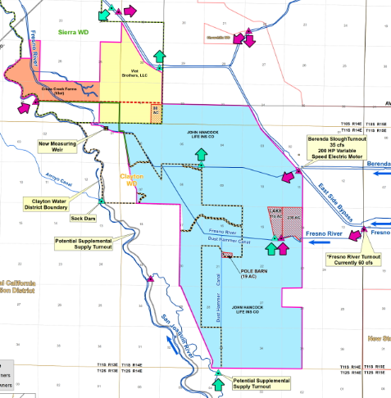
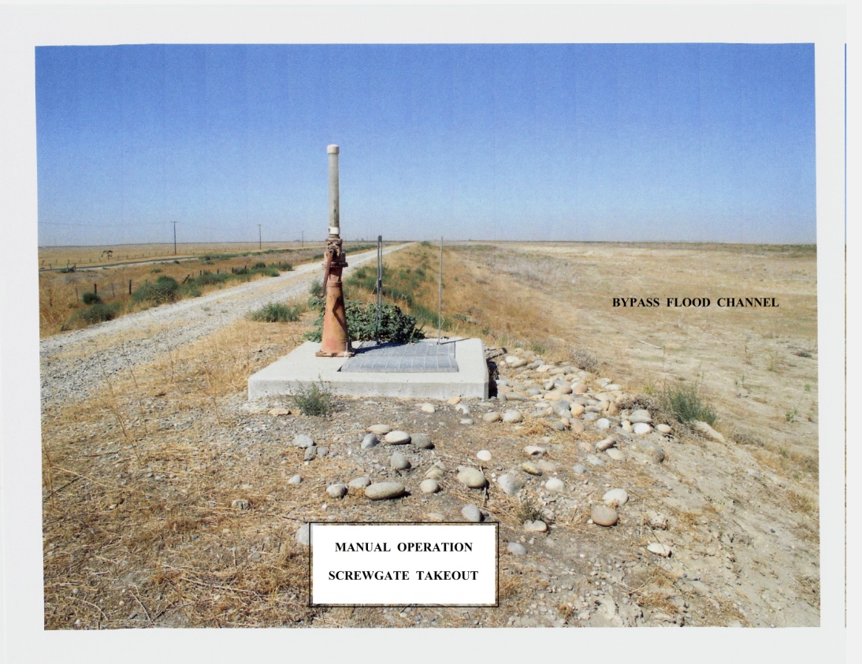
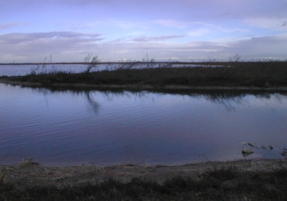
Western Madera and Merced County Subsidence Study - Long Term Solutions
  Complete subsidence and wheeling agreement and import water through Red Top Pipeline. (Avoid adjudication)
  Continue to revive existing districts, to manage water supply, subsidence and SGMA.
  Continue needed project improvements.
  Curtail Subsidence and help our neighbors comply with SGMA.
  Subsidence has been reduced by 50% through management.

Slide 20

Contact Information
Chris White, Central California Irrigation District
Telephone: (209) 826-1421
Email: cwhite@ccidwater.org

